Slide 1
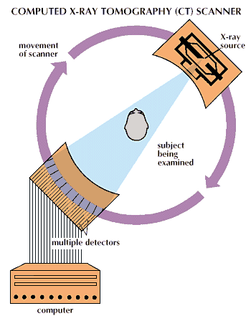
New results from seismic studies
Supporting evidence for the low velocity mantle comes from seismic studies
Involving tomography – a method that is similar to a CAT (computer aided tomography)
scan of your brain.

Slide 2
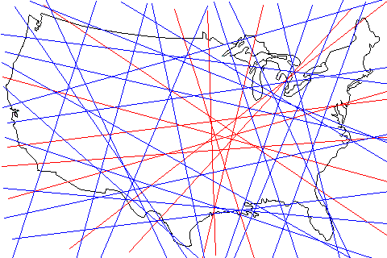
Where is Missouri?
Blue flight paths – plane did not fly over Missouri
Red flight path - plane flew over Missouri

Slide 3



Slide 4
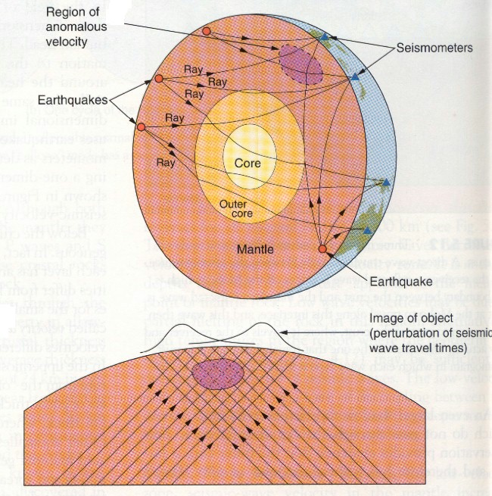
seismic
tomography

Slide 5
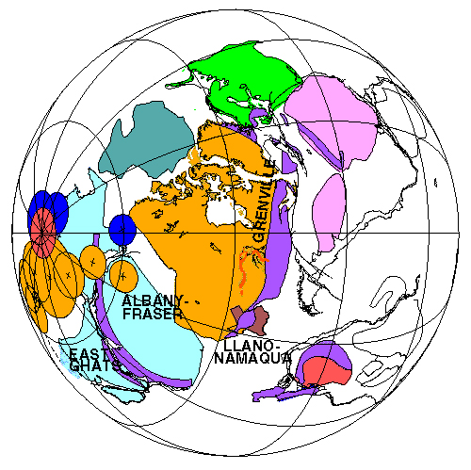
Why do we have earthquakes? The geologic history of the region is important.
About 1.6 billion years ago, the entire area was part of a stable continental interior and
little tectonic activity was taking place. This is like the central U.S. today. The area was
part of the super continent Rodinia.
1.1 Ga
Rodinia

Slide 6
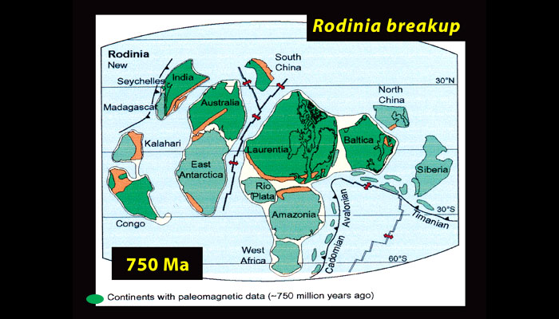

Slide 7
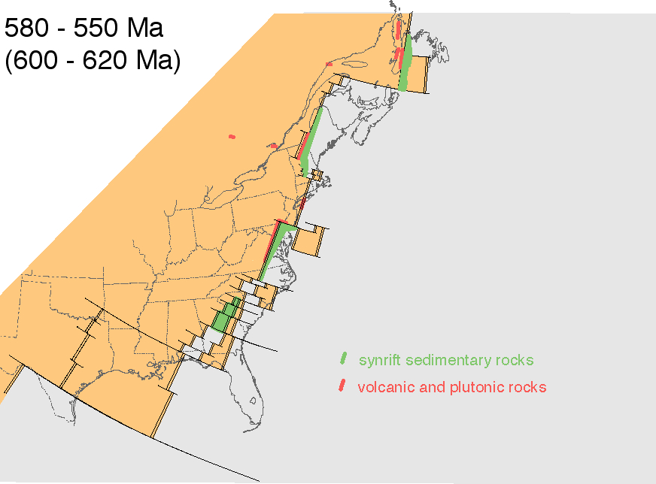
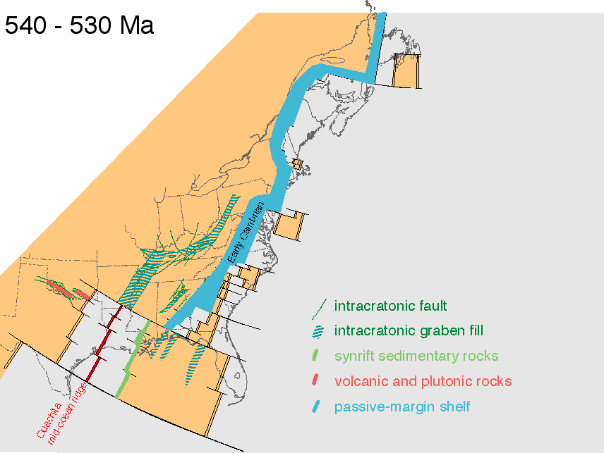
800 – 550 Ma
Late Precambrian
About 700 million years ago, Rodinia started
to split up. The Reelfoot Rift formed when
the central U.S. tried to open up and form a
new ocean.
Early Cambrian
Reelfoot Rift

Slide 8
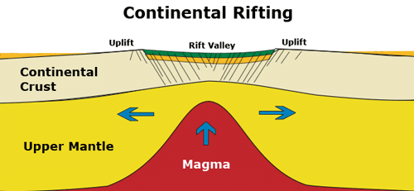
Reelfoot rift is a failed rift
Thinned heavily faulted crust
Moho
Thinned and weak mantle

Slide 9
Following the rifting, the region was under water and thick sediments were deposited

Slide 10
8
AR
Thomas 1991

Slide 11
Limestones deposited through
Early Ordovician (450 Ma)
Thomas 1991

Slide 12
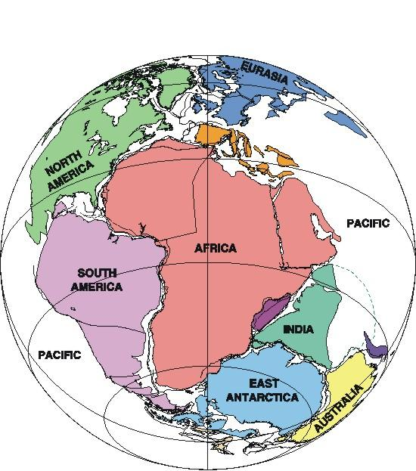
About 250 million years ago, the entire area was part of another super continent, Pangaea.
Closing of the ocean in between Africa and North America created the Appalachian
and Ouachita Mountains and intrusions of molten rock (magma) along the center of the
Reelfoot Rift
250 Ma
Pangaea

Slide 13
Blue: Mississippian-Pennsylvanian
synorogenic shallow marine clastic facies
Deposited during construction of Pangaea
Thomas 2011

Slide 14
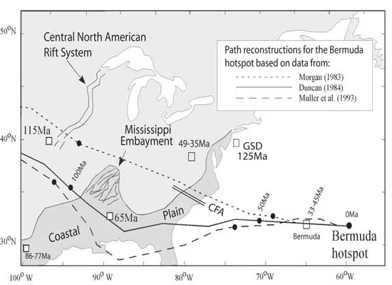
More intrusion of magmas occurred along the edges of the Reelfoot Rift when the
Bermuda shotspot passed by just to the south.
Cretaceous- Paleocene

Slide 15
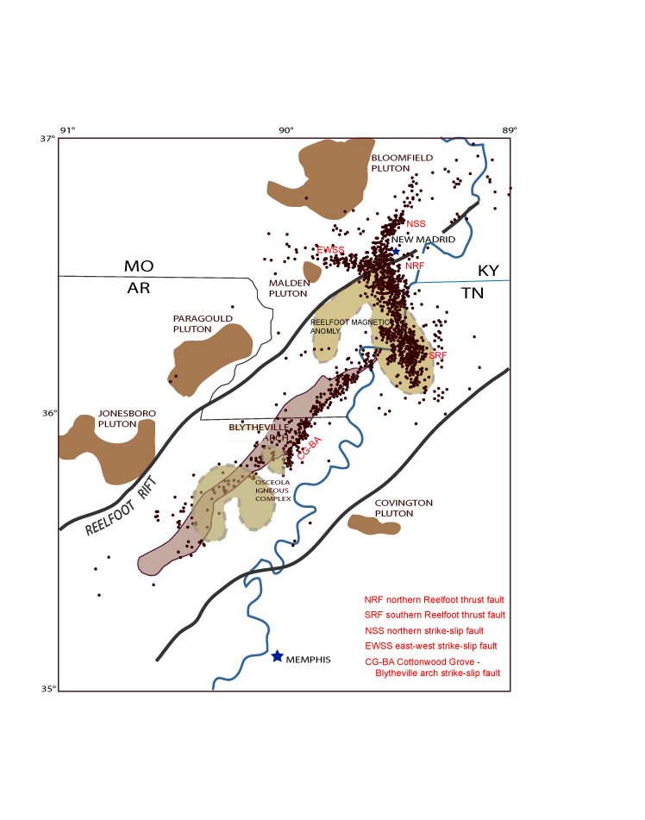
Many intrusions in the
crust

Slide 16
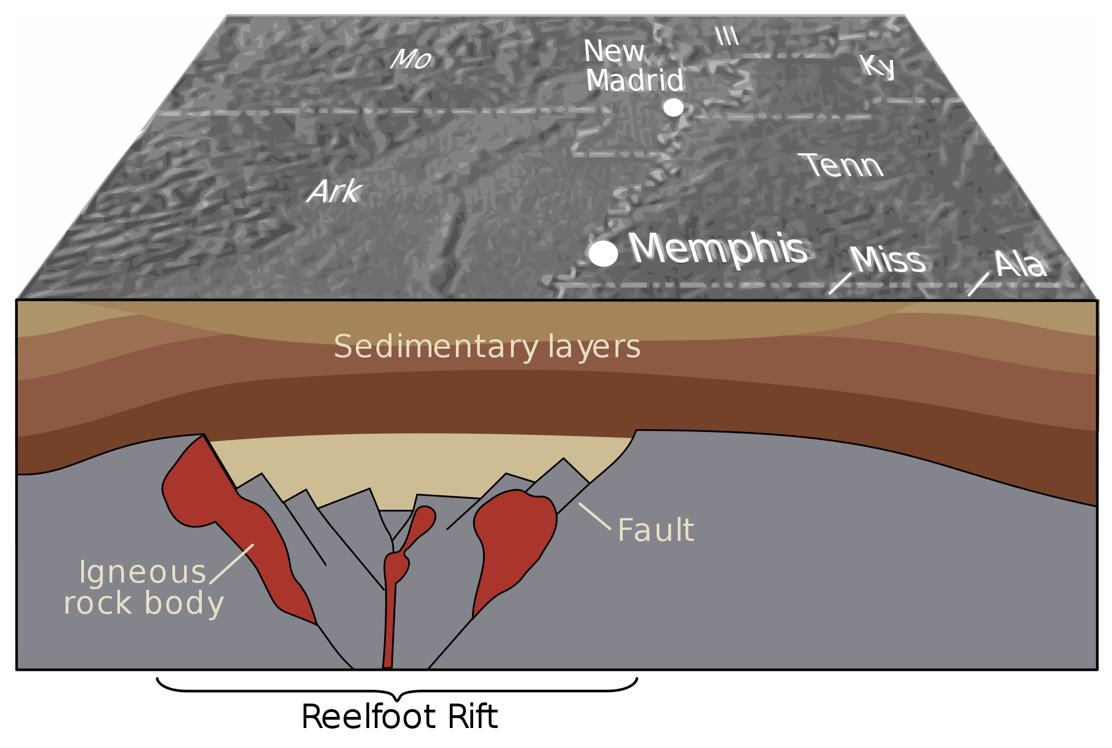

Slide 17
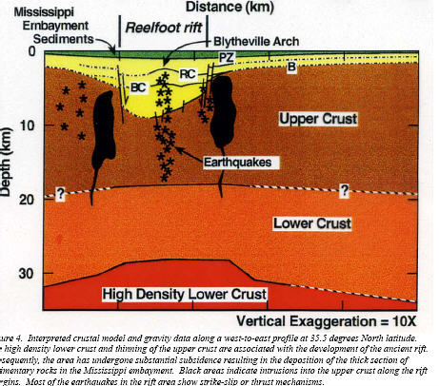
Mafic pillow

Slide 18
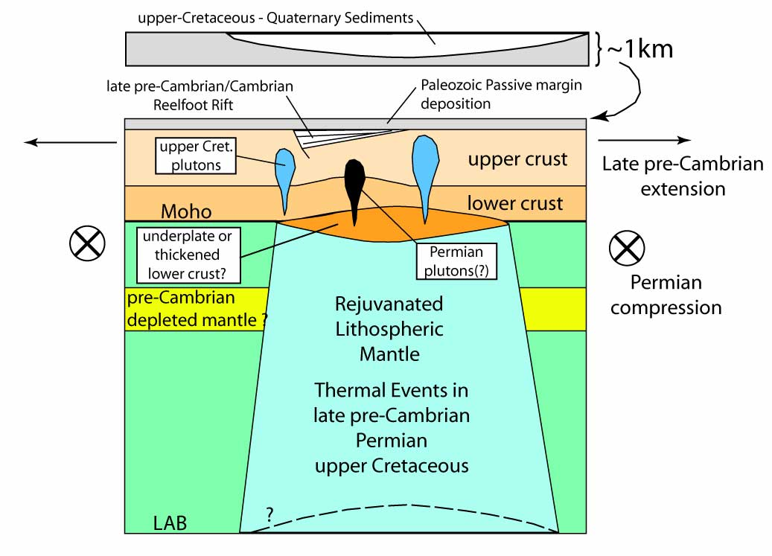
All of this was long ago so WHY DO WE HAVE EARTHQUAKES NOW??
STRONG
VERY WEAK

Slide 19
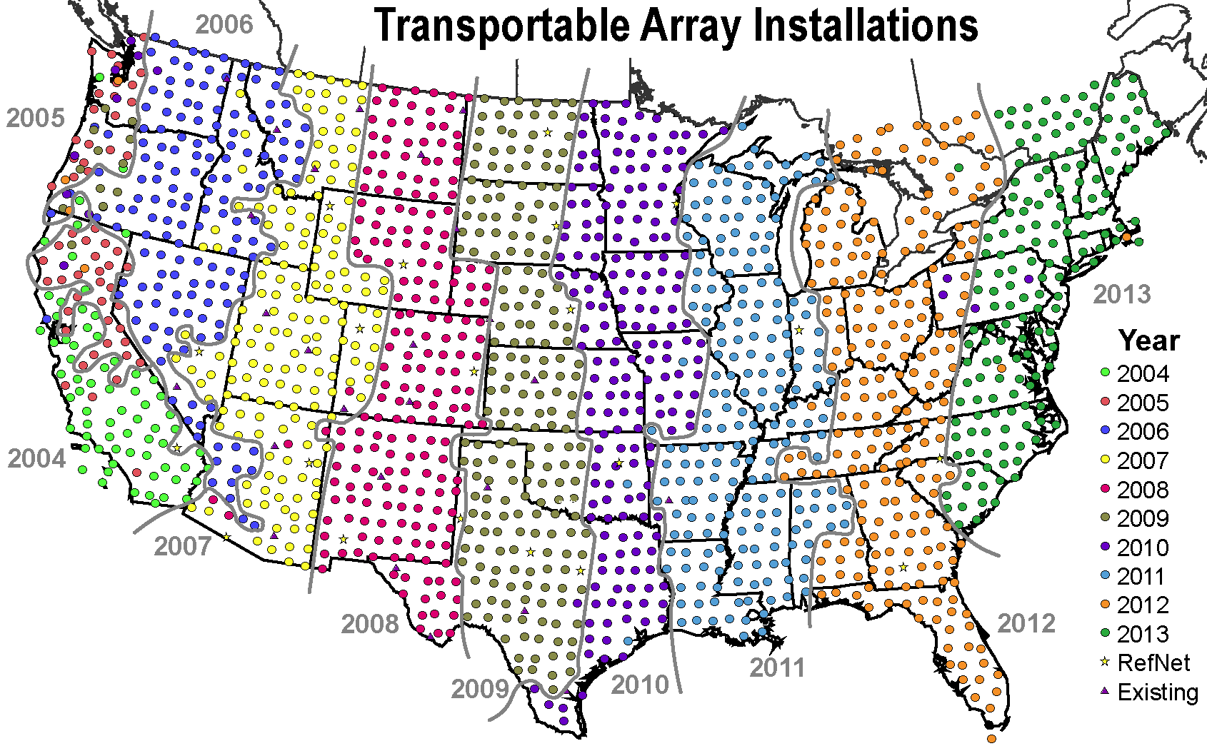
EarthScope

Slide 20
S-wave velocity model using surface waves recorded by EarthScope TA stations stations.
Note the low velocity zone associated with the New Madrid seismic zone.
Pollitz and Mooney (2014)

Slide 21
Red – low
velocity
Blue- high
velocity
P-wave velocity model based upon
teleseismic arrival times at TA stations
Chen et al. (2014)

Slide 22
Stations
TA: Green squares
NELE: Blue, purple,
orange, red circles
and black stars
NMSZ: white squares
NELE:
Northern
Embayment
Lithosphere
Experiment
2011-2015

Slide 23
What is producing the low velocities in the mantle? Three main factors:
Compositional variations
Temperature variations
Presence of fluids
The similar Vp and Vs anomaly magnitudes provide insight because Vp
and Vs are affected differently by these factors.
Compositional variations: a refertilized or primative mantle may lower Vs but the
observations require an unrealistically low Mg# (74) (Mg#=100XMg/(Mg + Fe)
(Lee, 2003). Also, very little dependence of Vp and Vs on melt depletion of fertile
peridotite found by Shutt and Lesher (2006).
Temperature variations: An excess temperature of ~400+100°C is needed to produce
the Vs anomalies and ~670+140°C to produce the Vp anomalies (Cammarano et al., 2003).
This would produce melting. Not the only factor.
Fluids: the presence of fluids decreases Vs and Vp. For example ~1.96 wt% H2O will
produce the -6% Vp anomaly (Miller and Christensen, 1997). Not unreasonable in
the presence of a flat slab (Ichiki et al., 2006; Kusky et al., 2014).
We conclude that the observed negative Vp and Vs anomalies are produced by
elevated temperatures and the presence of fluids. Hot and wet.

Slide 24
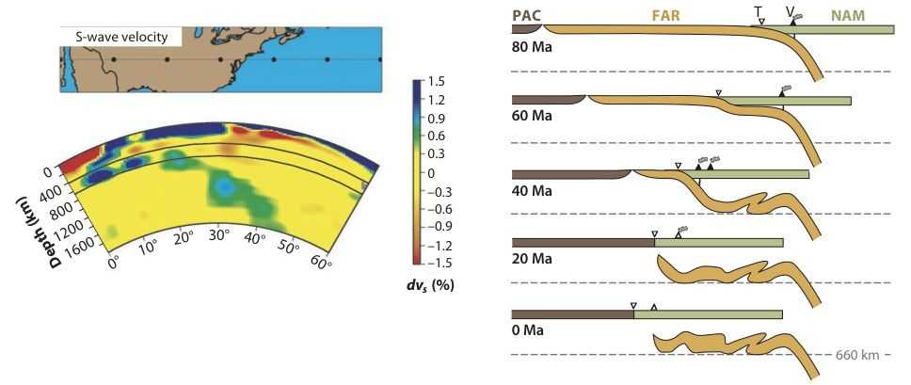
What happened to the Farallon plate?
S-wave velocity from
tomography
Part of the Farallon plate is stuck
above 660 km and is now below
the central U.S.

Slide 25
F1 Laramide flat
slab segment
Sigloch 2011;
Sigloch et al., 2008

Slide 26
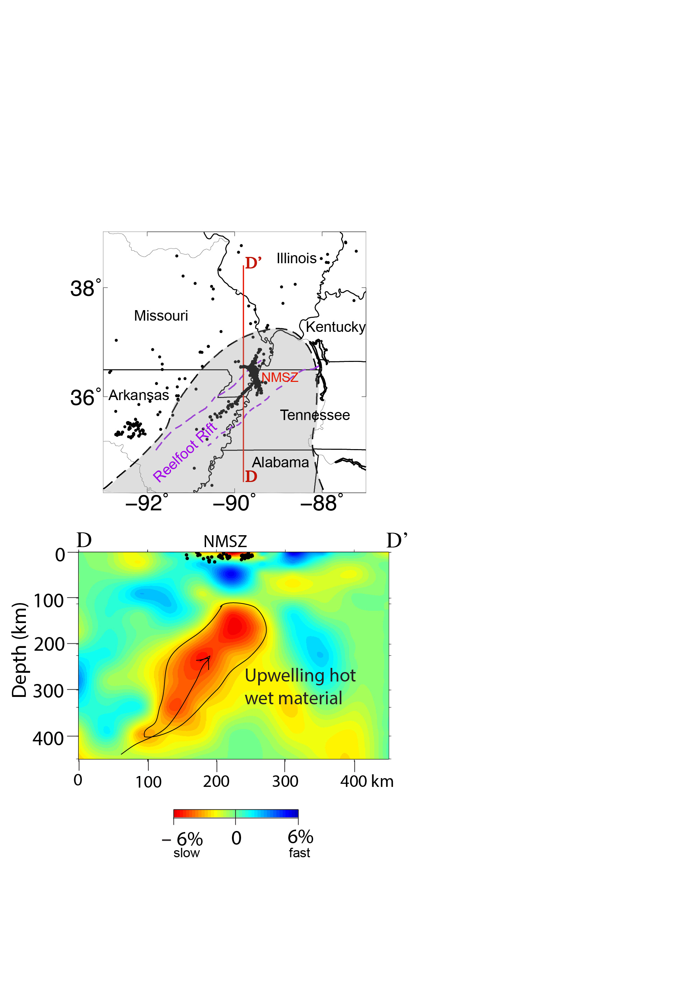
Hot, hydrous, upwelling fluids from
the stalled Laramide slab produce
the negative Vp and Vs anomalies.
stalled Laramide slab
(Sigloch et al., 2008; Sigloch, 2011)
Notes:
Upper portion of the mantle slab (peridotite and H2O)

Slide 30
Synthetic input model
20 second period
50 second period
100 second period
Notes:
To assess the ability of two-plane wave tomography to resolve the phase velocity anomalies identified here, we perform checkerboard tests. Using the actual distribution of events and stations used in our study, we calculate synthetic phase and amplitude measurements that would be expected at each period for our array sampling a checkerboard pattern of alternating 4% high and low phase velocity anomalies [Yang and Forsyth, 2006a] (Figure S1a). We include the effects of random errors in the actual observations by adding a Gaussian distribution of noise to the synthetic phase and amplitude measurements. The amplitude of the noise is chosen to reflect the range of the standard deviation of the measured phase and amplitude at each period. Inverting the synthesized data following the same approach as with the actual data reveals how the checkerboard pattern can be resolved.

Slide 31
Rayleigh wave
phase velocity
maps for the
periods indicated

Slide 32
Shear wave velocity maps

Slide 34
The low Vs region is attributed to the presence of refertilized upper mantle with
contributions from elevated heat flow and water content.

