Slide 1
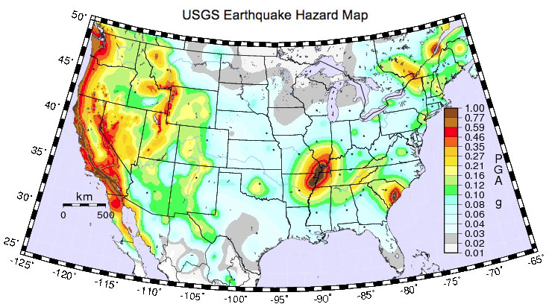
Charlevoix Seismic Zone
CSZ
USGS Earthquake Hazard Map

Slide 2
Saguenay M5.8
Source zones for the Canadian seismic hazard map. Includes all historical
earthquakes M>3 in the Geological Survey of Canada earthquake catalog

Slide 3
CSZ
St. Lawrence Rift
CSZ Charlevoix seismic zone
LSL Lower St. Lawrence
OBG Ottawa-Bonnechere graben
WQ Western Quebec seismic zone
SG Saguenay graben
Background seismicity MN≥2 since 1985
Historic events M>5.0 since 1663
Maximum horizontal stress trends NE-SW
Most large earthquakes involve thrust faults

Slide 4
Rivers searched for paleoseismic evidence of large earthquakes by Tish Tuttle.
White lines with sawteeth are thrust faults from the Taconic orogeny (dashed
under the river). Other white lines Iapetan rift faults. No evidence for large
earthquakes in the last 10,000 years outside of the Charlevoix seismic zone.
Tuttle and Atkinson (2010)

Slide 5
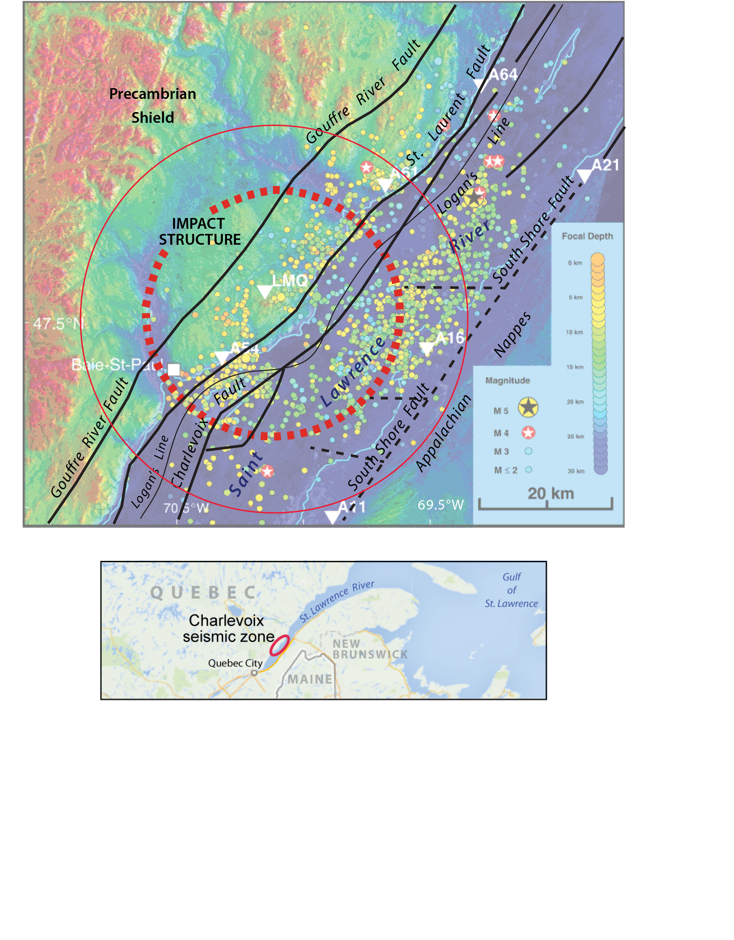
Charlevoix Region

Slide 6
Tectonic history:
1100-990 Ma Grenville orogeny resulted in the accretion of several exotic
terranes onto Laurentia in a compressional tectonic environment. Amphibolite
to granulite facies metamorphic rocks of the Grenville province form the
basement rocks.
2. Late Proterozoic to early Paleozoic (750-550 Ma) successful rifting opened the Iapetus
Ocean. Normal faults form the paleorift system and this was the passive margin
of the proto-North American continent.
3. Deposition of tens of meters of limestone in the passive margin setting to form the
St. Lawrence platform
4. Closing of the Iapetus Ocean during the Taconic orogeny (470-440 Ma). Thrusting
of Appalachian Paleozoic sedimentary rocks (sandstones and mudstones) over the
basement and the St. Lawrence platform along a plane dipping ~20° to the SE.
The deformation front, known as Logan’s Line, trends along the NW side of the
St. Lawrence River. Thrust wedges are several km thick thinning to 0 along Logan’s
Line.
5. Devonian impact (~350 Ma).
6. Hundreds of meters of Quaternary sediments deposited below the river.

Slide 7
Earthquakes from National Resources Canada catalog 1978-2015. Focal
mechanisms for earthquakes > M4. Inset: maximum horizontal stress direction
from boreholes (blue arrows) focal mechanisms (red arrows)

Slide 8
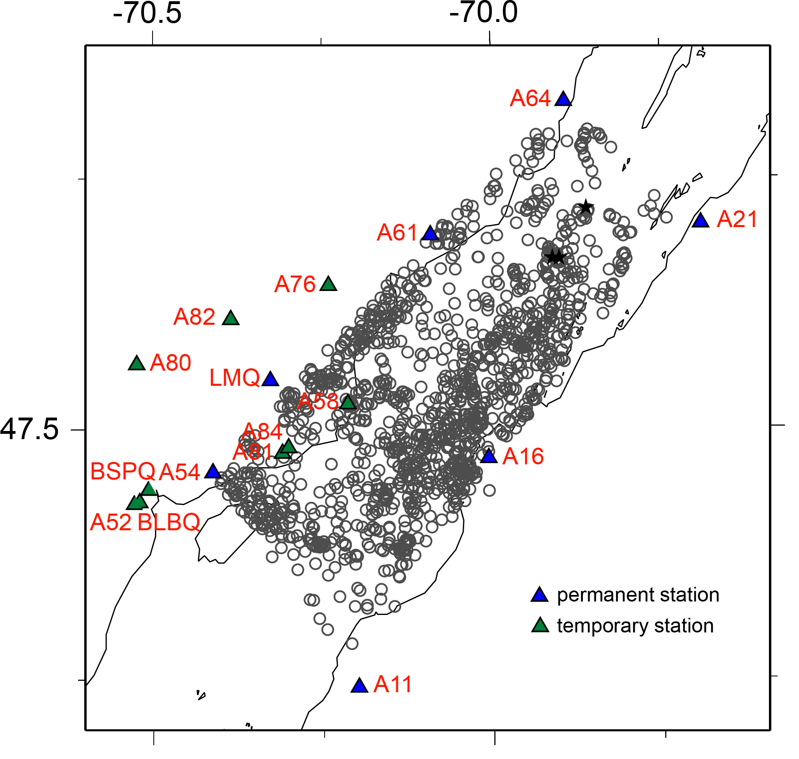
Local earthquake tomography
P- and S-wave velocity models
Hypocenter relocation
1329 earthquakes
8540 P arrivals; 8304 S arrivals
Block size 2x2x2 km
Homogeneous starting model
Vp=6.2 km/s; Vp/Vs=1.73

Slide 9
Accumulated ray path
coverage per block.
Same for P- and S-wave
inversions

Slide 10
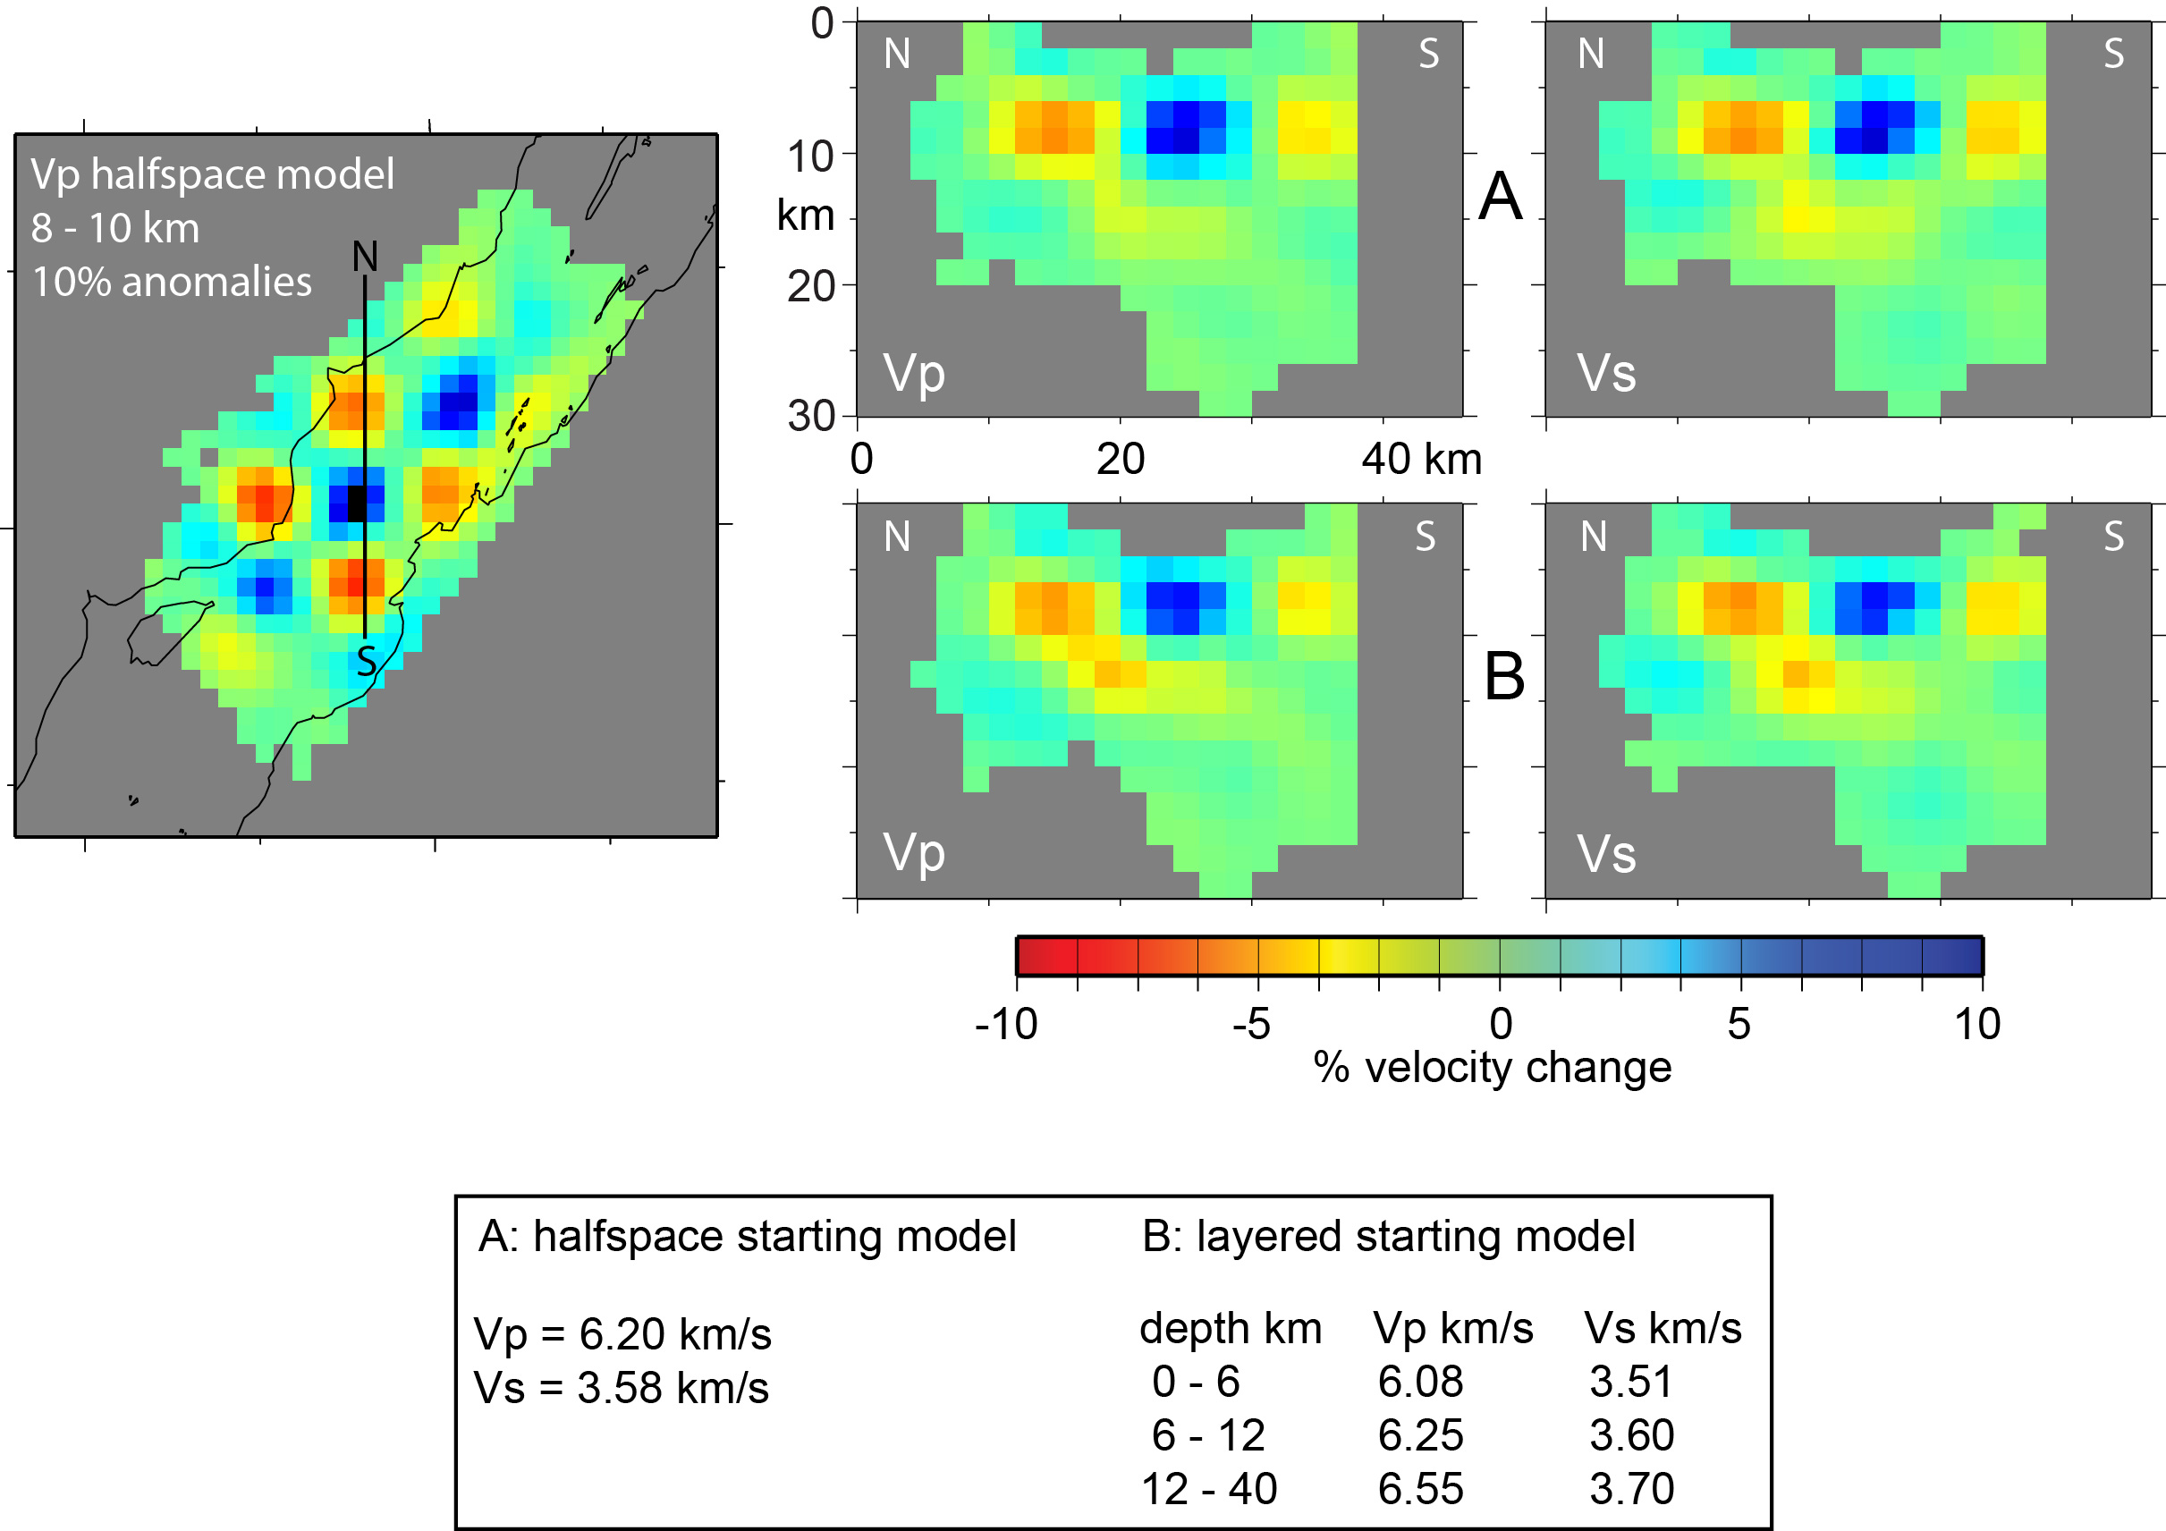
Starting model problems

Slide 11
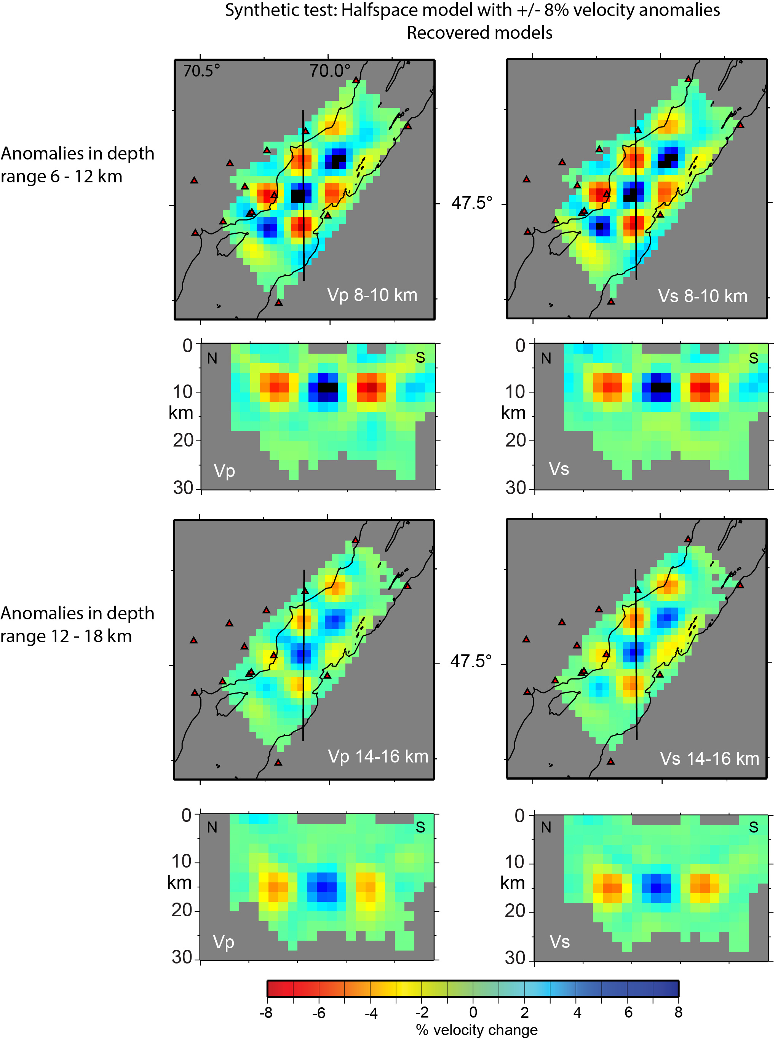
Note that resolution
is the same for P and S

Slide 13
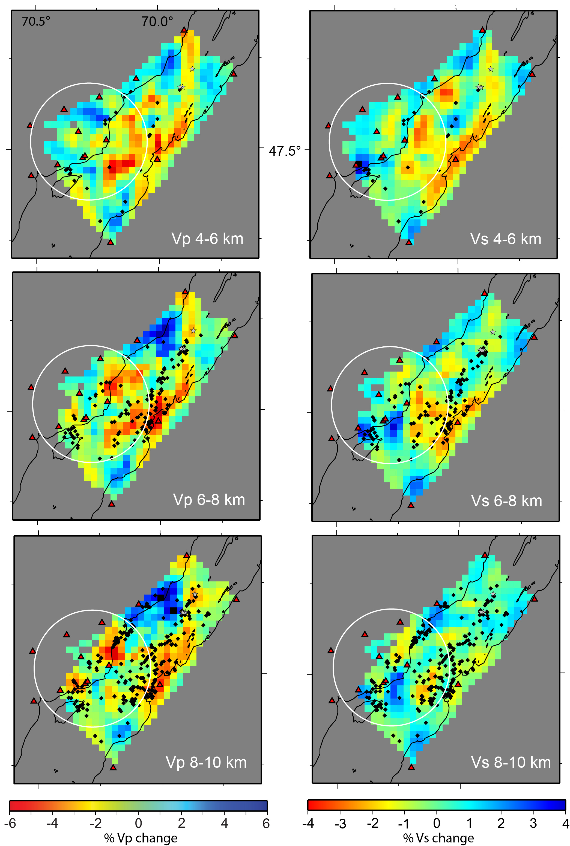
Vp
Vs
Velocity solutions 4-10 km
Relocated hypocenters
(black dots)
Note change in scale for
Vp and Vs velocity models
Vs
Vp
Vs
Low velocity associated
with the impact
High velocity region NE of
the impact
Low velocity along SE shore
Vp
Vs
Earthquakes occur along
the eastern edge of the
impact structure

Slide 14
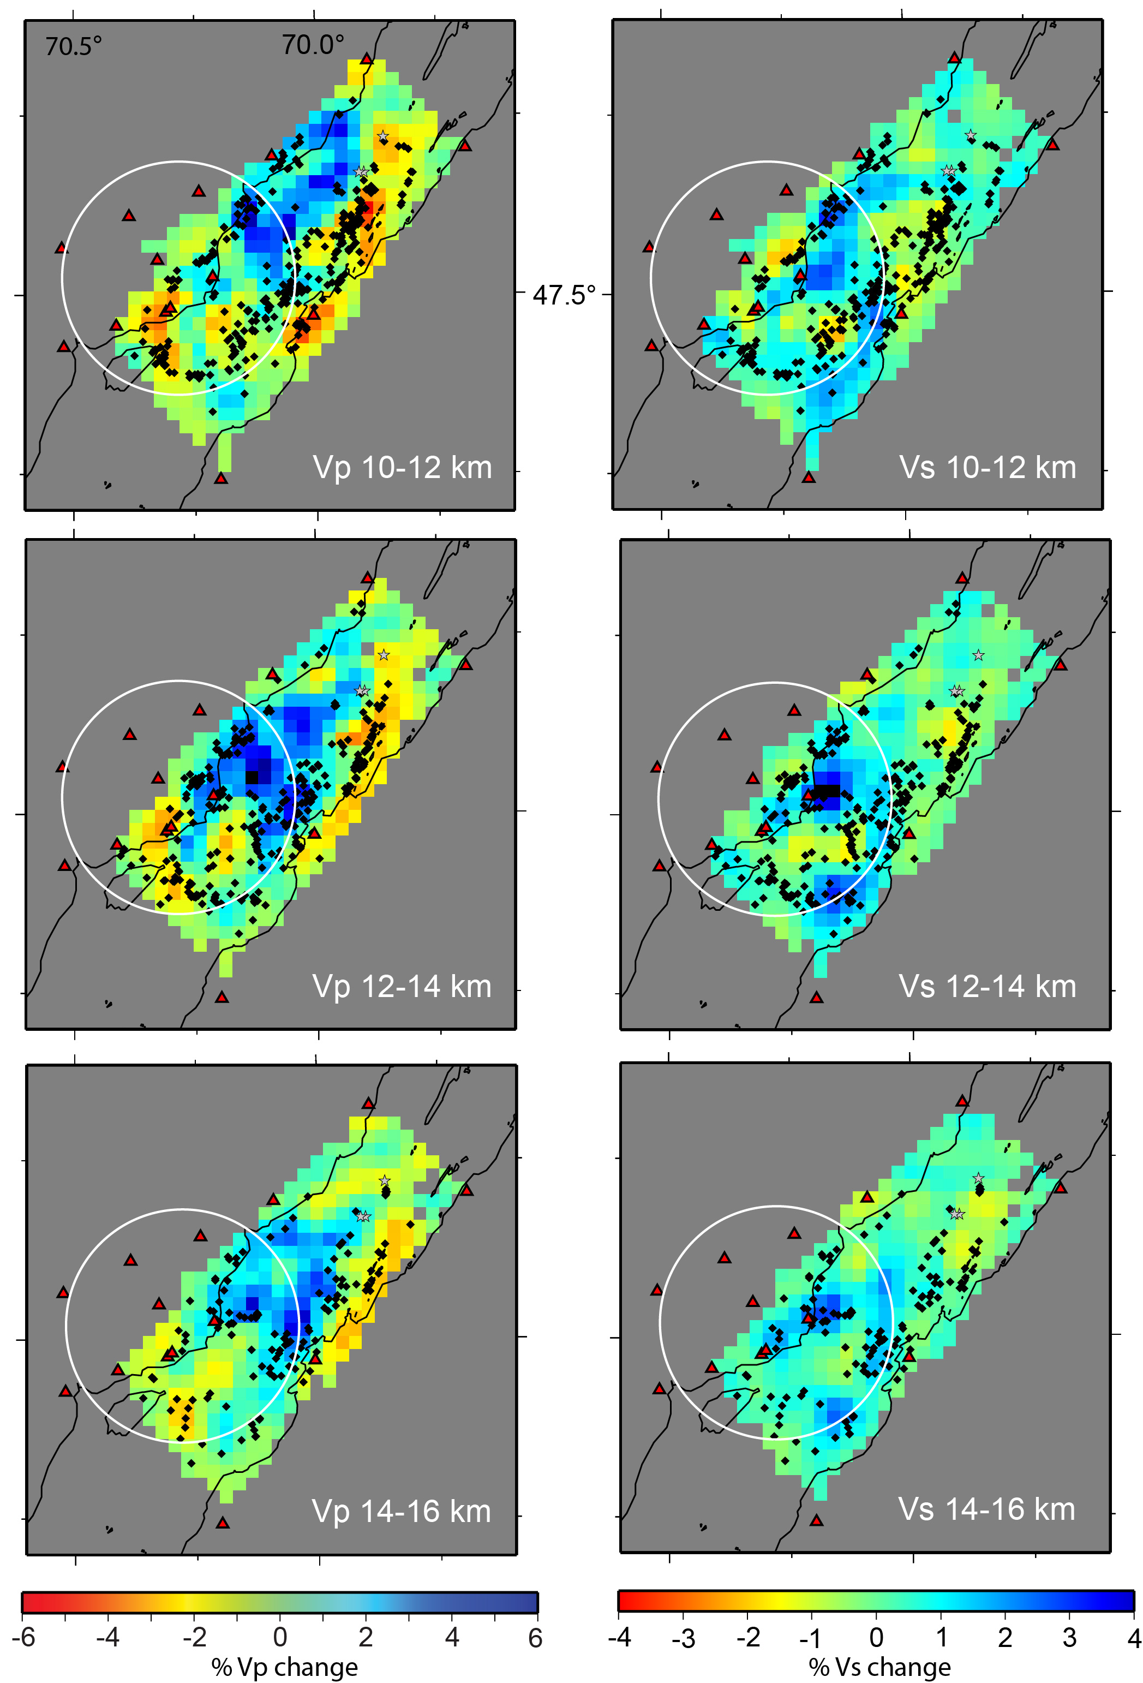
Vp
Vs
Velocity solutions 10-16 km
Relocated hypocenters
(black dots)
Note change in scale for
Vp and Vs velocity models
Vp
Vs
High velocity below the
Impact structure
Hypocenters display partial
ring structure 10-12 km
Vp
Vs

Slide 15
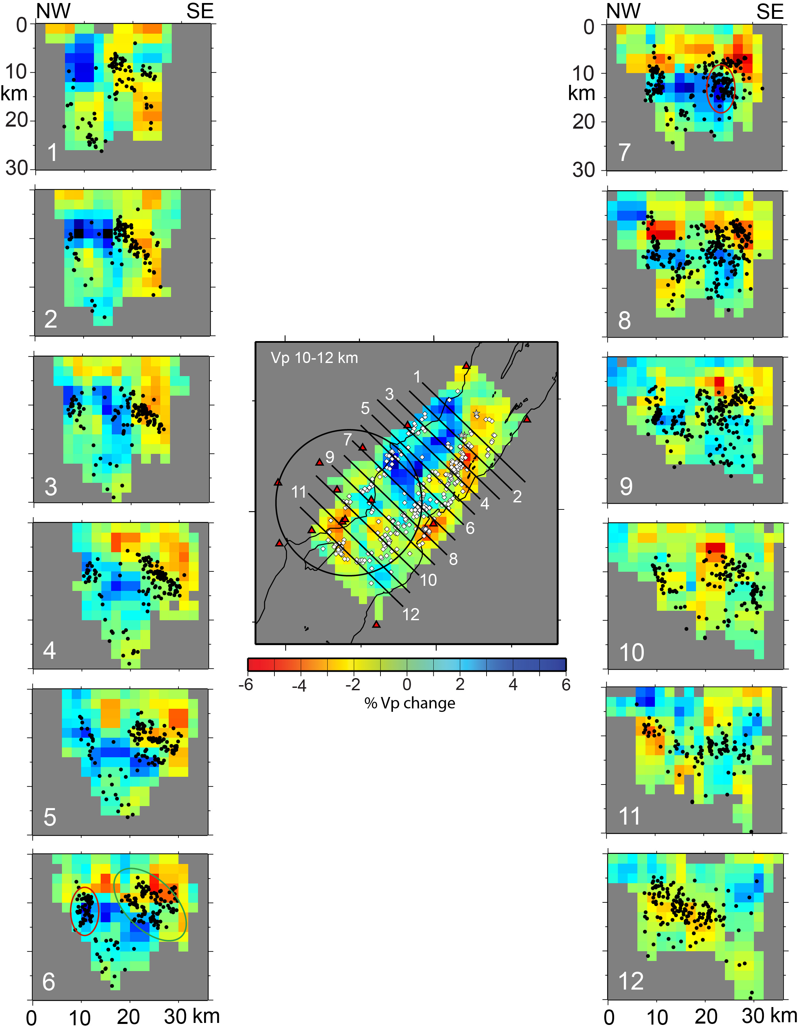
Earthquakes up to
3 km from each profile
plotted; no overlap
Earthquakes defining
the two faults below
the river scatter when
they hit the impact
structure (red circle).
Hypocenters define
several planes
SE dipping plane
below the NW shore
of the river may be the
Gouffre fault
Earthquakes associated
with the Gouffre fault
scatter when they hit
the impact structure
(red circle). Two SE dipping
faults under river (green
circle).

Slide 16
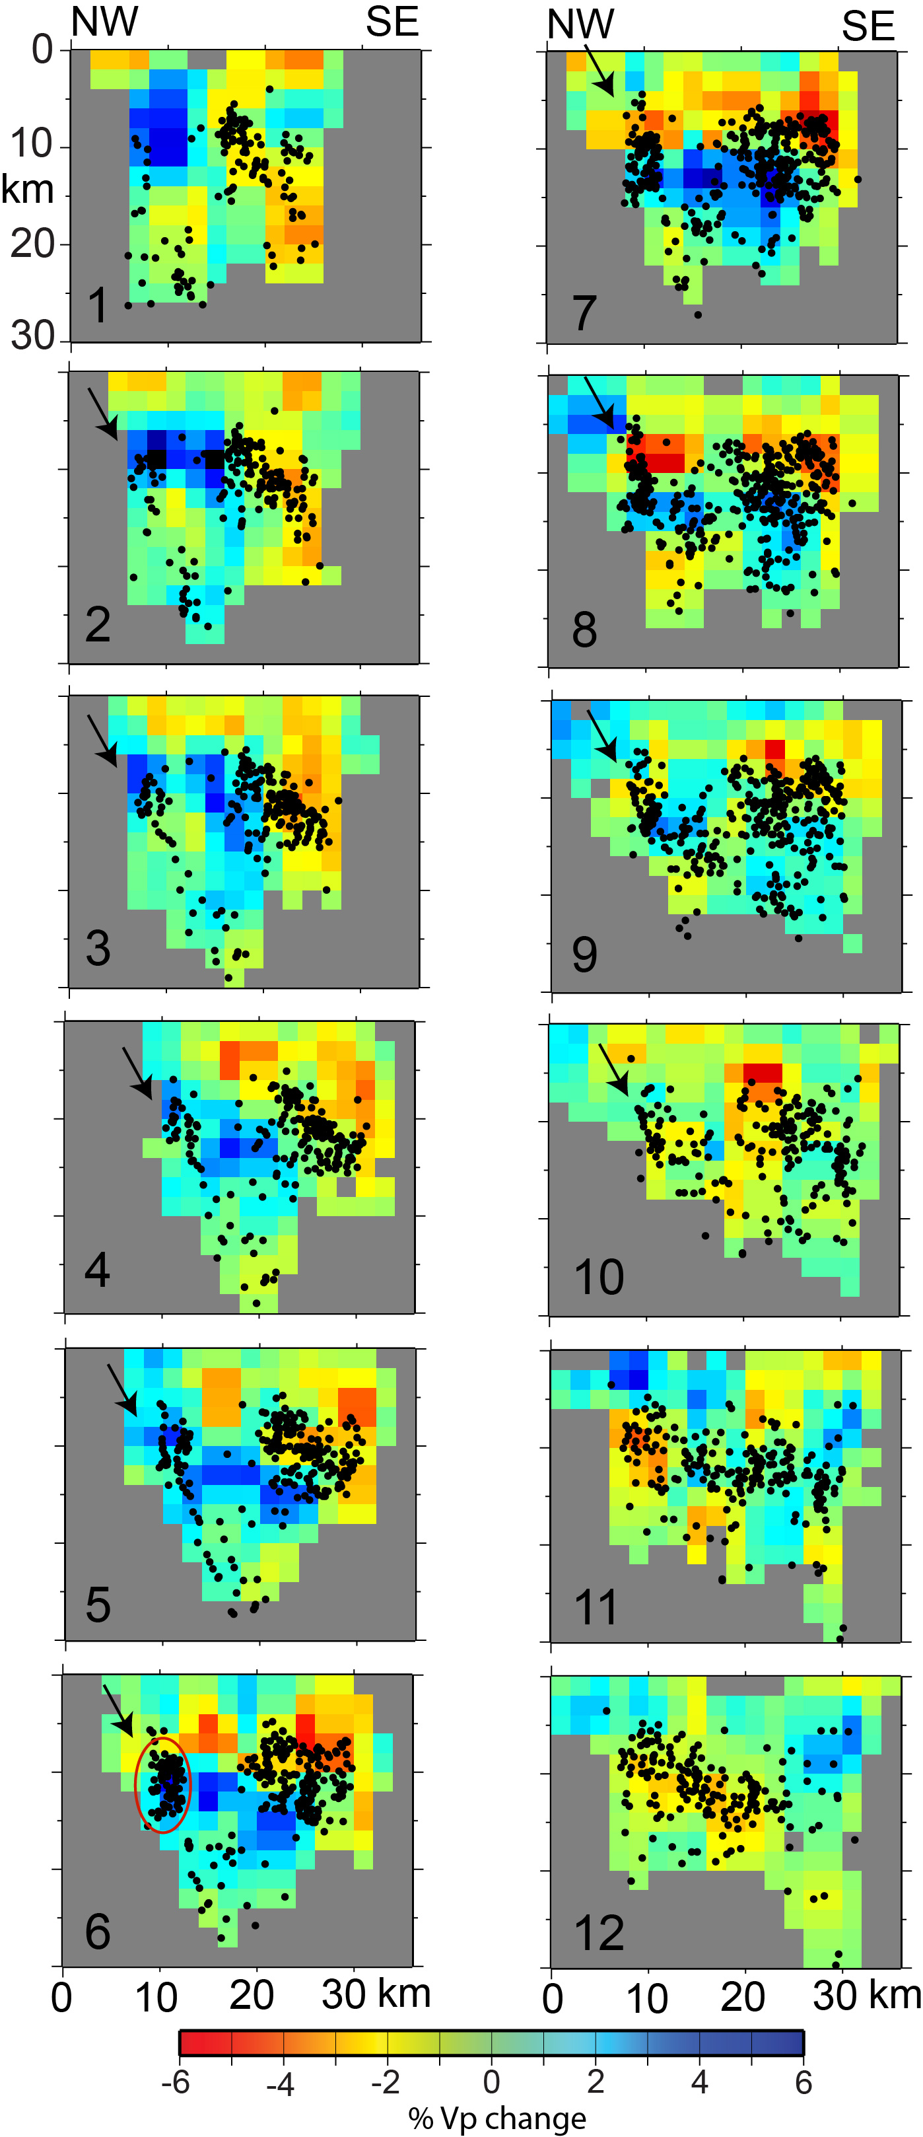
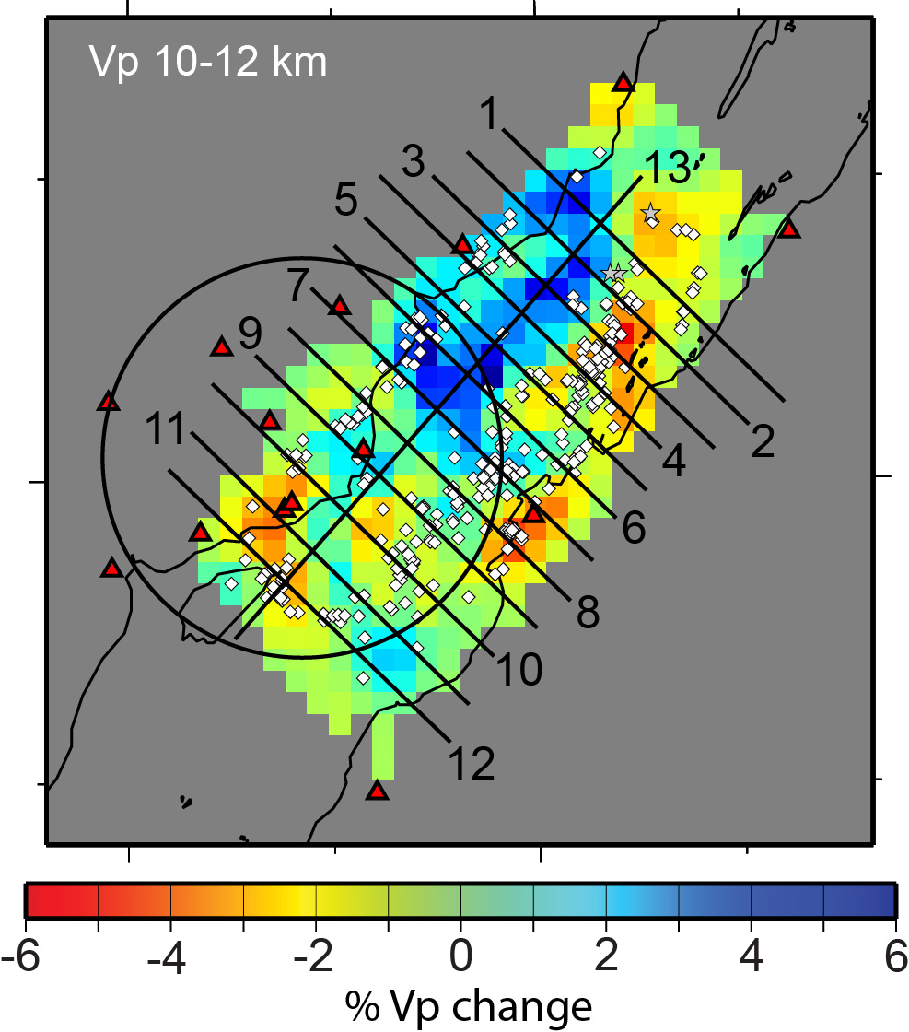
Profile locations same as previous slide
Earthquakes within 5 km of each profile
plotted. Profile spacing 4 km so some
overlap.

Slide 17
Earthquakes up to
3 km from each profile
plotted; no overlap

Slide 18
Former depiction of
epicenter and hypocenter
distribution
Looks like the Iapetan
Rift faults are not
seismogenic, just the regions
in between them

Slide 19
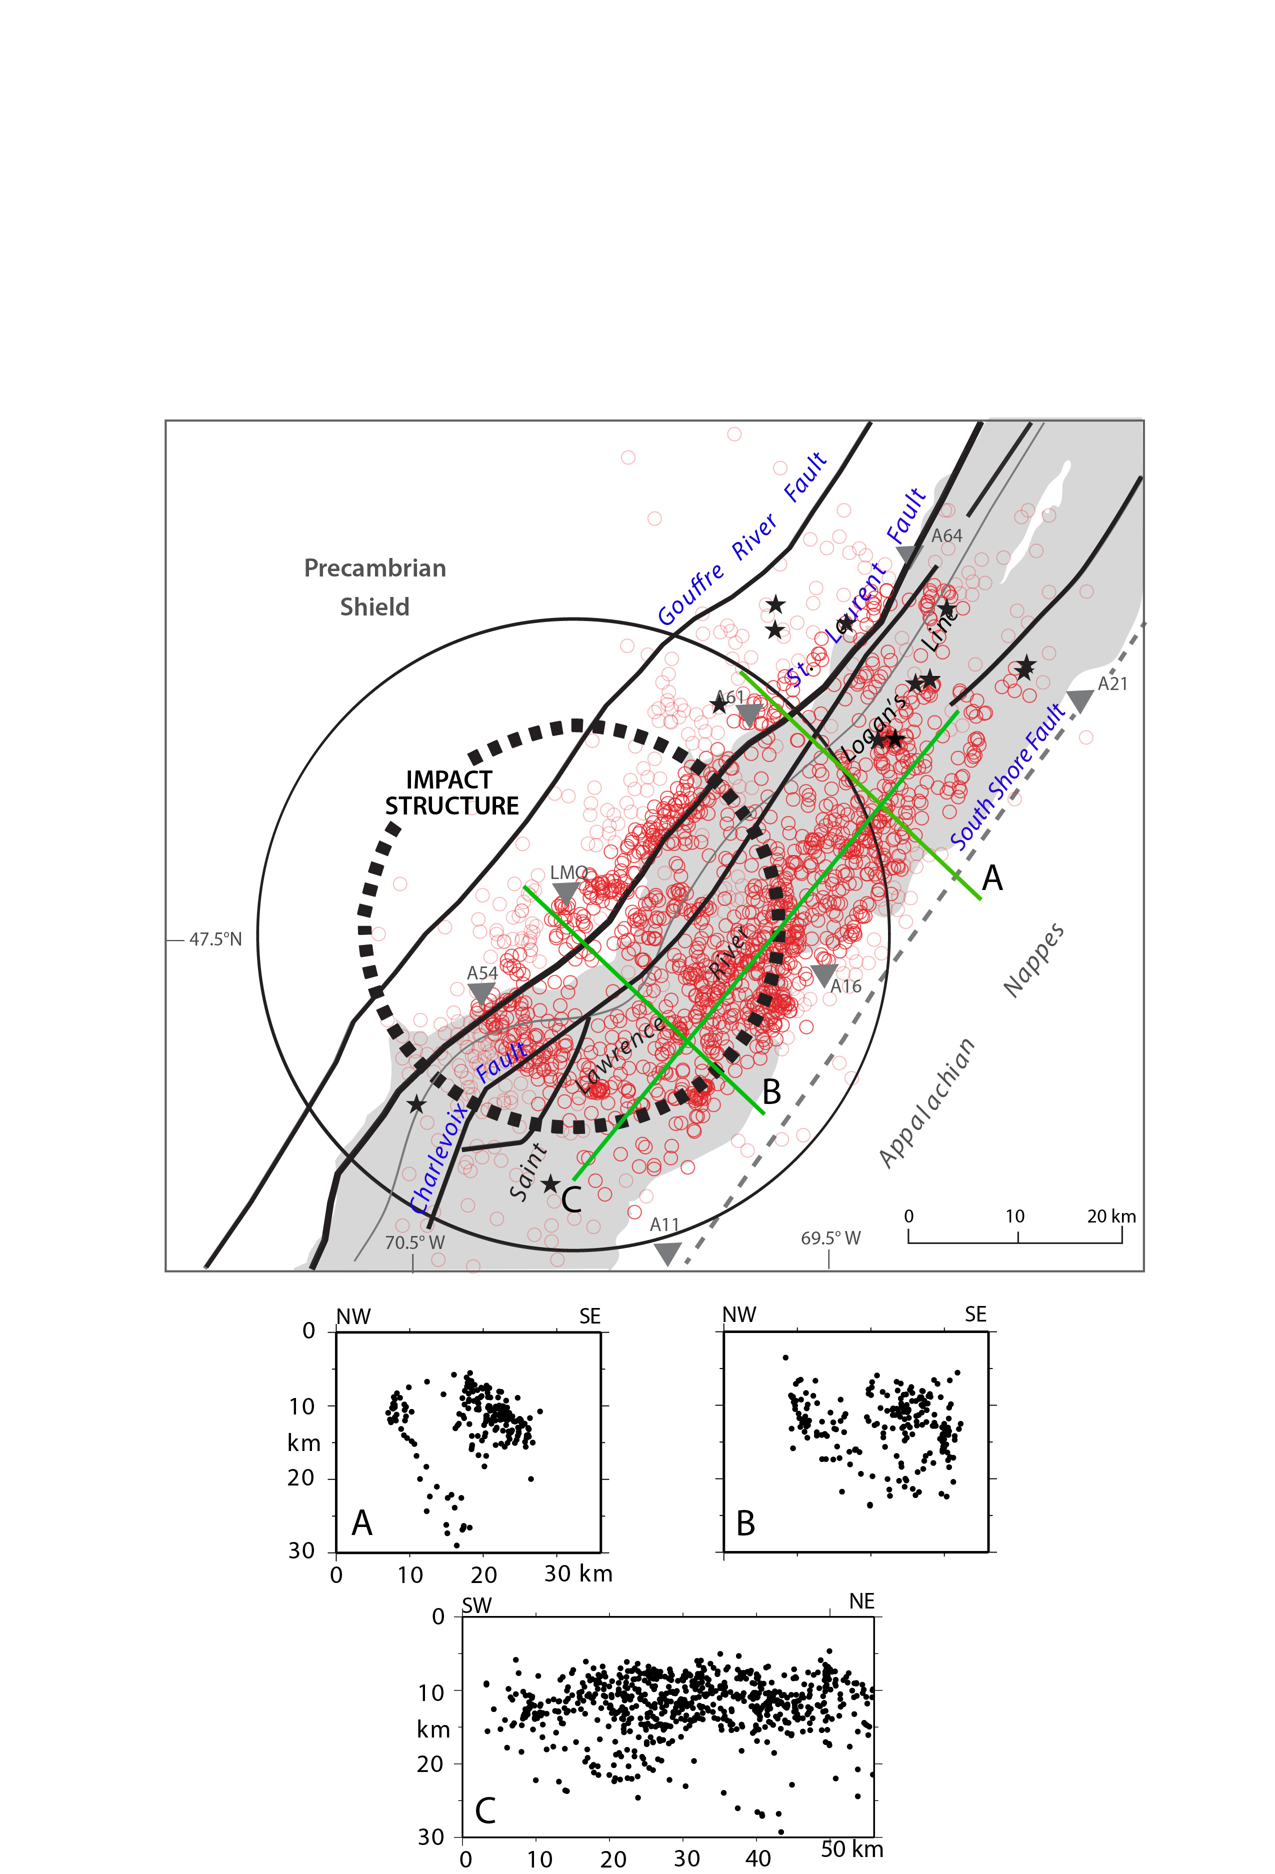

Slide 20
Changes in differential stress (σ1 – σ3) relative to an aseismic control model. Uses finite
difference code FLAC3D to compute stress and strain in discretized blocks.
Crust represented by an elastic continuum constitutive model; impact structure modeled as a
continuum of lowered elastic modulus. Weak rift faults assigned a friction angle of 5°.
Regional stress as shown by arrows. Initial stress field is lithostatic then horizontal stress
is slowly increased through boundary displacements. Very dependent on fault location and dip.
From Baird et al. (2010).

Slide 21
Velocity Models:
Low Vp and Vs are associated with the impact crater to a depth of ~12 km.
2. High Vp and Vs anomalies present north of the impact zone extend below
the zone at depths exceeding 12 km.
3. Vs anomalies are consistently smaller than Vp anomalies, particularly
below 8 km.
Hypocenter Distribution:
1. Earthquakes align along distinct planes trending parallel to the rift north of
the impact crater and could be associated with rift faults.
2. A gap in seismicity exists between two groups of “rift faults”.
3. Earthquakes in the two groups become scattered in the impact zone but
the gap between the groups is still evident; earthquake distribution north
of the impact zone is strongly influencing earthquake distribution within the
zone.

