Slide 1
Relationship between observed upper mantle structures and recent tectonic
activity across the Southeastern United States
Berk Biryol, Lara Wagner, Karen Fischer, Robert Hawman
Teleseismic tomographic inversion using P wave relative travel times
514 stations
753 teleseisms for the period 2010-2015
M>5.5
Also use PKP diffracted phases
Starting model IASP91
117,812 direct P and 2287 PKPdf travel time residuals
Corrections for crustal velocity variations are made using all available crustal
velocity information but the corrections have minimal effect on the tomographic
solution.

Slide 2
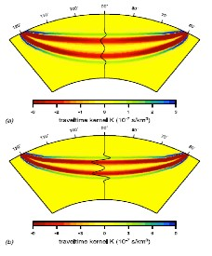
Finite frequency tomography.
Seismic signals have finite-frequency spectra so the arrival times are sensitive to
seismic speed variations around the raypath; different frequency bands are sensitive
to the velocity structure of different volumes around the raypath. So – repeat the picking
procedure over three frequency bands 0.2-0.8 Hz, 0.1-0.4 Hz, 0.04-0.16 Hz
Banana doughnut
sensitivity kernels

Slide 3
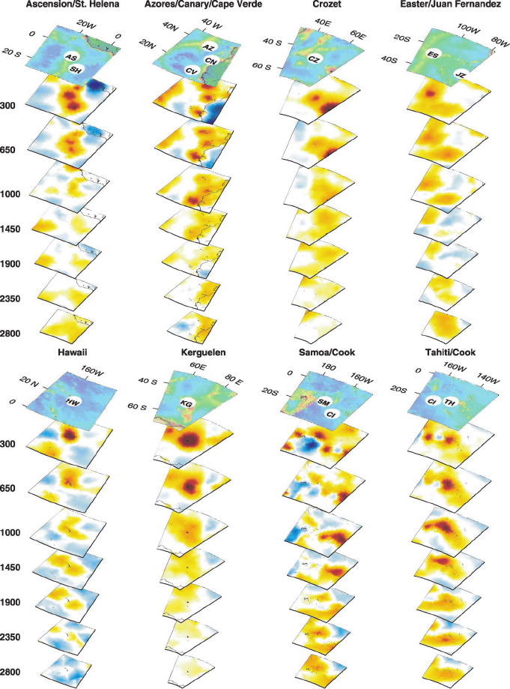

Slide 5
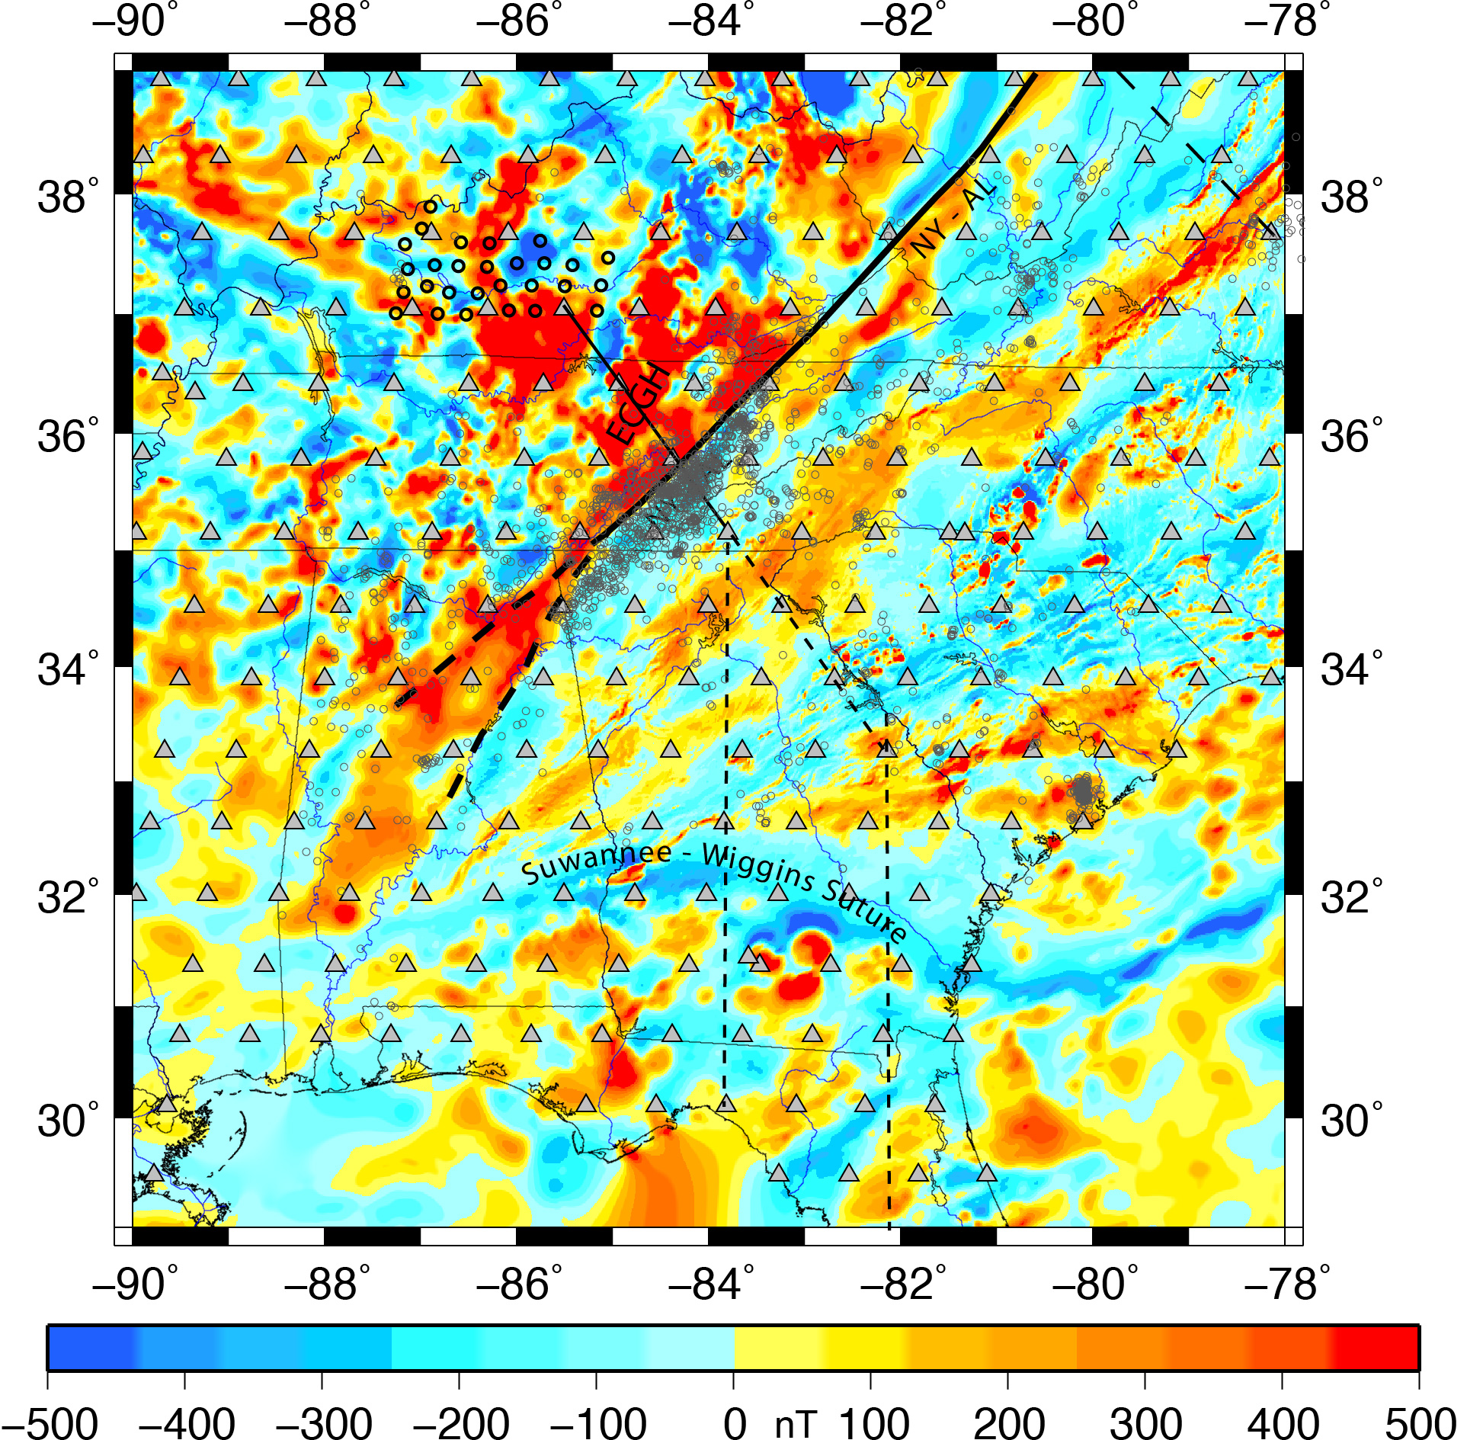

Slide 6
Yellow areas contain the largest residuals

