Slide 1
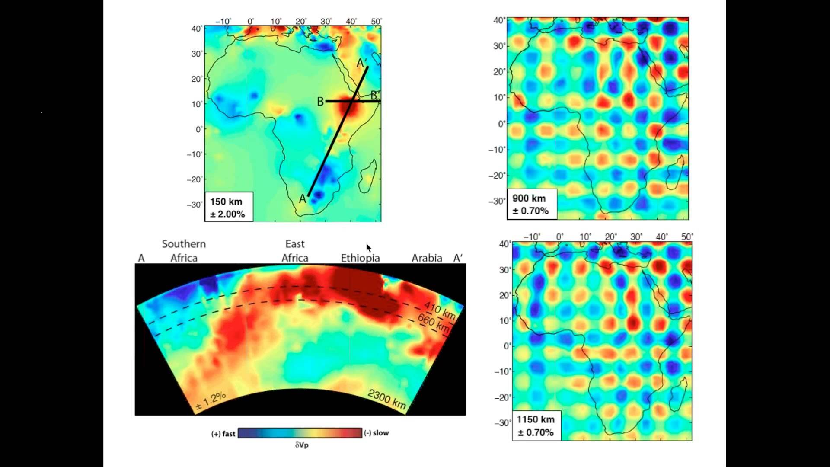

Slide 2
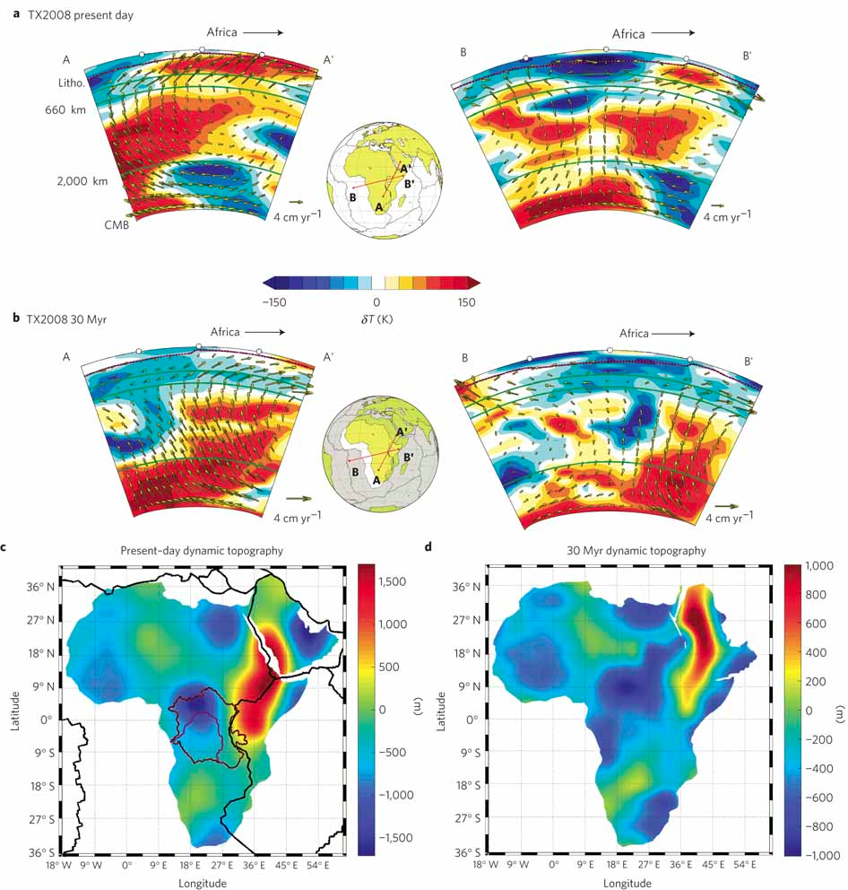
Compare to this
In the next slide

Slide 3
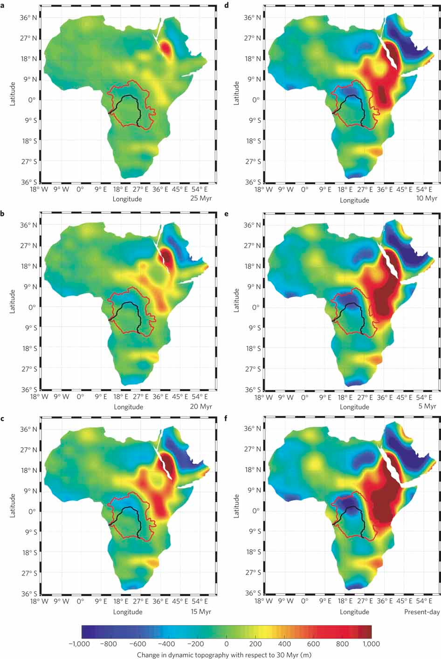
Dynamic topography (m)
change wrt 30 Myr
25 Myr
10 Myr
20 Myr
5 Myr
15 Myr
now

Slide 6
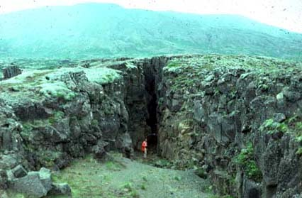

Slide 7
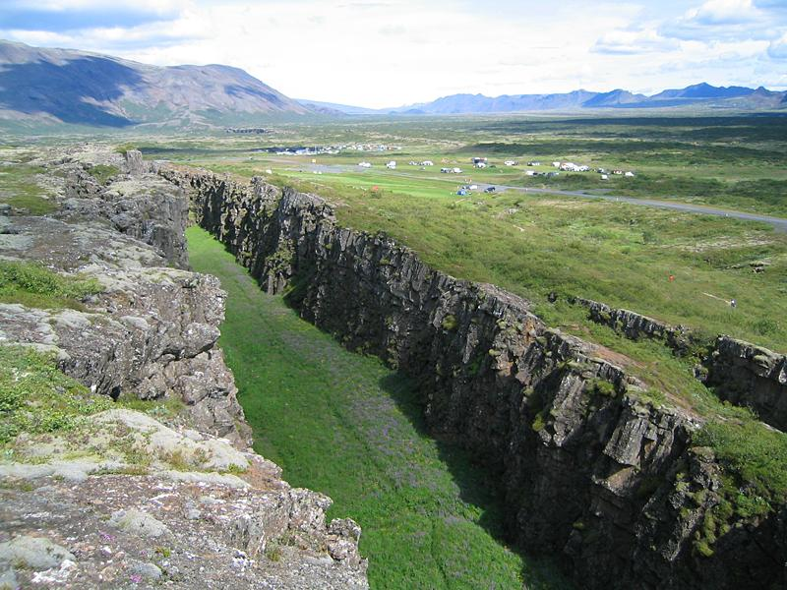

Slide 8
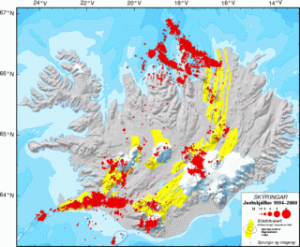
Earthquakes 1994-2000
Earthquakes along the rift segments and at volcano locations

Slide 9
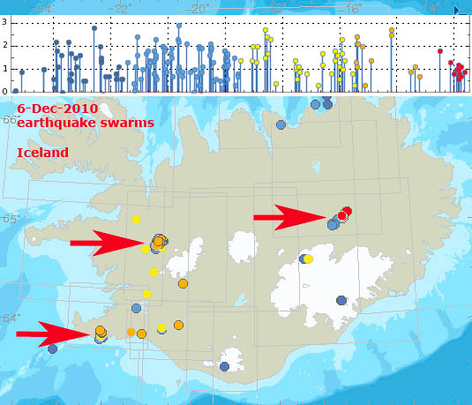

Slide 10
