Slide 1
CERI-7104/CIVL-8126 Data Analysis in Geophysics
Continue Introduction to Matlab
Graphics Handles
Lab: practice with interactive input, reading file, and plotting.
Lab – 9, 09/24/19

Slide 2
More on Graphics
Handles
How to improve the graphics.
See how2handlegraphics.m

Slide 3
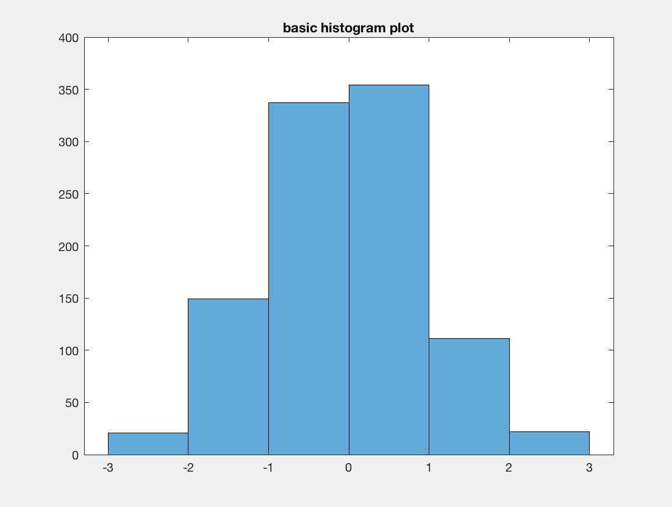
Notes:
This is simple histogram call

Slide 4
>> get(0)
CallbackObject: [0×0 GraphicsPlaceholder]
Children: [1×1 Figure]
CurrentFigure: [1×1 Figure]
FixedWidthFontName: 'Courier New'
HandleVisibility: 'on'
MonitorPositions: [1 1 1440 900]
Parent: [0×0 GraphicsPlaceholder]
PointerLocation: [219 68]
ScreenDepth: 32
ScreenPixelsPerInch: 72
ScreenSize: [1 1 1440 900]
ShowHiddenHandles: 'off'
Tag: ''
Type: 'root'
Units: 'pixels'
UserData: []
>> get(0,'default')
ans =
struct with fields:
defaultFigurePosition: [440 378 560 420]
defaultFigurePaperPositionMode: 'auto'
defaultAxesColorOrder: [0 0 0]
defaultAxesLineStyleOrder: [5×2 char]
defaultAxesFontSize: 18
defaultTextFontSize: 16
defaultLineLineWidth: 3
>>
Notes:
Objects that can be set – control graphics
get(0) gets info on the root
This is where all figures come from

Slide 5
>> a=gcf
a =
Figure (1: basic histogram plot) with properties:
Number: 1
Name: 'basic histogram plot'
Color: [0.940000000000000 0.940000000000000 0.940000000000000]
Position: [440 378 560 420]
Units: 'pixels'
Show all properties
>>
gcf gets current figure handle.
Next slide shows what happens when you click on “show all properties”

Slide 6
Show all properties
Alphamap: [1×64 double]
BeingDeleted: 'off'
BusyAction: 'queue'
ButtonDownFcn: ''
Children: [1×1 Axes]
Clipping: 'on'
CloseRequestFcn: 'closereq'
Color: [0.940000000000000 0.940000000000000 0.940000000000000]
Colormap: [64×3 double]
CreateFcn: ''
CurrentAxes: [1×1 Axes]
CurrentCharacter: ')'
CurrentObject: [0×0 GraphicsPlaceholder]
CurrentPoint: [0 0]
DeleteFcn: ''
DockControls: 'on'
FileName: ''
GraphicsSmoothing: 'on'
HandleVisibility: 'on'
InnerPosition: [440 378 560 420]
IntegerHandle: 'on'
Interruptible: 'on'
InvertHardcopy: 'on'
KeyPressFcn: ''
KeyReleaseFcn: ''
MenuBar: 'figure'
Name: 'basic histogram plot'
NextPlot: 'add'
Number: 1
NumberTitle: 'on'
OuterPosition: [440 378 560 493]
PaperOrientation: 'portrait'
PaperPosition: [0.361111111111111 2.583333333333334 7.777777777777779 5.833333333333332]
PaperPositionMode: 'auto'
PaperSize: [8.500000000000000 11]
PaperType: 'usletter'
PaperUnits: 'inches'
Parent: [1×1 Root]
Pointer: 'arrow'
PointerShapeCData: [16×16 double]
PointerShapeHotSpot: [1 1]
Position: [440 378 560 420]
Renderer: 'opengl'
RendererMode: 'auto'
Resize: 'on'
Scrollable: 'off'
SelectionType: 'normal'
SizeChangedFcn: ''
Tag: ''
ToolBar: 'auto'
Type: 'figure'
UIContextMenu: [0×0 GraphicsPlaceholder]
Units: 'pixels'
UserData: []
Visible: 'on'
WindowButtonDownFcn: ''
WindowButtonMotionFcn: ''
WindowButtonUpFcn: ''
WindowKeyPressFcn: ''
WindowKeyReleaseFcn: ''
WindowScrollWheelFcn: ''
WindowState: 'normal'
WindowStyle: 'normal'
XDisplay: 'Quartz’
Notes:
Lots of stuff – shrunk to fit on 1 p

Slide 7
>> c=gca
c =
Axes (basic histogram plot) with properties:
XLim: [-3.300000000000000 3.300000000000000]
YLim: [0 400]
XScale: 'linear'
YScale: 'linear'
GridLineStyle: '-'
Position: [0.130000000000000 0.123333333333333 0.775000000000000 0.801666666666667]
Units: 'normalized'
Show all properties
>>
Next slide shows what happens when you click on “show all properties”
(there are 138 things in the list!!)
Notes:
get current axis

Slide 8
Show all properties
ALim: [0 1]
ALimMode: 'auto'
ActivePositionProperty: 'outerposition'
AlphaScale: 'linear'
Alphamap: [1×64 double]
AmbientLightColor: [1 1 1]
BeingDeleted: 'off'
Box: 'on'
BoxStyle: 'back'
BusyAction: 'queue'
ButtonDownFcn: ''
CLim: [0 1]
CLimMode: 'auto'
CameraPosition: [0 200 17.320508075688771]
CameraPositionMode: 'auto'
CameraTarget: [0 200 0]
CameraTargetMode: 'auto'
CameraUpVector: [0 1 0]
CameraUpVectorMode: 'auto'
CameraViewAngle: 6.608610360311924
CameraViewAngleMode: 'auto'
Children: [1×1 Histogram]
Clipping: 'on'
ClippingStyle: '3dbox'
Color: [1 1 1]
ColorOrder: [0 0 0]
ColorOrderIndex: 1
ColorScale: 'linear'
Colormap: [64×3 double]
CreateFcn: ''
CurrentPoint: [2×3 double]
DataAspectRatio: [3.300000000000000 200 1]
DataAspectRatioMode: 'auto'
DeleteFcn: ''
FontAngle: 'normal'
FontName: 'Helvetica'
FontSize: 18
FontSizeMode: 'auto'
FontSmoothing: 'on'
FontUnits: 'points'
FontWeight: 'normal'
GridAlpha: 0.150000000000000
GridAlphaMode: 'auto'
GridColor: [0.150000000000000 0.150000000000000 0.150000000000000]
GridColorMode: 'auto'
GridLineStyle: '-'
HandleVisibility: 'on'
HitTest: 'on'
Interactions: [1×1 matlab.graphics.interaction.interface.DefaultAxesInteractionSet]
Interruptible: 'on'
LabelFontSizeMultiplier: 1.100000000000000
Layer: 'bottom'
Legend: [0×0 GraphicsPlaceholder]
LineStyleOrder: [5×2 char]
LineStyleOrderIndex: 1
LineWidth: 0.500000000000000
MinorGridAlpha: 0.250000000000000
MinorGridAlphaMode: 'auto'
MinorGridColor: [0.100000000000000 0.100000000000000 0.100000000000000]
MinorGridColorMode: 'auto'
MinorGridLineStyle: ':'
NextPlot: 'replace'
OuterPosition: [0 0 1 1]
Parent: [1×1 Figure]
PickableParts: 'visible'
PlotBoxAspectRatio: [1 0.776497707072624 0.776497707072624]
PlotBoxAspectRatioMode: 'auto'
Position: [0.130000000000000 0.123333333333333 0.775000000000000 0.801666666666667]
Projection: 'orthographic'
Selected: 'off'
SelectionHighlight: 'on'
SortMethod: 'childorder'
Tag: ''
TickDir: 'in'
TickDirMode: 'auto'
TickLabelInterpreter: 'tex'
TickLength: [0.010000000000000 0.025000000000000]
TightInset: [0.111785708686490 0.122857142857143 0 0.068928571428571]
Title: [1×1 Text]
TitleFontSizeMultiplier: 1.100000000000000
TitleFontWeight: 'bold'
Toolbar: [1×1 AxesToolbar]
Type: 'axes'
UIContextMenu: [0×0 GraphicsPlaceholder]
Units: 'normalized'
UserData: []
View: [0 90]
Visible: 'on'
XAxis: [1×1 NumericRuler]
XAxisLocation: 'bottom'
XColor: [0.150000000000000 0.150000000000000 0.150000000000000]
XColorMode: 'auto'
XDir: 'normal'
XGrid: 'off'
XLabel: [1×1 Text]
XLim: [-3.300000000000000 3.300000000000000]
XLimMode: 'auto'
XMinorGrid: 'off'
XMinorTick: 'off'
XScale: 'linear'
XTick: [-3 -2 -1 0 1 2 3]
XTickLabel: {7×1 cell}
XTickLabelMode: 'auto'
XTickLabelRotation: 0
XTickMode: 'auto'
YAxis: [1×1 NumericRuler]
YAxisLocation: 'left'
YColor: [0.150000000000000 0.150000000000000 0.150000000000000]
YColorMode: 'auto'
YDir: 'normal'
YGrid: 'off'
YLabel: [1×1 Text]
YLim: [0 400]
YLimMode: 'auto'
YMinorGrid: 'off'
YMinorTick: 'off'
YScale: 'linear'
YTick: [0 50 100 150 200 250 300 350 400]
YTickLabel: {9×1 cell}
YTickLabelMode: 'auto'
YTickLabelRotation: 0
YTickMode: 'auto'
ZAxis: [1×1 NumericRuler]
ZColor: [0.150000000000000 0.150000000000000 0.150000000000000]
ZColorMode: 'auto'
ZDir: 'normal'
ZGrid: 'off'
ZLabel: [1×1 Text]
ZLim: [-1 1]
ZLimMode: 'auto'
ZMinorGrid: 'off'
ZMinorTick: 'off'
ZScale: 'linear'
ZTick: [-1 0 1]
ZTickLabel: ''
ZTickLabelMode: 'auto'
ZTickLabelRotation: 0
ZTickMode: 'auto’
Notes:
Cant shrink enough to fit on 1 page!

Slide 9
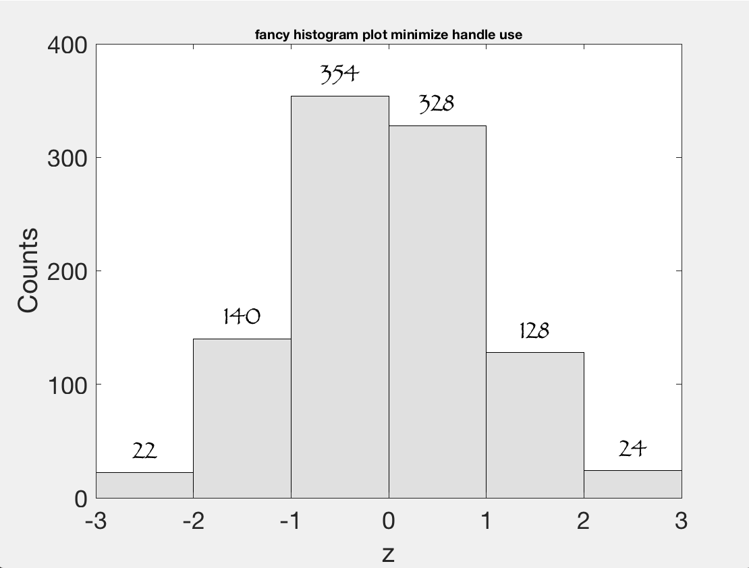
Notes:
Change fonts, sizes, colors in the histogram fill, add display of counts in the bins
Can also change line thickness, etc., could add grid, …
Most of this is “self explanatory” when you read the code (you can figure it out from the variable names and what you see on the plot. But you have to know what is available).
Here’s the code (gca is get current axis handle, when you put a variable on the lhs of a plot command the command puts the handle value in that variable –you can then use that to modify stuff on that plot, axis, label, title, etc.)
BinWidth=1;
BinEdges = (-3:BinWidth:3);
histogram(z,BinEdges,'FaceColor',[0.8 0.8 0.8]);
xlabel('z');
ylabel('Counts');
set(gca,'FontSize',18);
set(gca,'XLim',[-3,3],'YTick',(0:100:400));
BinCounts = histcounts(z,BinEdges);
for bincnt=1:length(BinCounts)
handlet=text(BinEdges(bincnt)+BinWidth/2,BinCounts(bincnt), ...
num2str(BinCounts(bincnt)),...
'HorizontalAlignment','center', ...
'VerticalAlignment','bottom', ...
'FontSize',18,...
'FontName','Papyrus');
end
title(f(fn).Name,'FontSize',10);

Slide 10
This web page has the documentation for all the graphics object properties
https://www.mathworks.com/help/matlab/graphics-object-properties.html
Go there to see how it is organized.

Slide 11
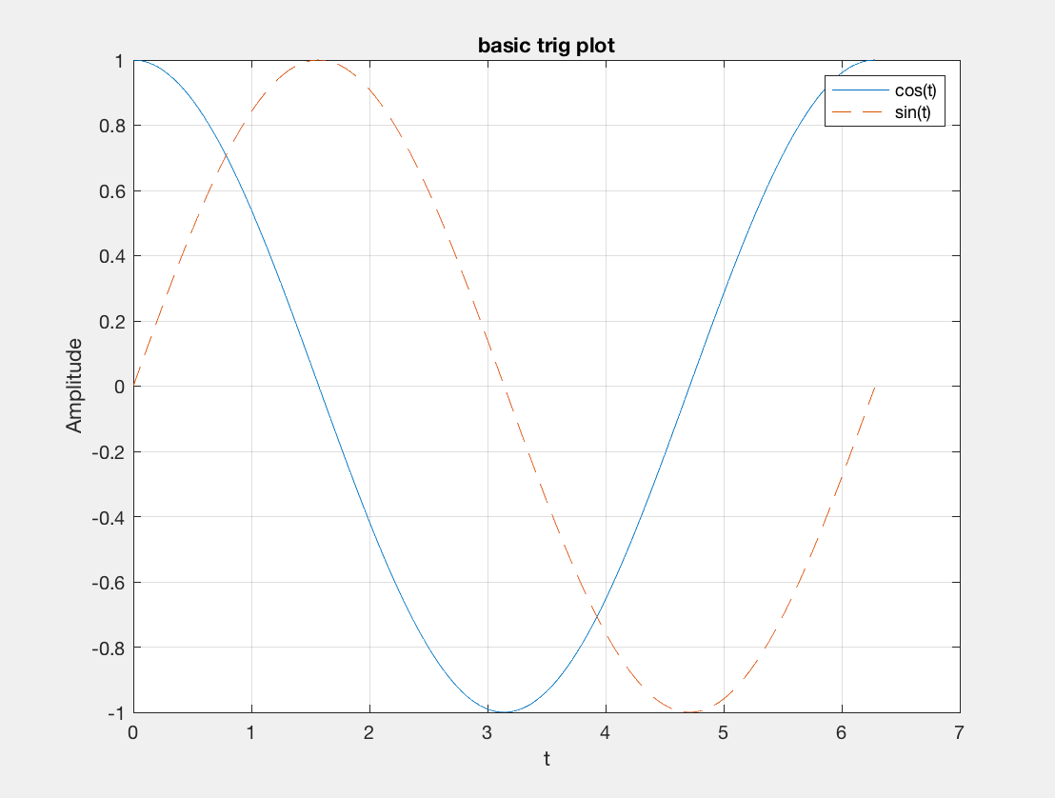
Notes:
Lines too thin
Varies colors for multiple lines (repeat when runs out)
Lables too small
Legend too small
Cant see grid (due to being set almost completely transparent)

Slide 12
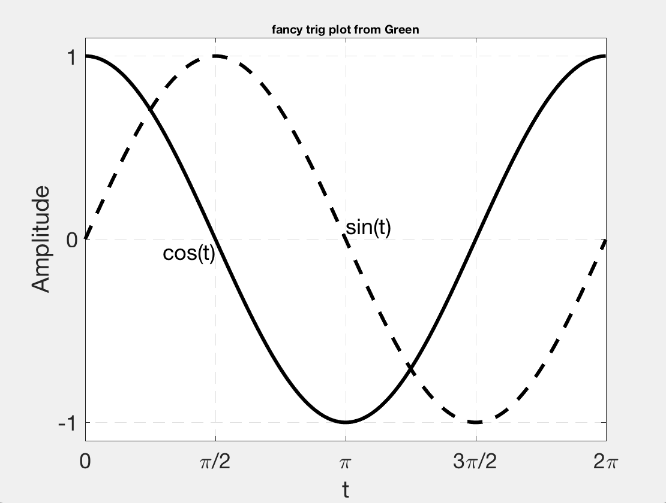
Notes:
Fixed up
Thicker lines
Use different line styles rather than different colors to distinguish between the two plots
Label plots
Greek letters in x axis labels (uses TEX)
plot(t,x,'k-',t,y,'k--','LineWidth',3)
xlabel('t');
ylabel('Amplitude');
set(gca,'FontSize',18)
grid('on');
set(gca,'XLim',[0,2*pi],'YLim',[-1.1 1.1],'GridLineStyle','--','GridAlpha',1,'FontSize',18,'FontName','Helvetica’,'YTick',(-1:1),'XTick',(0:pi/2:2*pi),'XTickLabel',[{'0'};{'\pi/2'};{'\pi'};{'3\pi/2'};{'2\pi'}]);
text(pi,0,'sin(t)','FontSize',18,'VerticalAlignment','bottom');
text(pi/2,0,'cos(t)','Fontsize',18,'HorizontalAlignment','right', 'VerticalAlignment','top');
title(f(fn).Name,'FontSize',10)

Slide 13
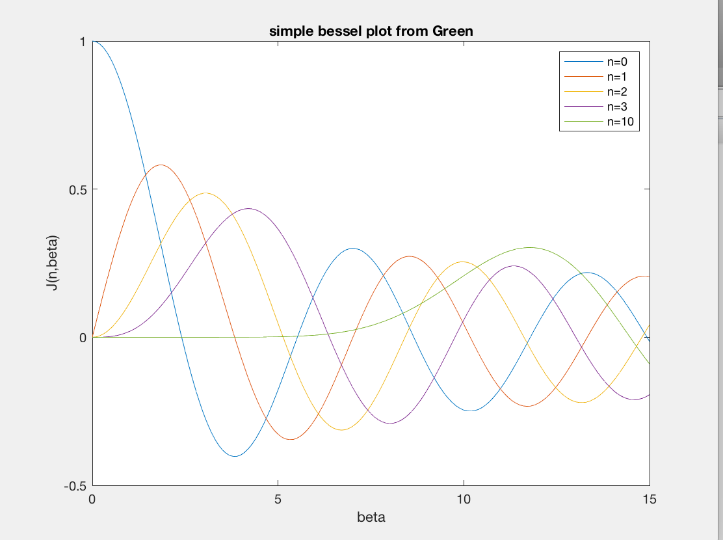
Notes:
Similar probelms
Lines too thin
Changing colors not best way to plot multiple plots
Labels/text too small

Slide 14
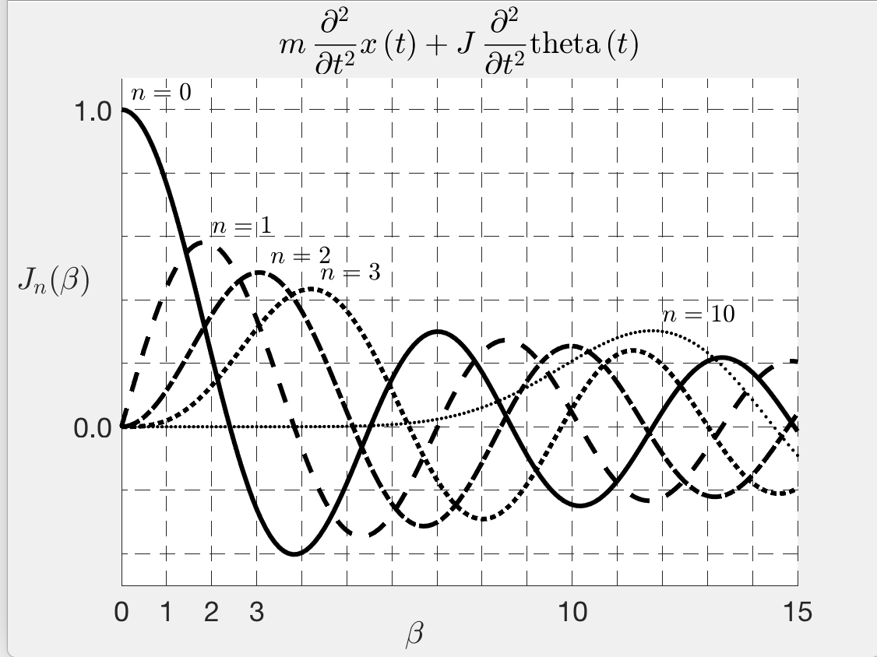
Notes:
Now fancy –
Thicken lines
Rotate through line styles rather than colors.
Axis labels with greek letters, and subscripts, and italics.
Label each order rather than with legend
Title is not related to rest of plot – shows how to write equations with LATEK. Note have to turn on the LATEX interpreter (the interpreter is what translates what you wrote into stuff on the screen – the default interpreter is TEX – what we used to get the greek letters. LATEK understands TEK and adds stuff.)
beta = (0:0.1:15);
n = [0:3,10];
for cnt=1:length(n)
J(cnt,:) = besselj(n(cnt), beta);
end
set(0,'DefaultAxesColorOrder',[0 0 0],'DefaultAxesLineStyleOrder’,('-|--|-.|:|.'),'DefaultAxesFontSize',18,'DefaultTextFontSize',16,'DefaultLineLineWidth',3);
plot(beta,J);
xlabel('$\beta$','Position',[6.5 -0.6 1.0],'Interpreter','latex');
ylabel('$J_n(\beta)$','Rotation',0,'Position',[-1.5 0.4 1.0],'Interpreter','latex');
grid on
set(gca,'GridLineStyle','--','GridAlpha',1);
set(gca,'box','off','XTick',(0:15),'XTickLabel',[{'0'}; {'1'};{'2'};{'3'};{' '};{' '};{' '};{' '};{' '};{' '};{'10'};{' '};{' '};{' '};{' '};{'15'}],'YTick',(-.4:.2:1),'YTickLabel',[{' '},{' '},{'0.0'},{' '},{' '},{' '},{' '},{'1.0'}],'XLim',[0 15],'YLim',[-0.5 1.1]);
for cnt = 1:length(n)
[mx,ind] = max(J(cnt,:));
text(beta(ind)+0.2,mx+0.05, ...
['$n = ',num2str(n(cnt)),'$'],'Interpreter','latex');
end
LaTeX_Expr = 'm\,\frac{\partial ^2}{\partial t^2} x\left(t\right)+J\,\frac{\partial ^2}{\partial t^2} \mathrm{theta}\left(t\right)';
title(['$$' LaTeX_Expr '$$'], 'Interpreter','latex')

Slide 15
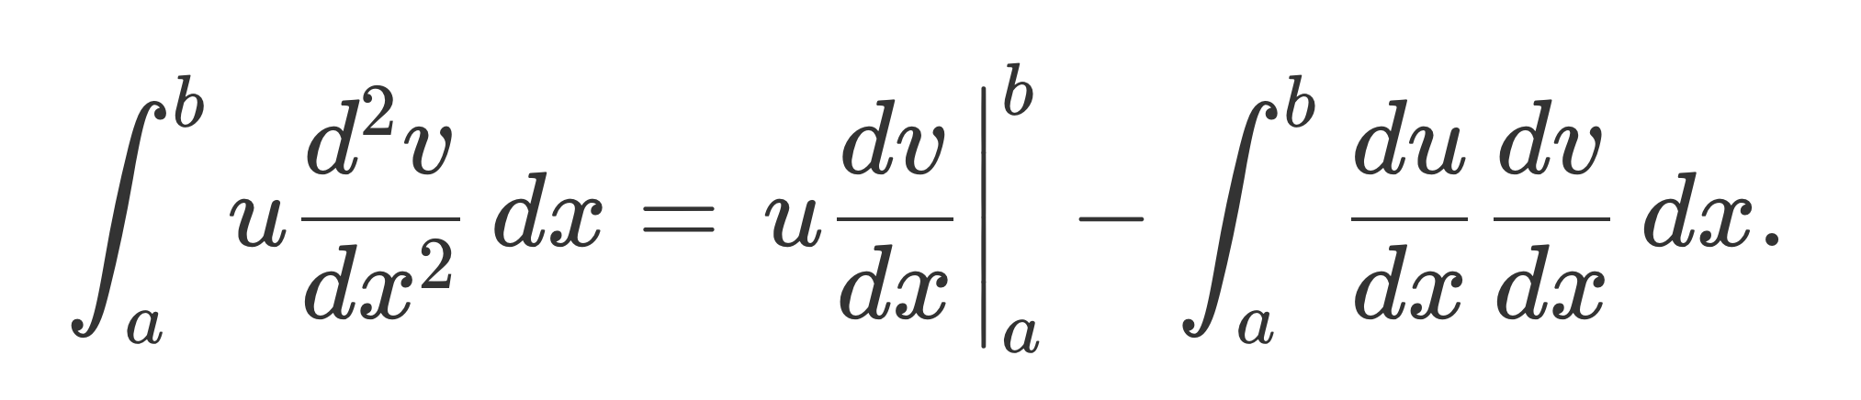
Another example of tex and the gibberish you have to type/understand to make pretty output (TEK is a typesetting program and makes the prettiest outputs – but at a cost! You can guess how it works reading it and looking at the output, but it is hard to come up with it.)
\[
\int_a^bu\frac{d^2v}{dx^2}\,dx
=\left.u\frac{dv}{dx}\right|_a^b
-\int_a^b\frac{du}{dx}\frac{dv}{dx}\,dx.
\]
Notes:
Latex
https://www.authorea.com/users/3/articles/165181-latex-mathematics-examples

Slide 16
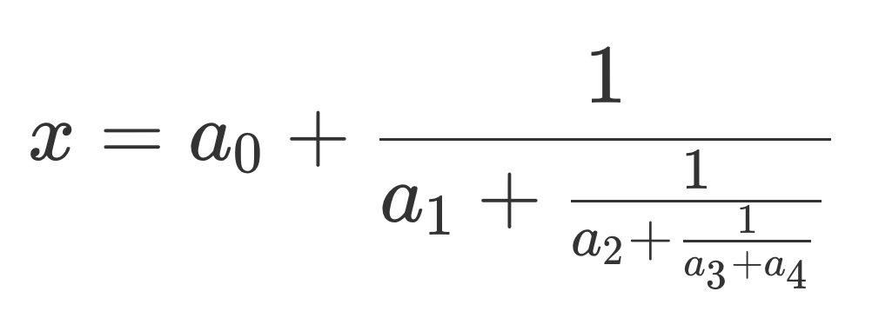
And another
Typesetting continued fractions is easy:
\[
x = a_0 + \frac{1}{a_1 + \frac{1}{a_2 + \frac{1}{a_3 + a_4}}}
\]
This is pretty much the antithesis of the WYSIWYG (an acronym for ”What You See Is What You Get”) philosophy of MS Word, Pages (Apples version of Word). etc.
Notes:
Latex
https://www.authorea.com/users/3/articles/165181-latex-mathematics-examples
Also see
https://www.mathworks.com/help/matlab/creating_plots/greek-letters-and-special-characters-in-graph-text.html

Slide 17
How turn off underscore signifying next character is a subscript (default intrepreter is TEX).
This way you don’t have to escape the underscore (“\_”) to get it to be an underscore.
This is needed when the text is not “hard coded”, eg. a file name.
Set the Interpreter property for that field to 'none'; the default for text() fields is TEX.
title('This_title has an underline', 'Interpreter', 'none');
Notes:
“escape” means turn off some default behavior signified by a character and take the character as is and print it.
We will see this use of “escape” with unix, where many non-letters have some special meta-character meaning – as a wildcard, etc.

Slide 18
Write script to read the files
mixedin1.dat and mixedin2.dat
These files have earthquake data.
Most earthquake data files have a mixture of numbers and text (the first file) and time formatted data, and a header (that typically identifies the data columns (the second file).

Slide 19
Prompt for file name
Empty response?
File exists?
Read file into inbuf
Display line
Prompt for positions in input line of x and y data to plot
Get number lines
Preallocate memory (for speed, need to know how many lines in input file)
Loop over lines to pull (x,y) data out of input cell array
Plot x,y data
Notes:
Use this to make a flow chart of what you are going to do.

Slide 20
Another way to read data – a line at a time
fgets and fgetl.
First one keeps newline character, second one drops the newline character – see red stuff below
>> tline = fgets(fid)
tline =
'2014 04 26 -55.8259 -27.1533 34.93 4.6 2014-04-26T02:02:20.930Z near s georgia
’
tline = fgetl(fid)
tline =
'2014 04 01 -60.1681 -24.8498 10 4.9 2014-04-01T08:29:13.300 near s georgia‘
As you read the file a line at at time it advances through the file. If need to go back to the beginning you have to rewind.
frewind(fid)
Notes:
tline = fgets(fileID) reads the next line of the specified file, including the newline characters.
Read using fgetl, which excludes the newline character.

Slide 21
You can also give handles to functions, this allows you to pass functions as arguments to other functions
f = @(x) x.^3 -3*x+1;
Then call f(3.4) etc., (like sin, cosine, etc.)
This also makes function handles – so you can pass functions to other functions
X=linspace(0,2);
Plot(x,f(x))

