Slide 1
CERI-7104/CIVL-8126 Data Analysis in Geophysics
Programming.
Lab – 3b, 09/03/19

Slide 2
More on vectorization.
MATLAB is a vectorized high level language
Requires change in programming style
(if one already knows a non-vectorized programming language such as Fortran, C, Pascal, Basic, etc.)
Vectorized languages allow operations over arrays using simple syntax, essentially the same syntax one would use to operate over scalars.
(looks like math again.)

Slide 3
What is vectorization?
(with respect to matlab)
Vectorization is the process of writing code for MATLAB that uses matrix operations or other fast built-in functions instead of using explicit loops.
The benefits of doing this are usually sizeable.
The reason for this is that MATLAB is an interpreted language. Function calls have very high overhead, and indexing operations (inherent in a loop operation) are not particularly fast.

Slide 4
Loop versus vectorized version of same code.
New commands “tic” and “toc” - time the execution of the code between them.
>> a=rand(1000);
>> tic;b=a*a;toc
Elapsed time is 0.229464 seconds.
>> tic;for k=1:1000,for l=1:1000,c(k,l)=0;for m=1:1000, c(k,l)=c(k,l)+a(k,m)*a(m,l);end, end, end, toc
Elapsed time is 22.369451 seconds.
>> whos
Name Size Bytes Class Attributes
a 1000x1000 8000000 double
b 1000x1000 8000000 double
c 1000x1000 8000000 double
k 1x1 8 double
l 1x1 8 double
m 1x1 8 double
>> max(max(b-c))
ans =
9.6634e-13
Factor 100 difference in time for multiplication of 10³x10³ matrix!
Notes:
Compare matrix multiplication using matlab vectorized implementation, to fortran/c style triple nested do loop implementation
Answers about the same (e-13 max difference).

Slide 5
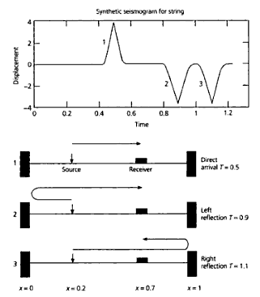
Vectorization of synthetic seismogram example from
Stein and Wysession
Intro to Seismology and Earth Structure.
Section on scientific programming

Slide 6
Start by just "translating" the Fortran code into Matlab.
So far we probably don't fully understand the math, but we have a formula and so we can calculate u(x,t).

Slide 7
%synthetic seismogram for homogeneous string, u(t)
%calculated by normal mode summation
%string length
alngth=1;
%velocity m/sec
c=1.0;
%number modes
nmode=200;
%source position
xsrc=0.2;
%receiver position
xrcvr=0.7;
%seismogram time duration
tdurat=1.25;
%number time steps
nstep=50;
%time step
dt=tdurat/nstep;
%source shape term
tau=0.02;
fprintf('%s\n','synthetic seismogram for string')
fprintf('%s %0.5g\n','number modes', nmode)
fprintf('%s %0.5g %0.5g\n','length and velocity', alngth, c)
fprintf('%s %0.5g %0.5g\n','posn src and rcvr',xsrc,xrcvr)
fprintf('%s %0.5g %0.5g %0.5g\n','durn, time steps, del t',tdurat,nstep,dt)
fprintf('%s %0.5g\n','source shape', tau)
%initialize displacement
for cnt=1:nstep
u(cnt)=0;
end
for k=1:nstep
t(k)=dt*(k-1);
end
%outer loop over modes
for n=1:nmode
anpial=n*pi/alngth;
%space terms - src & rcvr
sxs=sin(anpial*xsrc);
sxr=sin(anpial*xrcvr);
%mode freq
wn=n*pi*c/alngth;
%time indep terms
dmp=(tau*wn)^2;
scale=exp(-dmp/4);
space=sxs*sxr*scale;
%inner loop oner time steps
for k=1:nstep
% t=dt*(k-1);
% cwt=cos(wn*t);
cwt=cos(wn*t(k));
%compute disp
u(k)=u(k)+cwt*space;
end
end
plot(t,u)
Slightly cleaned up version of Fortran program in Stein and Wysession “translated” to Matlab. (took calculation of time out of inner loop – is recalculated each time through, waste of time, calculate as vector once at beginning)
Doing translation for homework
Notes:
Matlab version = basically just change fortran "do" loops into matlab "for" loops. Equating things is same (add semicolons).

Slide 8
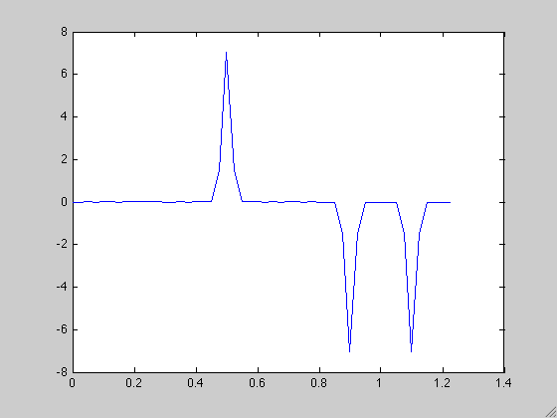
Synthetic seismogram produced by Matlab code translated from Fortran.

Slide 9
Variables
>> whos
Name Size Bytes Class Attributes
alngth 1x1 8 double
anpial 1x1 8 double
c 1x1 8 double
cnt 1x1 8 double
cwt 1x1 8 double
dmp 1x1 8 double
dt 1x1 8 double
k 1x1 8 double
n 1x1 8 double
nmode 1x1 8 double
nstep 1x1 8 double
scale 1x1 8 double
space 1x1 8 double
sxr 1x1 8 double
sxs 1x1 8 double
t 1x1 8 double
tau 1x1 8 double
tdurat 1x1 8 double
u 1x50 400 double
wn 1x1 8 double
xrcvr 1x1 8 double
xsrc 1x1 8 double
Notes:
List of variables – only one vector – the final seismogram

Slide 10
Let's return to the original problem and try to understand what is going on.
We will use this to understanding to further vectorize (speed up) the code.

Slide 11
This is just the Fourier domain representation for waves on a string with fixed ends
Weight - no dependence on x or t, only ω_{n}.
Standing wave made from 2 opposite direction traveling waves. Amplitude varies with time, but does not "move"
Going left Going right
Notes:
Rearrange
Put all constant stuff together
Look at space and time varying parts
Turn into traveling and standing waves
Weights change by factor of ½ between last two lines

Slide 12
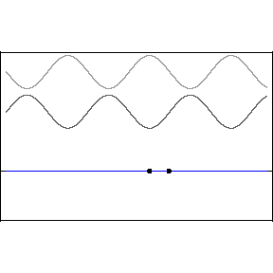
Normal Mode (and combination of traveling waves to make standing wave) formulation for displacement of a string
This is a sinusoidal wave that is fixed in space, cos(kx), whose amplitude is modulated
harmonically in time, cos (ωt)

Slide 13
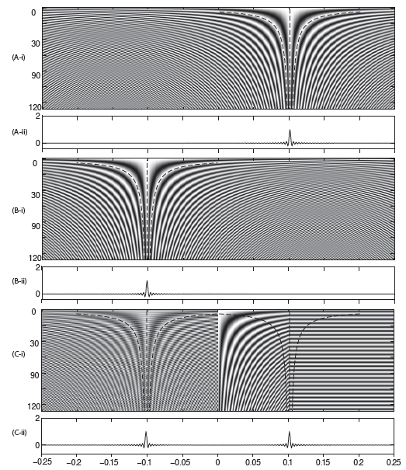
Do over a range of frequencies.
Delta functions going right on top
and left in middle
and combined (bottom).
u(x,t)=Acos (kx+ωt)+Acos(kx−ωt)
u(k,ω)=Acos (kx+ωt)+Acos(kx−ωt)
u(x,t)=u(k,ω)=2Acos(ωt)cos(kx)
Notes:
Constructive interference where cos(ωt)=cos(kx) phases agree – stationary phase.
Space part constant, time part chages with time – the two line up at different spot at different times, get constructive interferenece there only!

Slide 14
Look at the basic element of Fourier series, weighted sum of sin and cos functions
(look at cos only to see how works).
Dot product
or matrix multiply: ac=(c'a')'
matrix multiply, at multiple times to make full seismogram
Notes:
Calculate at one time – first 3 lines
Transpose between 3rd and 4th lines
Calculate for lots of times – bottom 2 lines
Final – have cosins basis functions of Fourier series in the columns (time series in t), times column vector of weights.

Slide 15
Look at the basic Fourier series
At constant time, weighted sum of cosines at different frequencies at that time
constant frequency cosine as function of time (basis functions)
This is multiplication of a matrix (with cosines as functions of frequency – across - and time - down) times a vector containing the Fourier series weights.

Slide 16
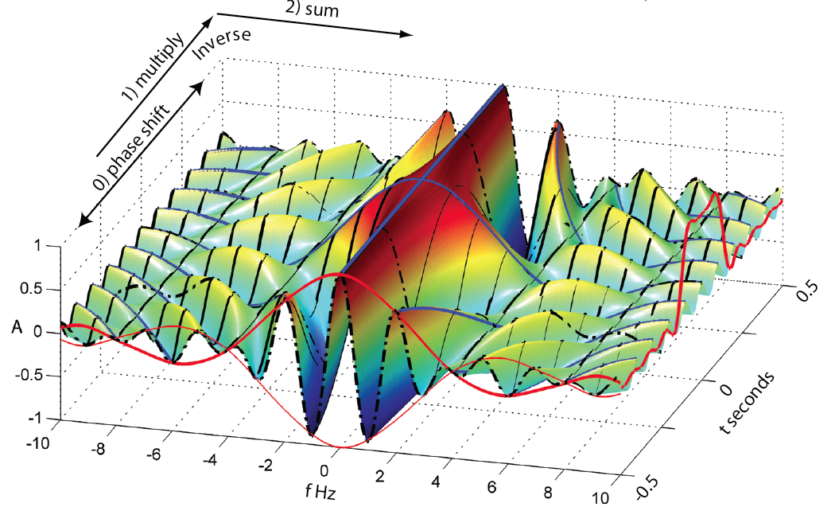
We have just vectorized the equations for the Fourier series!
Notes:
The surface is composed of cosines in time or frequency as per the matrix on the last slide (start with plotting matrix on last slide as surface).
They are multiplied by the fourier weights (the red lines in front, to make this picture) and summed across to make the Fourier series to make the time domain function – red line at the right

Slide 17
Even though this is a major improvement over doing this with for loops, and is clear conceptually, it is still not "computable" as it takes O(N²) operations (and therefore time) to do it. This is OK for small N, but quickly gets out of hand.
Fourier analysis is typically done using the Fast Fourier transform (FFT) algorithm – which has O(N log₂ N) operations and is significantly faster for large N.
Notes:
Big O is for "order" as in order of magnitude.

Slide 18
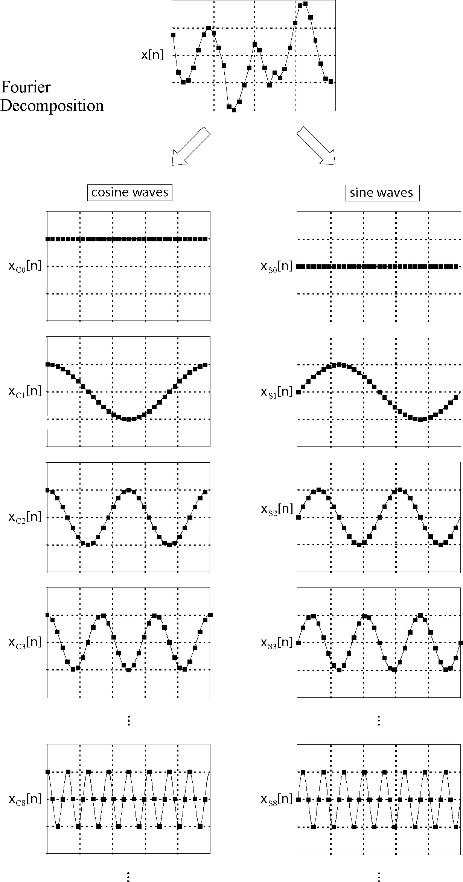
Fourier decomposition.
“Basis” functions are the sine and cosine functions.
Notice that first sine term is all zeros (so don’t really need it) and last sine term (not shown) is same as last cosine term, just shifted one – so will only need one of these).
Figure from Smith

Slide 19
Fourier transform (actually Fourier series)
The Fast Fourier Transform (FFT) depends on noticing that there is a lot of repetition in the calculations – each higher frequency basis function can be made by selecting points from the ω₀ function. The weight value is multiplied by the same basis function value an increasing number of times as ω increases.
Figure from Smith
Notes:
Second cos/sin term is "basis"
Third is every other point from first
Fourth is every third point from first
Etc.

Slide 20
FFT
The FFT uses regularities of the calculation to calculate the basis functions and then basically does each unique multiplication only once, stores it, and then does the bookeeping to add them all up correctly.
The points in the trace at the top are made from vertical sums of the weighted points at the same time in the cos and sin traces in the bottom.
Figure from Smith
Notes:
Notice that a1 is multiplied by the same basis value 2x (2 cycles) (4x if you include +/- values)
a2 is multiplied by the same basis value several times, etc.
Savings from 2 places – computing the basis functions and multiplications of basis functions by same values.

Slide 21
FFT
The FFT uses the following symmetry properties
Symmetry
Periodicity
FFT needs number points = power of 2.
Figure from Smith

Slide 22
% number of time samples M % points
% source/receiver position:
% xs/xr (meters)
% speed c (meters/sec)
% length L (meters)
% number of modes N
% source pulse duration Tau % (sec)
% length of seismogram T (sec)
M=50;
xs=0.25;
xr = 0.7;
c=1;
L=1;
N=200;
Tau=0.02;
T=1.25;
%time vector, 1 row by M %columns: start, step, stop
%will need lots, calc once
dt=T/M;
t=0:dt:T-dt;
Same program in Matlab after vectorization (is mostly comments!)
Notes:
N%stein actually starts at mode %1, use stein freq definition
%freq vector from 0 to n*pi*c/L %1 row by N columns
N=1:N;
Wn=n*pi*c/L;
%time independent terms - modes %- 1xN vector (row vector)
timeindep=sin(wn*xr).*sin(wn*xs).*exp(-(wn*Tau).^2/4);
%time dependent terms - %time*freqs = MxN matrix, basis
%cosines down each column – 50 %long, modes across rows, 200
%long
timedep=cos(t'*wn);
%use matrix * vector multiply %to do "loop"
%(MxN)times(Nx1)=(Mx1) (column %vector)
seism=timedep*timeindep';
plot(t,seism)
ow vecorize it. t and wn vectors for time and freq, then form matrix of basis functions (timedep) and vector of weights (timeindep)

Slide 23
Notes:
Weight a_{n} here is ½ that on page with development since sin(kx-wt)+sin(kx+wt)=2sin(kx)sin(wt)

Slide 24
We need to make the matrix and the vector
Making the matrix.
What size does it have to be?
What does each row and column represent?

Slide 25
There are N=200 columns for the M frequencies
There are N=50 rows for the N samples in the seismogram time series.
How do we make the elements (k,l) of the matrix?
Use fact that values needed are proportional to k and l.

Slide 26
Make appropriate vectors for time and frequency.
How big is each?
How combine them to make the matrix as a function of k and l?

Slide 27
Multiply elements of the matrix by dt and .
Take cosine of matrix.

Slide 28
Now calculate the weights.
Note the weights depend on n, and ,but not t.
All t dependence is in the matrix elements.

Slide 29
So now have matrix with the trigonometric basis functions and a vector of the weights.
Just multiply them!
(careful with sizes)

Slide 30
This is not the way it is typically done (although some people still do it the "Fortran" way) as it is still O(N²).
The Matlab matrix multiplication method is faster than the Matlab loop method.
(a good Fortran compiler will beat the pants off either implementation in Matalb).
We did it this way for educational purposes.
Typically, it is done using the FFT (Fast Fourier Transform) algorithm which avoids duplication of effort in the multiplications and results in O(N log₂ N) multiplications.

Slide 31
For a time series 2¹⁶=65,536
(FFT needs number of points = power of two, this is pretty typical number of points in seismogram, about 10 minutes at 100 Hz sampling)
We need O(16 * 2¹⁶)=1,048,576
Vs
4,294,967,296
Multiplications (slow)
(ratio 2.44140625e-4 -> 4096 times faster!!)

Slide 32
Two lessons
Vecotorizing Matlab (turn loops into matrix operations) makes Matlab go lots faster.
Should do it.
Vectorizing in general
- is not algorithmic
- is case specific
can give gigantic speed improvements (much more than Matlab style vectorizing) and even make something that is non-computable, computable.
But is lots of work - an art!
Notes:
Simplest vectorizing is to do stuff in parallel that you can – speed up by factor of however many jobs/cpus you can run/get ahold of.
Some problems need the FFT type solution to be useful.

Slide 33
Get same figure as before.

