Slide 1
CERI-7104/CIVL-8126 Data Analysis in Geophysics
Introduction to PYTHON
Lab – 26, 11/26/19
Python
We are going to continue to interactively look at and modify python code.
Math, matrix, and plotting libraries

Slide 2
The three principal libraries for scientific number crunching and plotting are
SciPy (pronounced "Sigh Pie") contains modules for statistics, optimization, integration, linear algebra, Fourier transforms, signal and image processing, ODE solvers, and more.
NumPy (pronounced ”Num Pie") is an extension to Python, adding support for large, multi-dimensional arrays and matrices, along with a large library of high-level mathematical functions to operate on these arrays.
matplotlib is a plotting library for Python and its numerical mathematics extension NumPy.
Notes:
See https://www.quora.com/What-are-the-best-Python-mathematics-libraries for more libraries

Slide 3
The first thing one has to do is import them.
python_stuff:544 $ python
>>> import numpy
>>> import scipy
>>> import matplotlib

Slide 4
Next look at - matplotlib.pyplot –
a collection of command line functions that make matplotlib work like MATLAB. Each pyplot function makes some change to a figure: e.g., creates a figure, creates a plotting area in a figure, plots some lines in a plotting area, decorates the plot with labels, etc.
matplotlib.pyplot preserves various states across function calls, so it keeps track of things like the current figure and plotting area, and the plotting functions are directed to the current axes (please note that "axes" here and in most places in the documentation refers to the axes part of a figure and not the strict mathematical term for more than one axis).
Notes:
Based on https://matplotlib.org/3.1.1/tutorials/introductory/pyplot.html

Slide 5
Import and create alias so we don’t have to call matplotlib.pyplot.method to do method
import matplotlib.pyplot as plt
Plot a list
plt.plot([1, 2, 3, 4])
Label it
plt.ylabel('some numbers’)
Not seeing anything? You need to “show” it.
plt.show()

Slide 6
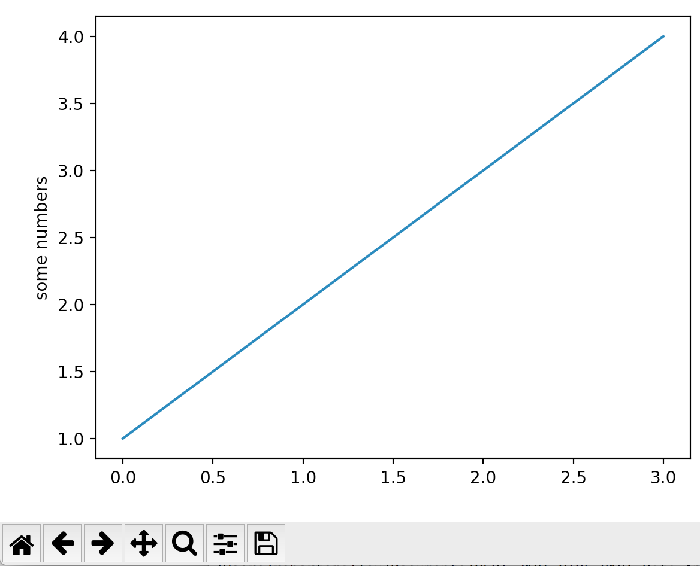
Notes:
To get out of plot() and return to prompt – if you can see the plot window close it (red filled circle with x), if can’t see plot window, select X-quartz and then select from the application menu “hide others”. Follow instructions for if you and see it (as you are).

Slide 7
You may be wondering why the x-axis ranges from 0-3 and the y-axis from 1-4.
If you provide a single list or array to plot(), matplotlib assumes it is a sequence of y values, and automatically generates x values.
Since python ranges start with 0, the default x vector has the same length as y but starts with 0.
Hence the x data are [0,1,2,3].
Return to the Python prompt by closing the X-window (click in the red X).

Slide 8
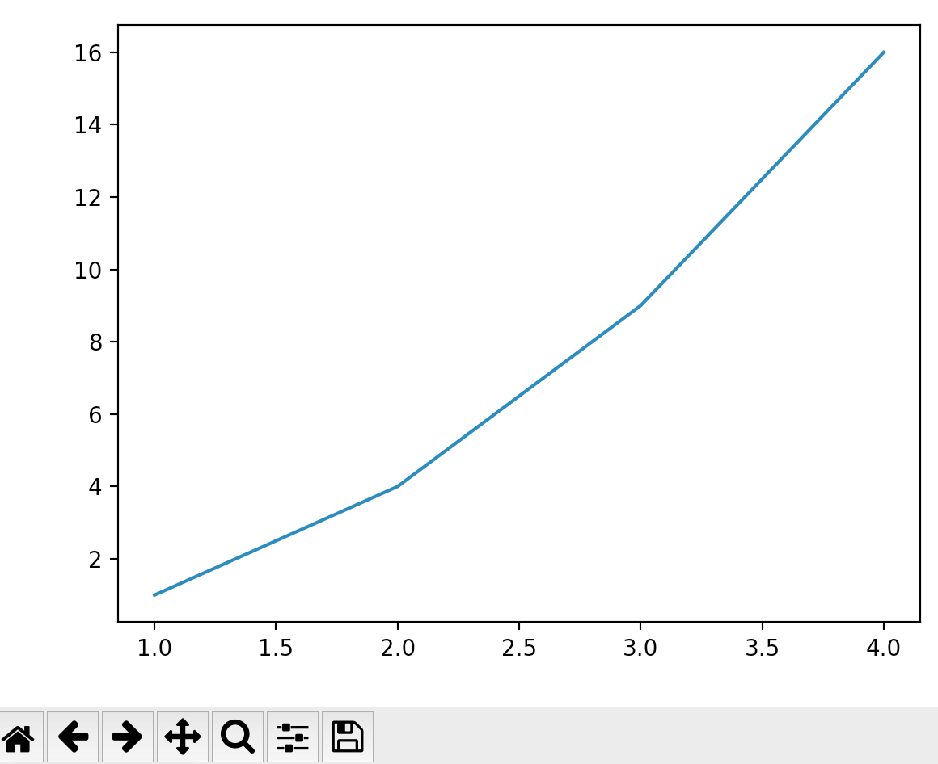
As in MATLAB, plot() can take an arbitrary number of arguments. For example, to plot x versus y, use:
plt.plot([1, 2, 3, 4], [1, 4, 9, 16])
Notes:
Remember the “plt.show()”

Slide 9
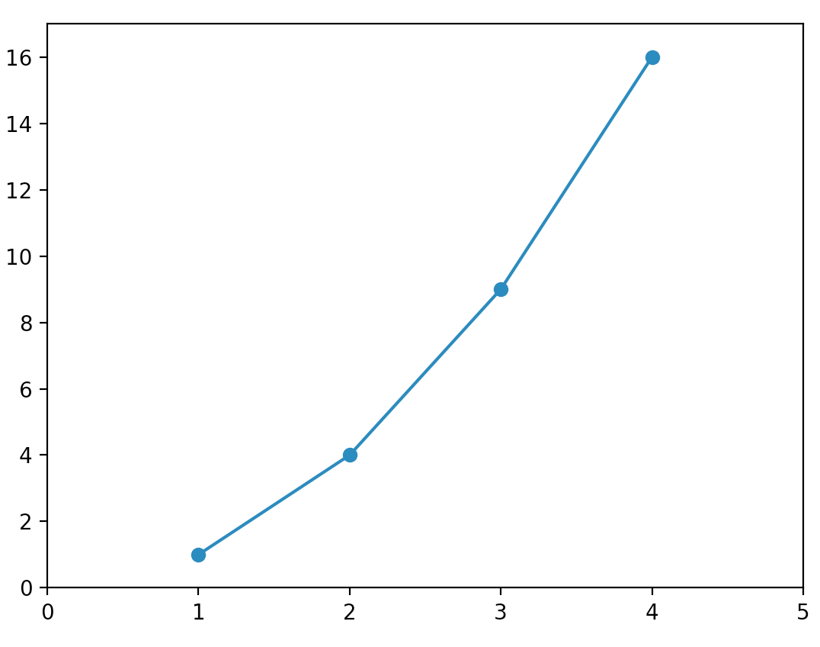
More MATLAB emulation. Optional 3rd argument: the format string that indicates the color and line type of the plot. Same as MATLAB.
plt.plot([1, 2, 3, 4], [1, 4, 9, 16], '-o’)
plt.axis([0, 5, 0, 17])
Notes:
Remember the “plt.show()”
This same as MATLAB – add axis, etc, to current plot window with calls that modify the plot.
Each call “erases” the previous (plt.plot erases whole current plot, plt.axis erases current axis)

Slide 10
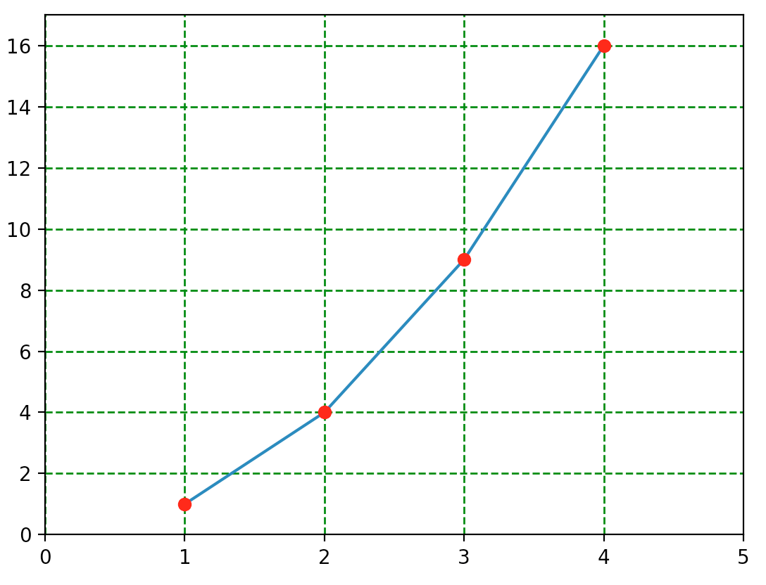
Different from MATLAB emulation. A new plot() call does not clear plot.
X=[1, 2, 3, 4]
Y=[1, 4, 9, 16]
plt.plot([X, Y)
plt.axis([0, 5, 0, 17])
plt.plot(X,Y,'ro’)
plt.grid(color='g', linestyle='.', linewidth=1)
Notes:
Remember the plt.show()
Notice – do not need “hold” command – there is a deprecated hold command that still behaves properly (su[[psedly, I’ve not verified that).
Getting tired of typing the data so make lists.
Add grid

Slide 11
Different from MATLAB emulation. A new plot() call does not clear plot.
X=[1, 2, 3, 4]
Y=[1, 4, 9, 16]
plt.plot([X, Y)
plt.axis([0, 5, 0, 17])
plt.plot(X,Y,'ro’)
plt.grid(color='g', linestyle='.', linewidth=1)
Notes:
Remember the plt.show()
Notice – do not need “hold” command – there is a deprecated hold command that still behaves properly (su[[psedly, I’ve not verified that).
Getting tired of typing the data so make lists.
Add grid

Slide 12
If matplotlib were limited to working with lists, it would be fairly useless for numeric processing.
Generally, you will use numpy arrays.
In fact, all sequences are converted to numpy arrays internally.
The next example illustrates plotting several lines with different format styles in one command using arrays.

Slide 13
Define array (look up numpy.arrange on web, np.arange(start, stop, delta)) goes from [start to stop) in steps of delta.
In this case math operates on vectors (but not exact same way as MATLAB, this is doing “.^”)
import matplotlib.pyplot as plt, numpy as np
# evenly sampled time at 200ms intervals
t = np.arange(0., 5., 0.2)
# red dashes, blue squares and green triangles
plt.plot(t, t, 'r--', t, t**2, 'bs', t, t**3, 'g^')
plt.show()
Note
t = np.arange(0., 5., 0.2)
>>> t
array([0. , 0.2, … , 4.6, 4.8])
Notes:
LOOK STUFF ON GOOGLE!!!
numpy.arange
numpy.arange([start, ]stop, [step, ]dtype=None) Return evenly spaced values within a given interval.
Values are generated within the half-open interval [start, stop) (in other words, the interval including start but excluding stop). For integer arguments the function is equivalent to the Python built-in range function, but returns an ndarray rather than a list.
When using a non-integer step, such as 0.1, the results will often not be consistent. It is better to use numpy.linspace for these cases.
numpy.linspace(start, stop, num=50, endpoint=True, retstep=False, dtype=None, axis=0)[source] Return evenly spaced numbers over a specified interval.
Returns num evenly spaced samples, calculated over the interval [start, stop].
The endpoint of the interval can optionally be excluded.
numpy.linspace says --- See also
arange Similar to linspace, but uses a step size (instead of the number of samples).
Note “closed” vs ”open” ends, start end is closed, stop end is open (does not include the stop value)
Here if X was a list X**2 falls over.

Slide 14
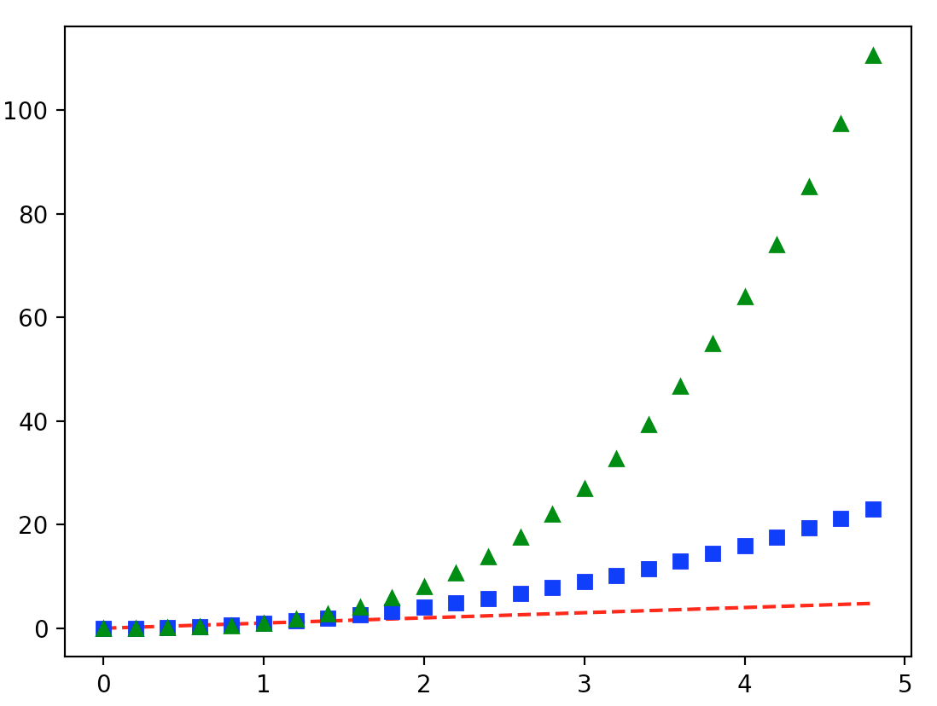
This is what we get

Slide 15
Working with multiple figures and axes
MATLAB, and pyplot, have the concept of the current figure and the current axes.
All plotting commands apply to the current axes.
The function gca() returns the current axes (a matplotlib.axes.Axes instance), and gcf() returns the current figure (matplotlib.figure.Figure instance).
Notes:
Normally, you don't have to worry about this, because it is all taken care of behind the scenes. Below is a script to create two subplots

Slide 16
Example of subplots with lots of new stuff
def f(t):
return np.exp(-t) * np.cos(2*np.pi*t)
t1 = np.arange(0.0, 5.0, 0.1)
t2 = np.arange(0.0, 5.0, 0.02) plt.figure()
plt.subplot(211)
plt.plot(t1, f(t1), 'bo', t2, f(t2), 'k') plt.subplot(212)
plt.plot(t2, np.cos(2*np.pi*t2), 'r--') plt.show()
Notes:
What does this do?

Slide 17
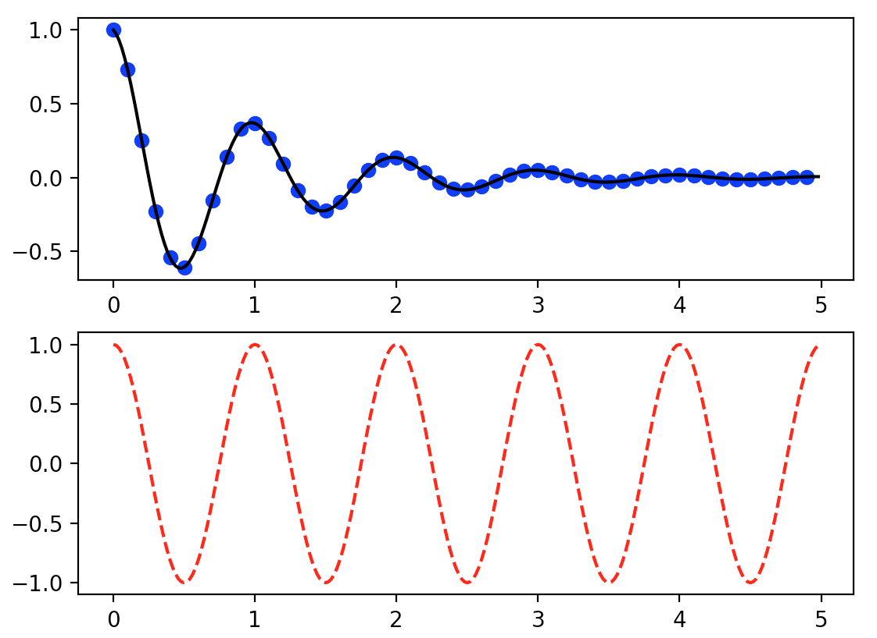
Run python mulplt.py

Slide 18
What does this do?
np.exp(-t) * np.cos(2*np.pi*t)
Is same as “.*” in MATLAB!
Notes:
What does this do?

Slide 19
Subplots in Matplotlib
planning your plots
Two ways to make subplots
.add_subplot()
.subplot2grid()
First simpler, but it can’t do everything
Notes:
https://towardsdatascience.com/subplots-in-matplotlib-a-guide-and-tool-for-planning-your-plots-7d63fa632857

Slide 20
def f(t):
return np.exp(-t) * np.cos(2*np.pi*t)
t1 = np.arange(0.0, 5.0, 0.1)
t2 = np.arange(0.0, 5.0, 0.02) plt.figure()
plt.subplot(211)
plt.plot(t1, f(t1), 'bo', t2, f(t2), 'k') plt.subplot(212)
plt.plot(t2, np.cos(2*np.pi*t2), 'r--') plt.show()
Notes:
What does this do?

Slide 21
def f(t):
return np.exp(-t) * np.cos(2*np.pi*t)
t1 = np.arange(0.0, 5.0, 0.1)
t2 = np.arange(0.0, 5.0, 0.02) plt.figure()
plt.subplot(211)
plt.plot(t1, f(t1), 'bo', t2, f(t2), 'k') plt.subplot(212)
plt.plot(t2, np.cos(2*np.pi*t2), 'r--') plt.show()
Notes:
What does this do?

Slide 22
def f(t):
return np.exp(-t) * np.cos(2*np.pi*t)
t1 = np.arange(0.0, 5.0, 0.1)
t2 = np.arange(0.0, 5.0, 0.02) plt.figure()
plt.subplot(211)
plt.plot(t1, f(t1), 'bo', t2, f(t2), 'k') plt.subplot(212)
plt.plot(t2, np.cos(2*np.pi*t2), 'r--') plt.show()
Notes:
we have already seen np.arrange – what does it do?
Type these two commands in and look at t1 and t2.
How long is each.
What is the maximum value for each?

Slide 23
def f(t):
return np.exp(-t) * np.cos(2*np.pi*t)
t1 = np.arange(0.0, 5.0, 0.1)
t2 = np.arange(0.0, 5.0, 0.02) plt.figure() #not really needed here
plt.subplot(211)
plt.plot(t1, f(t1), 'bo', t2, f(t2), 'k’) plt.subplot(212)
plt.plot(t2, np.cos(2*np.pi*t2), 'r--') plt.show()
Notes:
What does this do?
Subplot divides full figure area in to 2 rows, one column and takes first one (count is across rows and then increment down)
What is the difference between t1 and t2 (sampling interval over same range), f(t1) and f(t2)? Line looks continuous, dots are lower frequency ”sampling” of it. Line looks continuous, but it is not, it is the same as one with the dots. Probably another way to do this by decimating t2. Google it!

Slide 24
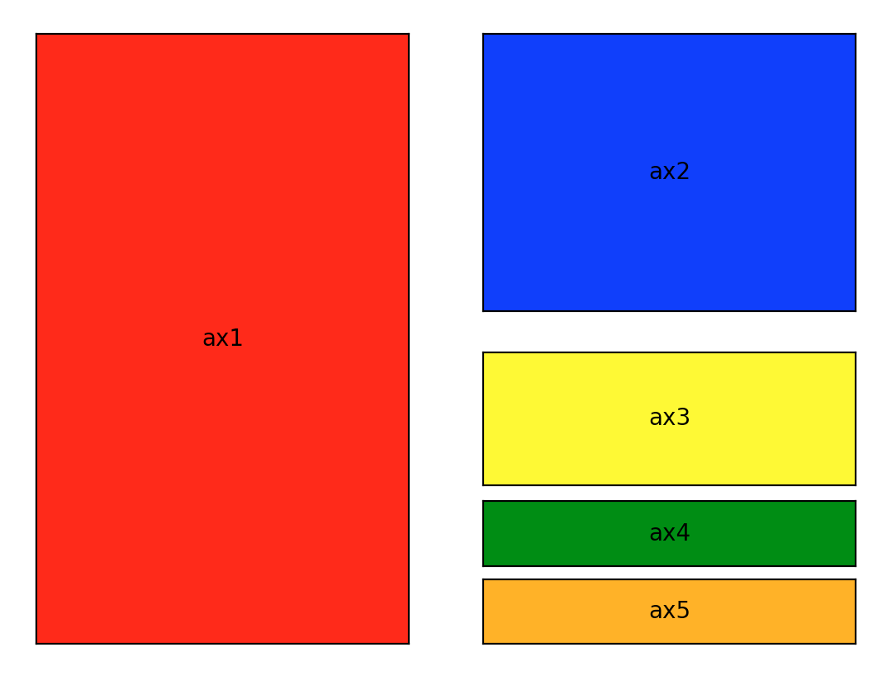
Defining subplot regions
Look at file subplotex1.py
That makes this figure.
Notes:
https://towardsdatascience.com/subplots-in-matplotlib-a-guide-and-tool-for-planning-your-plots-7d63fa632857
GUI from a “plot planner app”, but can’t find it.

Slide 25
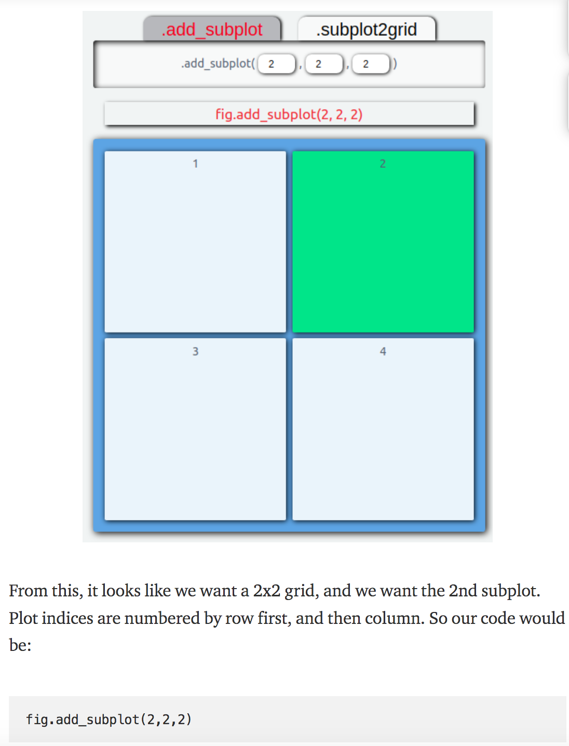
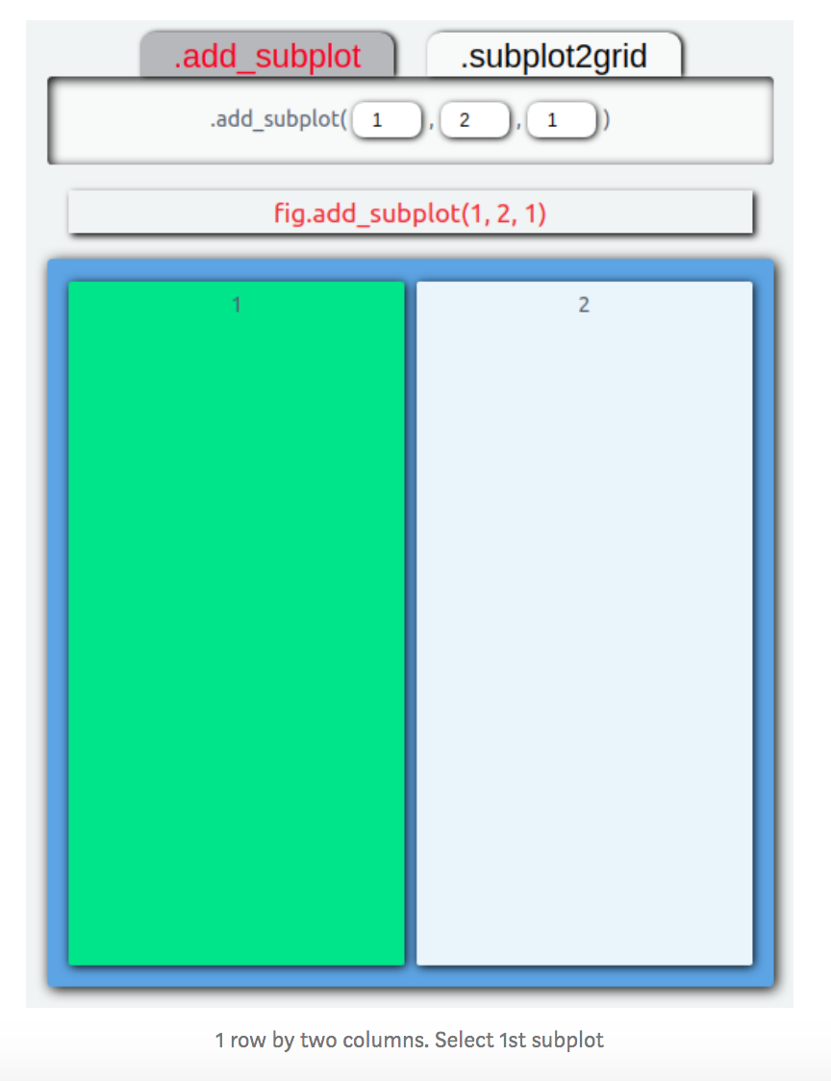
Defining subplot regions
Look at file subplotex1.py
NOTE – count from 1, not zero
Notes:
https://towardsdatascience.com/subplots-in-matplotlib-a-guide-and-tool-for-planning-your-plots-7d63fa632857
GUI from a “plot planner app”, but can’t find it.

Slide 26
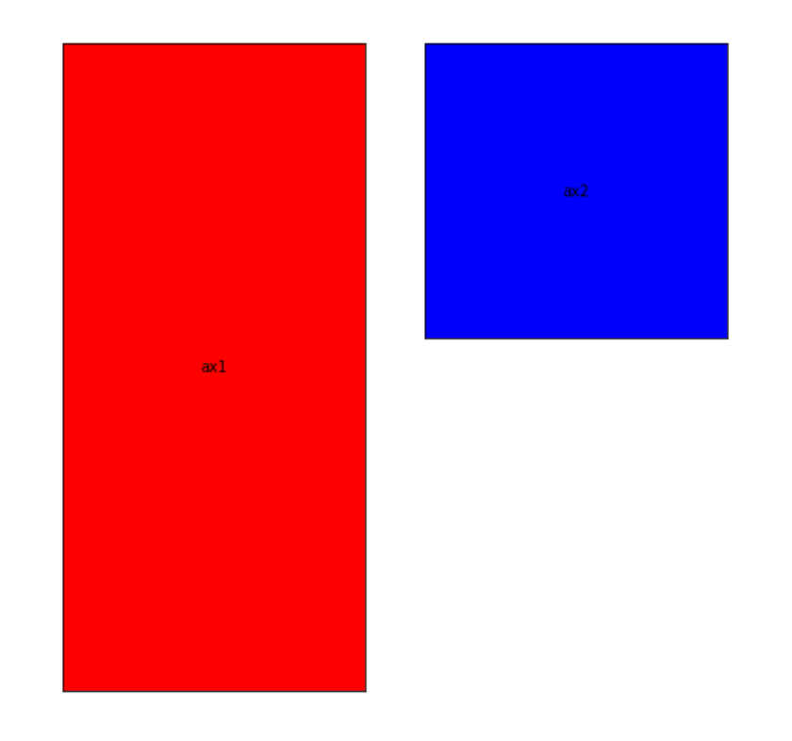
Defining subplot regions
Look at file subplotex1.py
Makes this so far
Notes:
https://towardsdatascience.com/subplots-in-matplotlib-a-guide-and-tool-for-planning-your-plots-7d63fa632857
GUI from a “plot planner app”, but can’t find it.

Slide 27
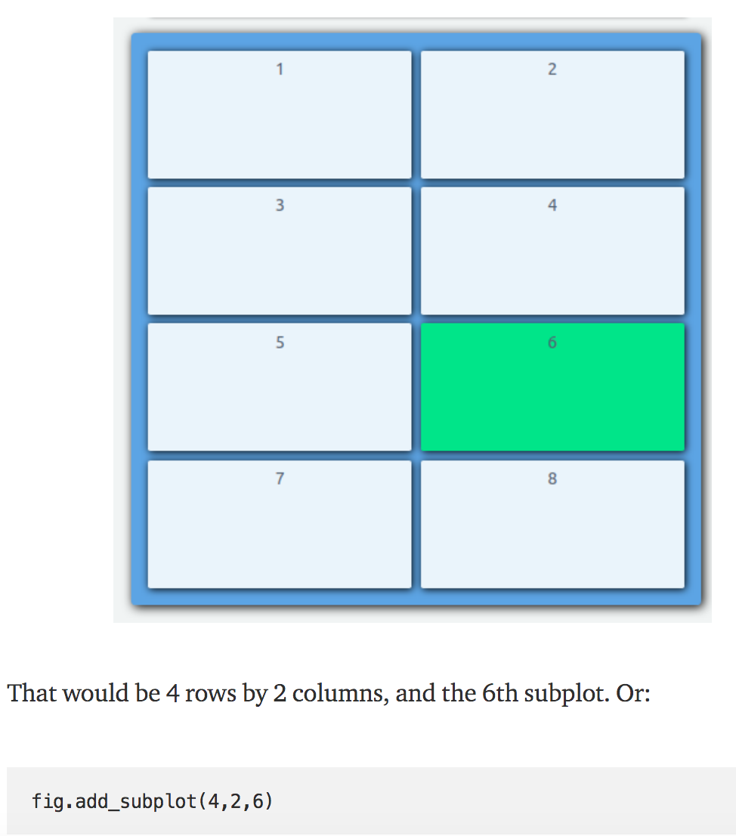
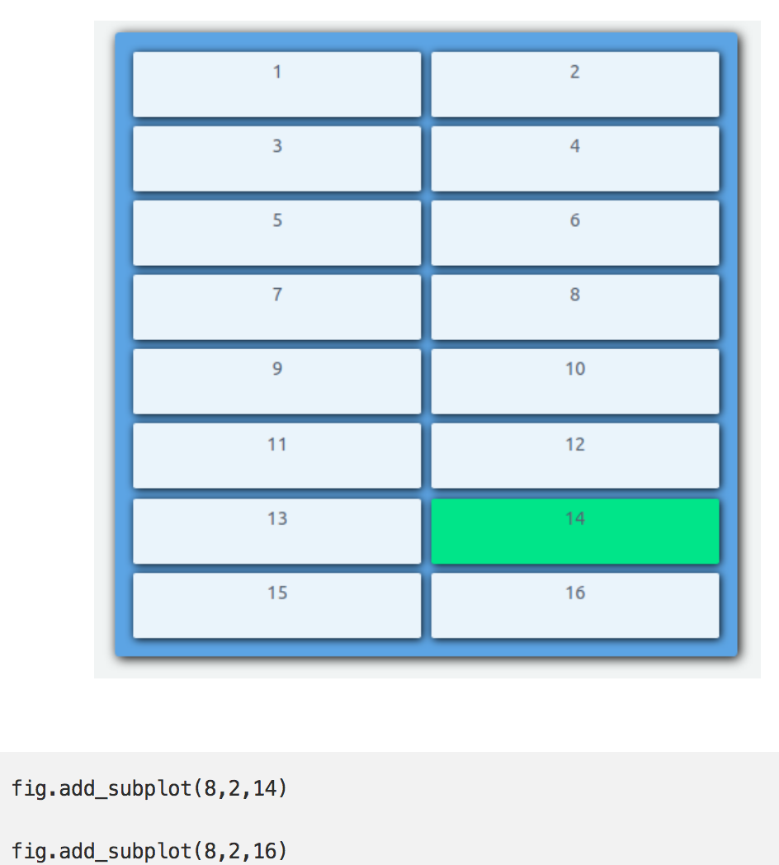
Defining subplot regions
Look at file subplotex1.py
Finish off
Notes:
https://towardsdatascience.com/subplots-in-matplotlib-a-guide-and-tool-for-planning-your-plots-7d63fa632857
Have to do last one twice to get both.

Slide 28
def f(t):
return np.exp(-t) * np.cos(2*np.pi*t)
t1 = np.arange(0.0, 5.0, 0.1)
t2 = np.arange(0.0, 5.0, 0.02) plt.figure()
plt.subplot(211)
plt.plot(t1, f(t1), 'bo', t2, f(t2), 'k') plt.subplot(212)
plt.plot(t2, np.cos(2*np.pi*t2), 'r--') plt.show()
Notes:
What does this do?
What subplot region selected?
What is plotted?

Slide 29
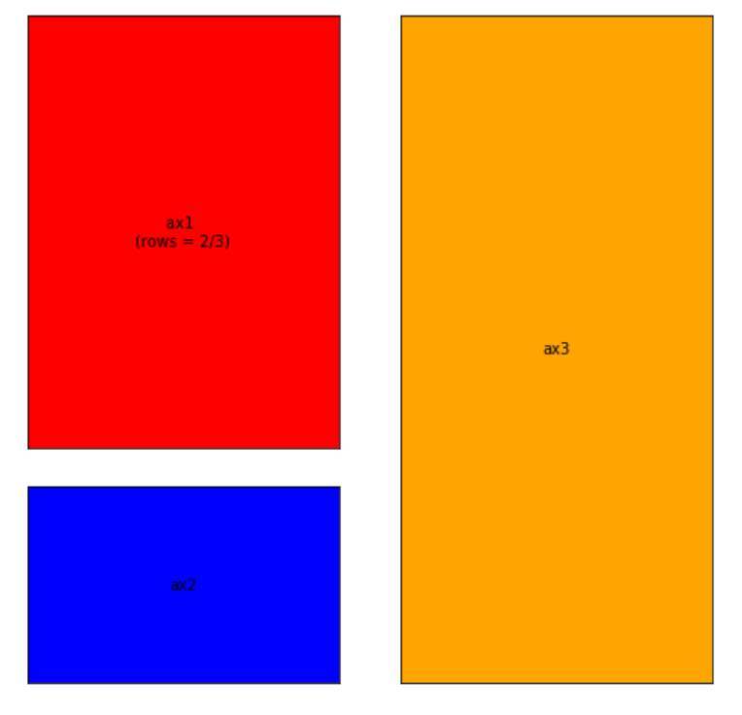
.add_subplot() has limitations.
For instance, every subplot you create can only take up one cell.
That means something like this isn’t possible with .add_subplot().
The problem here is that the red subplot takes up 2/3rds of the left-hand side.
Unfortunately, .add_subplot() can’t handle selecting 2/3rds of the figure area (2 cells).
Notes:
What does this do?

Slide 30
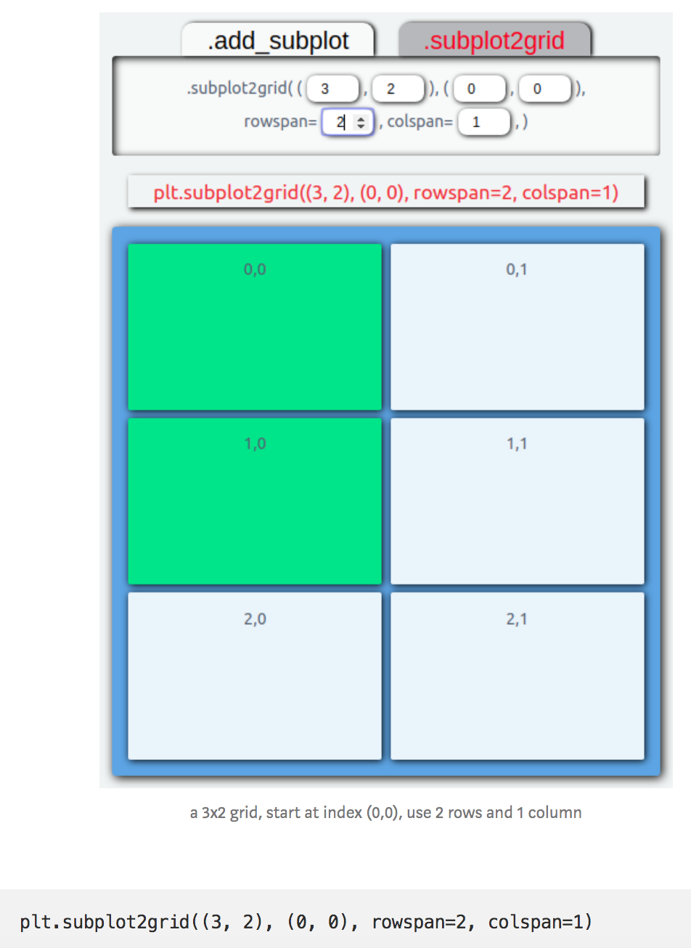
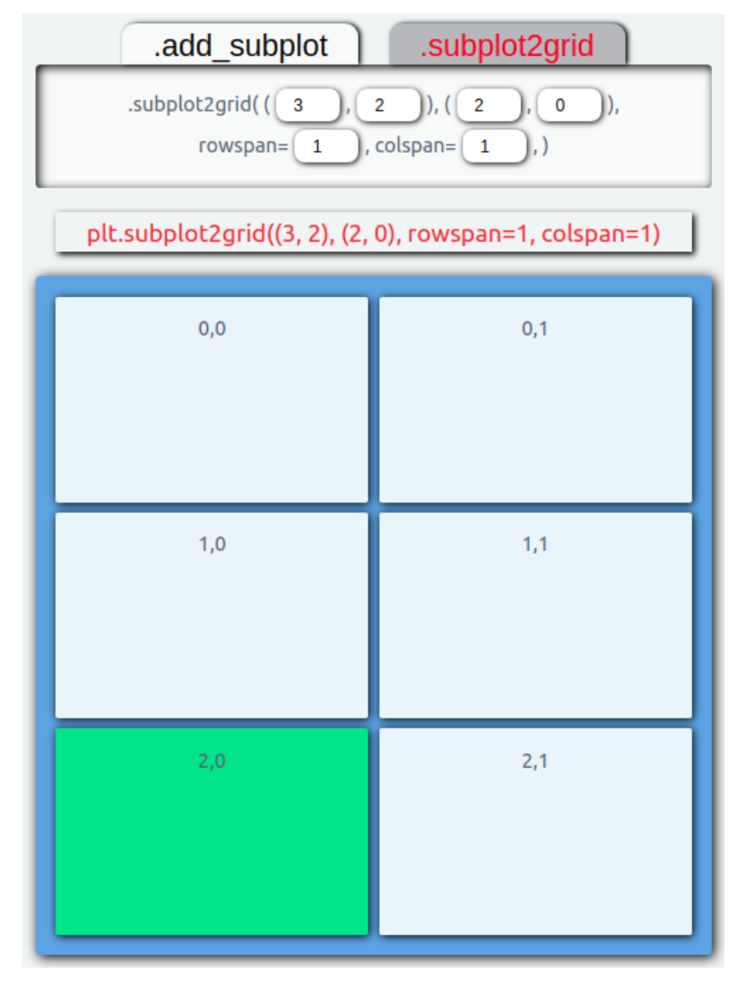
.subplot2grid()returns an axis object with the information about where the new subplot should be placed. It takes in two required positional arguments, shape, and loc.
For left-hand side
Note – counts from 0!
Notes:
Bottom – just change loc

Slide 31
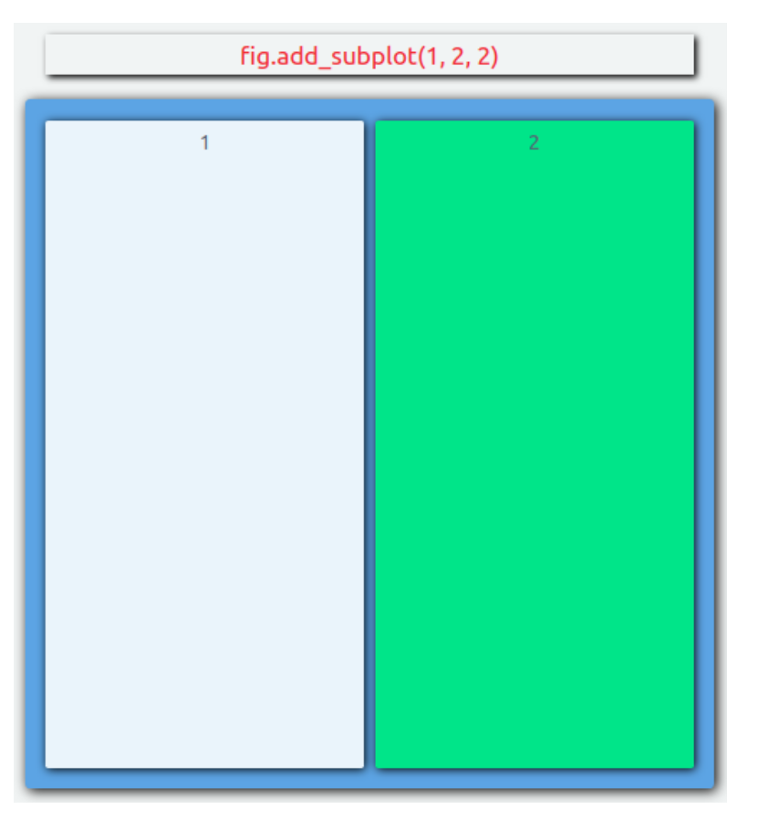
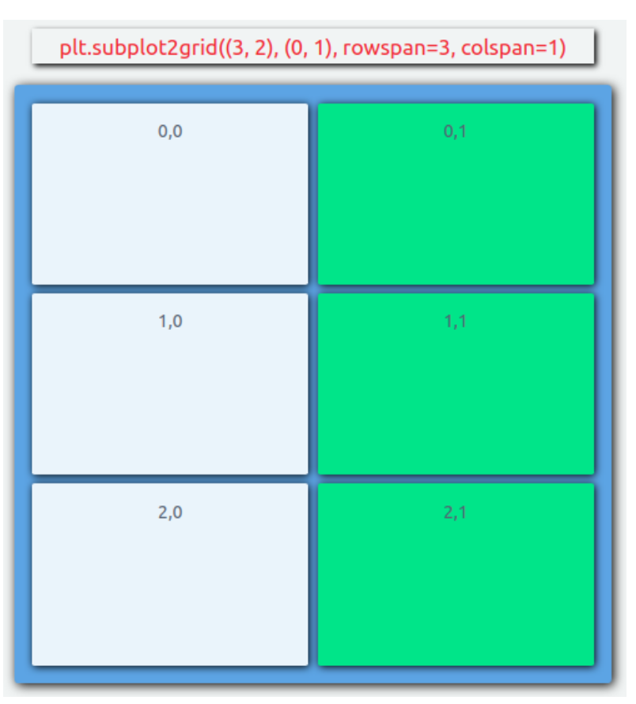
For right-hand side have 2 choices - .add_subplot or .subplot2grid
In this case, one on left is “cleaner” and recommended)
Notes:
Bottom – just change loc

Slide 32
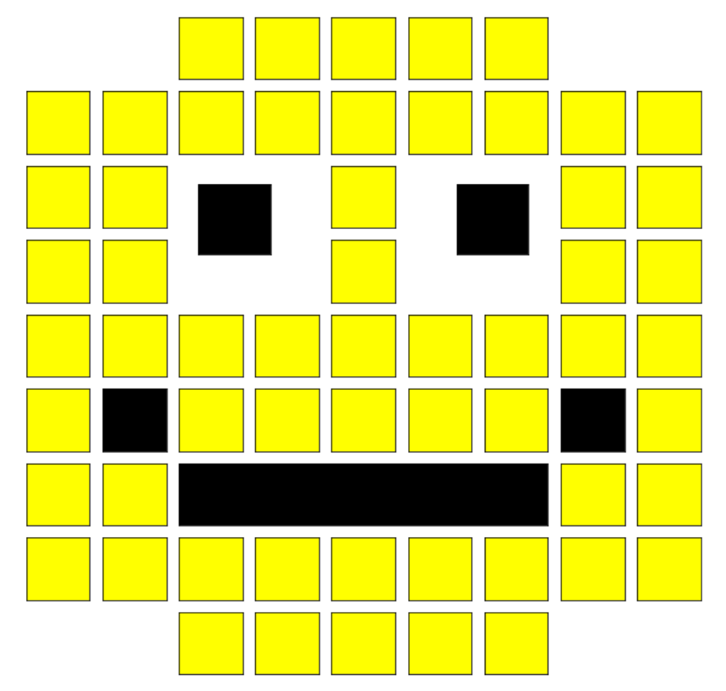
For fun you could try to make this!

Slide 33
To see your python path
import sys
>>> for path in sys.path:
print(path)
/Users/robertsmalley/anaconda2/lib/python27.zip
/Users/robertsmalley/anaconda2/lib/python2.7
/Users/robertsmalley/anaconda2/lib/python2.7/plat-darwin
/Users/robertsmalley/anaconda2/lib/python2.7/plat-mac
/Users/robertsmalley/anaconda2/lib/python2.7/plat-mac/lib-scriptpackages
/Users/robertsmalley/anaconda2/lib/python2.7/lib-tk
/Users/robertsmalley/anaconda2/lib/python2.7/lib-old
/Users/robertsmalley/anaconda2/lib/python2.7/lib-dynload
/Users/robertsmalley/anaconda2/lib/python2.7/site-packages
/Users/robertsmalley/anaconda2/lib/python2.7/site-packages/aeosa
Notes:
What does this do?

