Slide 1
CERI-7104/CIVL-8126 Data Analysis in Geophysics
Intro “Seismic Analysis Code” - SAC
Lab – 20, 11/01/19
Notes:
Retiina display – 220 pixels/inch

Slide 2
First
Sharing files between host OS (windows 10 for example) and your virtual machine (UBUNTU in VirtualBox for example)
Google “share folder virtual box and windows”
Use a shared folder
Use Windows for getting files from network, then access them from the shared folder (both “machines”/”systems” see it and can read/write to it)
Notes:
Retiina display – 220 pixels/inch

Slide 3
SAC (Seismic Analysis Code)
General purpose interactive program designed for the study of sequential signals, especially seismic timeseries data (seismograms).
Emphasis has been placed on analysis tools used by research seismologists in the detailed study of seismic events.

Slide 4
SAC (Seismic Analysis Code)
Analysis capabilities include:
- General arithmetic operations
Fourier transforms
integration/differentiation
- spectral estimation/processing techniques
- IIR and FIR filtering
Signal stacking
Decimation and Interpolation,
Correlation,
seismic phase (time and amplitude) picking
Instrument correction
Particle motion rotation
Trace envelopes
Linear regressions
Frequency-wavenumber analysis
various types of plotting.

Slide 5
SAC
It is a command-driven, as opposed to a menu or GUI driven, program.
It took advantage of several features of the PRIMEOS (the OS from the computer company PRIME), such as its command line processor that passes commands that are not part of the program to the OS.
(This means, that if one is running SAC and you need to get a directory listing, you just enter the “ls” command. Since this is not a SAC command, the command line processor will pass the command to the OS and you will get a directory listing. You don’t have to leave SAC, do the “ls”, write down/remember the file name, and restart SAC. This was very important in the pre –GUI days.)

Slide 6
SAC
Although it can run in batch mode, it was principally designed to be interactive and have interactive graphics.
It was designed to use the “state-of-the-art” Tektronix 401X “storage tube” line of graphics terminals.
Notes:
Retiina display – 220 pixels/inch

Slide 7
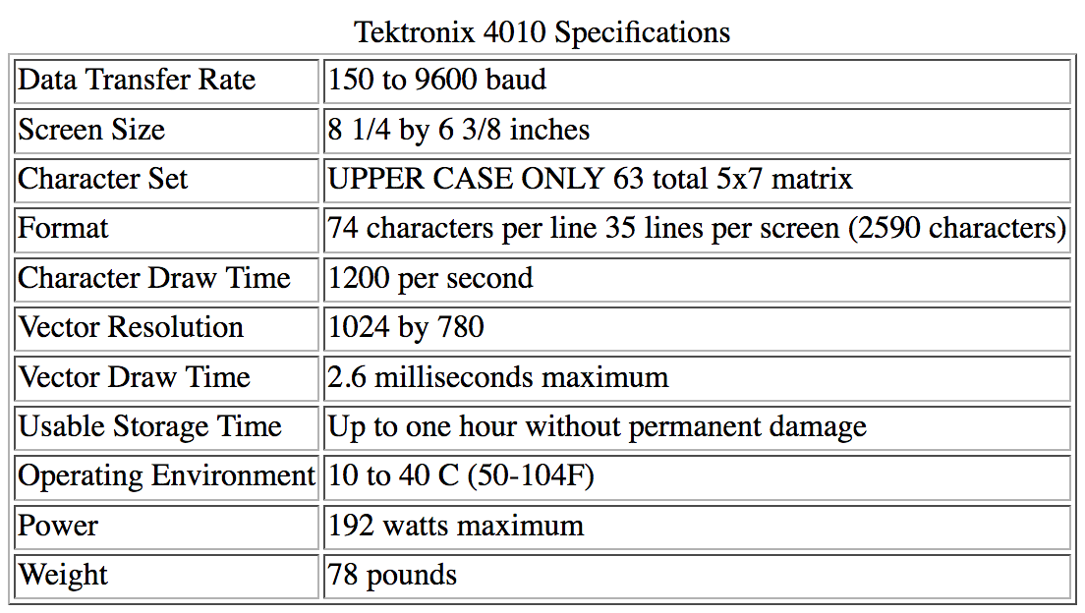
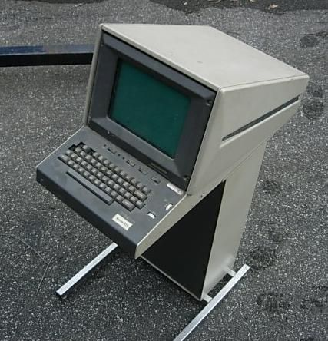
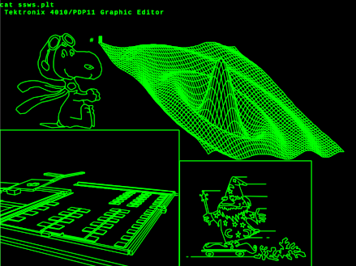
Tektronix 4010, one of the first “graphics” terminals. It had a 10” screen.
Notes:
Was basically a storage oscilloscope. Drew and held image. Had to erase whole page and start over.
There was a larger one – 4014 with a MONSTER 14” screen.

Slide 8
SAC
After the demise of PRIME in the early 90’s, SAC was beaten into submission to run under the UNIX operating system, specifically, SOLARIS, the SUN (which has followed PRIME into oblivion) OS.
(as with UNIX, SAC dragged along many of the idiosyncrasies of its birth associated with the PRIMEOS and the hardware limitations of the time – such as the TEK401X. The UNIX implementation was the simplest “make it run” under UNIX effort – amounted to writing a graphics translator from tektronix graphics commands to the current ones – no rethinking, etc. due to new hardware and capabilities – just translate line by line.)
It now runs on most UNIX/LINUX systems and has become one of the standard data manipulation tools in seismology.

Slide 9
SAC data
SAC’s data format, especially for binary data, is one of the principle data formats still used in storing, transferring, and manipulating (earthquake) seismological time series data.

Slide 10
SAC’s competitors (data format) include
ah (ad-hoc, used by IRIS/PASSCAL program, born about the same time as SUN)
SEED (Standard for the Exchange of Earthquake Data, native format IRIS-DMC)
CSS (Center for Seismic Studies, associated with treaty verification)
SUDS (Seismic Unified Data System, from Willie Lee PC based system/USGS)
SEG-Y (the standard for seismic reflection data)
Others (Panda,…)
(new ones crop up every 5-10 years to address the chaotic state of affairs.)

Slide 11
Commands
SAC commands fall into 3 main categories
Parameter-setting: change values of internal SAC parameters.
Action-producing: perform some operation on the signals currently in selected memory based upon the values of these parameters.
Data-set: determine which files are in active (selected) memory and therefore will be acted upon.

Slide 12
Commands
help calls up a list of all commands.
help command shows the manual page for the command.

Slide 13
Data File Command Module
This module is used to read, write, and access SAC data files.
read (can be shortened to “r”): reads data files from disk into memory
sac> r *.SAC
Uses standard UNIX wildcards: reads all files whose filenames end in “.SAC”

Slide 14
Data File Command Module
write ( “w”): writes the data currently in memory to disk
You can write the data into a range of file formats and file names or simply overwrite the current set of files.
(so be careful, you’ve been warned)

Slide 15
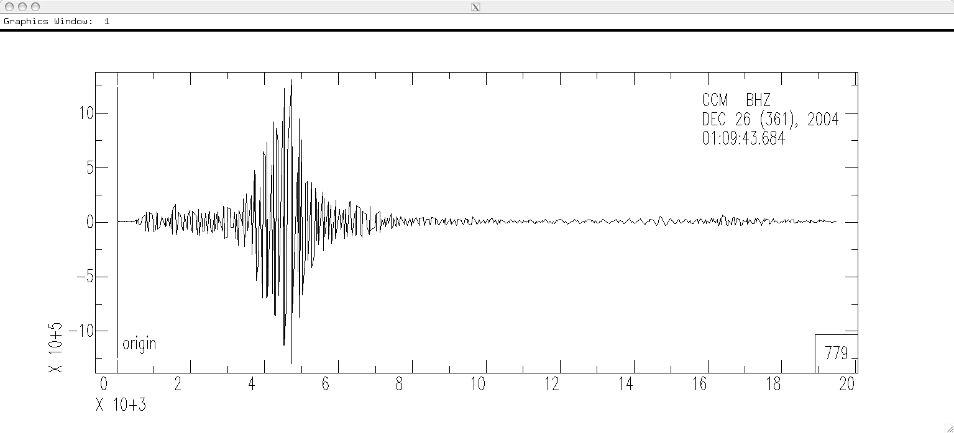
Let’s try it (and also jump ahead to graphics action module to plot (“p”) it) –
alpaca.ceri.memphis.edu504:> sac
SEISMIC ANALYSIS CODE [8/8/2001 (Version 00.59.44)]
Copyright 1995 Regents of the University of California
SAC> read ccm_sumatra_.bhz
SAC> plot
Which produces the following plot.

Slide 16
This plot shows the heritage of the SAC program.
The plot is a straight “port” of the TEK 401X graphics over to an X-Window display.
(It looks exactly the same as it did on the TEK 401X.)

Slide 17
This seismogram is 20,000 seconds long, with samples 20 times per second.
It has over 3,890,000 points and would take 270 hours to draw at 9600 baud (~960 bytes/second)!

Slide 18
Enter QDP (Quick and Dirty Plot mode) to the rescue.
Look at the lower right corner. There is a box there with the number 779.
This tells us that SAC is displaying every 779th point (that’s one point every 39 seconds!).

Slide 19
SAC automatically cuts down the amount of data it shows when the number of input points is ≥1000 (the resolution of the TEK401X series of devices is 1024) so that it only takes a few seconds to draw it at 9600 baud.

Slide 20
Unfortunately, about the only thing this plot tells us is that something was recorded.
The wiggles you see are absolutely completely useless for analysis (the data in memory is OK however)
(you will learn the technical reasons for this – known as aliasing - in signal analysis).

Slide 21
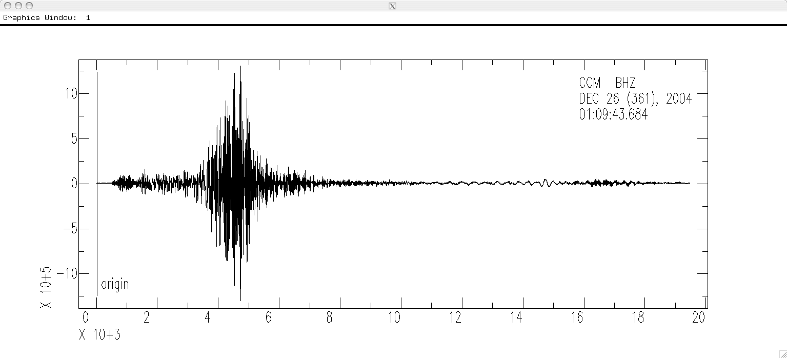
Since we are on a modern computer we can afford to plot all the data (although it is still sub-optimal to do so. Our plot will now legally represent the seismic signal).
So we turn the QDP “feature” off
(you can guess how to turn it back on.)
SAC> qdp off
SAC> plot
This plot is now “good” (compare to previous slide).
Notes:
Could have made this plot initially – either on the 401X or here by drawing 2000 vertical lines between the high and low point of each 39 samples - as I did for Masscomp
Here drawing all 4 million points, but much of the time is going up and down at same x position.

Slide 22
qdp is the correct idea (don’t waste time displaying stuff that you can’t see due to screen resolution), but it is very badly implemented.
qdp should have taken the max and min of each of the sections of N points (instead of each Nth point) and plotted a vertical line between them at each time (it would have taken twice as long to display, but the qdp display was relatively quick).
The display would be identical to the full display on the last slide (and look like a paper record).
(this would have cost some computer time to calculate what to display, but that is minimal compared to the data transfer time to the TEK401X. As it is now it takes the decimation factor longer to calculate what gets drawn on the screen – you don't notice it, but the drawing is instantaneous).

Slide 23
So far we have some files in memory.
If we simply read in another file(s) – the new data will clobber what we have.
If we need to read in more data (say we have processed the data we’ve read in and now want a spectral ratio of the processed data with the original data) we have to use the “more” option to read in additional data (to not clobber what is there).
read more filename

Slide 24
In general SAC does commands to all the files in memory.
If the command is starting from scratch (like a read) it clobbers what is already there.
Some commands require certain pairs of files
(N and E for example for rotating seismograms).
Notes:
Clobber is unix speak for delete/erase/ especially if you don’t really want to do it (but told the computer to do it).

Slide 25
We have now seen 4 SAC commands
(but only used 3).
read filename
write still to be determined
plot
qdp on or off

Slide 26
SAC handles wildcards
Here I have to be a little more careful when I specify the file name. I want to read in all 3 components of the seismogram.
(I’m also demonstrating a feature of SAC, if SAC does not understand a command [something you typed], it passes it to the OS for further processing.
Based on the output of the “ls” command, I don’t want SAC to read in the “.ai”, “.ps”, or “.tif” format files – although if I try to read them SAC will generate an error message that it cannot understand them and just skip/ignore them).
SAC> ls *sumatra*bh*
ccm_sumatra_.bhe ccm_sumatra_.bhn ccm_sumatra_.bhz ccm_sumatra_bhz.ai ccm_sumatra_bhz.ps ccm_sumatra_bhz.tif
SAC> r *sumatra*bh?
ccm_sumatra_.bhe ccm_sumatra_.bhn ccm_sumatra_.bhz
Notes:
Only reads things it recognizes as sac files, tries and complains about others.

Slide 27
Fortunately (in the newer versions of UNIX-SAC) the OS handles the command entry and you can still move around through the command line or “history” with the cursor keys and use regular expressions to build names (wildcards, etc.).

Slide 28
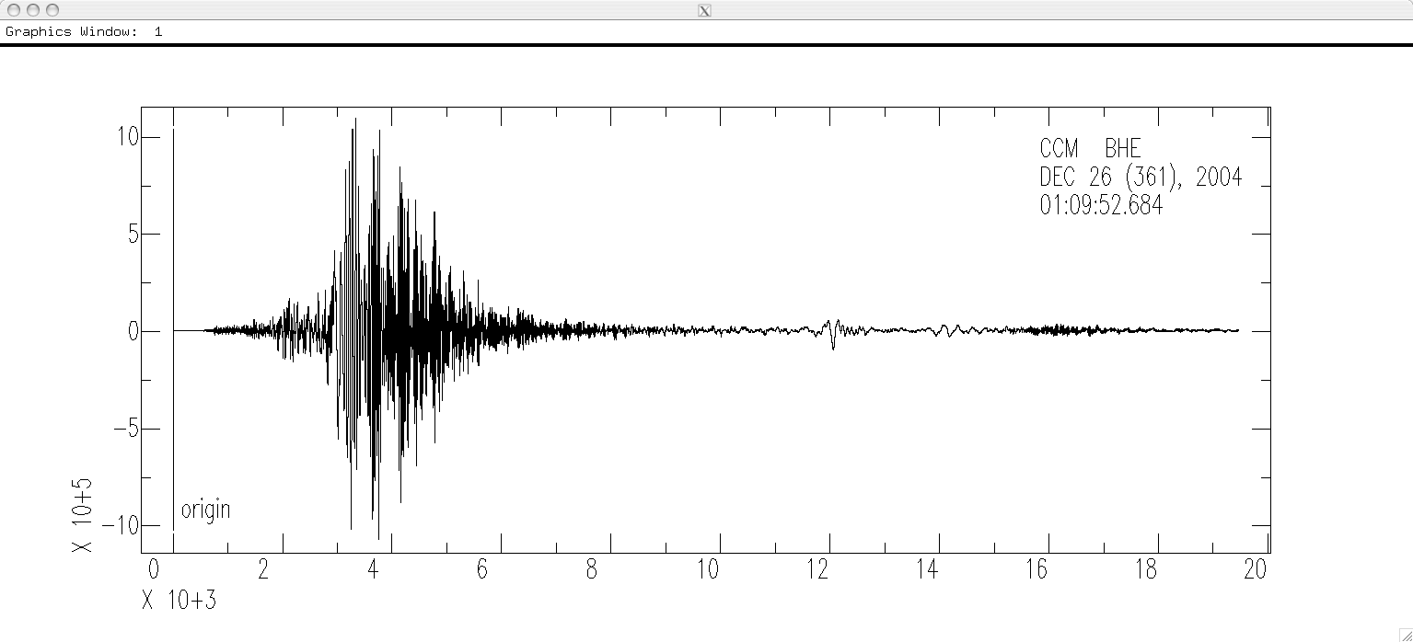
Try the command “plot”.
SAC> plot
Waiting
SAC plots the traces one at a time, in the order they are stored in memory (these happen to be in alphabetical order – BHE, BHN and BHZ – due to the wildcard expansion) (And that we don’t have to keep resetting qdp to off, it remembers it.) . Each time you enter a <CR> it plots the next trace.
(and says Waiting if there are more traces to display, or the prompt if not).

Slide 29
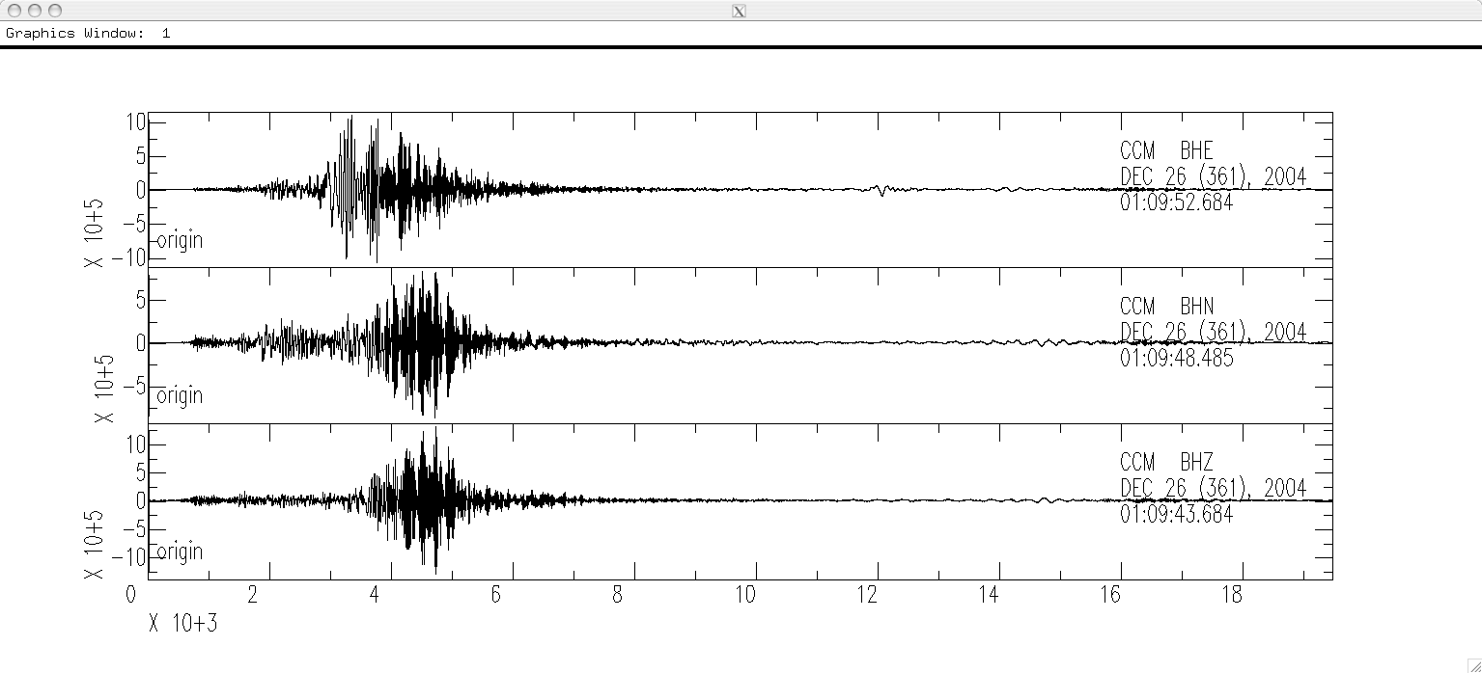
New command – plot1 ( “p1”).
SAC> plot1
SAC>
This command plots all the data in memory on one plot.
Also notice that the prompt returns so we can enter more commands.
Notes:
Unfortunately is one or all – you can't do in groups of three, etc.

Slide 30
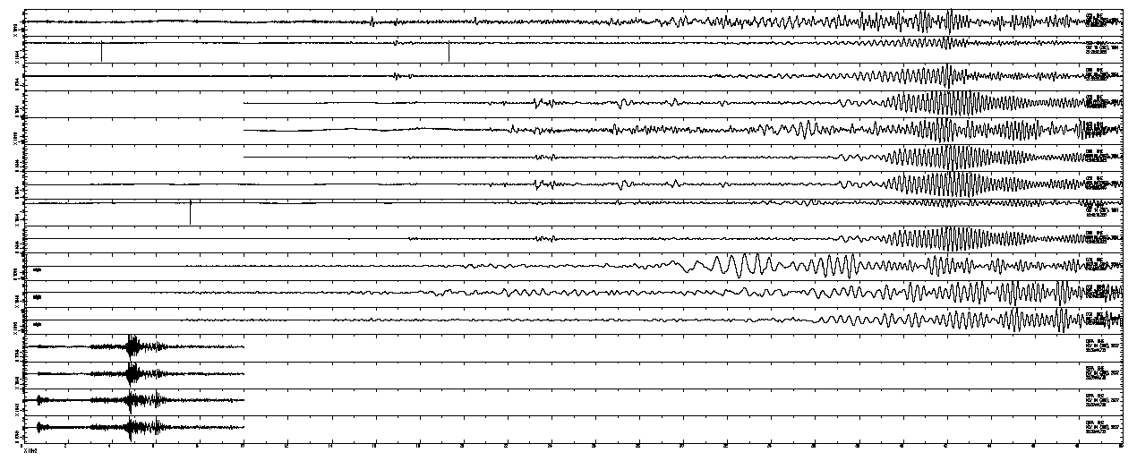
If you have too many traces it plots a mess

Slide 31
Say I want to process these three traces together.
UGLY little detail.
Notice that the three traces do not start at the same time, and they are not the same lengths, either. This comes from the datacenter from which we downloaded the data.).
Notes:
Note labels to rh side of each trace – site name, component, date and start time (could not read on last one, too small)

Slide 32
We can fix the time alignment using
synchronize (“synch”): which modifies (the headers of) the files in memory so that they all have the same reference time.
(Does not otherwise modify the data. If I need to combine two traces rotate them for instance, and they are not the same length, SAC will complain and not do it.)
SAC> synch
SAC> plot1
Notes:
Now they all have the same reference time in memory. The reference time is the latest of the traces in memory.

Slide 33
How do we find out what do we have in memory?
What metadata is available about the seismic data?
(metadata is data about data – examples are the name of the seismic station and component, the sampling rate, etc. This information is stored in the SAC header.)
listhdr (lh): lists the headers of the files in memory.

Slide 34
SAC> listhdr
FILE: ccm_sumatra_.bhe - 1
----------------------
NPTS = 389396
B = 0.000000e+00
E = 1.946975e+04
IFTYPE = TIME SERIES FILE
LEVEN = TRUE
DELTA = 5.000000e-02
IDEP = UNKNOWN
DEPMIN = -1.073057e+06
DEPMAX = 1.091875e+06
DEPMEN = 8.429739e+02
OMARKER = 7.315 (origin )
KZDATE = DEC 26 (361), 2004
KZTIME = 01:09:52.684
IZTYPE = BEGIN TIME
KSTNM = CCM
CMPAZ = 9.000000e+01
CMPINC = 9.000000e+01
STLO = -9.124470e+01
DIST = 8.818225e+03
AZ = 1.854116e+02
BAZ = 2.013326e+02
LOVROK = TRUE
NVHDR = 6
LPSPOL = TRUE
LCALDA = TRUE
KCMPNM = BHE
KNETWK = US
All sorts of good stuff. Look in SAC documentation for full details.
Obvious/important –
File name - FILE
Number points – NPTS
Beginning time offset - B
Sampling rate – DELTA
Start date – KZDATE
Start time –KZTIME
Station – KSTN
Orientation – CMPAZ
May have info about stn location, event locn, … .

Slide 35
Says Waiting when page is full (may not be complete header listing).
<CR> to continue till run out of stuff to display.
(there is no way to “break” out of the commands (e.g.: plot, listhdr, …) that do something for each file. You have to <CR> till it finishes, or ^C out and start over.)
Notes:
So if you have read in 100 files you have to <CR> a whole lot!

Slide 36
Commands to see/change header values
listhdr (lh): list the header contents.
readhdr (rh) and writehdr (wh): read and write headers without the data.
chnhdr (ch): change header values.
copyhdr : copy header values from one file to the others in memory.

Slide 37
Example: Say the header does not have the location of the event (if you do an “lh” and there is no EVLA – Event Latitude, or EVLO, - Event Longitude, reported). We can add this information to the headers of all files using chnhdr.
SAC> chnhdr EVLA = 4.079930e+01 # event latitude
SAC> chnhdr EVLO = 3.100330e+01 # event longitude
SAC> lh
. . .
EVLA = 4.079930e+01
EVLO = 3.100330e+01
. . .
SAC>
SAC> wh
We overwrite only the header because no changes were made to the seismic data (time series).

Slide 38
When you download preprocessed seismic data from the IRIS-DMC associated with an earthquake, it will now have the earthquake location, origin time, delta, azimuth, etc. in the header.
If you download data in some arbitrary time window (even if it has a big earthquake in it) it will not come with information about anything in particular within that time window (may be multiple events or none!).
You will have to put in the event information (if it has a event location, SAC now computes the delta and az/baz and stores it in the header for you).
Notes:
In the old days data did not come with anything in the header but the bare minimum of essential metadata - start time, sample rate, length/number points/end time, station name, station location (lat, lon, ht), sensor orientation (az, and angle from vertical – should also state direction of tilt but typically don't.
If has an earthquake you can put in eq location. In old days had to put in az, baz, delta and km. This calculated and put in automatically now (if have locn of both eq and stn)

Slide 39
Lining files up in time
Before synch After synch
FILE: ccm_sumatra_.bhe – 1
NPTS = 389396
B = 0.000000e+00
KZDATE = DEC 26 (361), 2004
KZTIME = 01:09:52.684
FILE: ccm_sumatra_.bhn – 2
NPTS = 389328
B = 0.000000e+00
KZDATE = DEC 26 (361), 2004
KZTIME = 01:09:48.485
FILE: ccm_sumatra_.bhz – 3
NPTS = 389600
B = 0.000000e+00
KZDATE = DEC 26 (361), 2004
KZTIME = 01:09:43.684
B = 0.000000e+00
KZDATE = DEC 26 (361), 2004
KZTIME = 01:09:52.684
B = -4.199000e+00
KZDATE = DEC 26 (361), 2004
KZTIME = 01:09:52.684
B = -9.000000e+00
KZDATE = DEC 26 (361), 2004
KZTIME = 01:09:52.684

Slide 40
To make them all start at the same time and be the same length
- Read them in, then synch (aligns them to the same relative time – the time of the file that starts last [all the bs are negative], but still different lengths.)
- Write them out (this clobbers the original file on the disk unless you rename them),
Set up a cut (reads from a start time [ which we just aligned above] to an end time with respect to the reference time, not the start time or number of samples)
Notes:
From the days of "small" computers. This is ridiculous now.

Slide 41
cut: defines how much of a data file is to be read.
You need to re-read the data after specifying a cut. (specifying the cut does not effect data in memory, or the files on disk)
You can also specify the cut with respect to times stored in the header (p wave arrival time for example) 5 s before to 30 s after t1 pick
SAC> cut t1 -5 30
SAC> r
Notes:
t1 is the time stored in header element t1

Slide 42
To make them all start at the same time and be the same length
- Then read again (under control of the cut, everything in memory will be the same size, [unless one was shorter, but that will not happen here]).
Write out again (if you want to save them, clobbering what was there).
(I don’t know how to do this “in-place”, you need the write and re-read since the SAC commands do not modify, except by writing, files on disk, data in memory.)
Notes:
From the days of "small" computers. This is ridiculous now.

Slide 43
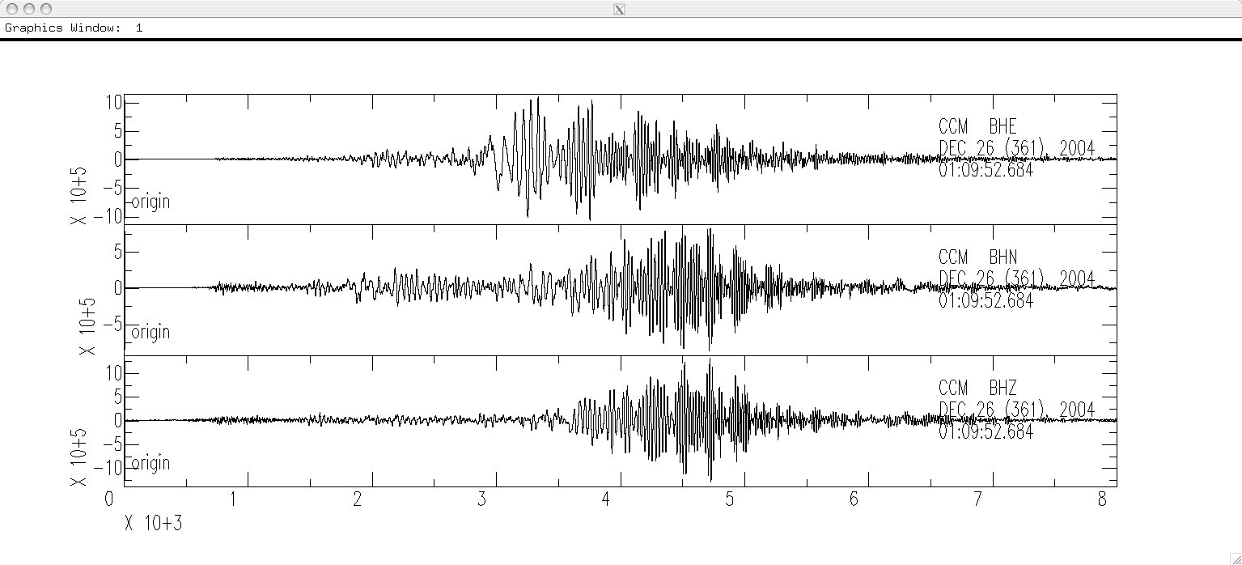
SAC> w over
SAC> cut 0 8000
SAC> r
ccm_sumatra_.bhe ccm_sumatra_.bhn ccm_sumatra_.bhz
SAC> p1
And they all have the following in their header
NPTS = 160001
B = 0.000000e+00
E = 8.000000e+03
KZDATE = DEC 26 (361), 2004
KZTIME = 01:09:52.684
Notes:
I no longer have copies of these files before synchronization – so can’t do here.

Slide 44
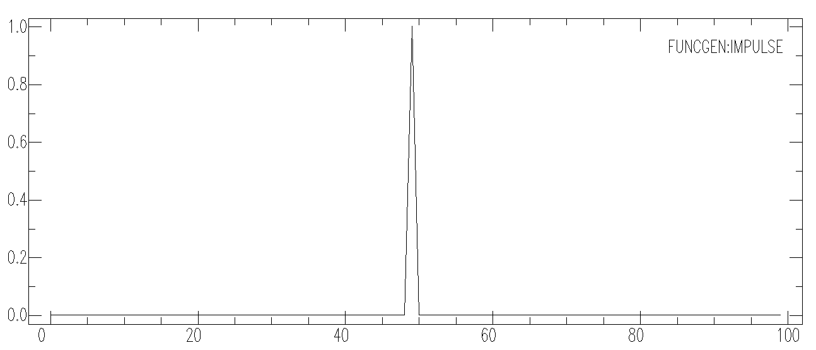
SAC can also generate data/time series
Start with some simple commands to generate seismic data
sac> funcgen impulse delta 0.01 npts 100 sac>
Notes:
We have generated a time series with an impulse

Slide 45
Can generate a number of basic signals
SAC> help funcgen
FUNCGEN
+++++++
SUMMARY
-------
Generates a function and stores it in memory.
SYNTAX
------
``FUNCGEN {type},{DELTA v},{NPTS n},{BEGIN v}``
where type is one of the following:
``IMPULSE``
``STEP``
``BOXCAR``
``TRIANGLE``
``SINE {v1 v2}``
``LINE {v1 v2}``
``QUADRATIC {v1 v2 v3}``
``CUBIC {v1 v2 v3 v4}``
``SEISMOGRAM``
``RANDOM {v1 v2}``
``IMPSTRIN {n1 n2 ... nN}``
INPUT …… for many pages
Notes:
Here has time specs, not using defaults

Slide 46
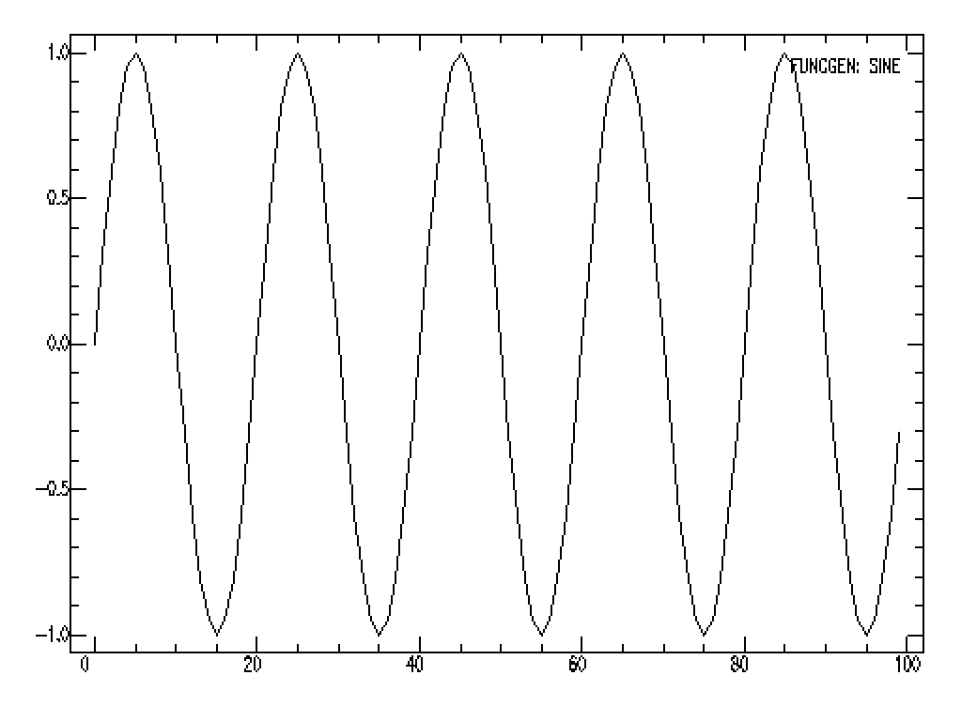
Sine – specify frequency plus the phase of first point in degress (specify phase = 90 for cosine). Default 100 points long.
SAC> funcgen sine 0.05 0 SAC> plot
Notes:
Here has time specs, not using defaults

Slide 47
Try another frequency.
SAC> funcgen sine 0.05 0 npts 1000
SAC > qdp off
SAC> plot
Notes:
Does not do good (any) job on labeling axis with function – x axis is point number.
qdp off to stop it from decimating by 2 (.ge.1000 points)

Slide 48
Unary Operations Module
The commands in this module perform some arithmetic operation on each data point of the signals in memory.
add
sub
mul
div
sqr
sqrt
abs
log,log10
exp,exp10
int
dif

Slide 49
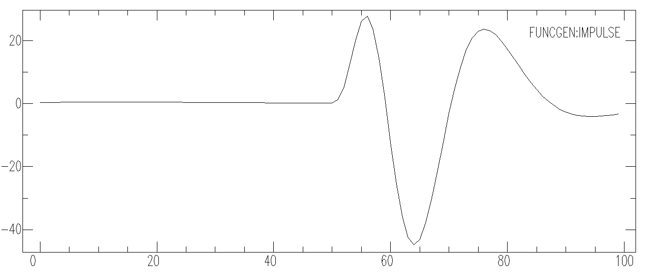
Start with some simple commands to generate seismic data
SAC> transfer to DWWSSN
Station (-12345 ), Channel (-12345 )
Waveform multiplied by 1.000000 after deconvolution.
SAC> p
Notes:
We have now generated a seismogram with the impulse response of a DWWSSN station (since we started with an impulse). SAC knows the impulse response of a large number of seismometers that were around in the 80’s. You can also specify the instrument response using sac instrument response files (typically have poles and zeros in them).

Slide 50
Binary Operations Module
The commands in this module perform some arithmetic operation on all the data in memory with an input file.
Super clunky legacy problem from the days of computers with limited power.
addf
subf
mulf
divf
merge
bnoperr

Slide 51
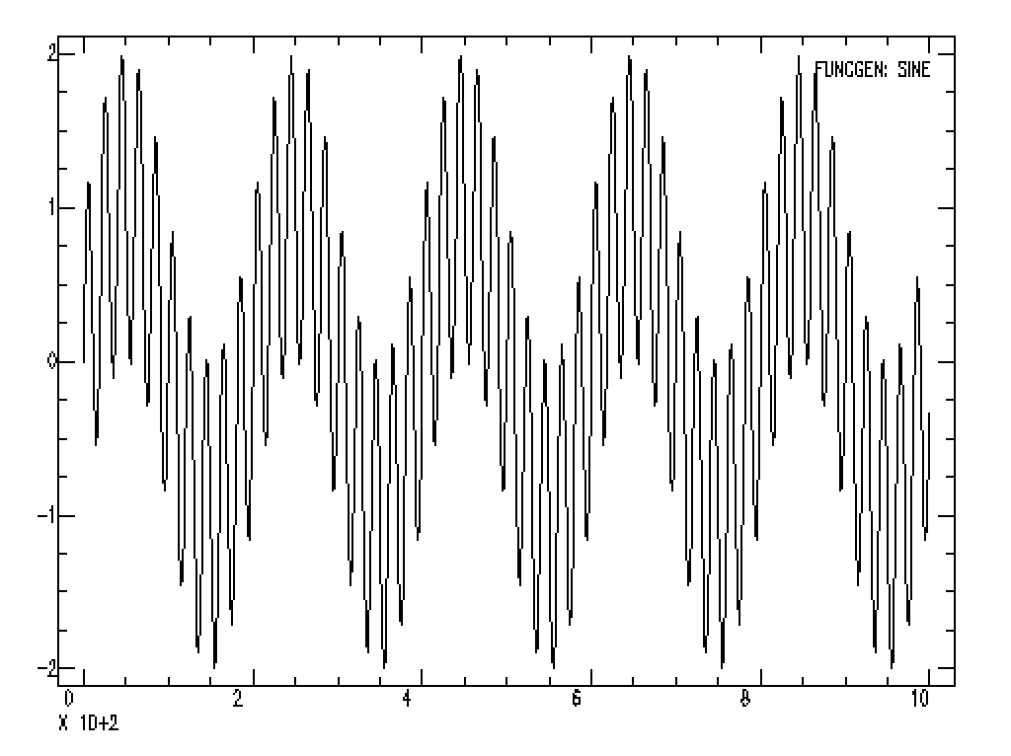
Binary Operations Module
SAC> read sine_0.005.sac
SAC> addf sine_0.05.sac
SAC> qdp off
SAC> plot
Notes:
Add (or other operation from binary operations module) some file on the disk to ALL the files in memory

Slide 52
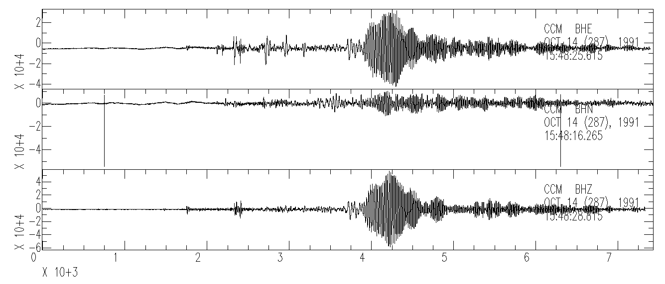
Read in some data – do some processing
SAC> read ./ccm_solomon*bh?
…
SAC> p1
Notes:
Read in some data

Slide 53
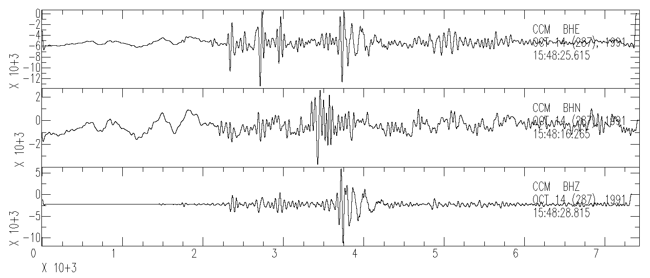
Low pass filter it
SAC> lp co .025 npoles 4 passes 2
SAC> p1
Notes:
Low pass filter it – 4 poles (how fast the filter cuts off) from corner freqeuncy (0.025 hz = 40 second period) and number of passes – 2 will run the filter forwards (first pass) and then backwards (second pass) over the data – this will produce a filter with no dispersion (the first pass disperses it and the second pass disperses it the inverse direction – so it cancels/removes any dispersion, also since the filter has 4 poles, the end result after two passes is 8 poles). This is what you want to do if you are studying surface wave dispersion, you don’t want your processing to introduce dispersion.

Slide 54
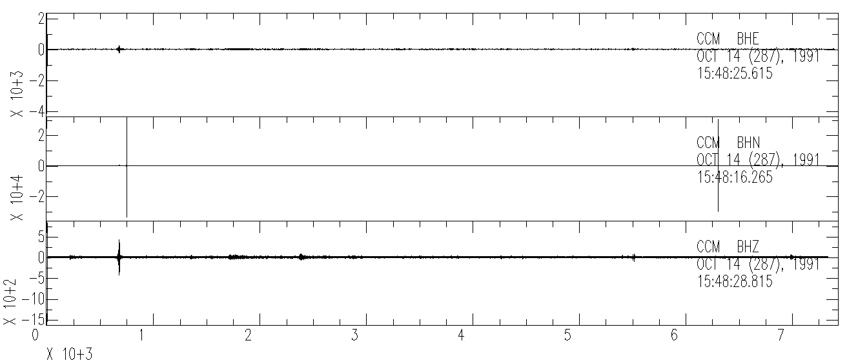
High pass filter it
SAC> r
SAC> hp co 1 npoles 4
SAC> p1
Notes:
Have to read it again. Now we get the body waves. Note that here we did not do 2 passes – we do not want to remove any dispersion (which is non-cuasal, we want a causal filter here).

Slide 55
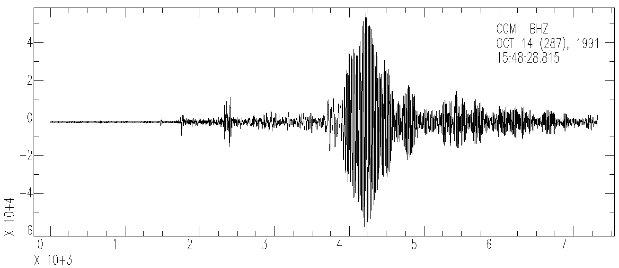
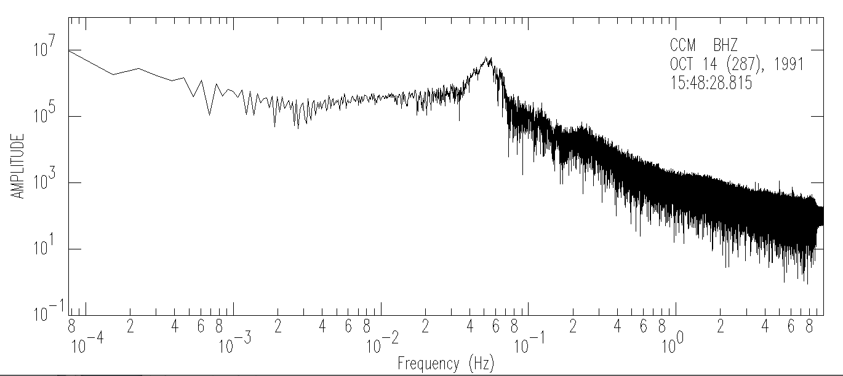
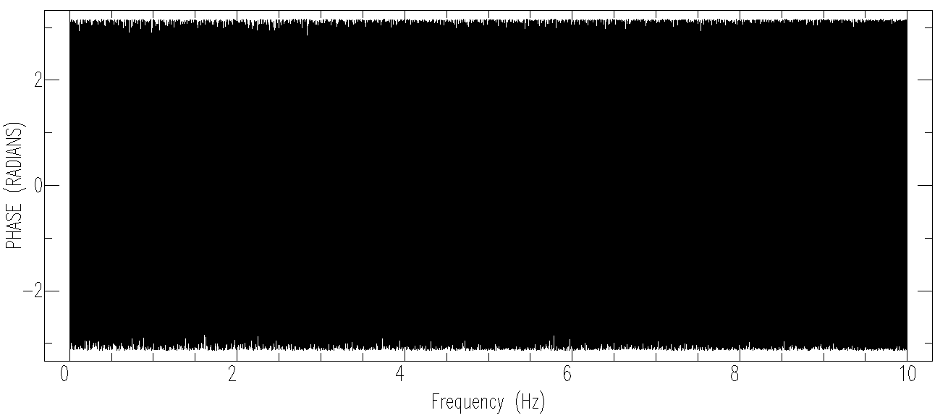
Spectral analysis – Fourier transform
SAC> read ccm_solomon_*z
SAC> fft
SAC> psp
Waiting
SAC>
Notes:
Read in one component (so don’t have to do p1 or step through N seismograms)
psp is plot spectrum
First plots spectrum, waits for CR, then plots phase

Slide 56
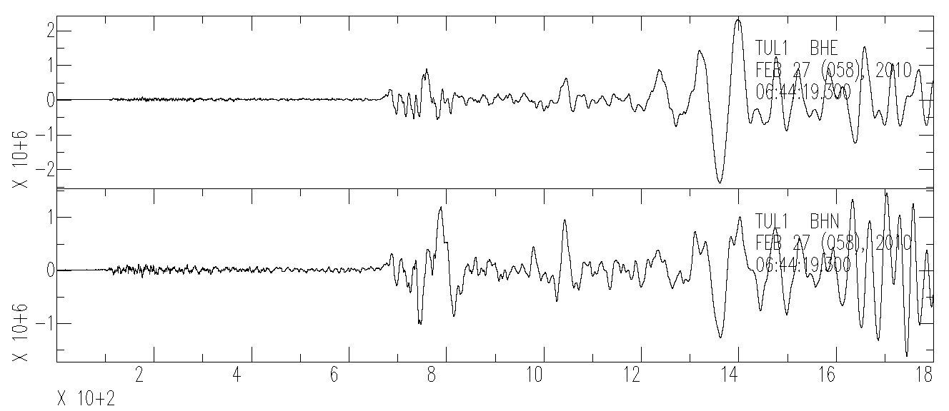
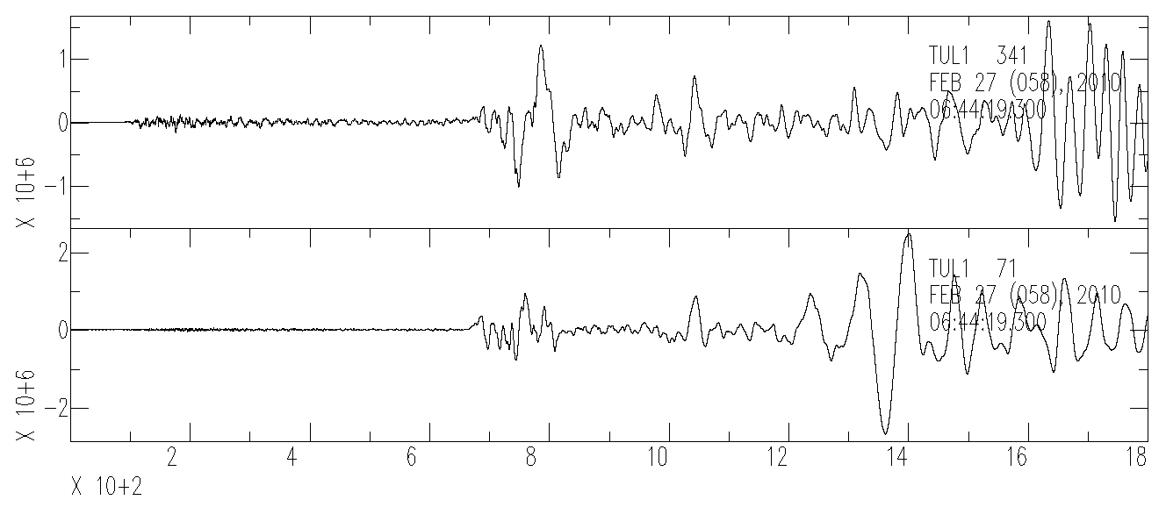
Rotate seismograms
SAC> read *TUL1*SAC
2010.058.06.42.30.9750.TA.TUL1..BHN.R.SAC …
SAC> p1
SAC> synch
SAC> w TUL1.BHN TUL1.BHE TUL1.BHZ
SAC> cut 0 1800
SAC> r TUL1.BHN TUL1.BHE
SAC> rotate
SAC> lh
FILE: TUL1.BHE - 1
--------------
...
STLA = 3.591040e+01
STLO = -9.579190e+01
STEL = 2.560000e+02
STDP = 0.000000e+00
EVLA = -3.612200e+01
EVLO = -7.289800e+01
EVDP = 2.290000e+04
DIST = 8.319518e+03
AZ = 3.408942e+02
BAZ = 1.609469e+02
GCARC = 7.476556e+01
...
Notes:
Need to have both station and earthquake data in header – will calculate dist, az, baz, gcarc automatically (have to write seismograms back out to save it in header – if you want it saved).
From AZ or BAZ can rotate the horizontals (synch and cut all 3, but only read in horizontals) to radial and transverse directions.
Note changes label from N and E to 341°(radial – is forward azimuth, not back azimuth) and 71° (transverse, R and T are given in same relationship as N and E, rotate as left hand rule).
This is the Feb 27, 2010, M8.8, Maule, Chile earthquake recorded near Tulsa, OK.

Slide 57
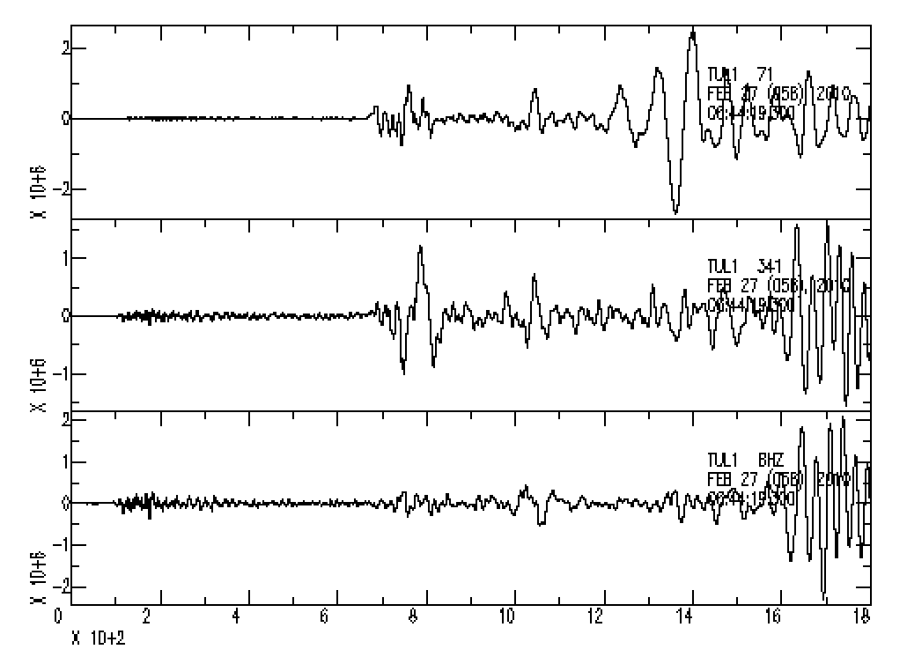
SAC> read TUL1.BH[NE]
TUL1.BHE TUL1.BHN
SAC> rotate
SAC> p1 Plots R,T,Z
SAC> write TUL1.BHR TUL1.BHT
SAC> read TUL1.BH[TR]
TUL1.BHR TUL1.BHT
SAC> read more TUL1.BHZ
Also plots R,T, Z (alphabetical order) –want R and Z together
SAC> read TUL1.BHT
SAC> read more TUL1.BHR
SAC> read more TUL1.BHZ
SAC> p1
SAC> read TUL1.BHT TUL1.BHR
SAC> read more TUL1.BHZ
SAC> p1
Both these work.
Can now see surface waves are separated by their polarization – radial and transverse.
Love wave
Transverse
Rayleigh wave Radial
Notes:
Need to have both station and earthquake data in header – will calculate dist, az, baz, gcarc automatically (have to write seismograms back out to save it in header – if you want it saved).
From AZ or BAZ can rotate the horizontals (synch and cut all 3, but only read in horizontals) to radial and transverse directions.
Note changes label from N and E to 341°(radial – is forward azimuth, not back azimuth) and 71° (transverse, R and T are given in same relationship as N and E, rotate as left hand rule).
This is the Feb 27, 2010, M8.8, Maule, Chile earthquake recorded near Tulsa, OK.

