Slide 1
CERI-7104/CIVL-8126 Data Analysis in Geophysics
Intro to MATLAB
Draw a circle

Slide 2
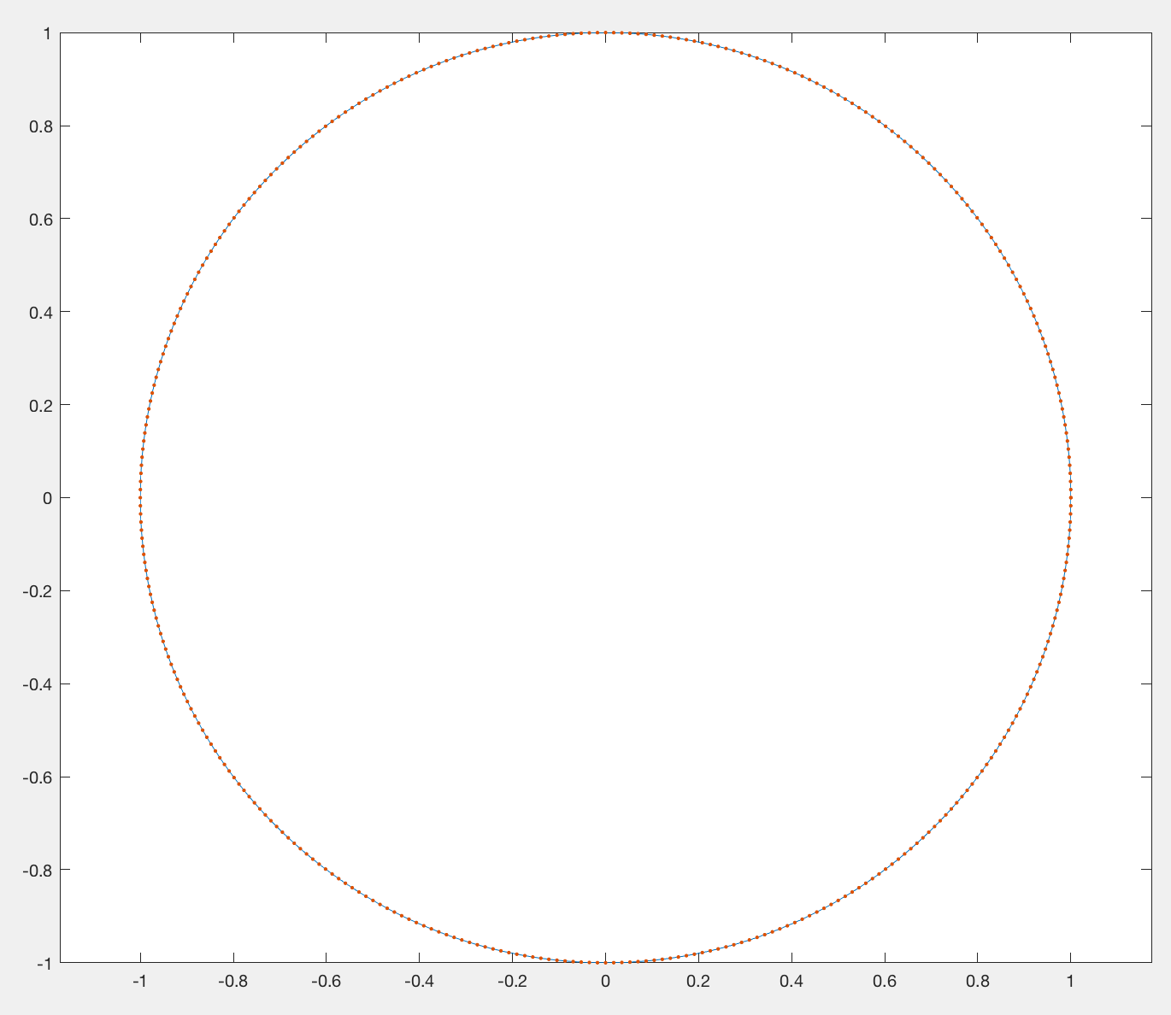
Need to make set of x and y values, in order, with coordinates of points on a circle such that when connected with line segments looks like a circle.
How to do?

Slide 3
First figure out math
Simple way to generate x and y values is with trig
x=cos(ϑ)
y=sin(ϑ)
Notes:
Will try to put code in courier font.

Slide 4
Next – non Matlab way
Loop over ϑ from 0° to 360° to make x and y positions and plot them.

Slide 5
Matlab way
Vectorize
Make vector from 0° to 360°: [0:360].
Convert to radians: pi*[0:360]/180.
No loops!
Notes:
Jumping ahead a bit – pi is a predefined variable in matlab.
By the way, aside, what is the best way to set the value of pi if it is not predefined?
pi=4*arctan(1)
This will get you pi defined to maximum precision on the computer you are using.

Slide 6
Matlab way
Vectorize
Now for “trick”, Matlab plots complex numbers
x+iy
the way they are visualized.
Remember that
e^{iϑ}=cos(ϑ)+i sin(ϑ)

Slide 7
Matlab way
Vectorize
e^{x} in Matlab is exp(x)
Combine everything
Plot(exp(i*pi*[0:360]/180))

