Slide 1
Earth Science Applications of Space Based Geodesy
DES-7355
Tu-Th 9:40-11:05
Seminar Room in 3892 Central Ave. (Long building)
Bob Smalley
Office: 3892 Central Ave, Room 103
678-4929
Office Hours – Wed 14:00-16:00 or if I’m in my office.
http://www.ceri.memphis.edu/people/smalley/ESCI7355/ESCI_7355_Applications_of_Space_Based_Geodesy.html
Class 13

Slide 2
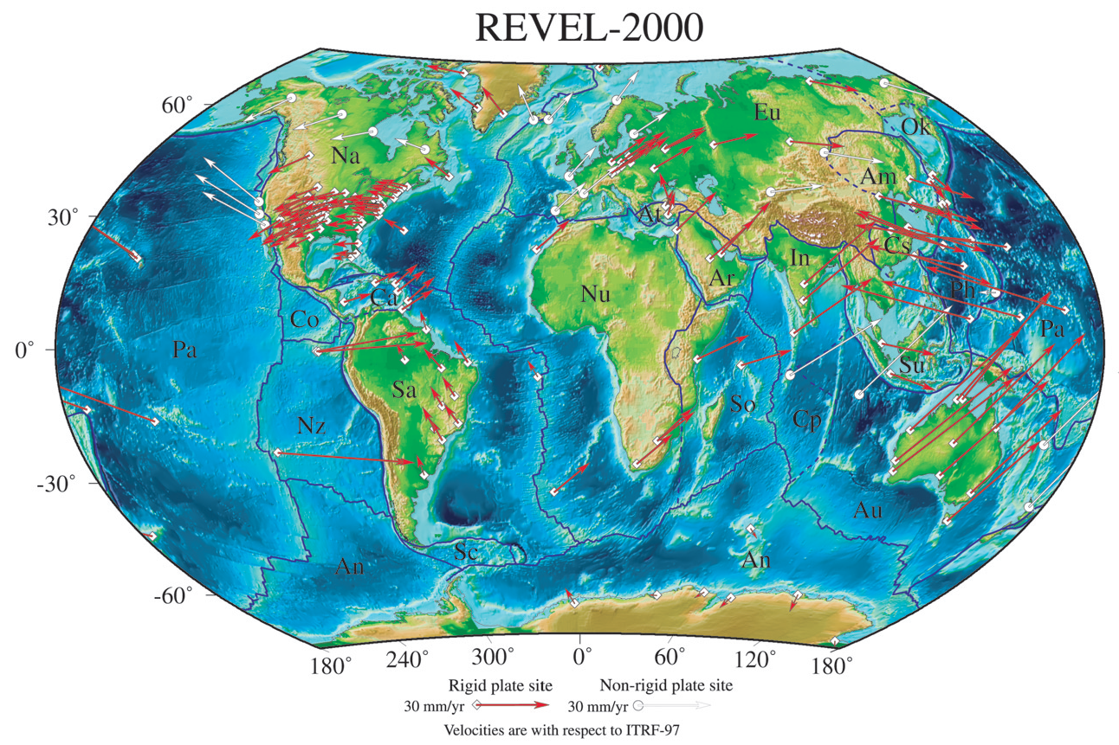
REcent VELocities – from GPS
(note holes – Scotia Plate for example)
Sella et al, 2002

Slide 3
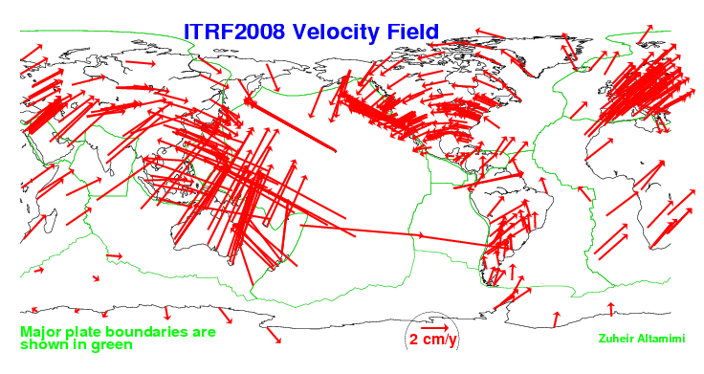
ITRF-2008

Slide 4
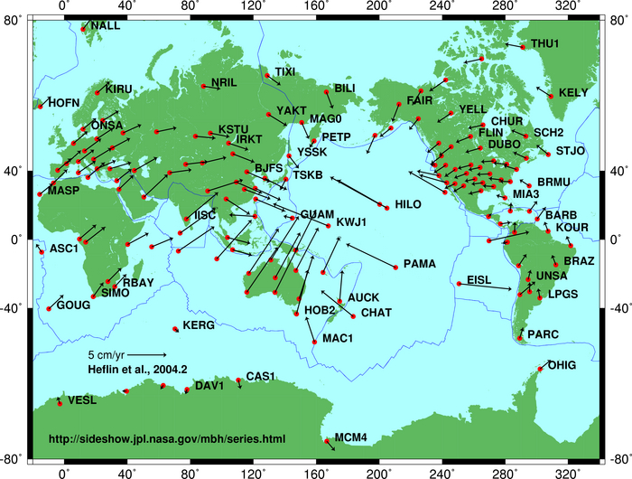
GPS picture – Scotia Plate missing (also missing from NUVEL-1, “included, but not constrained in NUVEL-1A)

Slide 5
Combine GPS and Geology to define motion Scotia plate.
Scotia plate “missing” from NUVEL-1
(in NUVEL-1A but estimated from closure)
Get small circles from transform plate boundaries (so theoretically can get location of pole) but no tie into spreading system for velocity.
Use GPS to get velocity.

Slide 6
Results for GPS-Geologic combination for Scotia Arc.
Use Combination of GPS (velocity and azimuth, focal mechanisms (azimuth), Scotia-South Sandwich spreading.
Smalley et al., 2007

Slide 7
Applications Space Based Geodesy
(GPS, VLBI, SLR/InSAR)

Slide 8
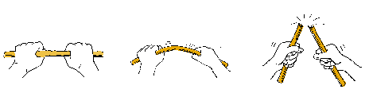
Dynamics:
“Physics” of earthquakes
http://www.washington.edu/burkemuseum/earthquakes/bigone/waves.html

Slide 9
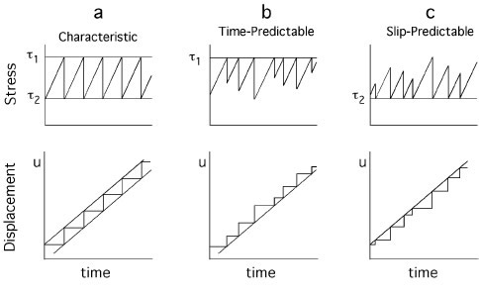
Earthquake “cycle”
Gives time and size of next earthquake. Seismic gap theory is application of this model.
Gives time, but not size of next earthquake.
Gives size of next earthquake for any selected time in future.

Slide 10
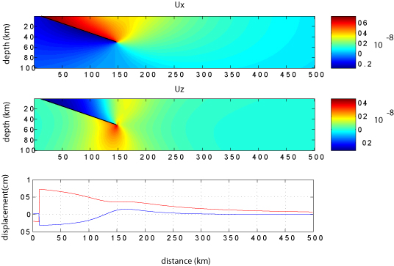
Elastic modeling of subduction process
No permanent deformation (no mountains)
Notes:
spring block

Slide 11
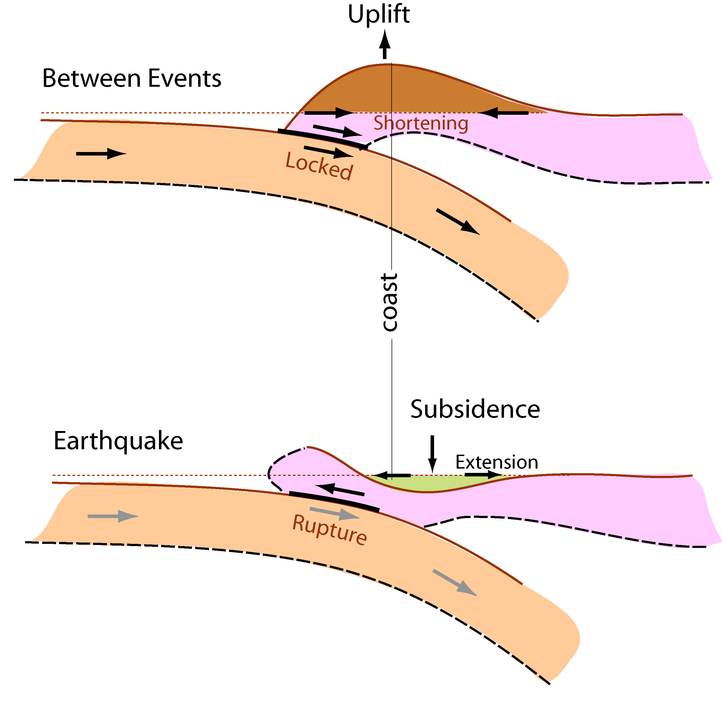
Subduction zone version of Elastic Rebound:
Cartoons for upper plate deformation during the interseismic (between earthquakes)
and seismic (earthquake)
stages of the earthquake cycle.
This occurs over hundreds-thousands of years
This occurs in seconds-minutes
After Hyndman

Slide 12
We will not look at each of the two parts individually.
The earthquake first.
After Hyndman

Slide 13
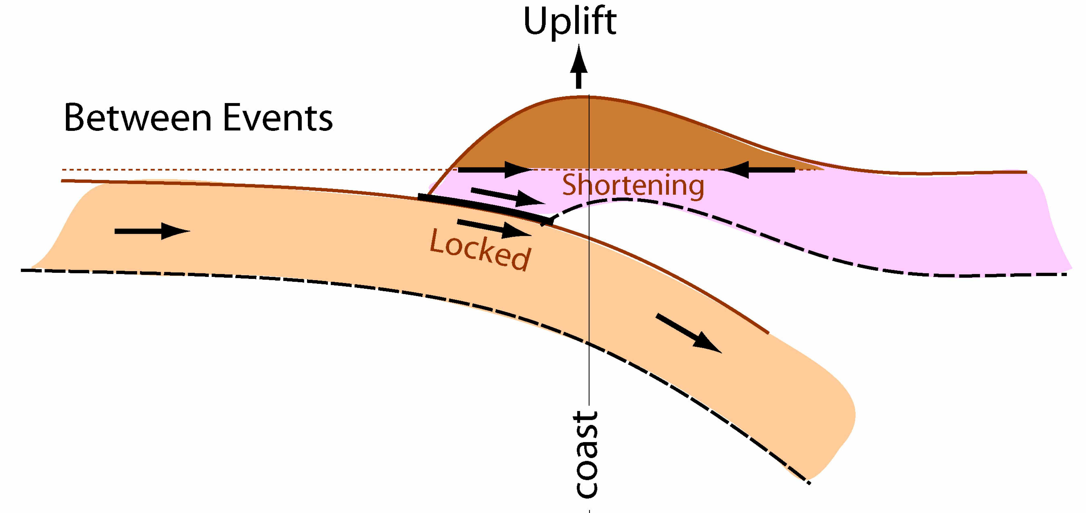
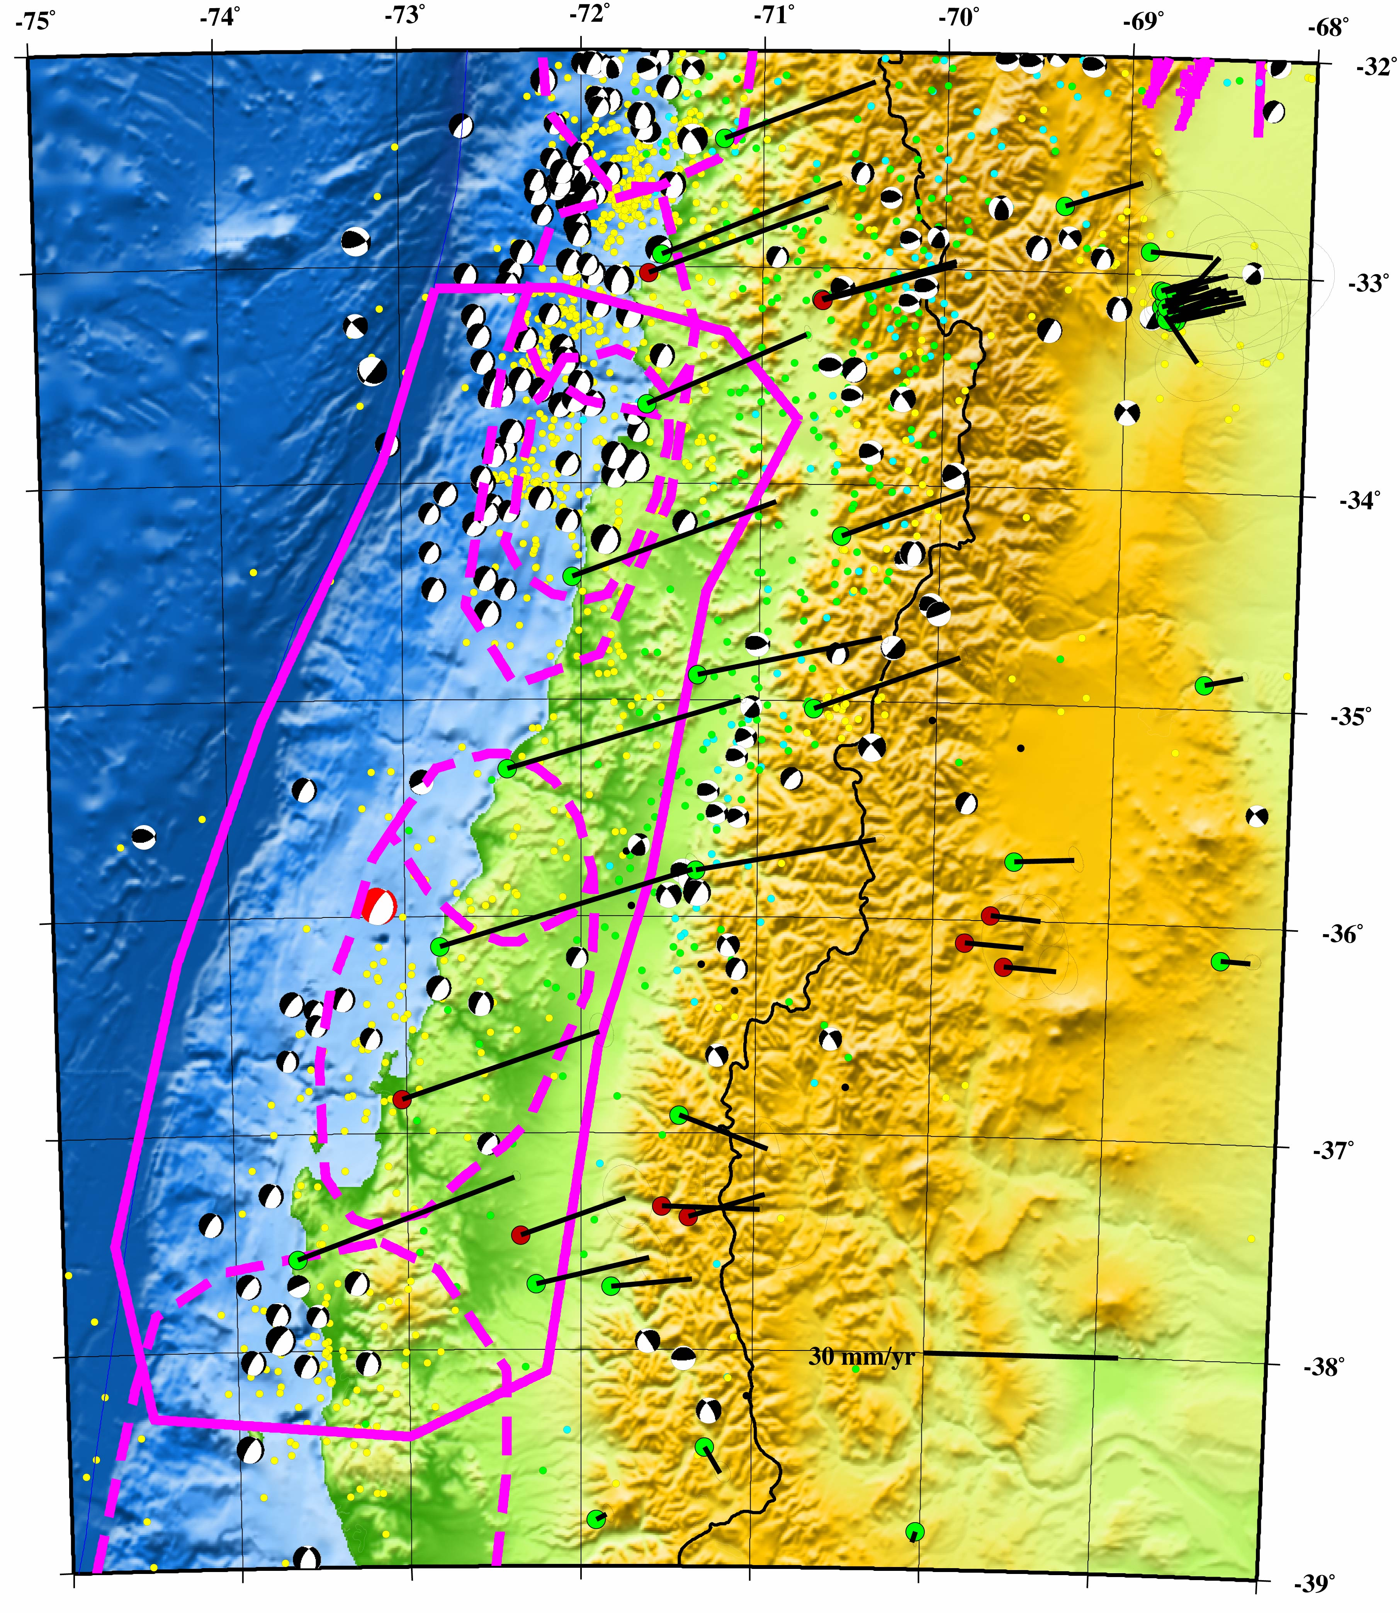

Slide 14
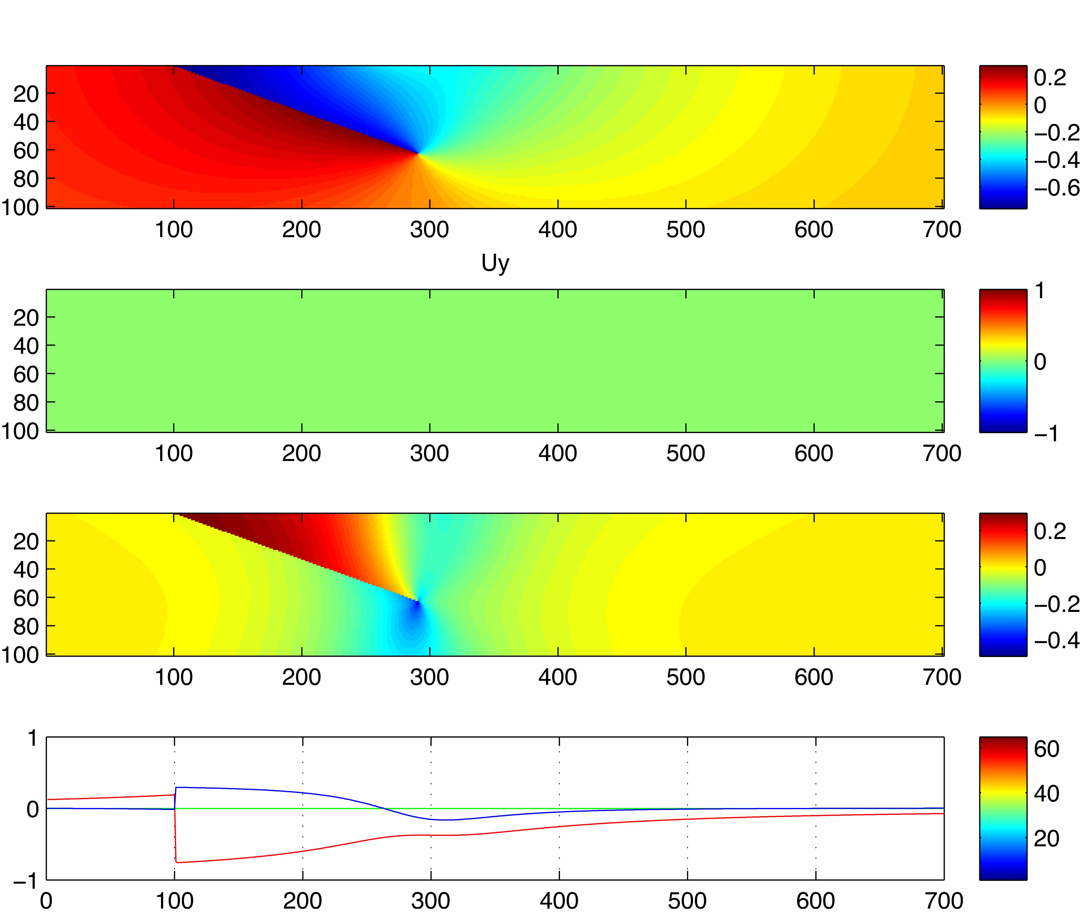
Vert
E-W
Elastic modeling of co-seismic deformation

Slide 15
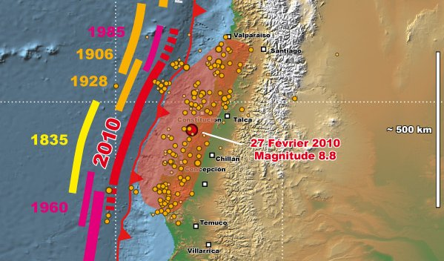
Historical seismicity
Ruegg (2009) – no earthquake since 1835 => “mature seismic gap”.
Estimated slip (rate x time) and max 8-8.5 from slip, but not rupture length.
Montessus de Ballore and Lacassin

Slide 16
Tangent / aside

Slide 17
How “big” is a magnitude 5 earthquake?
(assume a square fault.
The answer will specify
the dimensions of the square and
the amount of slip.)

Slide 18
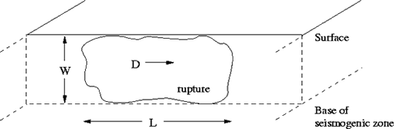
Earthquakes are caused by internal torques, from interactions of different blocks of the earth on opposite sides of faults.
After some rather complicated mathematics, it can be shown that the moment of an earthquake is simply expressed by:
M₀=μAD
where μ is rigidity (units of stress = force/Area), A is fault area and D is average slip

Slide 19
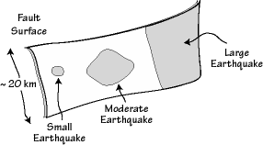
The size of the area that slips, and the amount of slip that occurs during an earthquake both increase with earthquake size.
The shaded regions on the fault surface are the areas that rupture during different size events. The largest earthquakes generally rupture the entire depth of the fault

Slide 20
Notice that seismic moment does not saturate.
Also notice that it has the same units (dyne-cm = force times distance) as work and energy BUT it is NOT the same as work and energy (that’s why we use dyne-cm or newton-m and not joules or ergs for seismic moment!).
Now we can (empirically) relate seismic moment, M₀, to the magnitude scales. We will do this by creating Moment Magnitude, M_{W}.
M_{W} = 2/3 log M₀ – 10.73
log M₀ = 3/2 M_{W} + 16.1
And doing the same for the energy
E = M₀/(2 x 10⁴) erg in terms of M₀, the seismic moment

Slide 21
Seismic moment is proportional to the product of the geologically reasonable and observable parameters – fault area that slipped and how much it slipped.

Slide 22
Seismic moment is proportional to the product of the geologically reasonable and observable parameters – fault area that slipped and how much it slipped.
So, how big are the fault areas and amounts of slip?

Slide 23
Seismic moment is proportional to the product of the geologically reasonable and observable parameters – fault area that slipped and how much it slipped.
So, how big are the fault areas and amounts of slip?
Are the fault area (or dimensions) and the amount of slip related?

Slide 24
Enter - Earthquake scaling relationships.

Slide 25
Earthquake scaling relationships.
Can we have 10 m of slip on a 1 m² fault?

Slide 26
Earthquake scaling relationships.
Can we have 10 m of slip on a 1 m² fault?
Obviously not (ridiculous example to make point).

Slide 27
Earthquake scaling relationships.
Can we have 10 m of slip on a 1 m² fault?
Obviously not (ridiculous example to make point).
We know rocks break when subjected to strains of between (small strain, weak rock) 10⁻⁵ and (larger strain, strong rock) 10⁻⁴.
This means you can only store up so much strain energy in a given volume of rock.
So let’s say a rock will break when it has been strained by 1 part in 20,000, and all the strain is released (by slip).

Slide 28
This means the rupture displacement in an earthquake will typically be about 1/20,000 of the rupture length.
For example, a 1 km long rupture would give a displacement of about 1km/20,000, or 0.05 meters.
A 100 km long rupture (more on this for non-symmetric faults a bit later) produces a displacement of a few meters.

Slide 29
Using this idea, scaling between fault size and slip, we can calculate typical rupture dimensions and slips for different moments and moment magnitudes.
Slip
5 cm
15 cm
.5 m
1.5 m
2.5m,10m?
What happens with the last example? Which “size” do we use? Answer (probably) depends on direction of the slip.

Slide 30
km2cm | slipratio | rigidigy | moment | moment mag
1.00E+05 | 1.00E-04 | 3.00E+11 | 1.00E+00 | -1.07E+01
perp dirn | slip dirn | slip | moment | moment mag | slip cm
km | km | km
1.00E+02 | 2.00E+01 | 2.00E-03 | 1.20E+27 | 7.35E+00 | 2.00E+02
1.00E+01 | 1.00E+01 | 1.00E-03 | 3.00E+25 | 6.28E+00 | 1.00E+02
2.00E+00 | 2.00E+00 | 2.00E-04 | 2.40E+23 | 4.89E+00 | 2.00E+01
2.50E+00 | 2.50E+00 | 2.50E-04 | 4.69E+23 | 5.08E+00 | 2.50E+01 | mag 5 size is 2.5 km x 2.5 km
3.00E+00 | 3.00E+00 | 3.00E-04 | 8.10E+23 | 5.24E+00 | 3.00E+01
3.50E+00 | 3.50E+00 | 3.50E-04 | 1.29E+24 | 5.37E+00 | 3.50E+01
8.00E+02 | 1.50E+01 | 1.50E-03 | 5.40E+27 | 7.79E+00 | 1.50E+02 | 1906 San Francisco
1.20E+03 | 2.00E+02 | 2.00E-02 | 1.44E+30 | 9.41E+00 | 2.00E+03 | 1960 Chile

Slide 31
km2cm | slipratio | rigidigy | moment | moment mag
1.00E+05 | 1.00E-04 | 3.00E+11 | 1.00E+00 | -1.07E+01
perp dirn | slip dirn | slip | moment | moment mag | slip cm
km | km | km
1.00E-03 | 1.00E-03 | 1.00E-07 | 3.00E+13 | -1.72E+00 | 1.00E-02
2.00E-03 | 2.00E-03 | 2.00E-07 | 2.40E+14 | -1.11E+00 | 2.00E-02
2.30E-03 | 2.30E-03 | 2.30E-07 | 3.65E+14 | -9.92E-01 | 2.30E-02 | mag -1 is 2.3 m x 2.3 m
3.00E-03 | 3.00E-03 | 3.00E-07 | 8.10E+14 | -7.61E-01 | 3.00E-02
4.00E-03 | 4.00E-03 | 4.00E-07 | 1.92E+15 | -5.11E-01 | 4.00E-02
5.00E-03 | 5.00E-03 | 5.00E-07 | 3.75E+15 | -3.17E-01 | 5.00E-02
6.00E-03 | 6.00E-03 | 6.00E-07 | 6.48E+15 | -1.59E-01 | 6.00E-02
7.00E-03 | 7.00E-03 | 7.00E-07 | 1.03E+16 | -2.51E-02 | 7.00E-02
8.00E-03 | 8.00E-03 | 8.00E-07 | 1.54E+16 | 9.09E-02 | 8.00E-02 | mag 0 is 8 m x 8 m
9.00E-03 | 9.00E-03 | 9.00E-07 | 2.19E+16 | 1.93E-01 | 9.00E-02
1.00E-02 | 1.00E-02 | 1.00E-06 | 3.00E+16 | 2.85E-01 | 1.00E-01
2.00E-02 | 2.00E-02 | 2.00E-06 | 2.40E+17 | 8.87E-01 | 2.00E-01
2.30E-02 | 2.30E-02 | 2.30E-06 | 3.65E+17 | 1.01E+00 | 2.30E-01 | mag 1 is 23 m x 23 m

Slide 32
km2cm | slipratio | rigidigy | moment | moment mag
1.00E+05 | 1.00E-04 | 3.00E+11 | 1.00E+00 | -1.07E+01
perp dirn | slip dirn | slip | moment | moment mag | slip cm
km | km | km
2.30E-02 | 2.30E-02 | 2.30E-06 | 3.65E+17 | 1.01E+00 | 2.30E-01 | mag 1 is 23 m x 23 m
8.00E-02 | 8.00E-02 | 8.00E-06 | 1.54E+19 | 2.09E+00 | 8.00E-01 | mag 2 is 80 m x 80 m
2.30E-01 | 2.30E-01 | 2.30E-05 | 3.65E+20 | 3.01E+00 | 2.30E+00 | mag 3 is 230 m x 230 m
7.00E-01 | 7.00E-01 | 7.00E-05 | 1.03E+22 | 3.97E+00 | 7.00E+00 | mag 4 is 700 m x 700 m
2.00E+00 | 2.00E+00 | 2.00E-04 | 2.40E+23 | 4.89E+00 | 2.00E+01
3.00E+00 | 3.00E+00 | 3.00E-04 | 8.10E+23 | 5.24E+00 | 3.00E+01
7.00E+00 | 7.00E+00 | 7.00E-04 | 1.03E+25 | 5.97E+00 | 7.00E+01
8.00E+00 | 8.00E+00 | 8.00E-04 | 1.54E+25 | 6.09E+00 | 8.00E+01
9.00E+00 | 9.00E+00 | 9.00E-04 | 2.19E+25 | 6.19E+00 | 9.00E+01
2.00E+01 | 2.00E+01 | 2.00E-03 | 2.40E+26 | 6.89E+00 | 2.00E+02
3.00E+01 | 3.00E+01 | 3.00E-03 | 8.10E+26 | 7.24E+00 | 3.00E+02
7.00E+01 | 7.00E+01 | 7.00E-03 | 1.03E+28 | 7.97E+00 | 7.00E+02
8.00E+01 | 8.00E+01 | 8.00E-03 | 1.54E+28 | 8.09E+00 | 8.00E+02
3.00E+02 | 2.00E+02 | 2.00E-02 | 3.60E+29 | 9.00E+00 | 2.00E+03
1.50E+03 | 2.00E+02 | 2.00E-02 | 1.80E+30 | 9.47E+00 | 2.00E+03

Slide 33
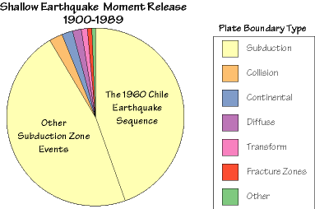
The seismic moment and moment magnitude give us the tool we need to compare the size of the largest quakes.
We find that the "moment release" in shallow earthquakes throughout the entire 20th century is dominated by several large subduction zone earthquake sequences.
energy released in the different plate settings:

Slide 34
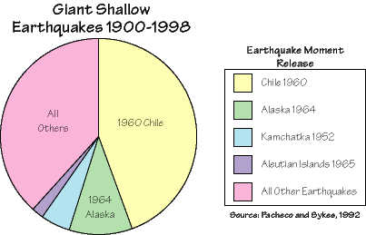
Energy released by largest four earthquakes (those with magnitudes greater than 9) and all the other shallow earthquakes
(needs updating for Sumatra 2004 and Maule 2010.)

Slide 35
1. | Chile | 1960 05 22 | 9.5 | -38.29 | -73.05 | Kanamori, 1977
2. | Prince William Sound, Alaska | 1964 03 28 | 9.2 | 61.02 | -147.65 | Kanamori, 1977
3. | Off the West Coast of Northern Sumatra | 2004 12 26 | 9.1 | 3.30 | 95.78 | Park et al., 2005
4. | Kamchatka | 1952 11 04 | 9.0 | 52.76 | 160.06 | Kanamori, 1977
5. | Offshore Maule, Chile | 2010 02 27 | 8.8 | -35.846 | -72.719 | PDE
6. | Off the Coast of Ecuador | 1906 01 31 | 8.8 | 1.0 | -81.5 | Kanamori, 1977
7. | Rat Islands, Alaska | 1965 02 04 | 8.7 | 51.21 | 178.50 | Kanamori, 1977
8. | Northern Sumatra, Indonesia | 2005 03 28 | 8.6 | 2.08 | 97.01 | PDE
9. | Assam - Tibet | 1950 08 15 | 8.6 | 28.5 | 96.5 | Kanamori, 1977
10. | Andreanof Islands, Alaska | 1957 03 09 | 8.6 | 51.56 | -175.39 | Johnson et al., 1994
11. | Southern Sumatra, Indonesia | 2007 09 12 | 8.5 | -4.438 | 101.367 | PDE
12. | Banda Sea, Indonesia | 1938 02 01 | 8.5 | -5.05 | 131.62 | Okal and Reymond, 2003
13. | Kamchatka | 1923 02 03 | 8.5 | 54.0 | 161.0 | Kanamori, 1988
14. | Chile-Argentina Border | 1922 11 11 | 8.5 | -28.55 | -70.50 | Kanamori, 1977
15. | Kuril Islands | 1963 10 13 | 8.5 | 44.9 | 149.6 | Kanamori, 1977

Slide 36
In last 100 years
1960 earthquake – 25% energy,
Six largest – 50% energy,
15 largest – 61% energy,
M>8 – >80% energy.
1960 Chile
1964 Alaska
2004 Sumatra-
Andaman

Slide 37
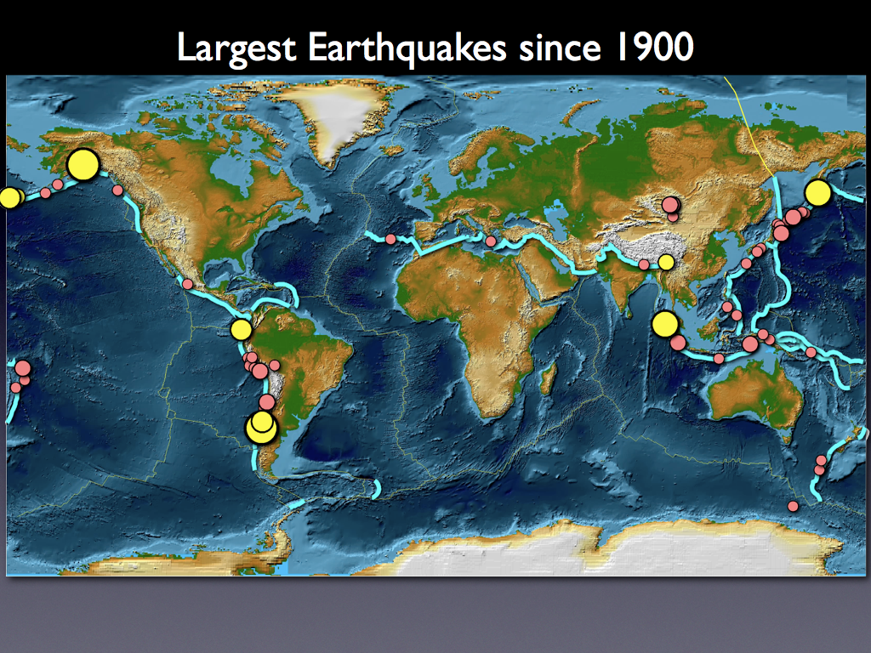

Slide 38
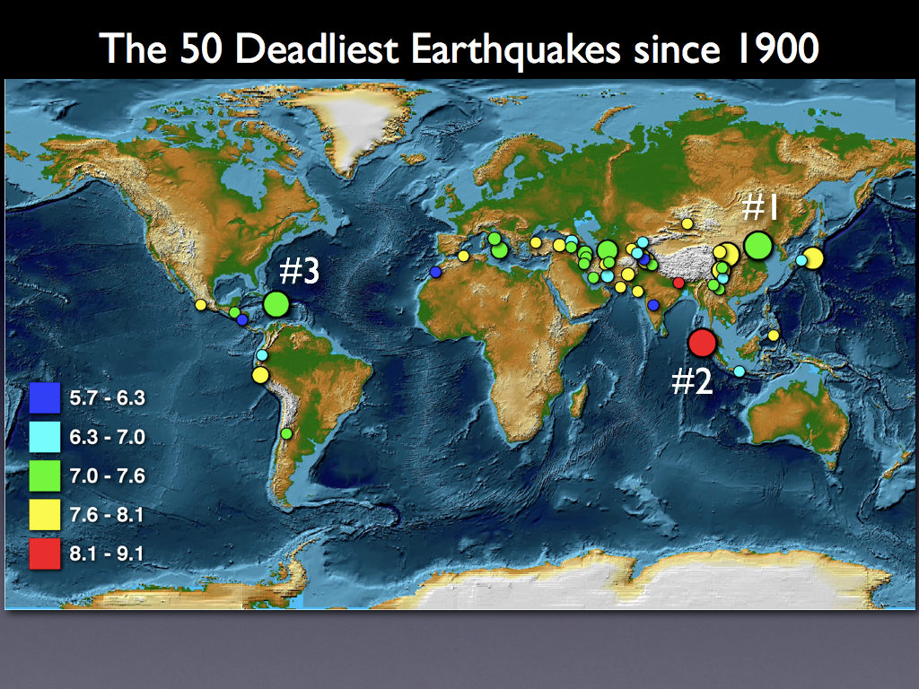
Magnitude often has little to do with number deaths.

Slide 39
Ratio sizes 2010 Maule, Chile, earthquake and Hatian earthquake.
Chile 550 times bigger in energy (big hazard).
Haiti earthquake killed 550 times more people (big risk).

Slide 40
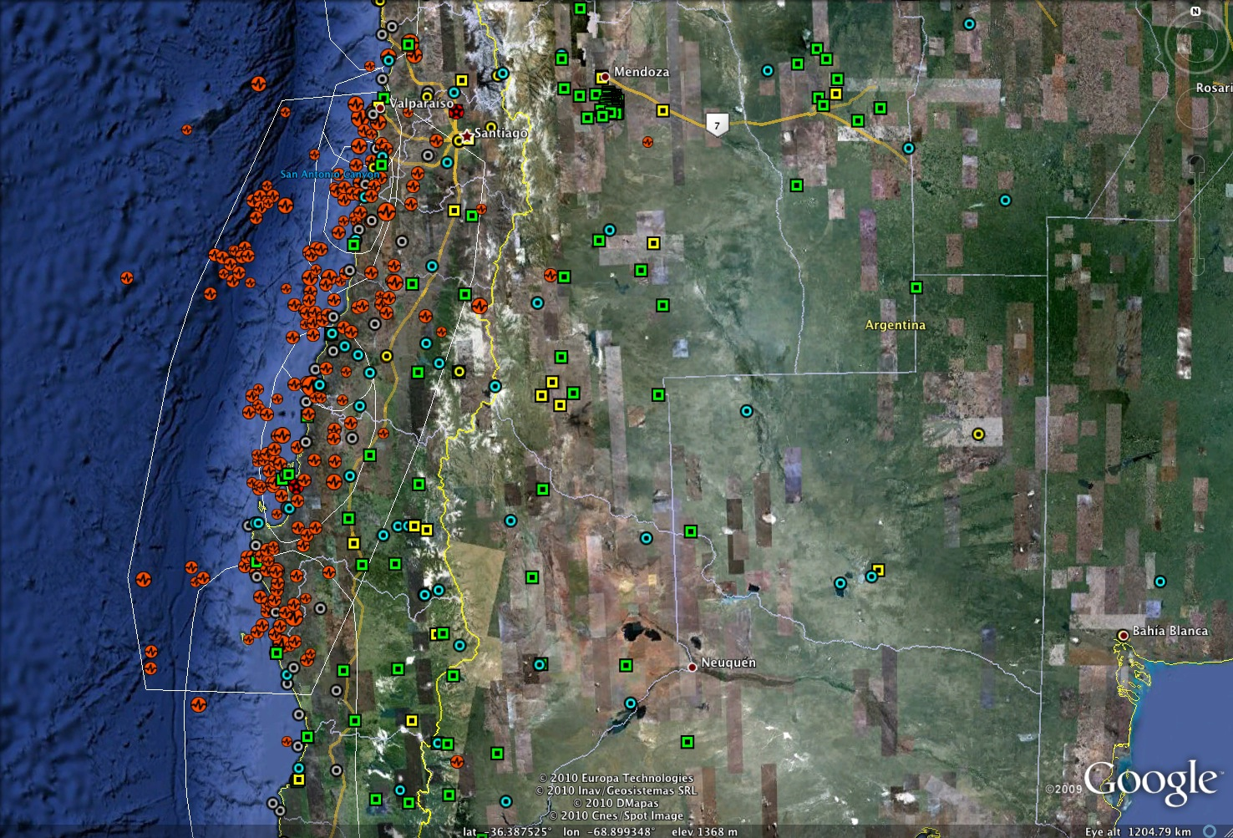
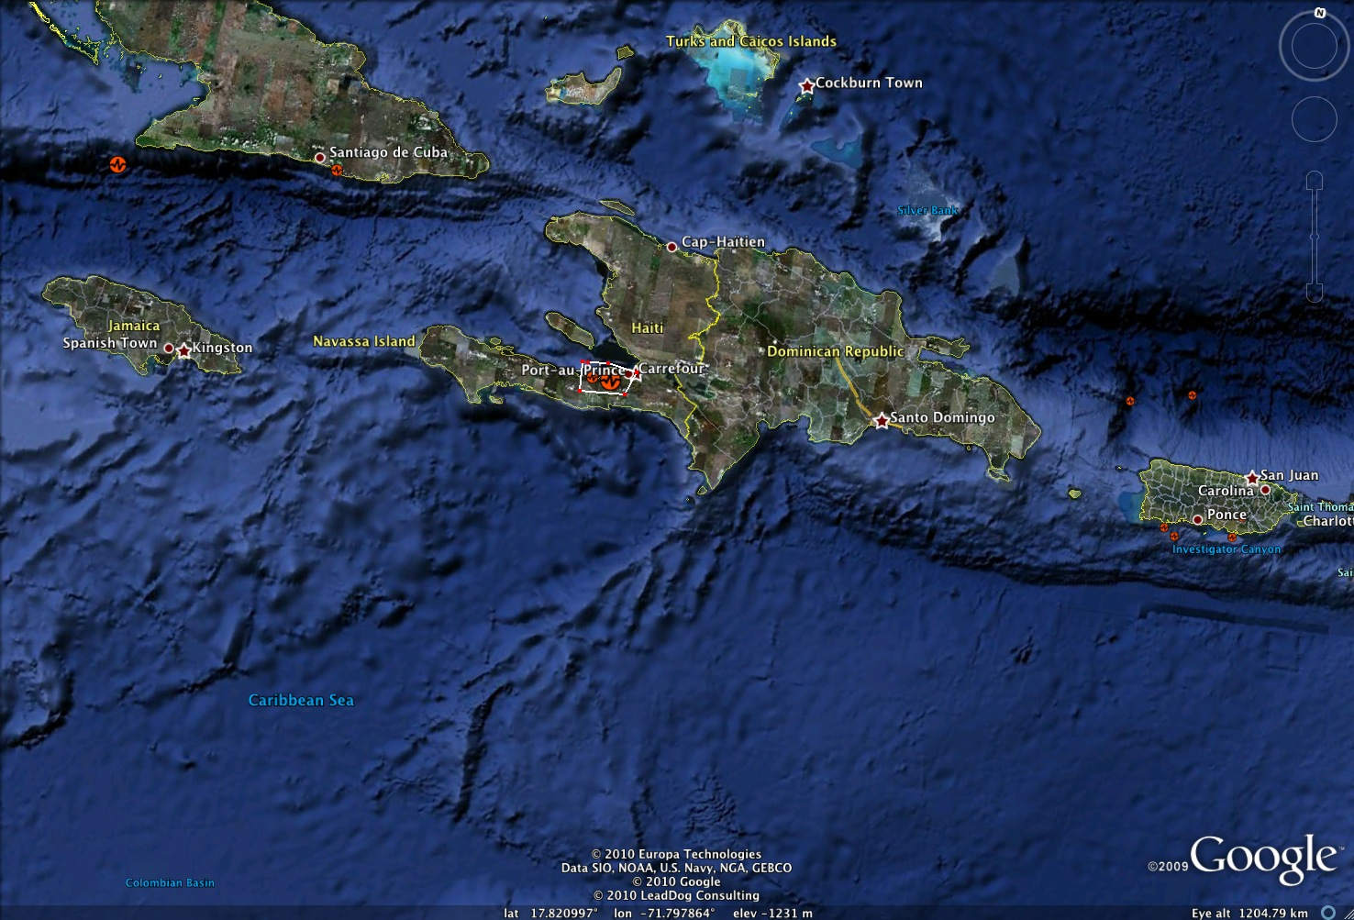
Comparison rupture areas from Maule and Haiti earthquakes
(figures at same scale)

Slide 41
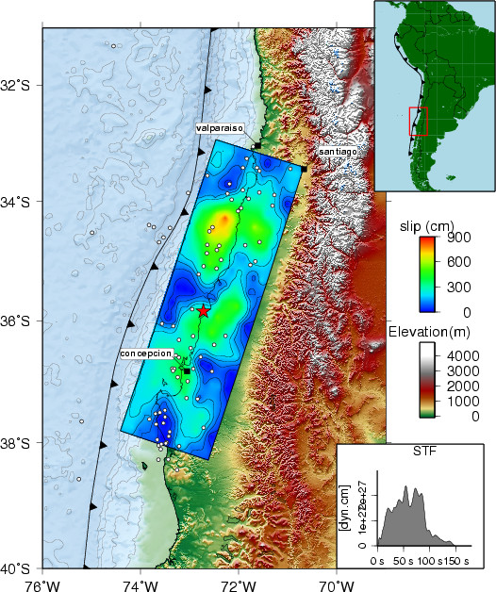
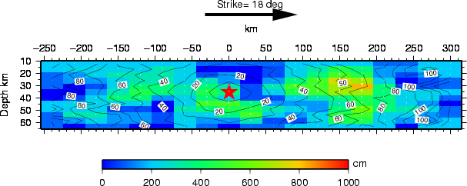
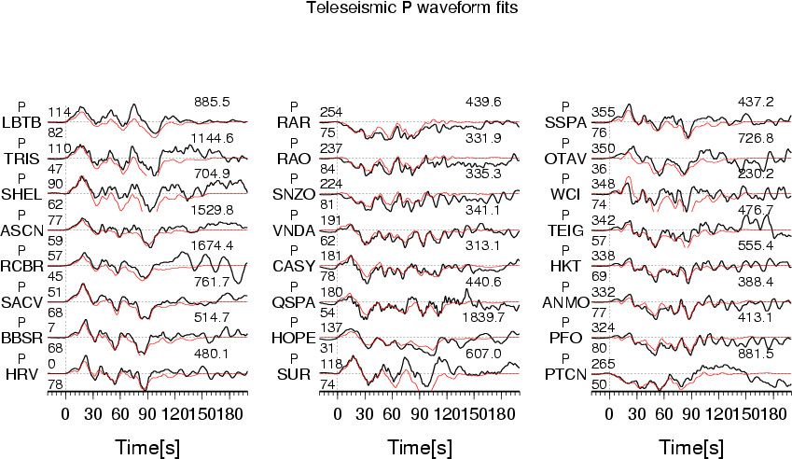
Finite Fault Model from seismic data
Preliminary Result of the Feb 27, 2010 Mw 8.8 Maule, Chile Earthquake
Anthony Sladen, CALTECH
Notes:
Rupture zone ~600 x ~130 km.

Slide 42
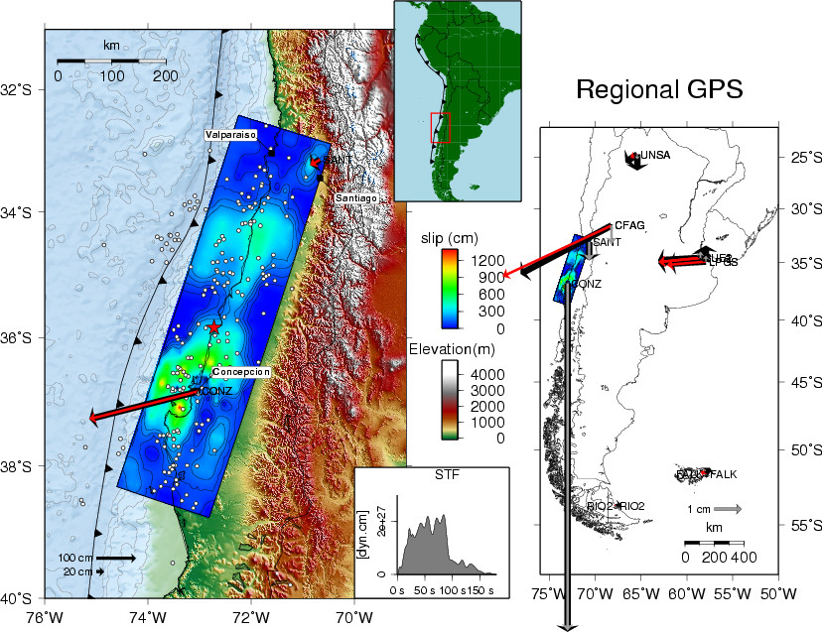
Finite Fault Model from seismic and GPS (static) data
Preliminary Result of the Feb 27, 2010 Mw 8.8 Maule, Chile Earthquake
Anthony Sladen and Susan Owen, CALTECH

Slide 43
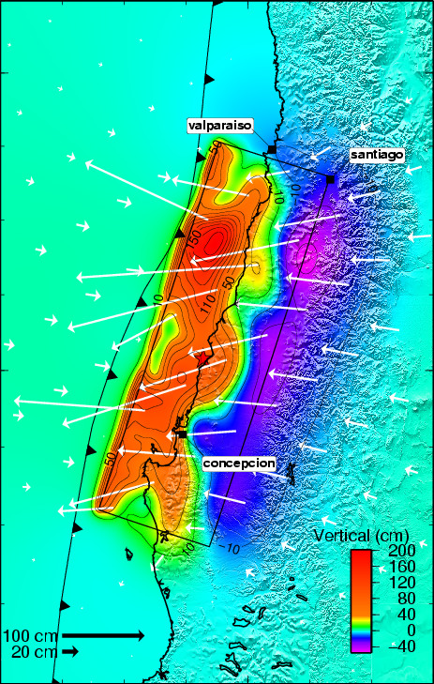
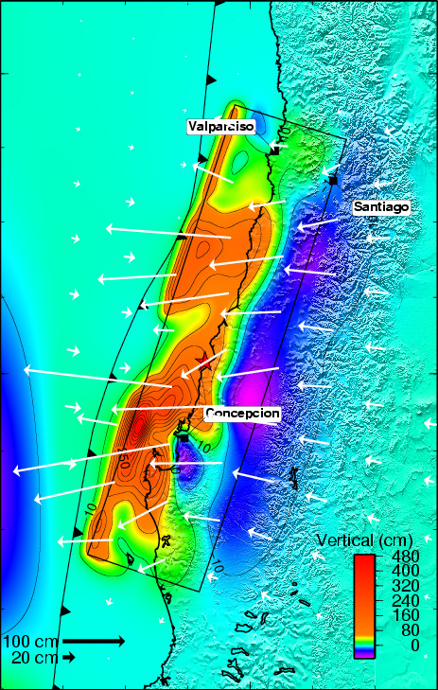
Static displacements from seismic only (left) and combined seismic and GPS (right)
Preliminary Result of the Feb 27, 2010 Mw 8.8 Maule, Chile Earthquake
Anthony Sladen and Susan Owen, CALTECH

Slide 44
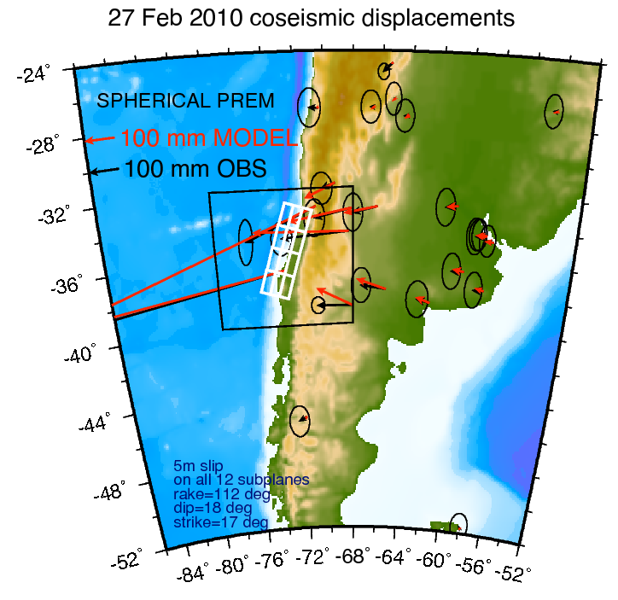
Fred Pollitz: USGS

Slide 45
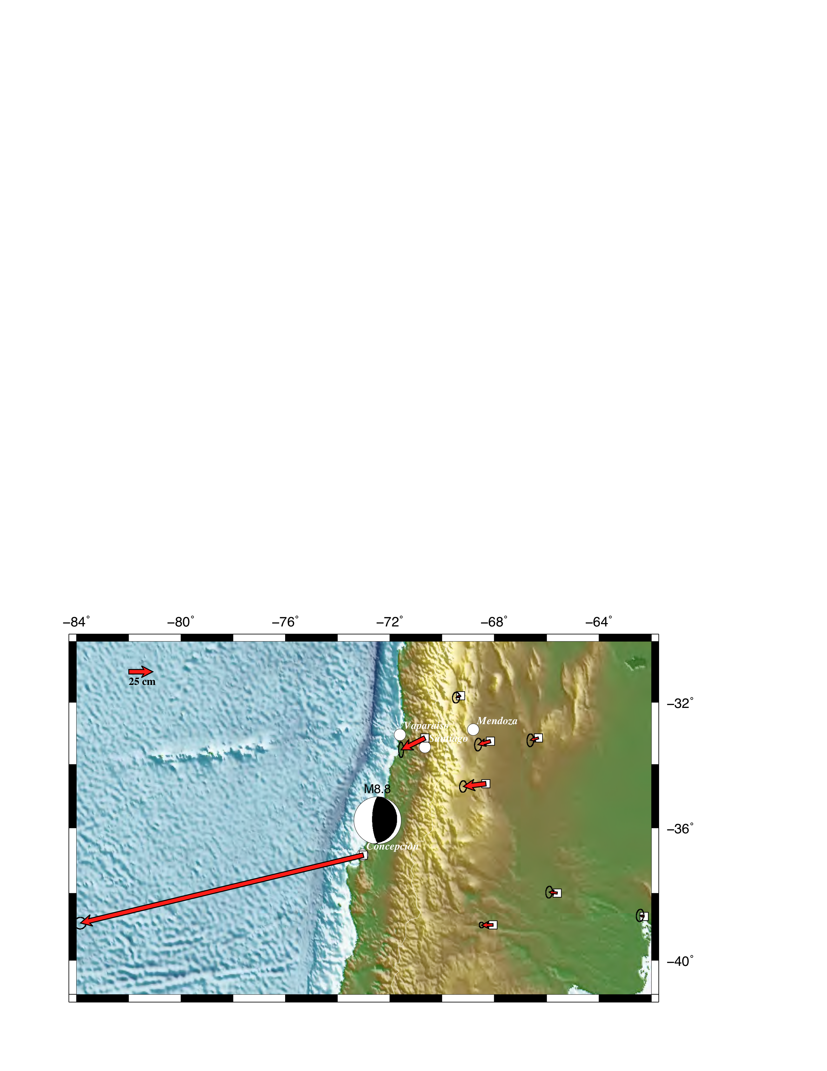
Co-seismic static deformation (all at same scale).

Slide 46
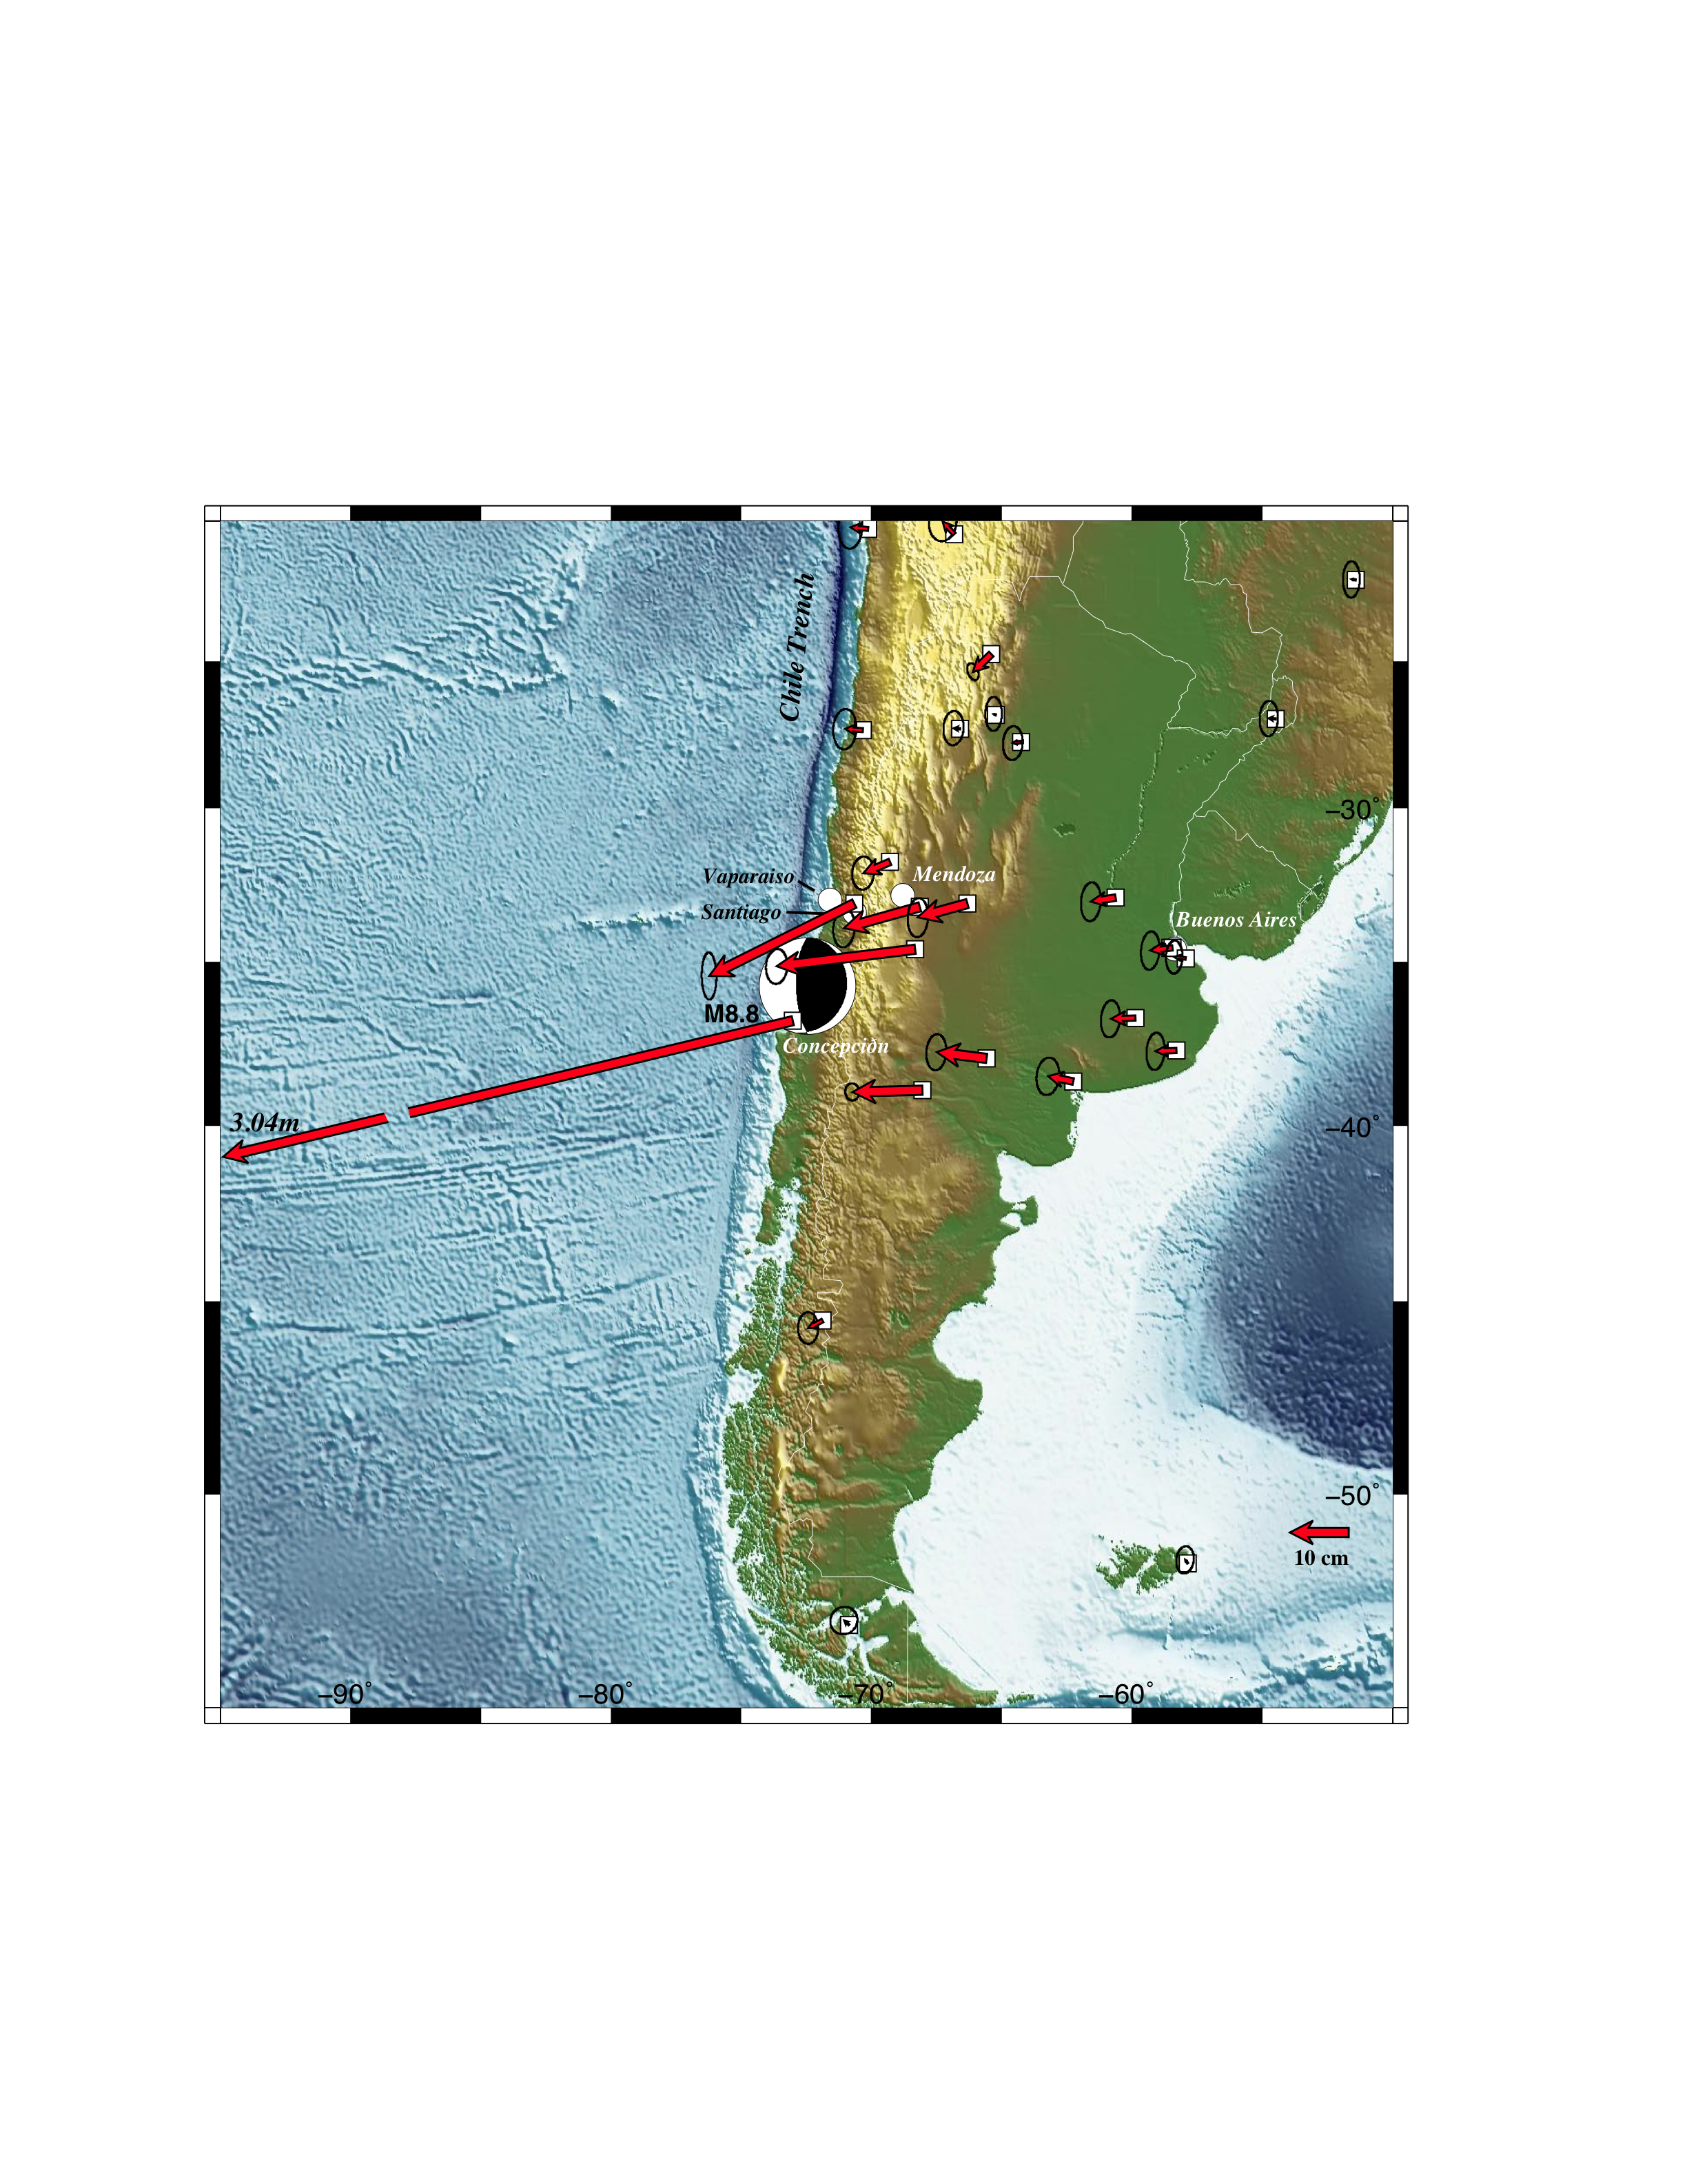
Co-seismic static deformation
(Concepción not to scale).

Slide 47
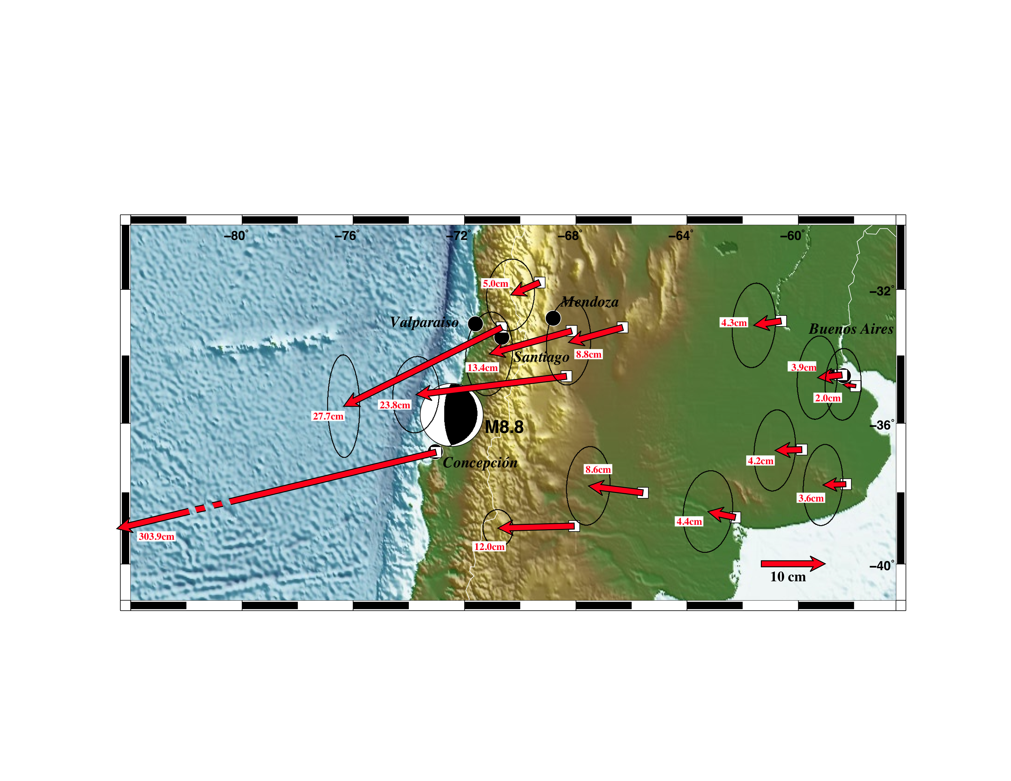
Co-seismic static deformation – zoom on far field (Concepción not to scale).

Slide 48
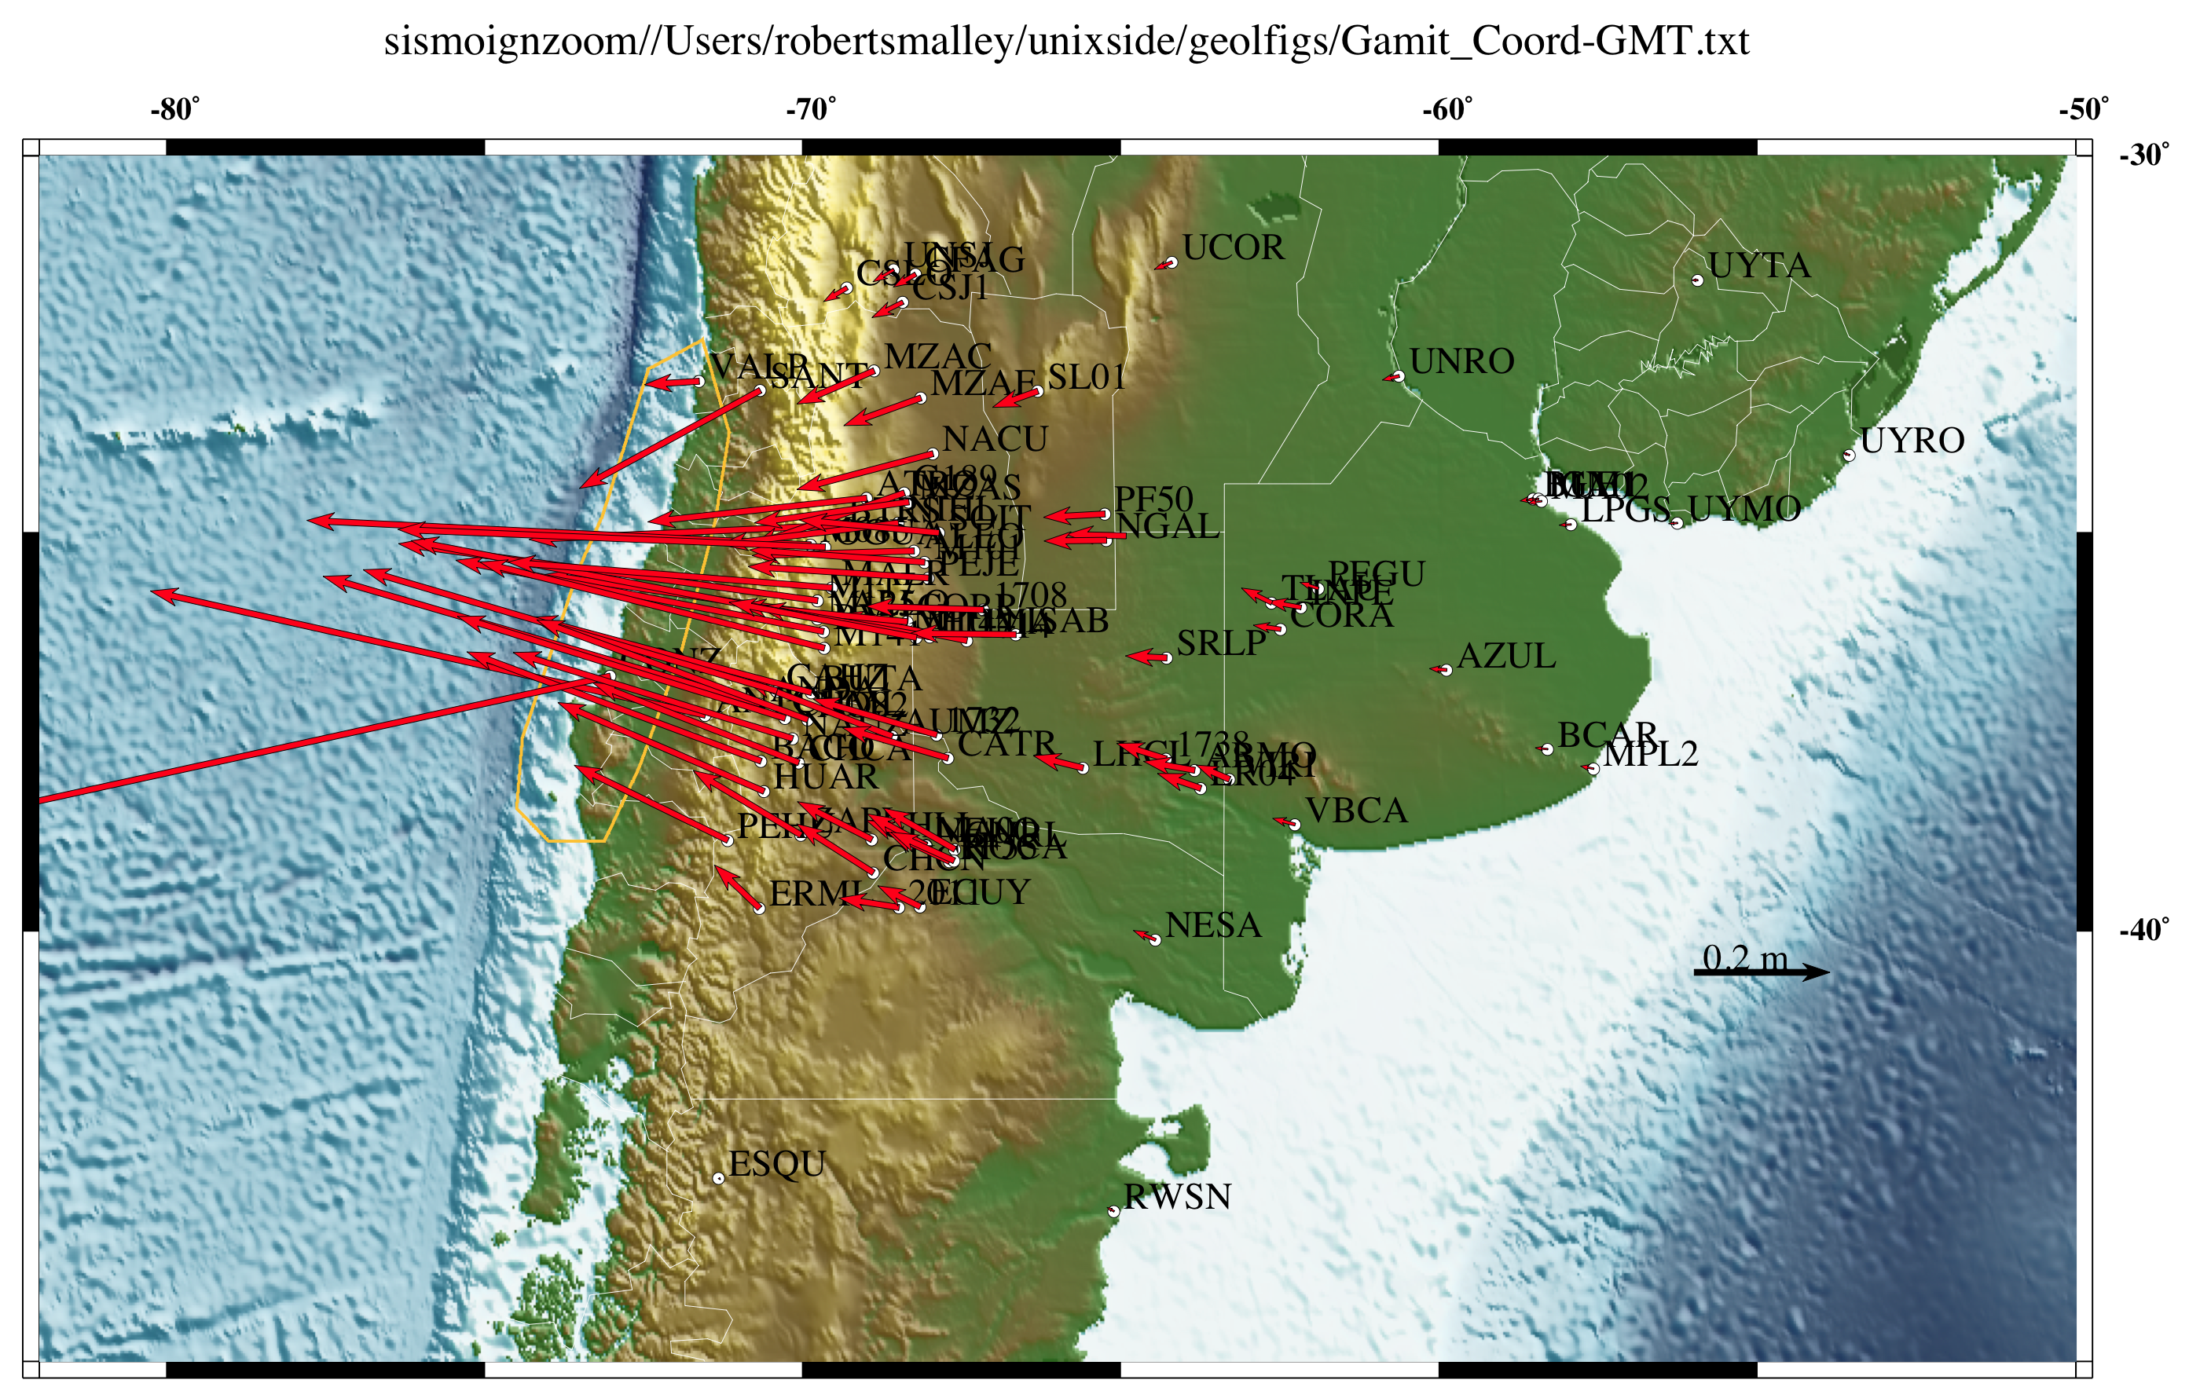

Slide 49
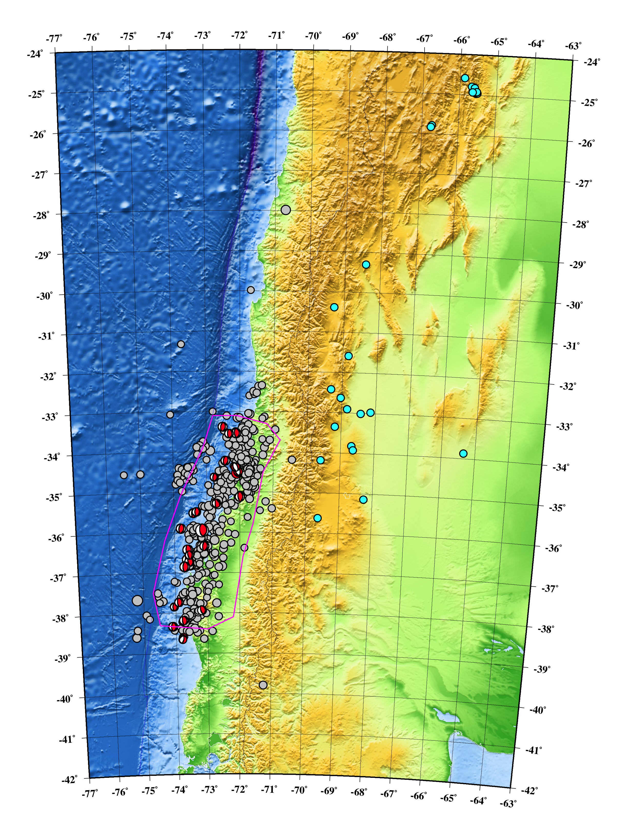
Aftershocks
“Triggered” seismicity in trench and back-arc in Argentina.
(grey – ANSS,
cyan – INPRES)

Slide 50
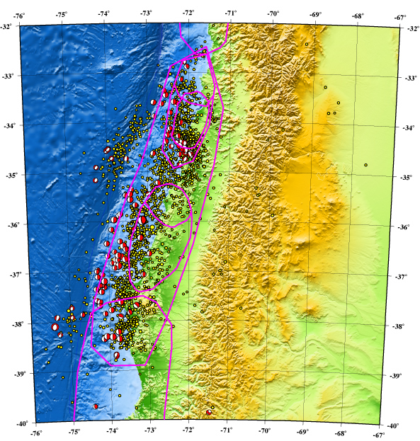
Plate bending events – normal faulting focal mechanisms - in subducting plate on west side of trench.
(not “regular” aftershocks).

Slide 51
Large deformation field associated with Maule earthquake – in accord with elastic rebound.
Start of measurements of post-seismic deformation.
GPS displacement seismograms (later).

Slide 52
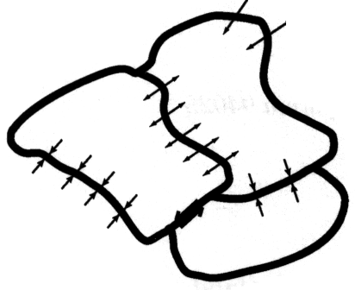
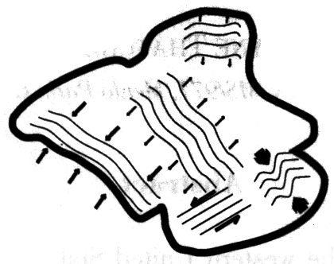
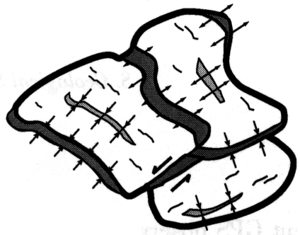
How might plates deform?
Continuum, block, etc.?
Thacher, 2003

Slide 53
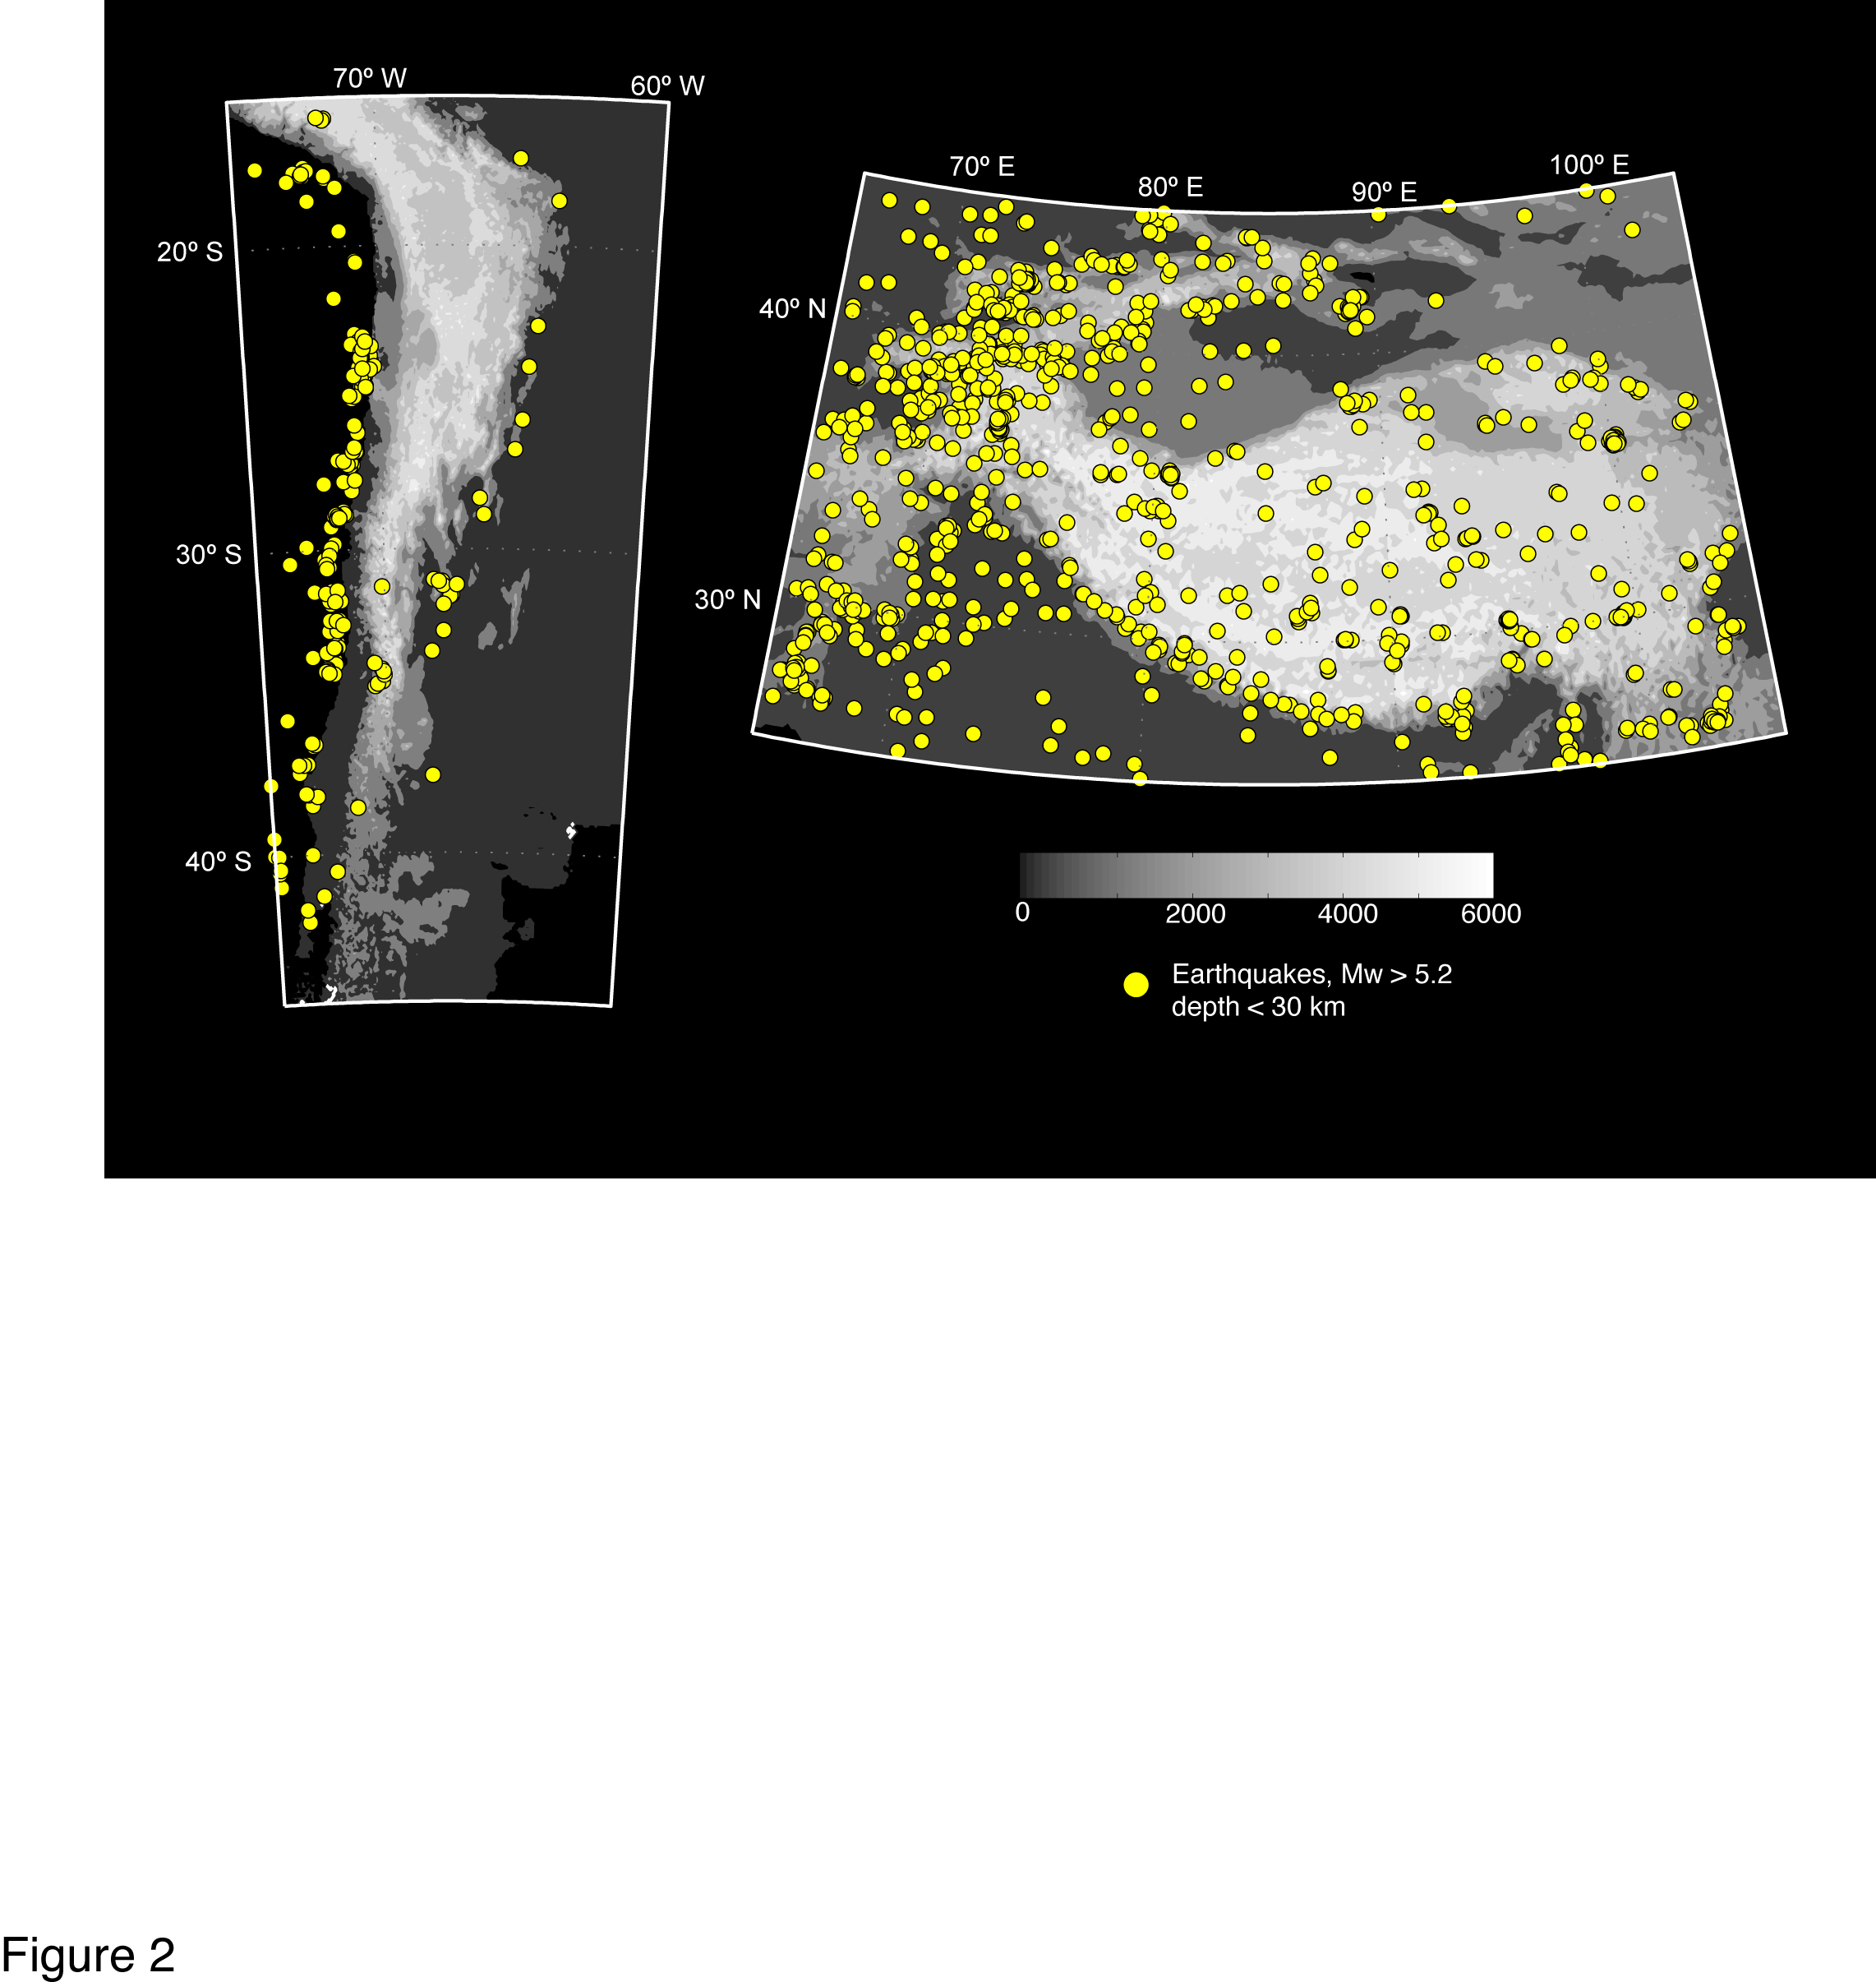
Andes
Thacher, 2003
Thacher, 2003
Rigid blocks.
Sort of mini-version of plate tectonics.
“Easy” to see with GPS.

Slide 54
Tibet
Quasi-continuous deformation. Pervasive internal deformation (but not fast enough to invalidate plate tectonics).
Continuum sea.
“Hard” to see with GPS.
Thacher, 2003

Slide 55
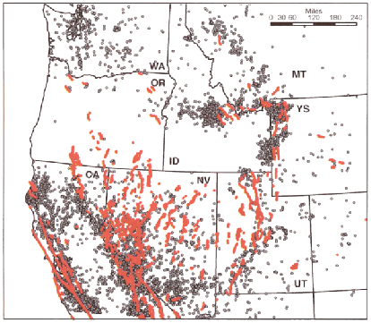
Narrow deformation zones.
Concentrated zones of deformation within inactive regions.
“Challenging” to see with GPS.
Thacher, 2003

Slide 56
More faults with evidence of active deformation than actively deforming zones.
May jump around (on human or geologic scale).
“Challenging” to see with GPS.
Thacher, 2003

Slide 57
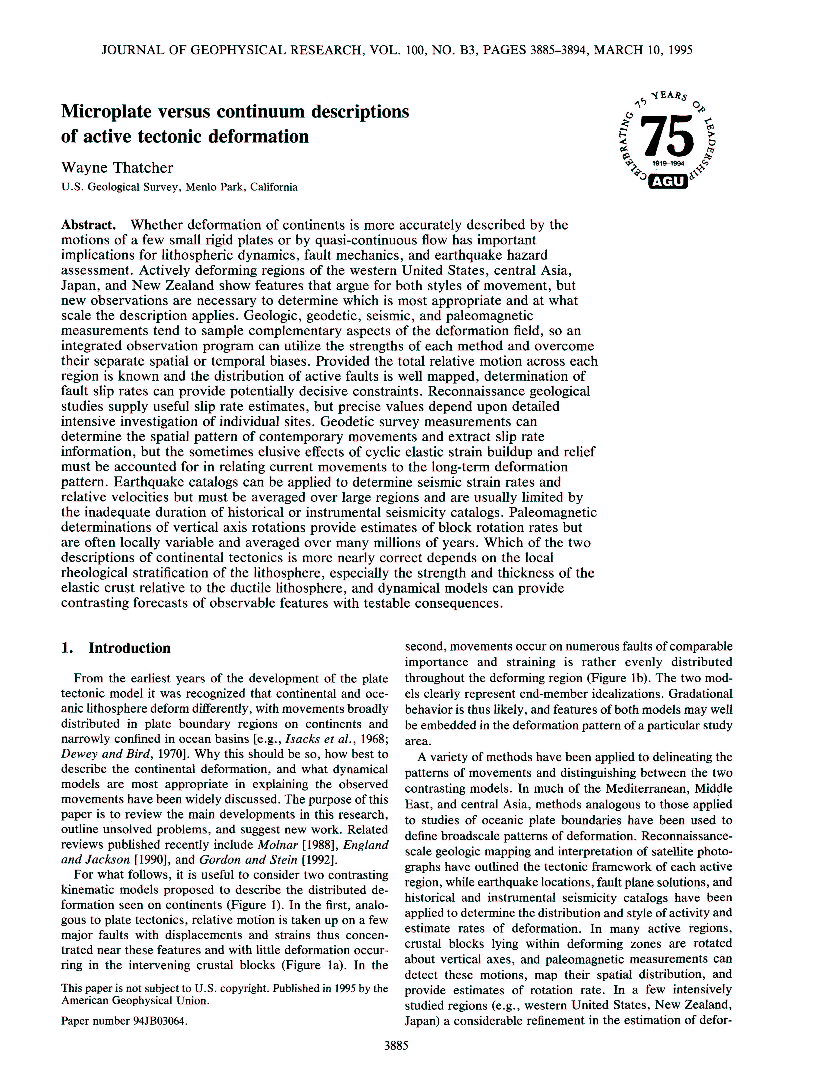
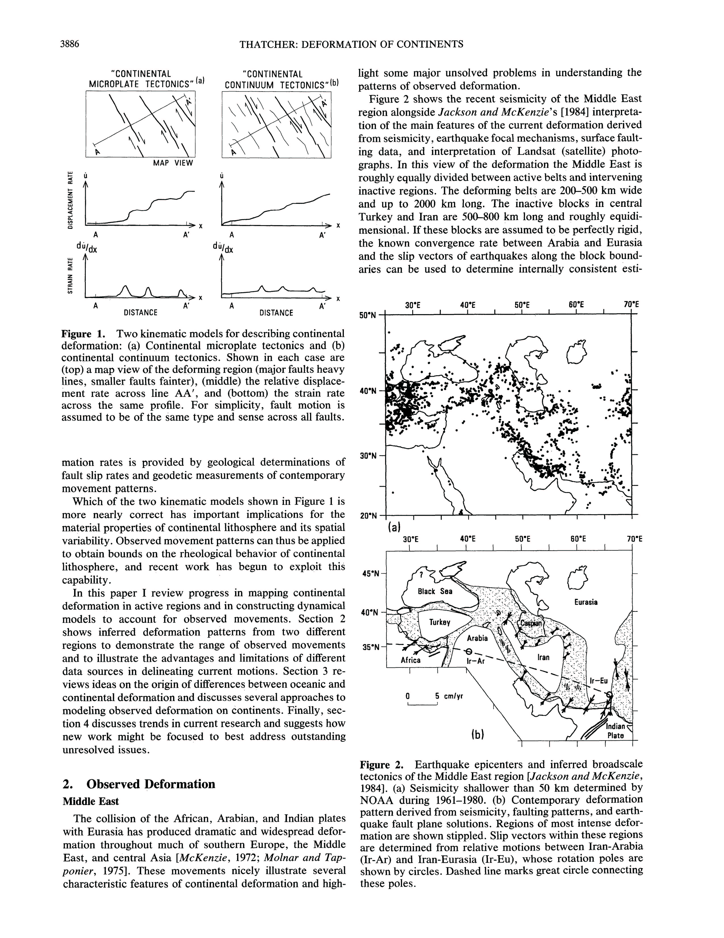

Slide 58
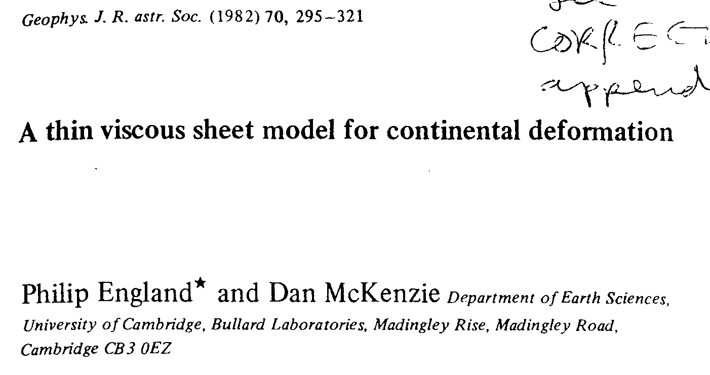
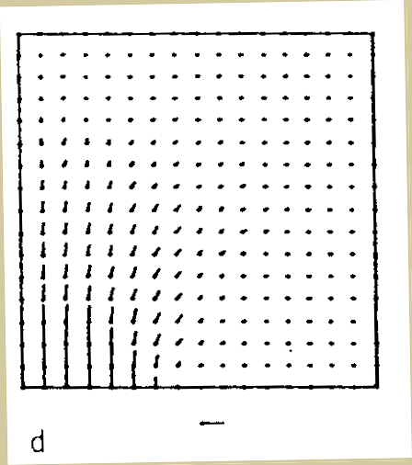
The TVS ‘test’:
‘If the orientation of buoyancy stresses
(calculated from maps of crustal thickness)
and tectonic stresses (from velocity field
and TVS formulation) are the same,
then the region is essentially
behaving as a fluid’ (England and Molnar, ‘97)

Slide 59
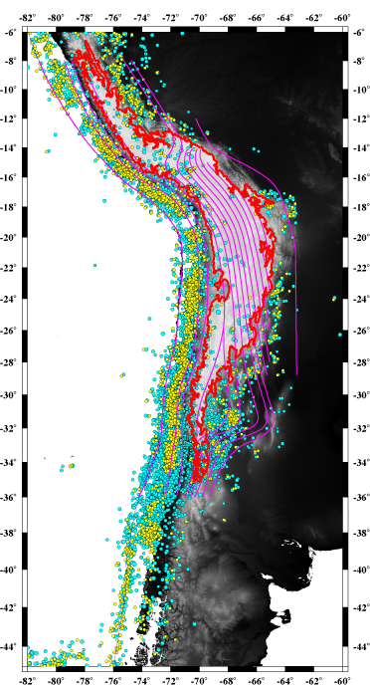
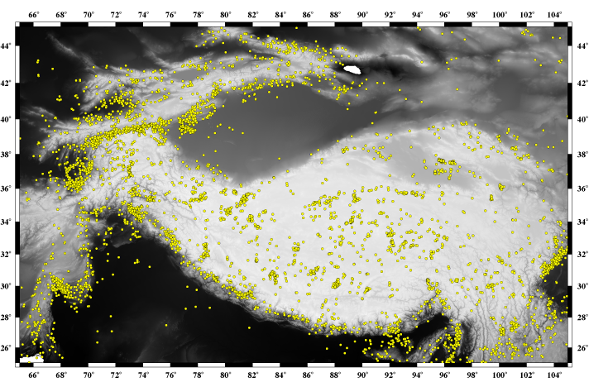
Compare seismicity of Himalaya and Andes
Around edges
Distributed
After Brooks et al, 2003

Slide 60
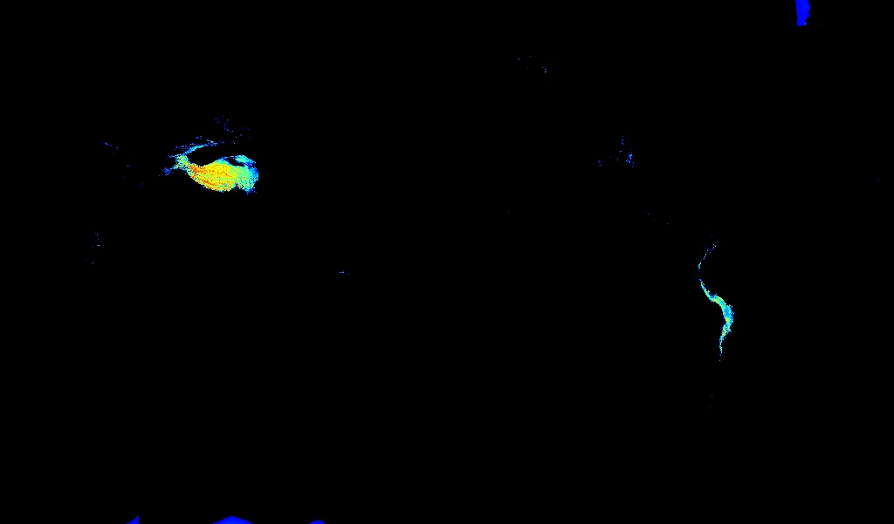
Map of topography higher than 3 km.
Himalaya and Andes

Slide 61
Andean seismicity:
- Plate boundary
- Crust is “aseismic” in high elevations
- Active crustal seismicity between eastern 3 Km elevation contour and epicenters (surface projection) of Wadati-Benioff seismicity.

Slide 62
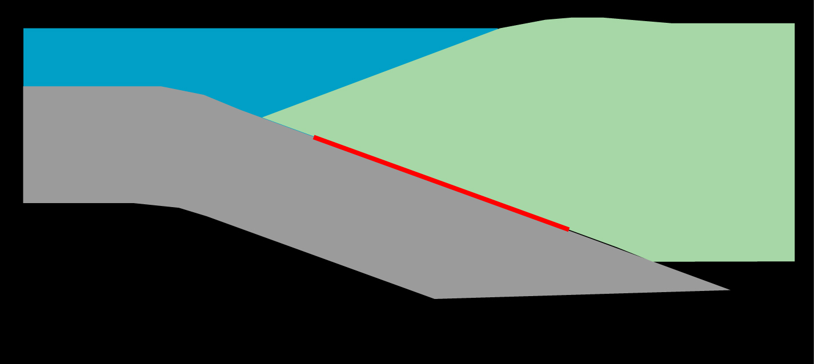
MODELING INTERSEISMIC STRAIN:
‘BACKSLIP’
(after Savage, ’83; Bevis & Martel, ’01)
So.Am.
Nazca
Savage backslip approach.
Run an earthquake “backwards” on the fault.
L
Notes:
We model interseismic strain associated with the Nazca-SAM plate boundary by assuming that a portion of the plate boundary is locked.
We model this locking using the backslip formalism.
- all modeling is carried out in an ELASTIC HOMOEGENOUS HALF SPACE
1) STEADY SLIP
2) perturb this with NORMAL SLIP OF AN ELASTIC DISLOCATION over some finite distance – LINEAR SUPERPOSITION
3) the result is the interseismic surface deformation field due to a locked Nazca-SAM boundary described by the parameter, L
(in the SAM reference frame, the velocity field is just that due to the backslip)

Slide 63
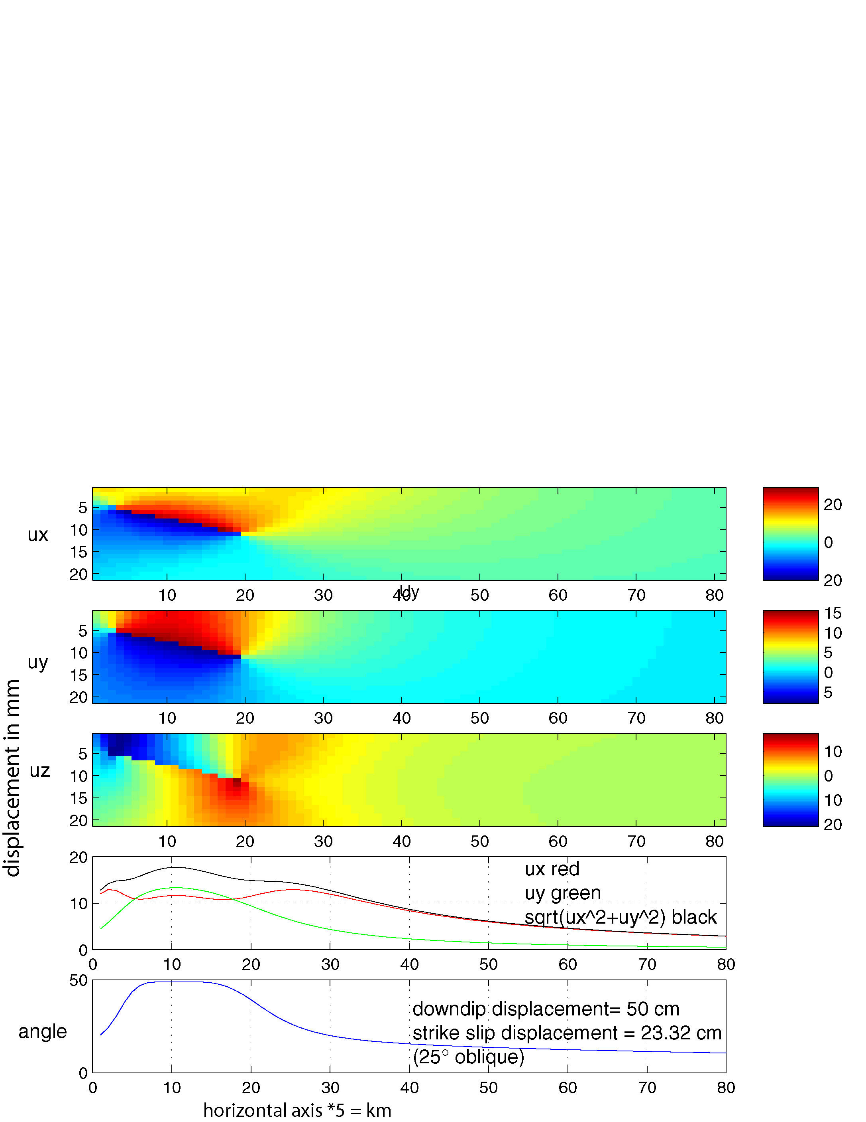
Elastic modeling – interseismic

Slide 64
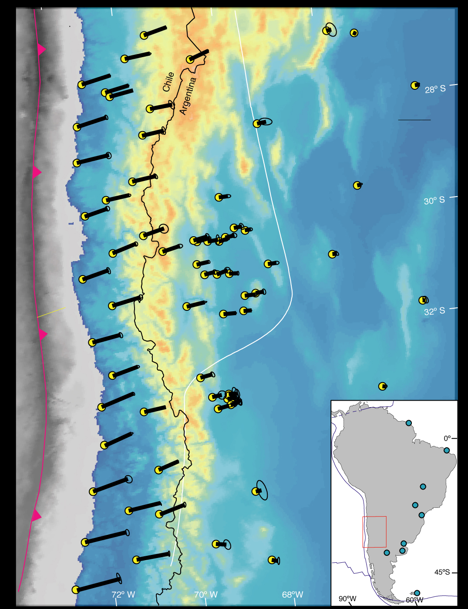
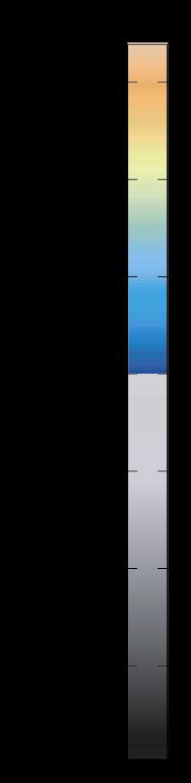
GPS velocity field, south central Andes
30 mm/yr
4000 m
-4000 m
From Brooks et al, 2003
Notes:
In the craton-fixed reference frame velocities are generally directed eastward – SHOW 30 mm’yr SCALE BAR
largest velocities (~35mm/yr) are nearest the plate boundary and they decrease eastwards towards the craton
Backarc velocity vectors tend to be rotated clockwise with respect to forearc vectors
Notably, the velocity field shows NO CHANGE IN CHARACTER ASSOCIATED with the changing dip of the subducted Nazca plate (Fig.1).
OK, now we want to analyze the data FIRST we’ll talk about modeling the earthquake cycle…

Slide 65
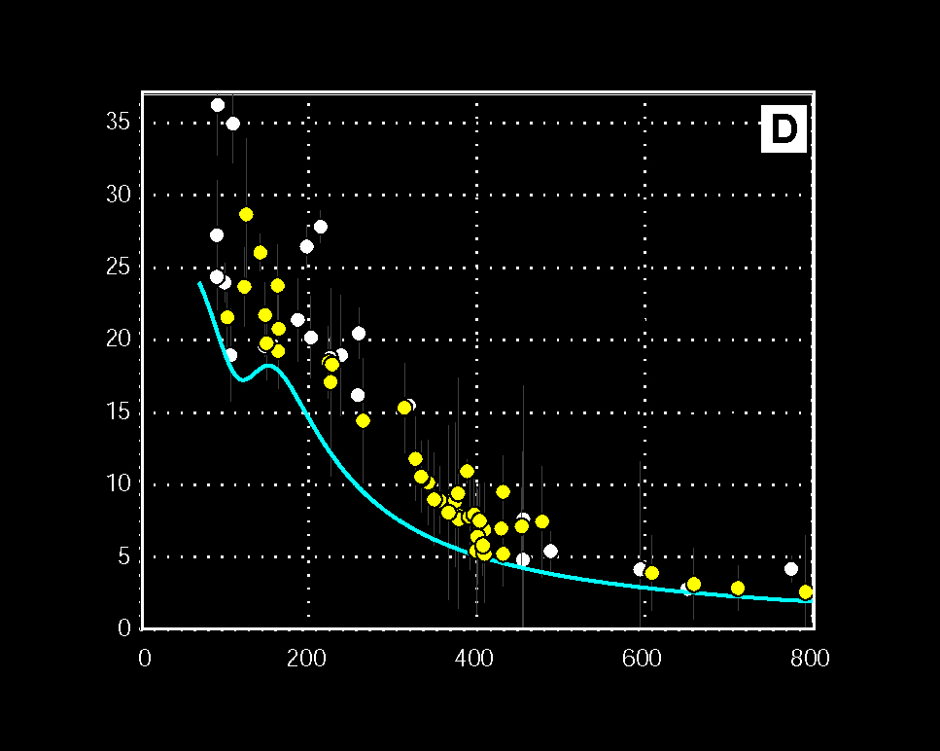
Horizontal velocity profile: back slip model (blue) vs data
100% locked
Sierras
Pampeanas
Precordillera
Vperp (mm/yr)
Distance from Trench (km)
From Brooks et al, 2003

Slide 66
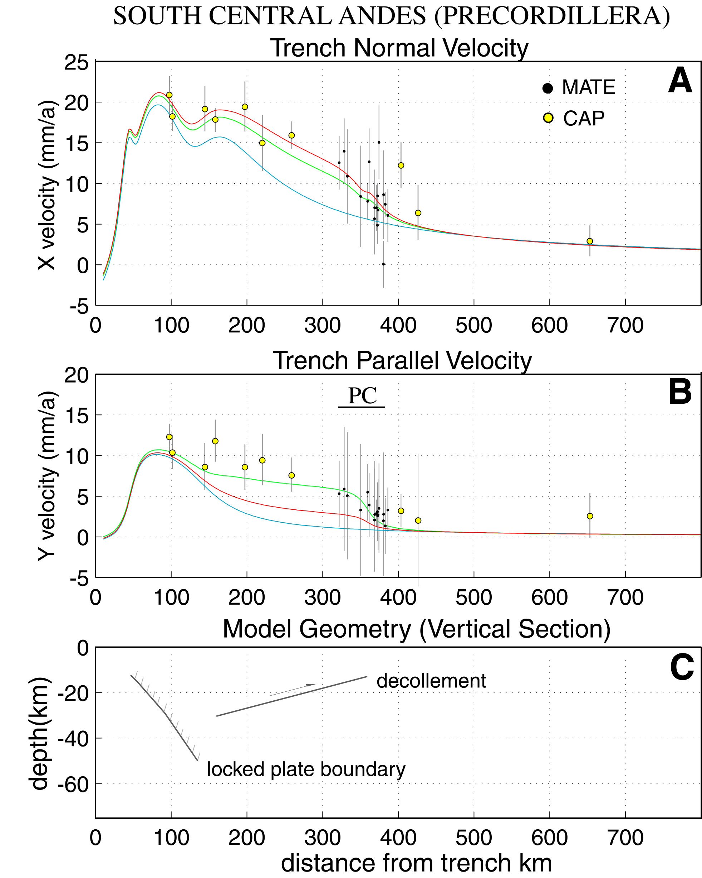
Cross section of horizontal velocity across south central Andes.
Strike is perpendicular to plate boundary.
From Brooks et al, 2003

Slide 67

Residual (data-100% locked model) velocity profile
V data-100%locked (mm/yr)
CONTINUUM
MICRO-PLATE
Distance from Trench (km)
From Brooks et al, 2003

Slide 68

Red line - pure Savage model, green line - model with Savage plus free slipping décollement in back arc.
Cross section of horizontal velocity across south central Andes.
Strike is perpendicular to plate boundary.
From Brooks et al, 2003

Slide 69

3-D, 3 “plate” model
U_{total} = U_{elastic} + U_{plate}
Inversion for 4 parameters:
L
AS_{lat}
AS_{lon}
AS_{w}
(n.b. L is a free parameter doesn’t have to be 100%)
From Brooks et al, 2003
Notes:
So we introuduce an ‘Andean’ plate to traditional Nazca-South America kinematics:
Nazca-South America motion is DECOMPOSED into Nazca-Andes and Andes-South America components (we know NS from Eric’s paper on the Euler vector) so we can invert for AS

Slide 70

Modeled vs measured velocity field
L = 1
AS velocity ~ 4.5 mm/yr
ω_{AS} in Canada
4000 m
-4000 m
From Brooks et al, 2003
Notes:
GEOMTERY of the locked portion of the subduction zone in the white triangles and known from earthquake seismology
In PINK are the boudnaries of the postulated Andes plate
Now in RED is the BEST MODEL which has an rms misfit of only 1.7mm/yr – that’s pretty close to the limit of our observational powers with GPS over such a large network
ALSO:
1) The model nicely captures the clockwise ROATION in the field which is due to obliqe slip at the plate boundary
2) MISFIT IN NORTH AND SOUTH DUE TO Eqs or presence of active arc?
OTHER THAN THAT, AT THIS SCALE IT’S DIFFICULT TO TALK ABOUT MISFIT
- WHAT WE’ve done is pose a 3-plate test and the Andes seem to pass that test

Slide 71

Horizontal, plate normal, velocity profile
3-plate
3-plate corrected
100% elastic
Vperp (mm/yr)
Distance from Trench (km)
From Brooks et al, 2003
Notes:
HERE’S ANOTHER VIEW OF THIS WITH the velocity profile and you can see that the 3 plate model break down at the boundary – not a surprise
The correction does pretty well

Slide 72

Comparative velocity profiles
ANDES
TIBET*
S.A. (par.) **
S.A. (perp.)**
(* Wang et. al, 2001; ** Bennett et. Al, 1999)
Notes:
Something fundamentally different between these regions: perhaps 3 different evolutionary stages of an orogen?

Slide 73
Simple visco-elastic modeling of subduction process
Permanent deformation (Mountains/Andes)
Mod from Hindle et al
Notes:
spring block damper

Slide 74




Andean Crustal Deformation – Short Term
(after Scholz, 1990)
entire boundary: M ≥ 8 earthquake somewhere every ~10 years
each segment: M ≥ 8 earthquake every ~100 years

Slide 75

Boundary conditions for Andean orogeny.
Contractional
wedge
Sierras
Pampeanas
?
?

Slide 76


Slide 77

Simple visco-elastic modeling of subduction plus Andes block
spring block damper backarc
Permanent deformation (Andes + foreland deformation)
Notes:
Spring block damper backacr.wmf to get transparent background but messed up text. jpg, tif or pdf for solid white local background

Slide 78

CSLO
CFAG
MZAE
MZAS
CONZ

Slide 79

One second GPS displacement seismogram
Simon Banville and Richard Langley, U. New Brunswick

Slide 80

One second GPS displacement seismogram
Davis and Smalley

Slide 81

One second GPS displacement seismogram
Davis and Smalley

Slide 82

One second GPS displacement seismogram
Davis and Smalley

Slide 83

One second GPS displacement seismogram
Davis and Smalley

