Slide 1
Shear stress needed to
produce frictional slip
at small crustal depths
and steady state creep
at greater depths
Meissner and Strehlau 1982

Slide 5
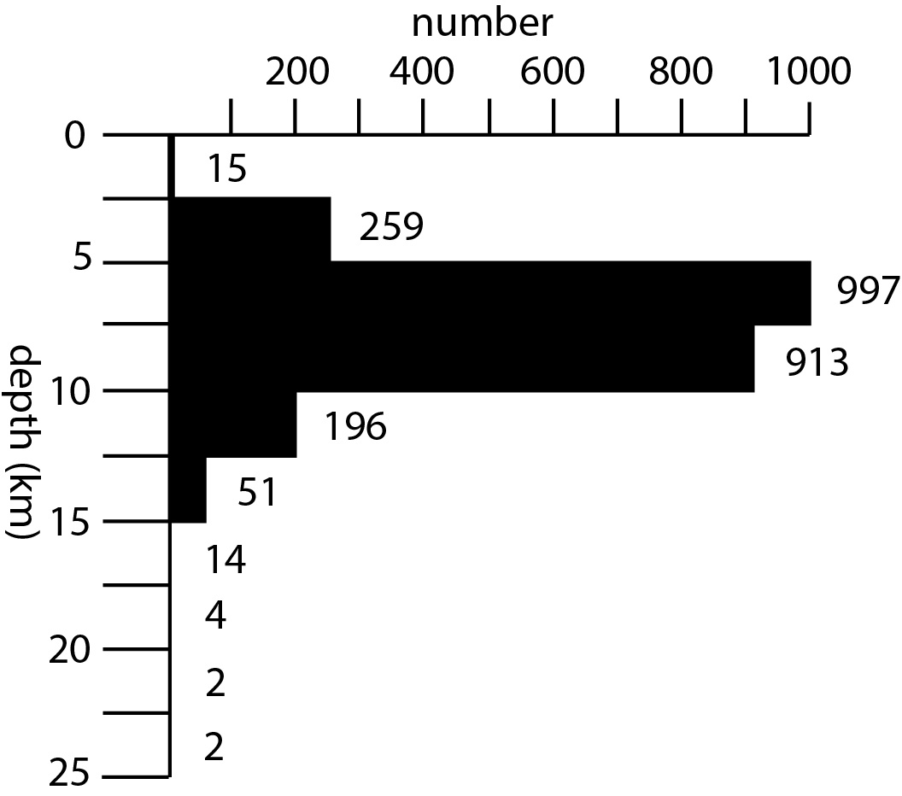
Charlevoix seismic zone
Eastern Tennessee
seismic zone
New Madrid seismic zone

