Slide 1
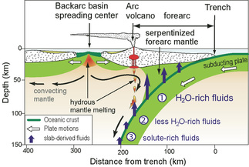

Slide 2
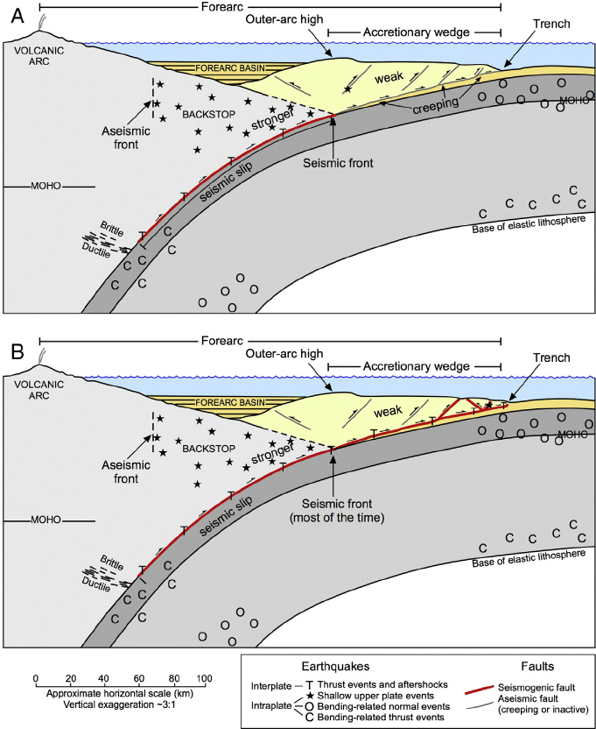

Slide 3
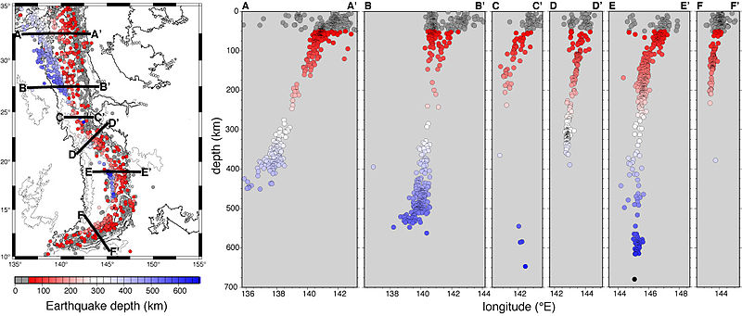

Slide 5
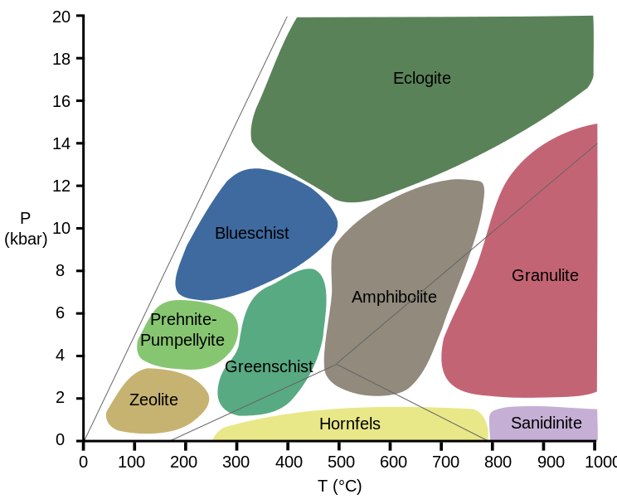

Slide 6
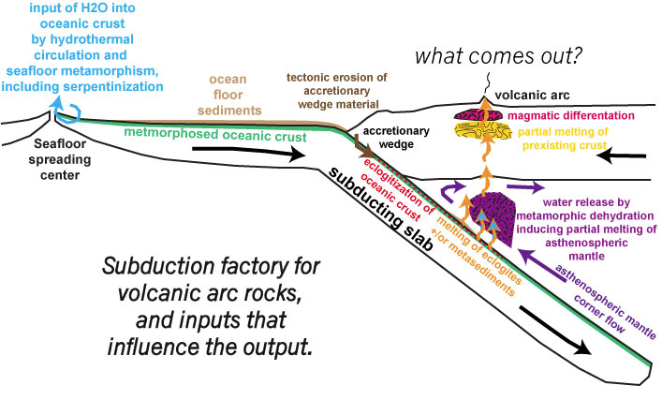

Slide 7
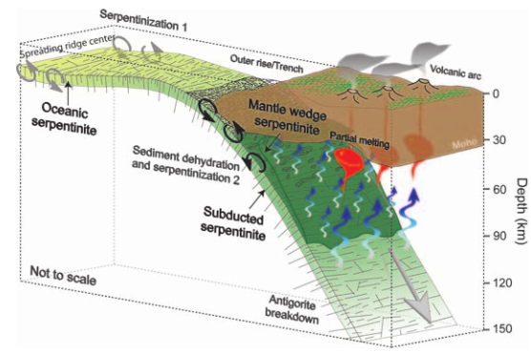

Slide 8
Notes:
Figure 3. Location map of the Philippine Sea region. The Izu-Bonin-Mariana (IBM) arc-trench system forms the convergent margin between Pacific and Philippine Sea plates. Backarc basins such as Shikoku Basin, Parece Vela Basin, and Mariana Trough were created by seafloor spreading between the formerly contiguous
remnant arc (Kyushu-Palau and West Mariana ridges) and the active IBM arc. At its northern tip, the IBM arc has collided with Honshu Island since 15 Ma. The X-X’ red line locates the structural model cross section

Slide 9
Notes:
Figure 4. (a) Seismic structure of the crust and upper mantle based on seismic refraction and wide-angle reflection data along a X-X’ cross-arc section within the IBM system (Figure 3). The arc crust seismic structure is explained by the distribution of upper, middle, and lower crustal layers as schematically shown in (b). IBM is the only juvenile intra-oceanic arc known to have a well-developed, low-velocity middle crust with Vp=6.0-6.3 km/s, possibly of similar composition to the average continental crust and provides key constraints on the process of continental crust formation. Numbers in (b) show schematic representation of proposed drill sites.

Slide 11
Section P15
Through Hokkaido

Slide 12
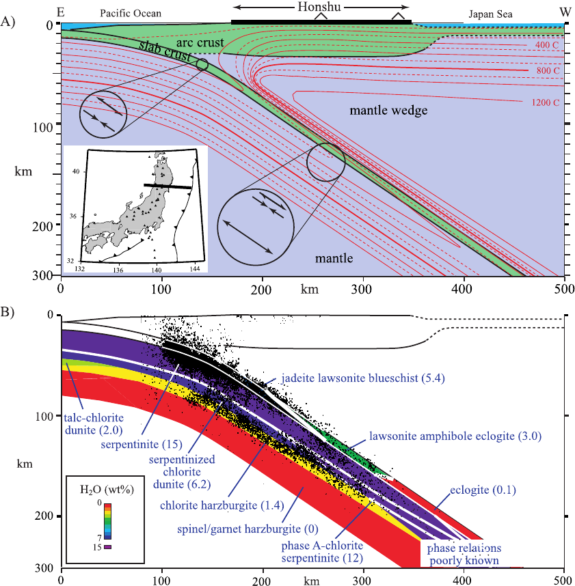

Slide 13
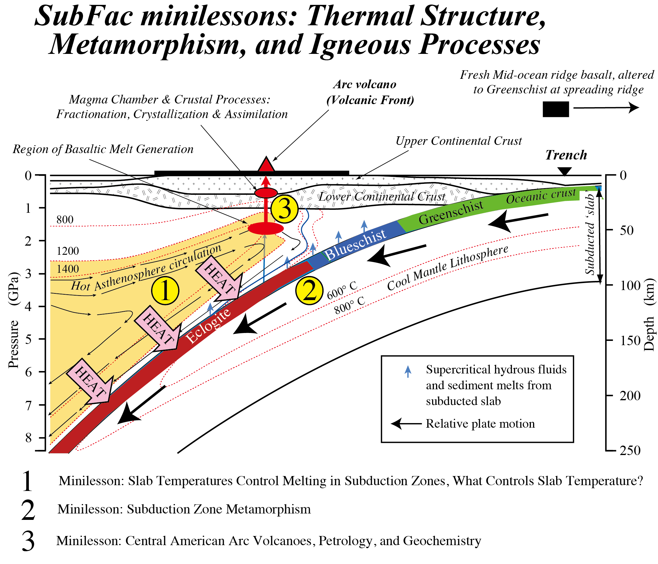

Slide 14
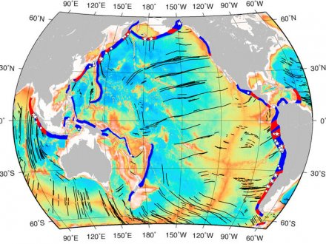
Large earthquakes more likely to occur at the intersections of fracture zones (black
lines) and subduction zones. These are the red areas on the map. Muller and
Landgrebe, 2012.

