Slide 1
Seismotectonics
CERI 7280/8280
Class 2
Aug 25, 2016

Slide 3
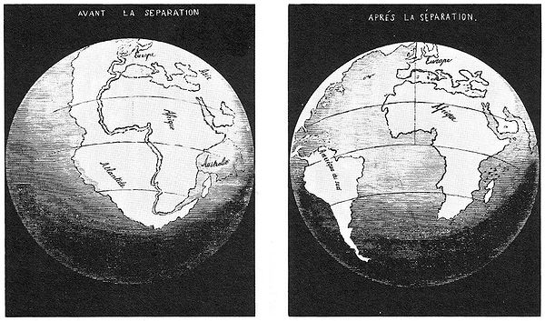
Notes:
Francis Bacon (1561-1620) generally considered first person to note the jig-saw puzzle fit of east coast of S. America into west coast of Africa.
First known figure showing them put together in the jig-saw puzzle fit - 1858 Snider-Pellegrini
La Création et ses mystères dévoilés ("The Creation and its Mysteries Unveiled")

Slide 4
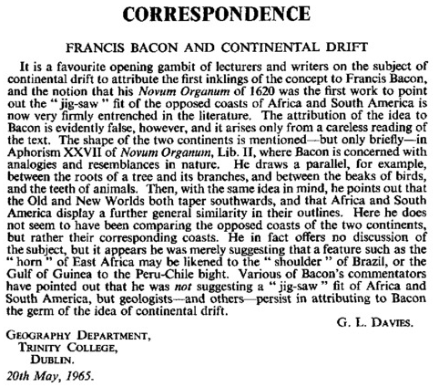
Notes:
http://journals.cambridge.org/action/displayAbstract?fromPage=online&aid=4617868
Unfortunately like many legends – the prescience of Bacon is undeserved
(the fact of knowing something before it takes place; foreknowledge.)

Slide 5
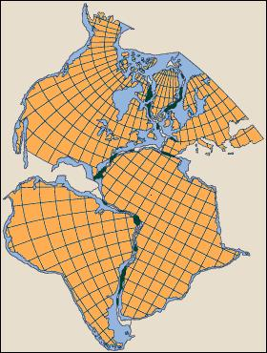
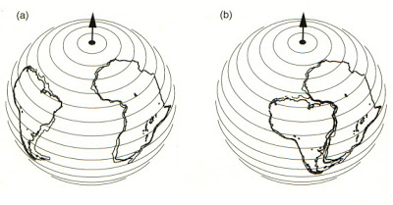
Bullard fit, 1965
Notes:
Idea resurrected by Wegner 1912, was luke-warmly accepted as hypothesis to be tested in Europe and vehemently rejected in the US.
Part of problem was no mechanism (although looking back the geological explanation of the time – the large number of geosyncline types was not a mechanism either).
Radioactive heat driven convection and sea floor spreading was proposed as a mechanism by Holmes in the same time frame as Wegner who also proposed the earth was much older than Kelvins 1-200 my from a purely cooling model. Was ahead of the data.

Slide 6
Now my own suspicion is that the Universe is not only queerer than we suppose, but queerer than we can suppose.
Usually attributed to Haldane, 1927, could also have been Eddington, or anonymous.
Notes:
This not first or only case where observations – usually driven by new knowledge/technology (development of ships, geology, evolution, …) – clashed with general view of how the world works. It was known for instance that the sun was not a chemical reaction (size, mass – density, vs energy output could not be explained before the discovery of radioactivity) – but this did not cause people to reject the existence of the sun!
This is the problem with pure deductive science (the famed scientific method of hypothesis testing) – new technologies come along that produce observations that are queerer that we can imagine. This is where inductive science (oftentimes derided as a “fishing expedition”) comes to the fore.

Slide 7
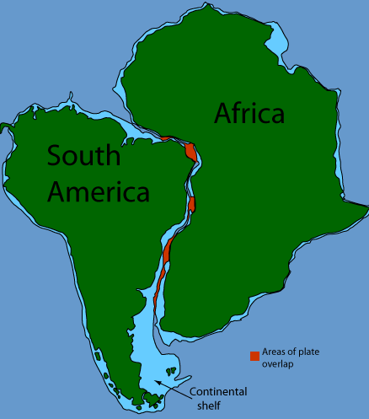
Notes:
Lutgens and Tarbuck Ch 16
Match up continental shelves, not coastlines.
We now understand that there was some extensional deformation and pieces moving around – Falkland plateau.

Slide 8
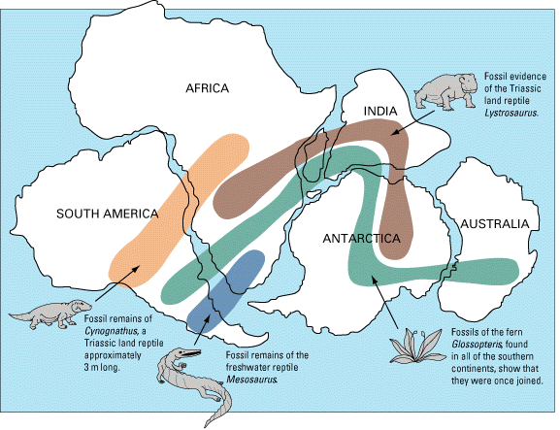
Notes:
USGS publication The Dynamic Earth http://pubs.usgs.gov/gip/dynamic/dynamic.html
Other evidence besides geometry
Snider-Pellegrini – same ref as map –
proposed that all of the continents were once connected together during the Pennsylvanian period. He based this theory on the fact that he had found plant fossils in both Europe and the United States that were identical. He found matching fossils on all of the continents.

Slide 9
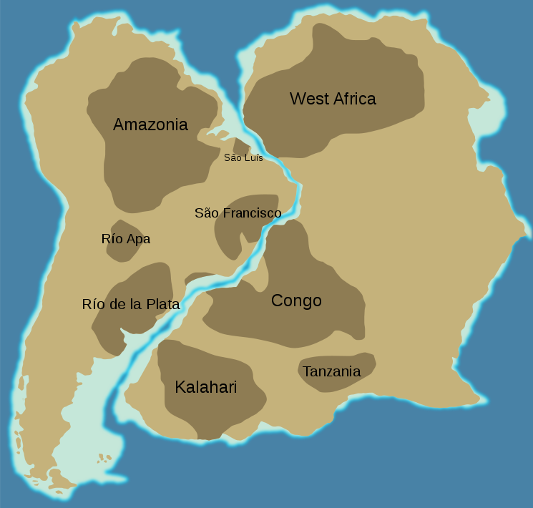
Notes:
Woudloper,
https://commons.wikimedia.org/wiki/File:Cratons_West_Gondwana.svg
Approximate location of Mesoproterozoic (older than 1.3 Ga) cratons in South America and Africa. These current two continents have been rotated back to their approximate positions during the Triassic period, to show which cratons were joined before the opening of the southern Atlantic Ocean.
Wegner 1st w/ Geology?

Slide 10
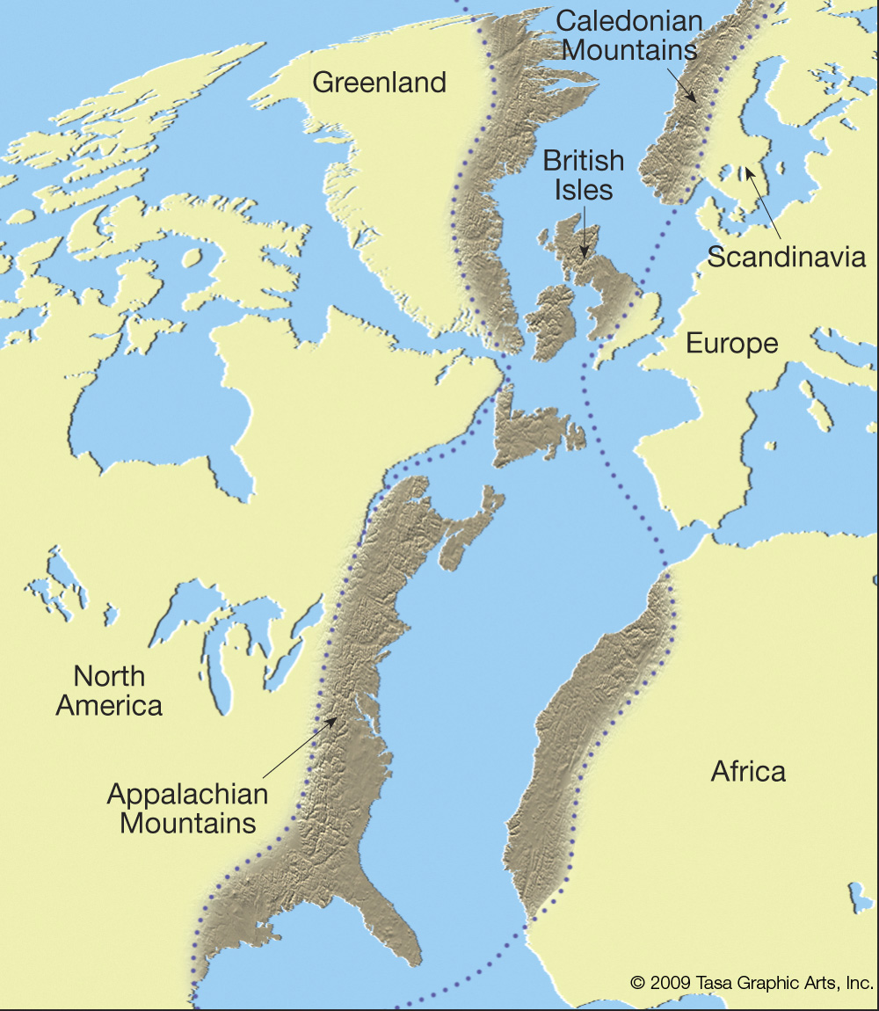
Notes:
On the last slide we saw a geological association based on matching up rock types across S. Atlantic.
Another geological association – matching mountain belts on either side of the N. Atlantic. The Applachians continue into Greenland and Caledonian mountains. Here it is age of deformation and structure that correlates.
As Ian Dalziel says – mountain ranges don’t just end – what runs off the edge of the continent in N America meets its original continuous other side.

Slide 11
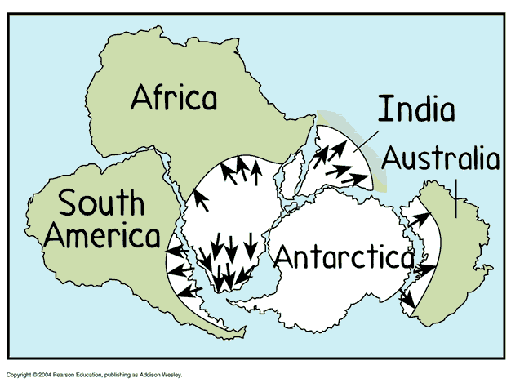
Notes:
Climatological - evidence of glaciation(existence, age, ice flow directions match up) around southern “pointy ends” of southern hemisphere continents.
As an aside here – notice the relative locations of South America and Antarctica – the ancestral Andes ran along the west side of South America into the Antarctic Peninsula. The southern end of South America was subsequently deformed into the current curve to the east, but the Antarctic Peninsula was “always” in that its current shape.

Slide 12
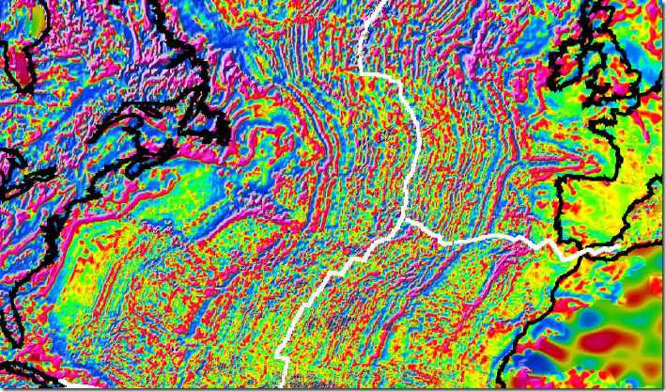
Notes:
http://freegeographytools.com/2007/world-digital-magnetic-anomaly-map-wdmam-released
The military industrial complex to the rescue. Technology developed to find submarines used to map out strange magnetic signal on the ocean floor. This shows the magnetic anomaly pattern in the ocean floor of the North Atlantic.
Contrast the pattern in the ocean to the one on land (Look at N. America – there are patterns, but they are not yet understood. Africa and Europe are “out of focus” due to less dense data coverage).

Slide 13
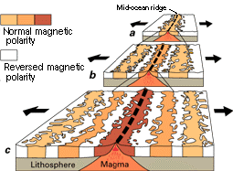
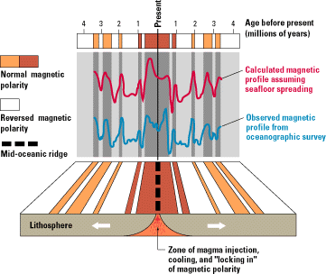
Notes:
W.J. Kious and R.I. Tilling, This Dynamic Earth: The Story of Plate Tectonics, U.S. Geological Survey, 1996. (on-line edition available.)
The oceanic signal is explained as a recording of the earths magnetic field – which is inferred to randomly switch directions (swap N and S) - at the time the ocean floor was formed at a mid ocean ridge and it retains this “remnant” magnetism as it moves away from the ridge.
This change in magnetic field direction is also observed in volcanoes on land (although during a much shorter time period).
By dating the fossils on the sea floor – it is observed that the fossils at the base of the sediments get systematically older as one goes away from the ridge. This allows one to date the magnetic anomalies. One can correlate the anomaly pattern/history among all the oceans, reinforcing the model.
The oceans also get deeper as one goes away from the mid ocean ridge, and the depth for ocean lithosphere out to about 80 my can be explained by a half-space cooling model – the lithosphere is a a thermal boundary layer.
The oldest ocean lithosphere (that is not scraped up onto a continent as an ophiolite) is about 280 My as it gets subducted.

Slide 14
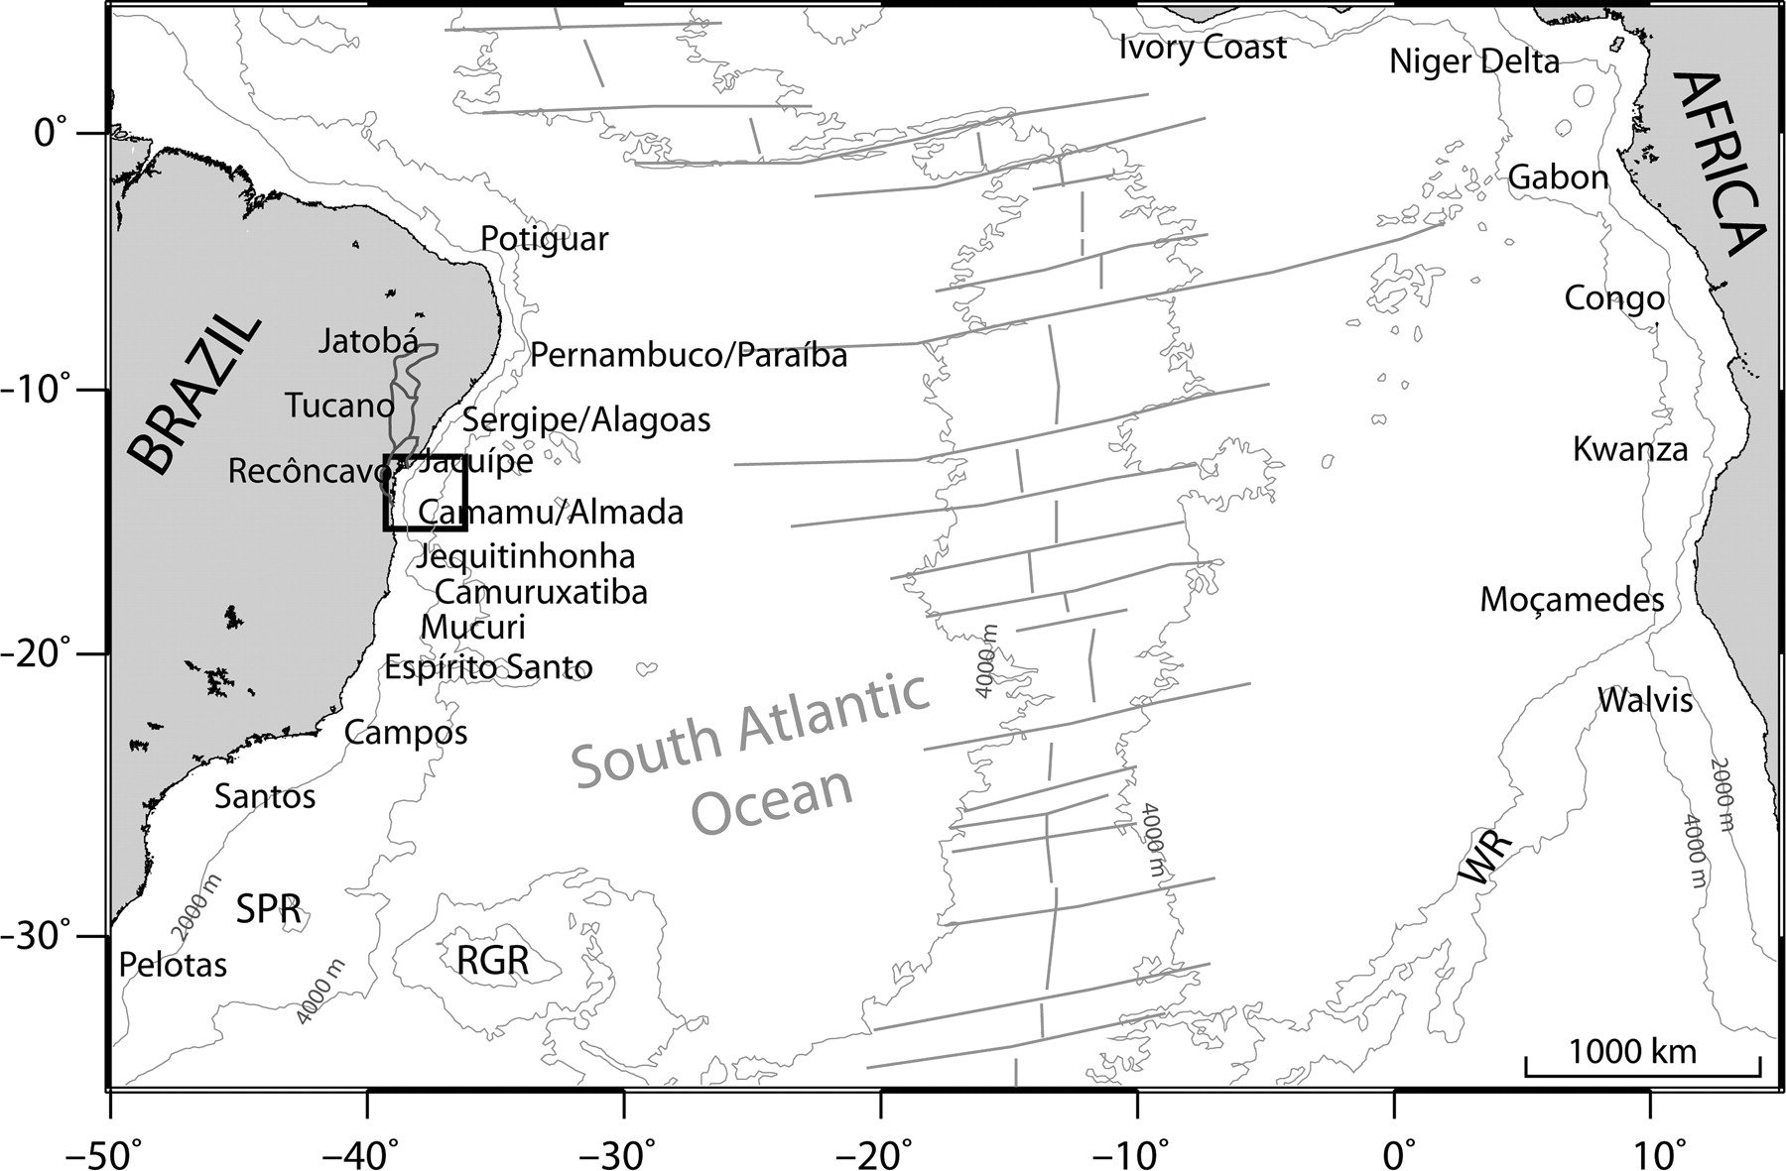
Notes:
Source unknown - From lyell collection – can’t get any additional information without paying
In addition to the mid ocean ridges and magnetic anomalies, sea floor spreading has another set of features – transform faults and fracture zones. There features connect parts of the mid ocean ridge along its length.

Slide 15
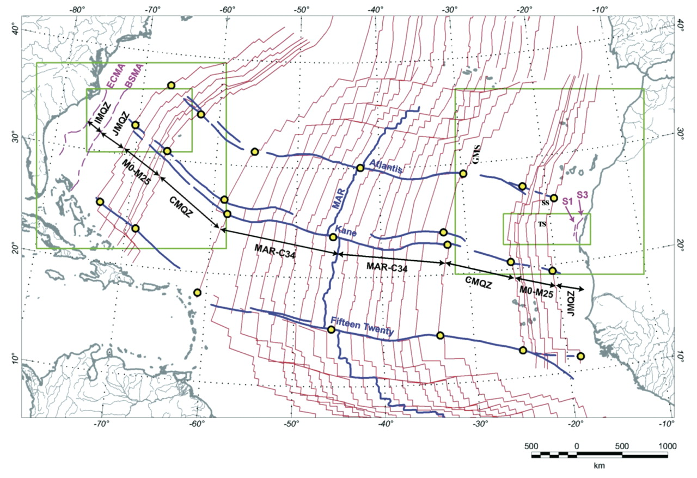
Notes:
Source unknown - This item requires a subscription to Geosphere
The magnetic anomalies, and age contours, are offset across the fracture zones, which can completely cross the ocean.

Slide 16
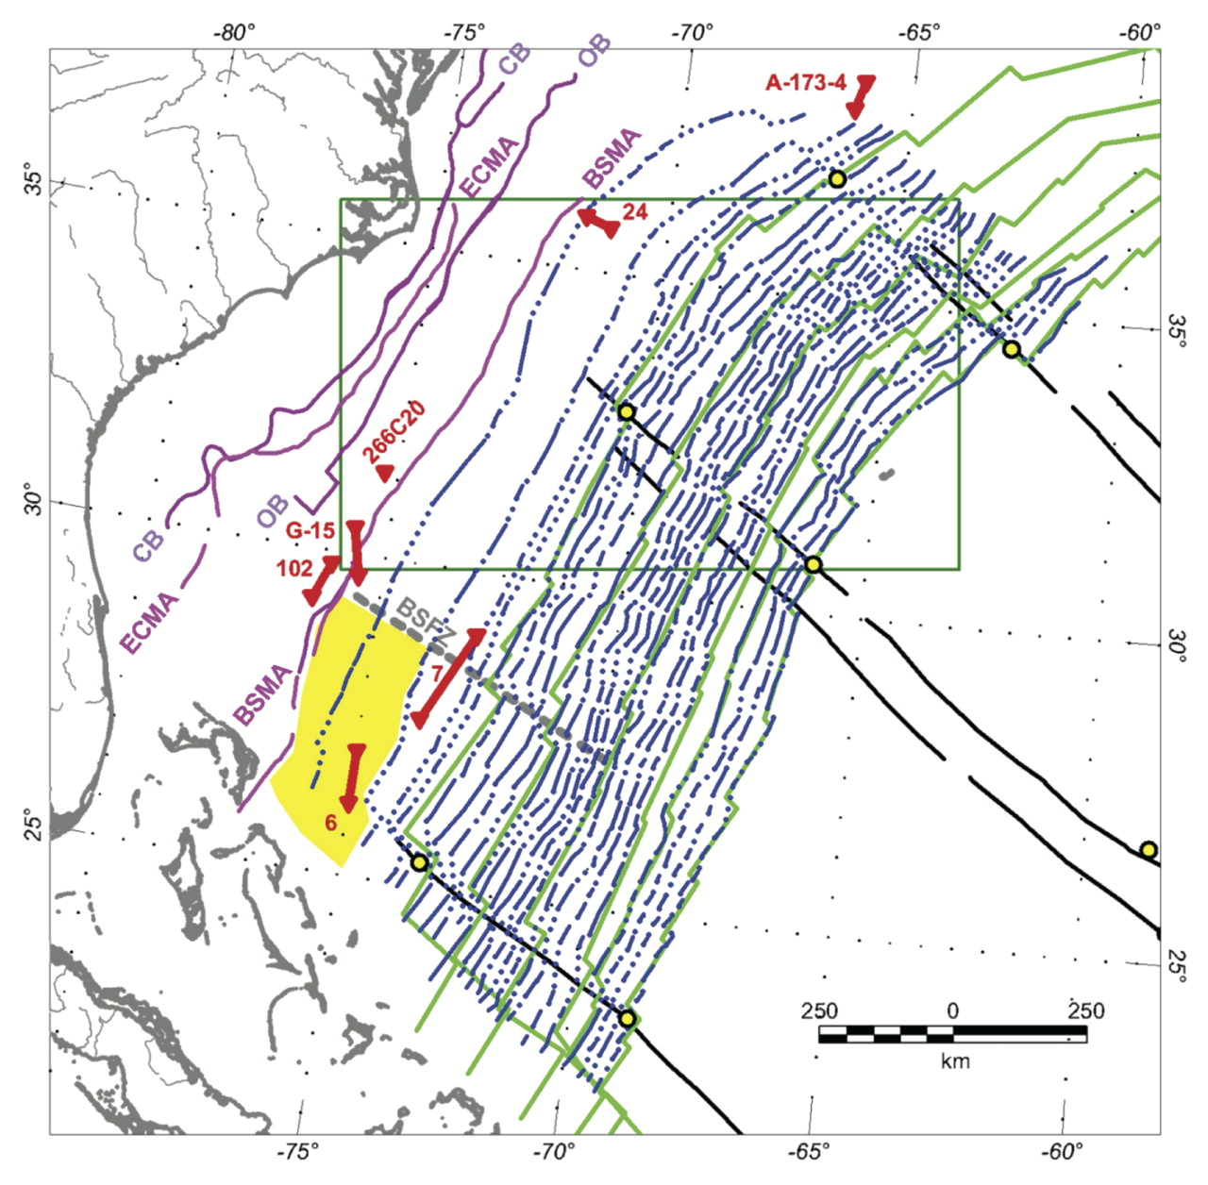
Notes:
Source unknown - This item requires a subscription to Geosphere
Magnetic anomalies along east coast of US. Some of these may be related to the less well organized rift volcanism in the early stages of the breakup.
So now we have a “breadcrumb” trail of the kinematics of the movement of the continents across the Atlantic (helped that there was a nice opening ocean and earth was not mostly like Pacific which is more complicated) and some ideas for the dynamics.

Slide 17
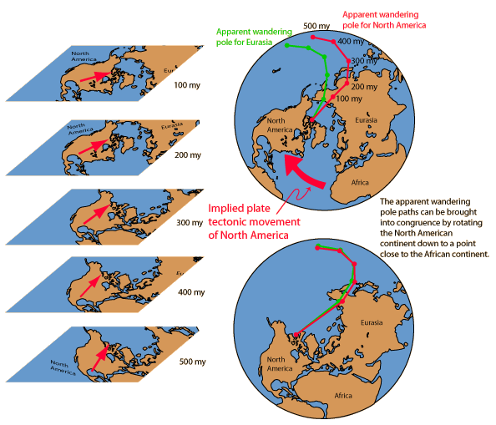
Notes:
Original source unknown, got from
http://hyperphysics.phy-astr.gsu.edu/hbase/geophys/platevid.html
Finally another clue - apparent polar wander

Slide 18
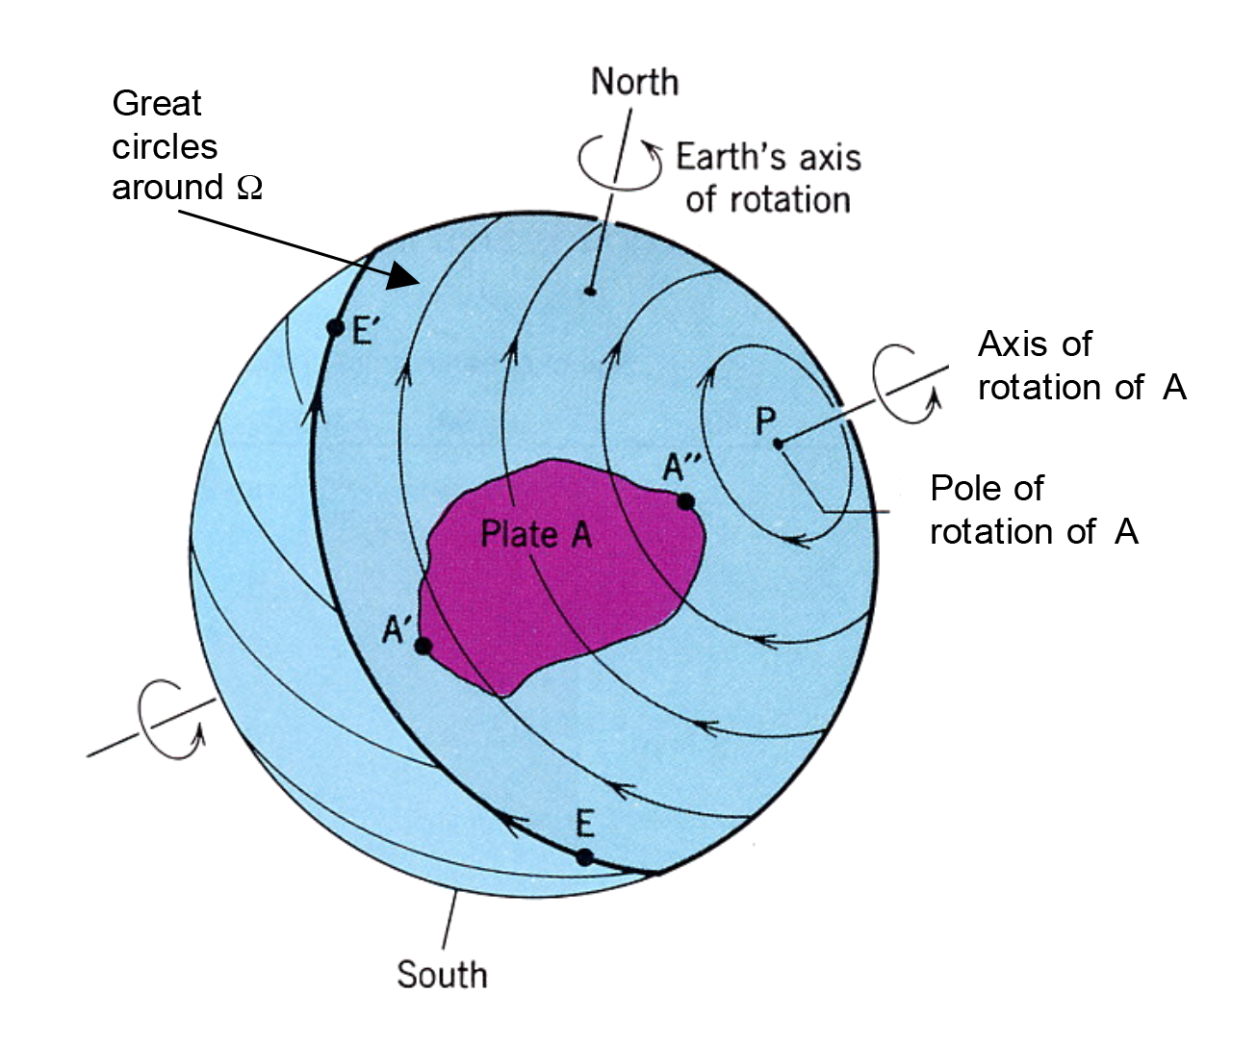
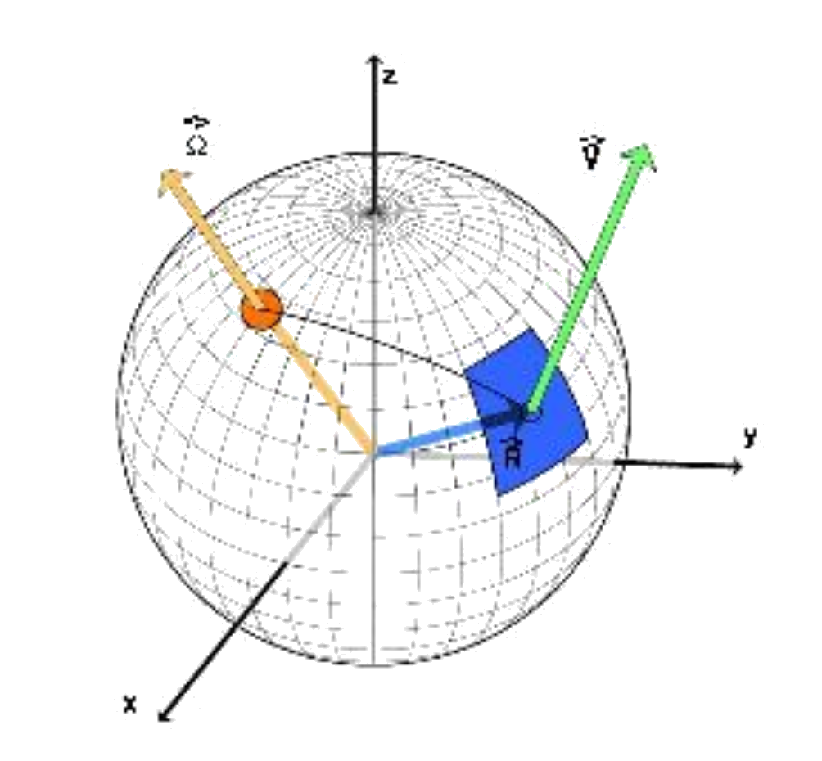
Notes:
The theorists now come on board with Euler’s theorem (actually one of many Eulers’s theorems).
All movements of rigid spherical caps/shells (why rigidity of plates helps ) on a sphere can be fully described as a rotation about an axis that passes through the center of the sphere. There is known as the Euler Pole of rotation. So we can now describe how (nondeforming) plates move.
Points on the spherical cap “Plate A” move on the streamlines drawn, which are also small circles of a coordinate system where the pole defines axis.
Notice that all the points on the plate do not move at the same velocity (vector, speed and direction)

Slide 19
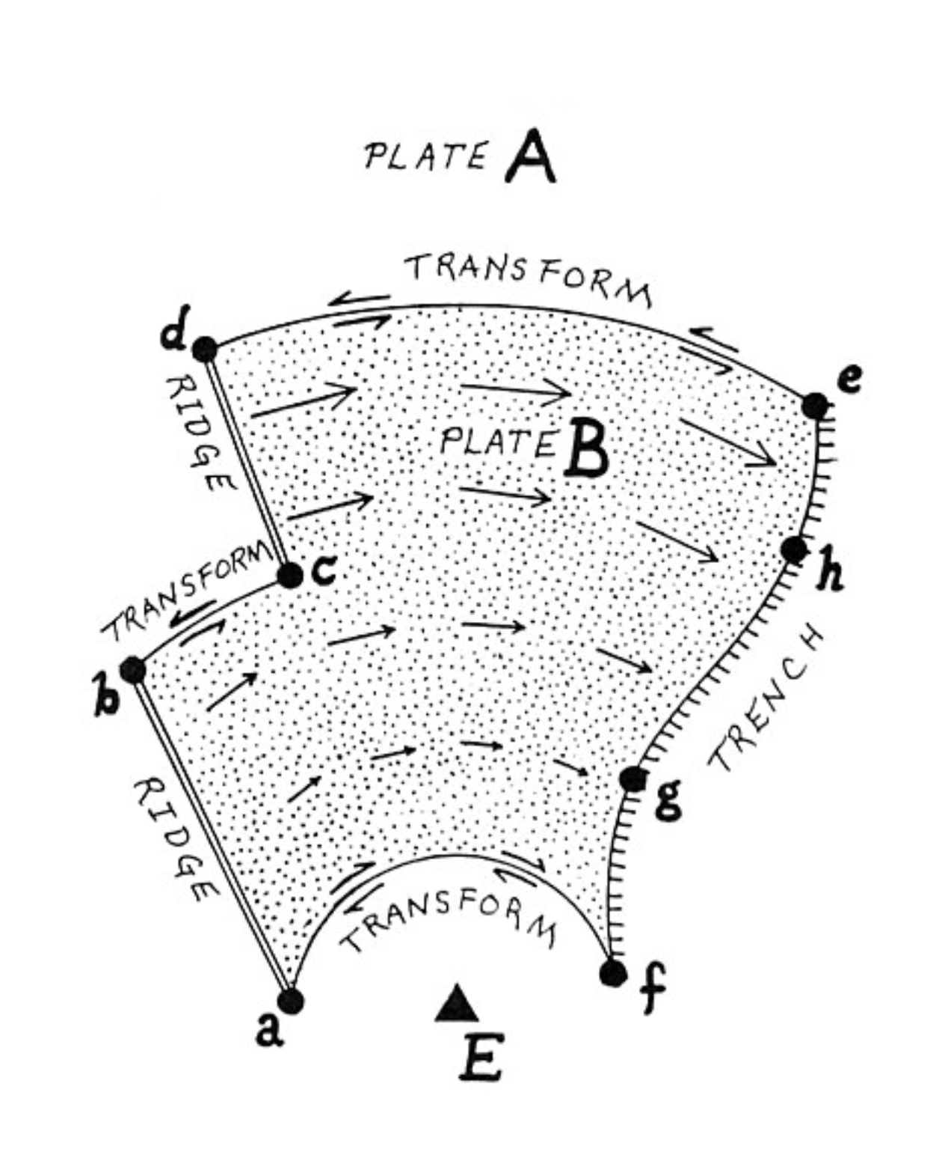
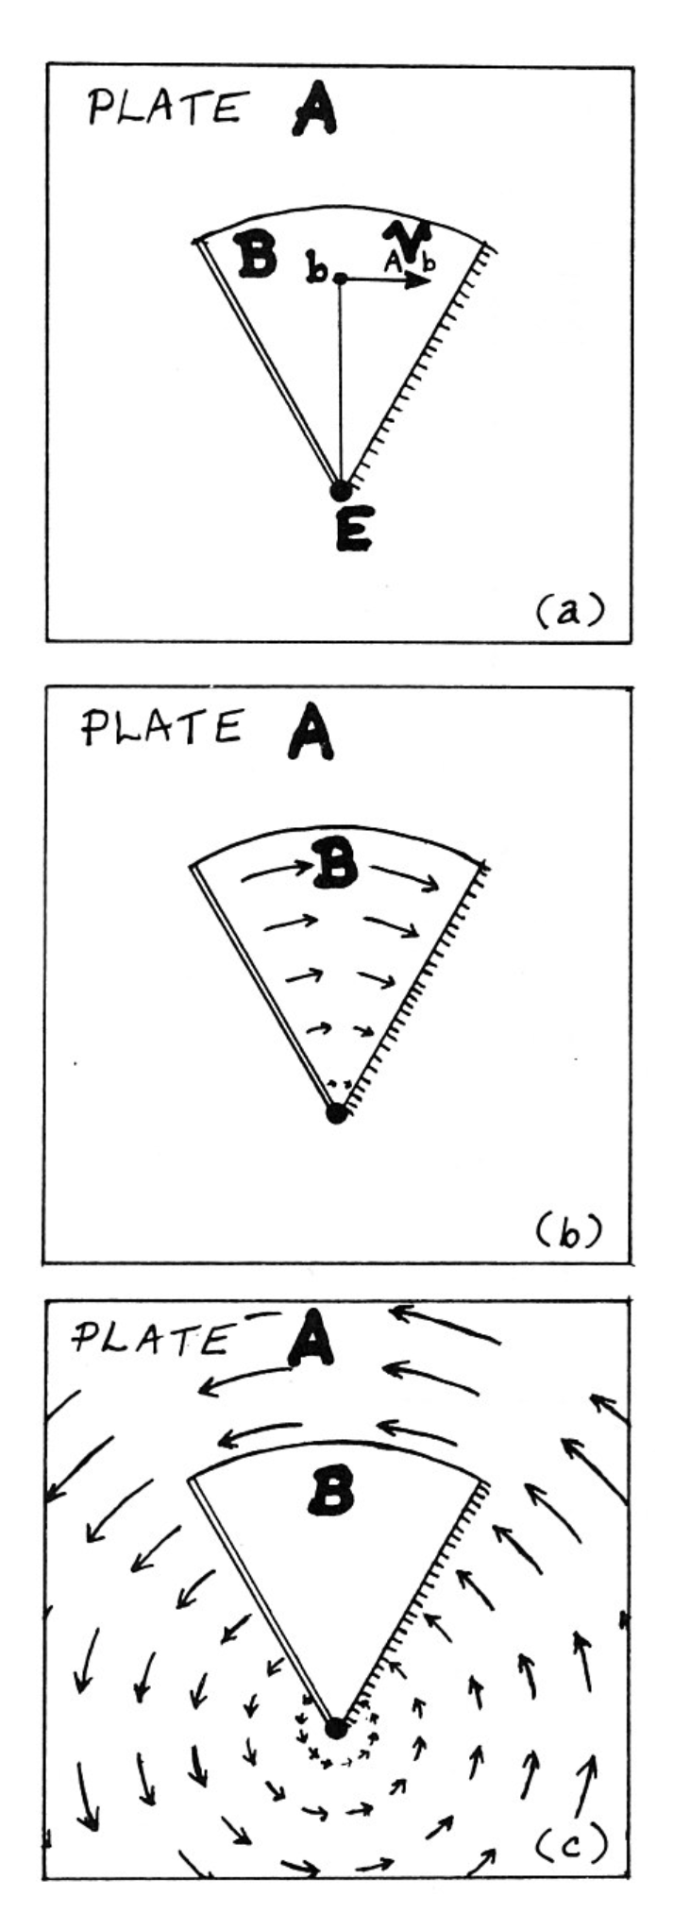
Notes:
So now we are going to look at what happens when you have more than one plate.
The important motions are relative – the motion of one plate with respect to the other. We are not considering absolute motions with respect to some other reference.
This is 2-D, but is still applicable.
Looking at the left - Plate A is background, Plate B is the pie shaped piece in the middle. It has a ridge on the left and a subduction zone on the right (so we don’t have to worry about changes in area of the two plates or evolution of the points of intersection).
The motion of plate B wrt plate A is shown in (b) by the arrows
Similarly the motion of A wrt B is shown by the arrows in (c).
The sense of motion across the actuate transform boundary at the top is left-lateral.
On the right we have the same thing with a bit more complicated geometry (the transforms don’t seem to be drawn correctly – done freehand, not with compass).
(there is a little bit of a problem here in that spreading is symmetric and plate A will also be growing across the spreading ridge)
Note the transform lengths (af, bc and de) are constant in time.

Slide 20
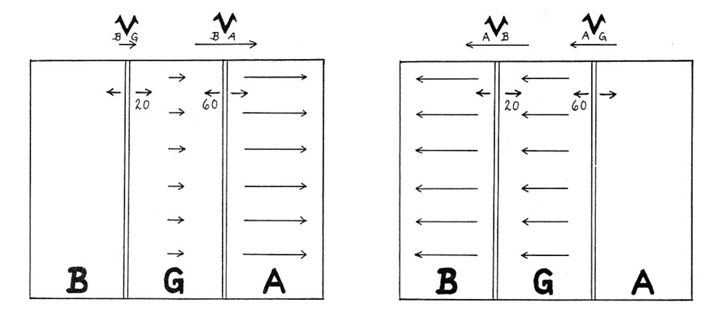
Notes:
Relative velocities across 3 plates – you can use any plate as a ref and do velocities between any pair.

Slide 21
Notes:
More on relative velocities, “reference” arbitrary.

Slide 22
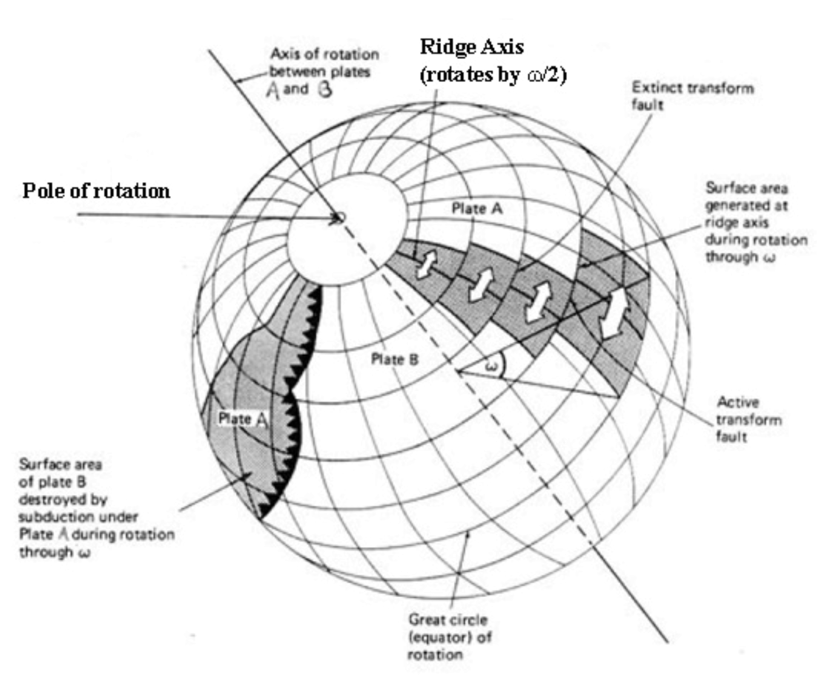
Notes:
Putting it on sphere
Velocity varies with distance from pole (spreading velocity also) – but no deformation.
Ridge axis on great circles, transform faults and fracture zones (old transform faults) on small circles.

Slide 23
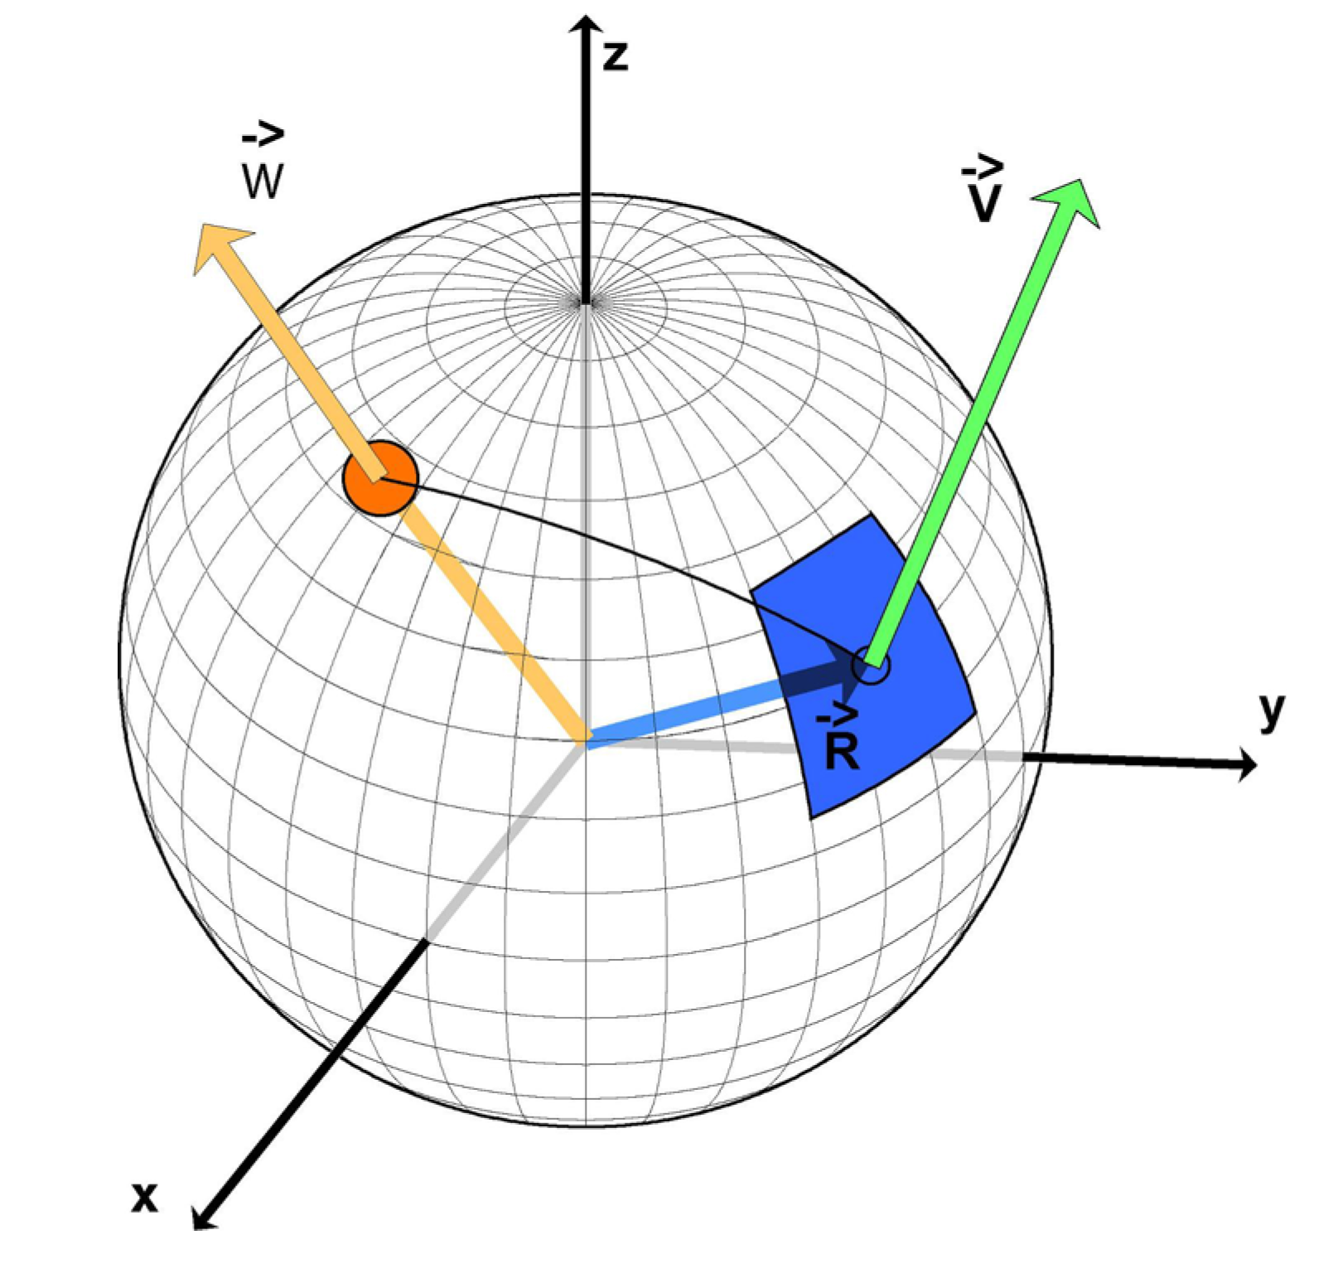
From Vigny, China GSoCAS Geodesy-Geodynamics 4, 2004
Notes:
Return to the picture to remind ourselves.
Orange dot is location of pole on surface of sphere
Blue square is our plate
V is the velocity vector – is tangent to surface of sphere (hard to draw well in 2-d)
Now from data – spreading velocities and transform azimuths – to poles
(actually velocities to poles is nice linear problem, azimuths is non-linear)

Slide 24
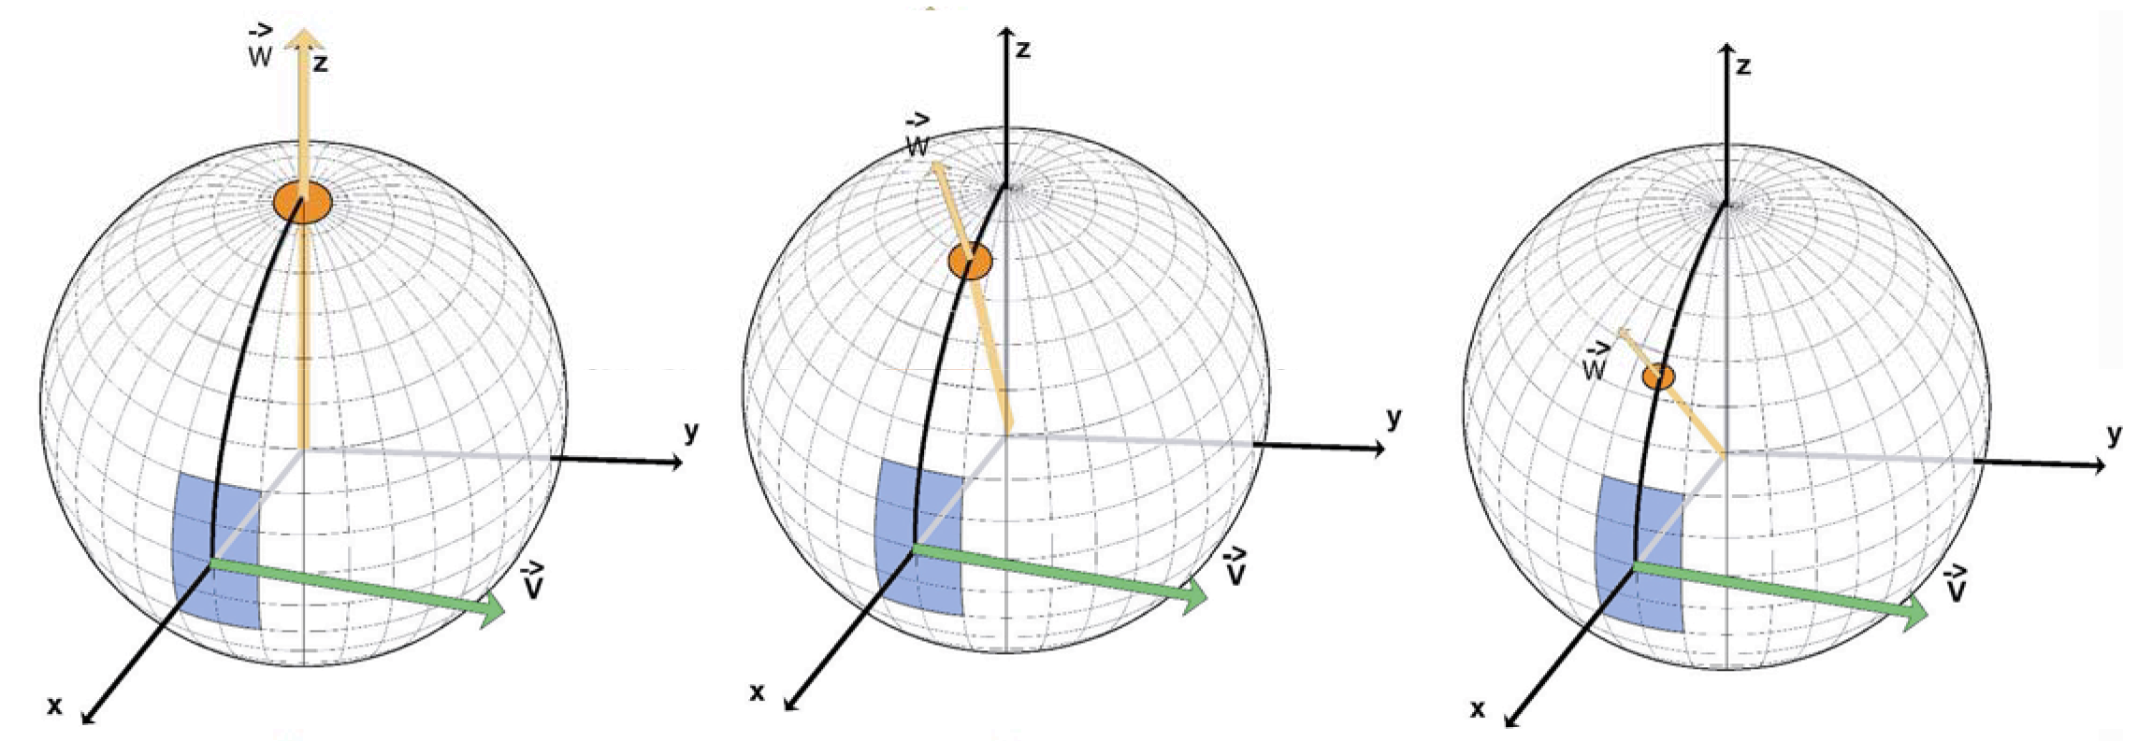
From Vigny, China GSoCAS Geodesy-Geodynamics 4, 2004
Notes:
With only one velocity – can get infinite number of poles. All in great circle perpendicular to V.

Slide 25
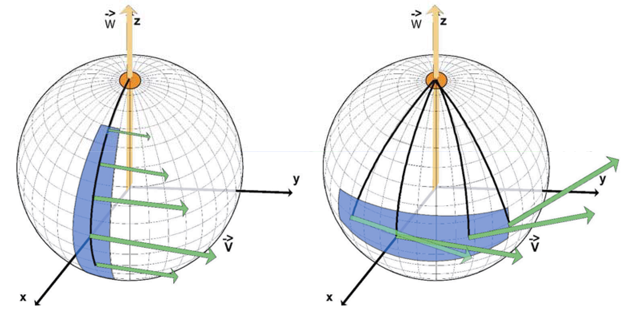
From Vigny, China GSoCAS Geodesy-Geodynamics 4, 2004
Notes:
Larger plates more well defined

Slide 26
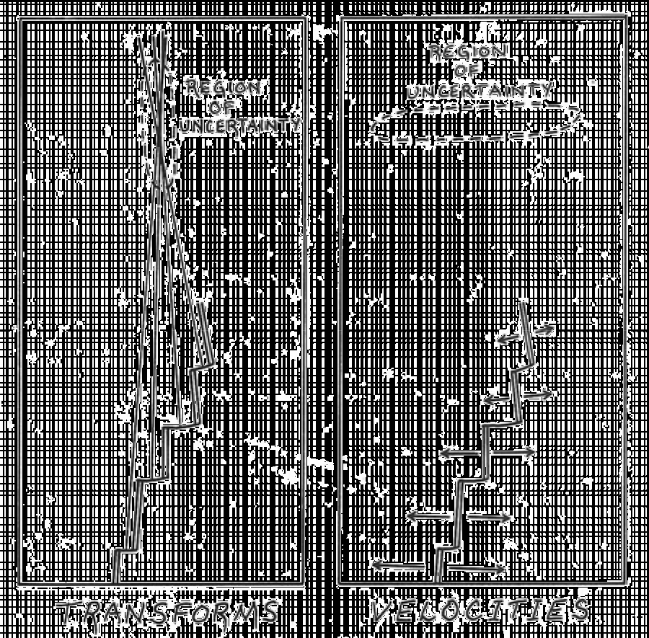
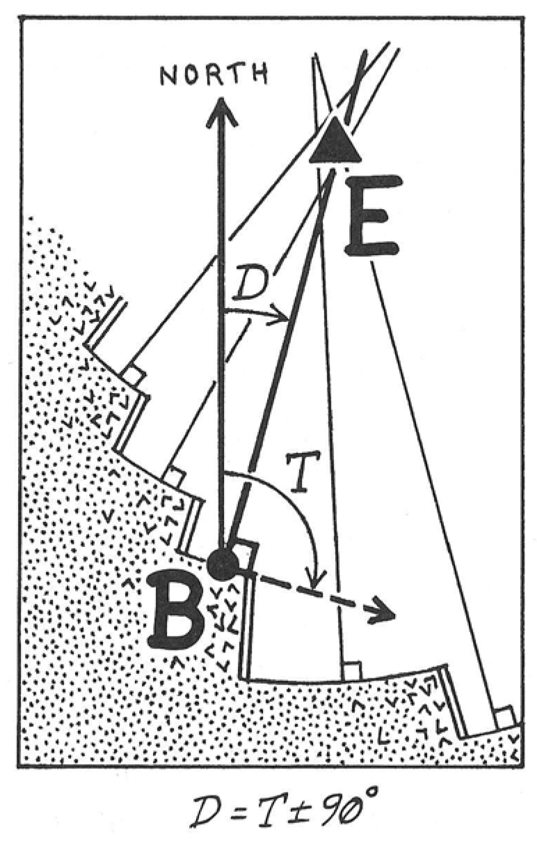
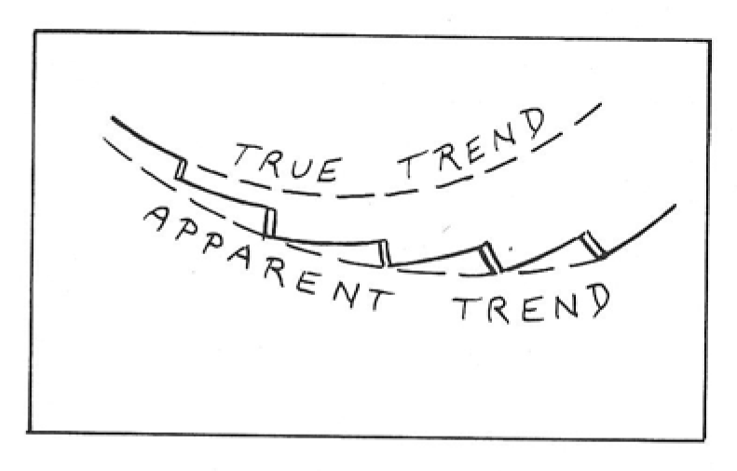
Notes:
Data – velocities and transforms (azimuths)
Top right shows how azimuths work – transforms are on arcs of concentric circles.
Have to be careful with measuring trend – see why longer is better.

Slide 27
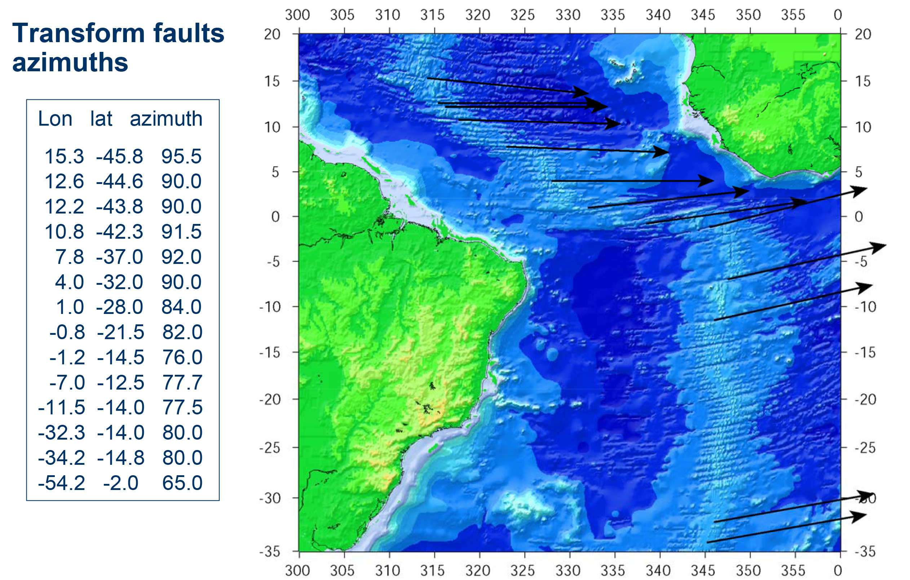
From Vigny, China GSoCAS Geodesy-Geodynamics 4, 2004
Notes:
Real modern data!

Slide 28
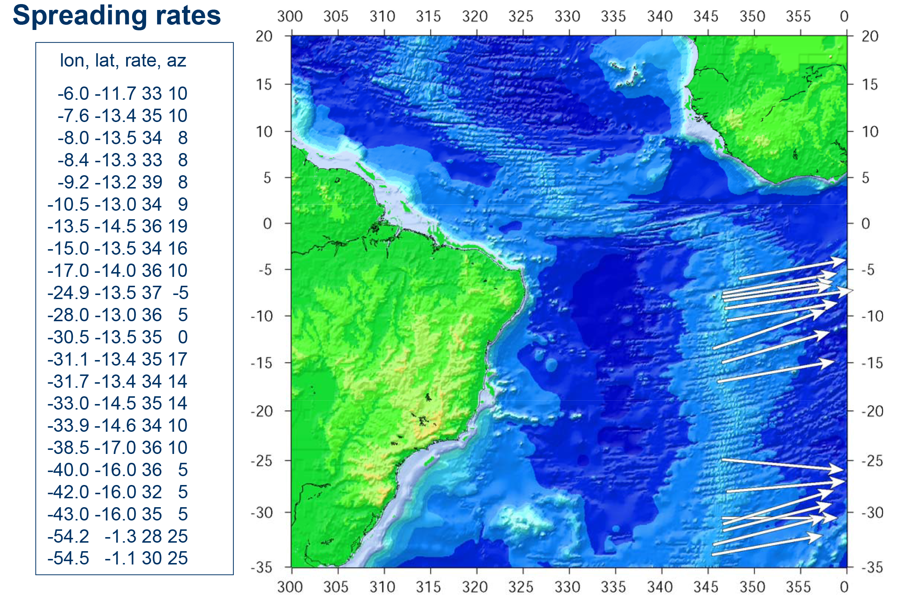
From Vigny, China GSoCAS Geodesy-Geodynamics 4, 2004

Slide 29
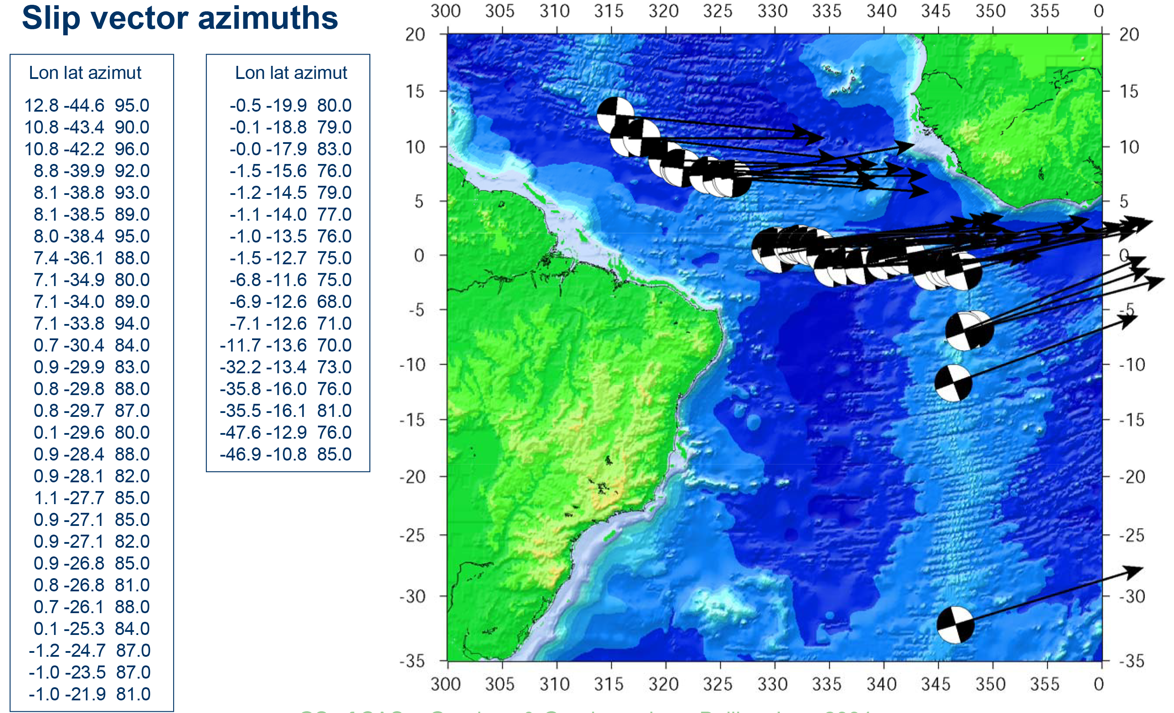
From Vigny, China GSoCAS Geodesy-Geodynamics 4, 2004

Slide 30
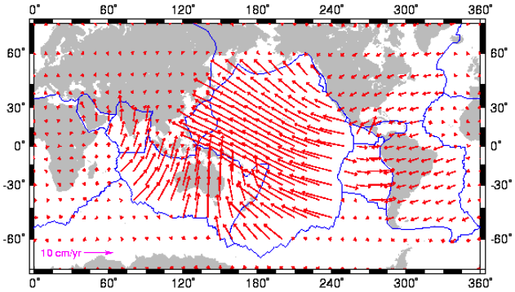
Notes:
http://www.ucl.ac.uk/EarthSci/people/lidunka/GEOL2014/Geophysics1-%20Plate%20tectonics/PLATE%20TECTONICS.htm
When done ---
From data to plate motions
Spreading velocities (velocity is vector – speed and direction)
Transform strike
Earthquake slip vectors
Satellite based geodesy velocities
Ref frame
NUVEL (1 and 1a) geology based – no reference frame – all based on relative velocities between plates. Can’t ask where is pole (vector – magnitude gives velocity) for plate X, can only ask where is pole for relative velocity between plates X and Y.
For ridges/transforms neither side is “reference” (i.e. fixed). For earthquake slip vectors in subduction the same.
Can show with respect to some reference frame – such as hotspots, or stars – but may not be meaningful (if reference frame is not stable).
Oftentimes apply no-net rotation condition. Comes close to hotspot frame.

Slide 31
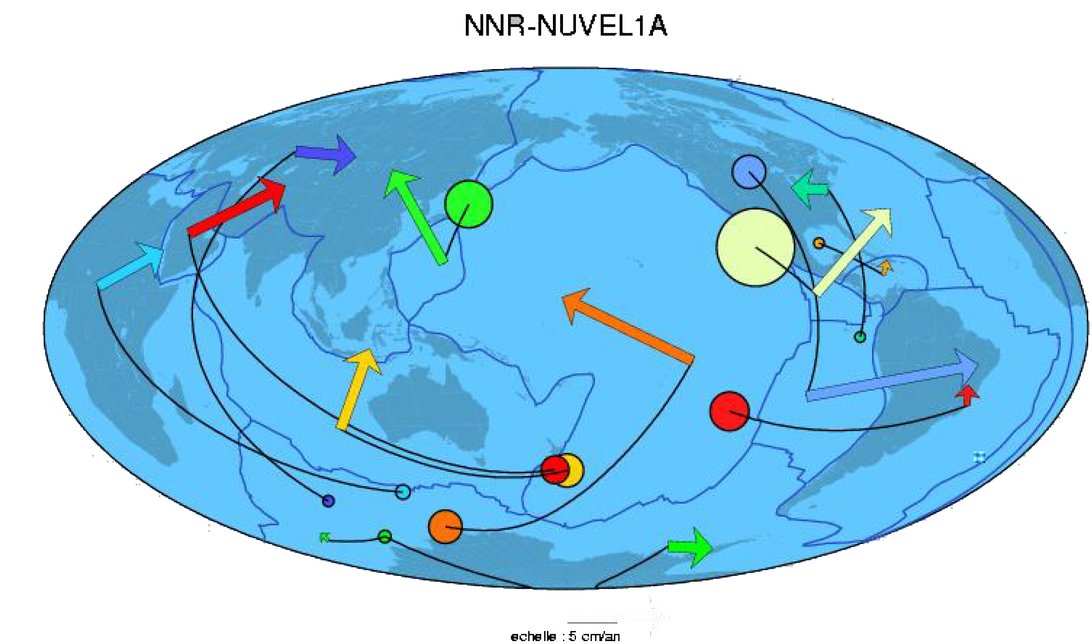

Slide 32
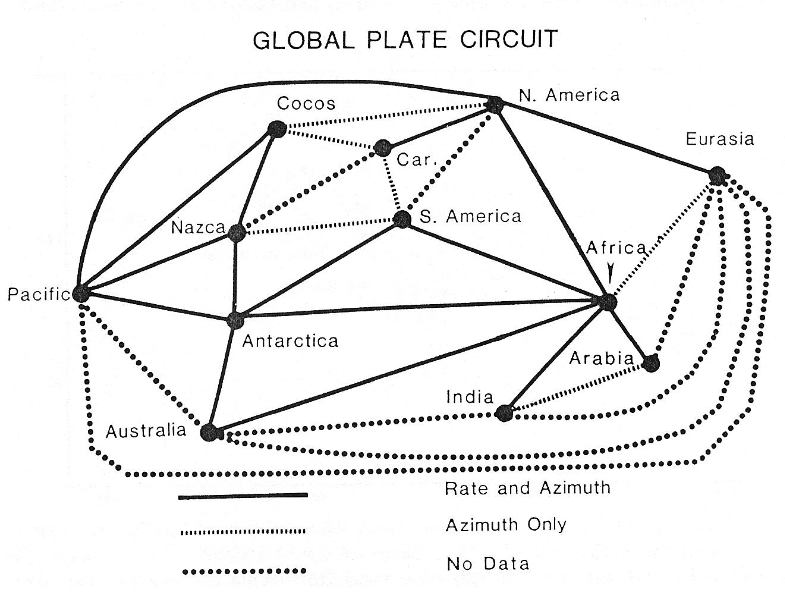

Slide 33
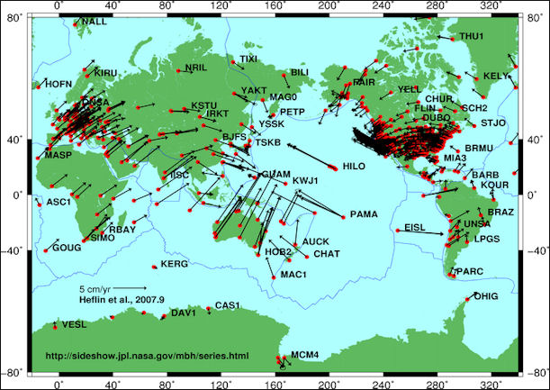
Notes:
By NASA - http://sideshow.jpl.nasa.gov/mbh/all/images/global.jpg, Public Domain, https://commons.wikimedia.org/w/index.php?curid=3899206

Slide 34
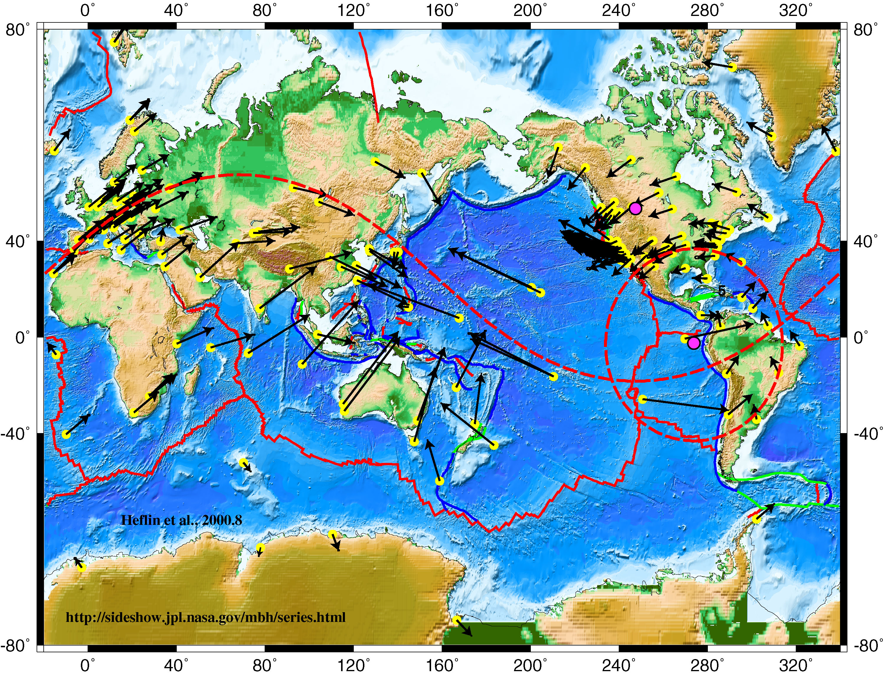
Velocities of IGS global tracking GPS sites in ITRF.
Notes:
Velocities of IGS global tracking GPS sites in ITRF.
Small “circles” for European and N. American poles.
Velocities are tangent to small circles (look like windshield wiper streaks).

Slide 35
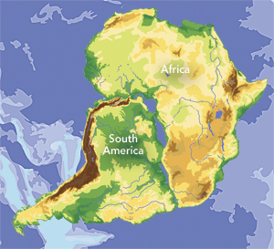
Notes:
http://www.esri.com/news/arcnews/winter1112articles/through-the-macroscope-geographys-view-of-the-world.html
You have received a paper to review that has this “reconstruction” of South America rotated into Africa. They claim the misfit is less than that of the Bullard fit. Discuss the evidence supporting, or rejecting, this fit.

