Slide 1
CERI-7104/CIVL-8126 Data Analysis in Geophysics
Continue with - Intro “Seismic Analysis Code” - SAC
Lab – 23, 11/14/19
Record section
Cross Correlation
Phase picking
Graphics output

Slide 2
Record section
850 $ sac
SAC> r *..BHZ*
IM.NV31..BHZ.M.2011.070.055653.SAC …
UU.SRU..BHZ.M.2011.070.055718.SAC
SAC> qdp off
SAC> sss
Signal Stacking Subprocess.
SAC/SSS> plotrecordsection
Notes:
Pretty easy to make record sections --- IF everything is in header (needs deltas).
Pretty ugly – does not deal with labeling nicely.

Slide 3
SAC subprocesses
Spectral Estimation Package – spe
Signal Stacking Subprocess – sss
http://www.iris.edu/software/sac/commands/spe.html

Slide 4
SAC subprocesses
A subprocess is effectively a small program within the main SAC program. You start a subprocess by typing its name (SPE in this case.)
You can terminate it and return to the main program using the
QUITSUB
commands.
http://www.iris.edu/software/sac/commands/spe.html

Slide 5
SAC subprocesses
While within a subprocess, you can execute any command belonging to that subprocess plus a limited number of main SAC commands.
See the manual for the list of main SAC Commands executable from within either the SPE or SSS subprocess
http://www.iris.edu/software/sac/commands/spe.html

Slide 6
Spectral Estimation Package – spe
SPE is a spectrum estimation package intended primarily for use with stationary random processes.
It contains three different spectral estimation techniques:
Power Density Spectra (PDS),
Maximum Likelihood Method (MLM), and Maximum Entropy Method (MEM).
http://www.iris.edu/software/sac/commands/spe.html
Notes:
The Estimators
The user has a choice of three spectral estimators: Power Density Spectra ( PDS), Maximum Likelihood Method ( MLM), and Maximum Entropy Method ( MEM). Command COR must be run before running any of these.
PDS
The PDS estimator is quite simple: the sample correlation function is multiplied by a correlation window, then the result is transformed with an FFT to obtain the spectral estimate. The user again has a choice of the window type and the size of the window. The above mentioned book by Jenkins and Watts could be considered as the detailed documentation for the PDS technique.
MLM
The MLM estimator generates a spectral estimate which is the power output of a bank of narrow band-pass filters which have been optimized to reject out-of-band power. The result is a smoothed, parametric estimate of the power density spectrum. The user can choose the number of parameters. Documentation for this method can be found in the paper by Richard Lacoss in the IEEE book "Modern Spectrum Analysis" by Donald Childers.
MEM
The MEM estimator is another parametric method, which uses a prediction error filter to whiten the data. The resulting spectral estimate is proportional to the inverse of the filter's power frequency response. The user is free to choose the order of the prediction error filter. Documentation for this method can be found in the review paper on linear prediction by John Makhoul in "Modern Spectrum Analysis." The formal name of the actual method implemented is the Yule-Walker method.

Slide 7
SPE Commands
COR : Computes the correlation function.
MEM : Calculates the spectral estimate using Maximum Entropy Method.
MLM : Calculates the spectral estimate using Maximum Likelihood Method.
PDS : Calculates the spectral estimate using Power Density Spectra Method.
http://www.iris.edu/software/sac/commands/spe.html

Slide 8
SPE Commands
PLOTCOR : Plots the correlation function.
PLOTPE : Plots the RMS prediction error function.
PLOTSPE : Plots the spectral estimate.
http://www.iris.edu/software/sac/commands/spe.html

Slide 9
SPE Commands
READ : within SPE works the same as in the main SAC program with two exceptions.
First, only ONE file may be read in while in SPE.
Second, executing this command deletes any correlation function or spectral estimate that may already have been computed.
http://www.iris.edu/software/sac/commands/spe.html

Slide 10
SPE Commands
READ
Parameters within SPE, such as the number of prewhitening coefficients or the window type and length, are not changed when read is executed.
To reinitialize all SPE parameters, terminate the subprocess using the QUITSUB command and then start it over again.
http://www.iris.edu/software/sac/commands/spe.html

Slide 11
SPE Commands
WRITECOR : Writes a SAC file containing the correlation function.
WRITESPE : Writes a SAC file containing the spectral estimate. Their abbreviated names are also allowed.
http://www.iris.edu/software/sac/commands/spe.html

Slide 12
There are two primary differences between SPE and the main SAC program.
Only one data file can be processed by SPE at a time.
This is because SPE produces and stores a number of auxiliary functions (the correlation function, the prediction error function, and the spectral estimate itself) as it proceeds.
This restriction to a single data file may be removed in the future.
http://www.iris.edu/software/sac/commands/spe.html

Slide 13
The second difference is that, unlike SAC itself, there is a specific order or progression in which the commands are generally executed.
Initialization (done with spe command), read, correlation, estimation, termination
http://www.iris.edu/software/sac/commands/spe.html

Slide 14
Signal Stacking Subprocess – sss
primarily a package for doing signal stacking (i.e. summation or beamforming).
http://www.iris.edu/software/sac/commands/sss.html

Slide 15
SSS
Each signal (i.e. SAC file) has properties such as a static delay, epicentral distance, weighting factor, and polarity associated with it.
In addition, dynamic delays can be calculated using a normal moveout or refracted wave velocity model.
http://www.iris.edu/software/sac/commands/sss.html

Slide 16
SSS
Certain delay properties can be automatically incremented between summations.
Files are easily added to or removed from the stack file list.
The time window for the stack is easily adjusted.
http://www.iris.edu/software/sac/commands/sss.html

Slide 17
SSS
Files which do not contain data throughout the stack time window are filled with zeros.
The stack file list can be plotted with or without the summation.
Each summation can be saved on disk for later use.
http://www.iris.edu/software/sac/commands/sss.html

Slide 18
SSS
A record section plot is also included in this subprocess.
http://www.iris.edu/software/sac/commands/sss.html

Slide 19
SSS Commands (in alphabetical order)
ADDSTACK : Add a new file to the stack file list.
CHANGESTACK : Change properties of files currently in the stack file list.
DELETESTACK : Deletes one or more files from the stack file list.
DELTACHECK : Change the sampling rate checking option.
http://www.iris.edu/software/sac/commands/sss.html

Slide 20
SSS Commands
DISTANCEAXIS : Define the record section plot distance axis parameters.
DISTANCEWINDOW : Controls distance window properties on subsequent record section plots.
GLOBALSTACK : Sets global stack properties.
INCREMENTSTACK : Increments properties for files in the stack file list.
http://www.iris.edu/software/sac/commands/sss.html

Slide 21
SSS Commands
LISTSTACK : Lists the properties of the files in the stack file list.
PLOTRECORDSECTION : Plots a record section of the files in the stack file list.
PLOTSTACK : Plots the files in the stack file list.
http://www.iris.edu/software/sac/commands/sss.html

Slide 22
SSS Commands
QUITSUB : Terminates the Signal Stacking Subprocess.
SUMSTACK : Sums the files in the stack file list.
TIMEAXIS : Controls the time axis properties on subsequent record section plots.
TIMEWINDOW : Sets the time window limits for subsequent stack summation.
http://www.iris.edu/software/sac/commands/sss.html

Slide 23
SSS Commands
TRAVELTIME : Computes traveltime curves for pre-defined models or reads traveltime curves from ascii text files.
VELOCITYMODEL : Sets stack velocity model parameters for computing dynamic delays.
VELOCITYROSET : Controls placement of a velocity roset on subsequent record section plots.
http://www.iris.edu/software/sac/commands/sss.html

Slide 24
SSS Commands
WRITESTACK : Writes a stack summation to disk.
ZEROSTACK : Zeros or reinitializes the signal stack.
http://www.iris.edu/software/sac/commands/sss.html

Slide 25
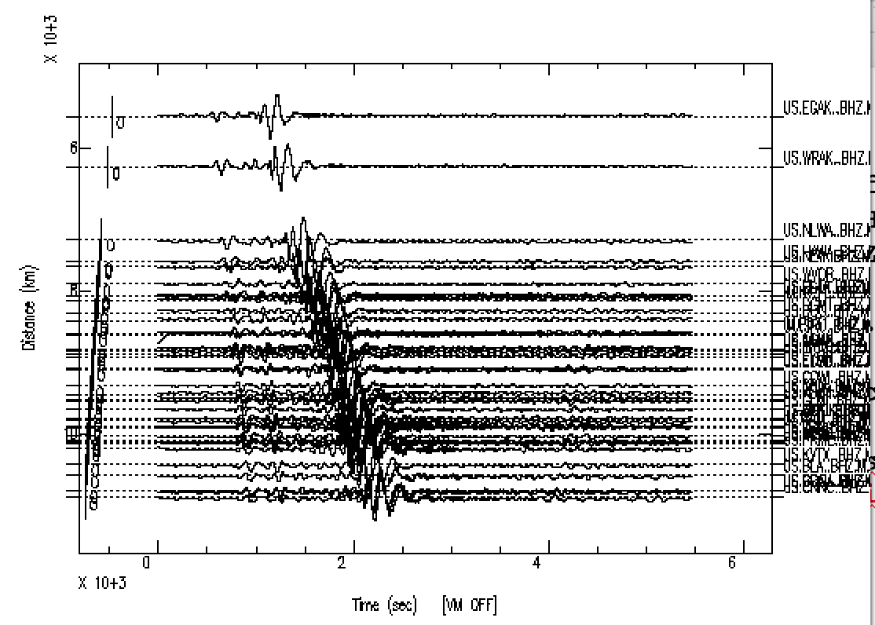
Record section
853 $ sac
SAC> qdp off
SAC> r *..BHZ*
IM.NV31..BHZ.M.2011.070.055653.SAC
...
UU.SRU..BHZ.M.2011.070.055718.SAC
SAC> sss
Signal Stacking Subprocess.
SAC/SSS> lp c .005
SAC/SSS> prs
SAC/SSS> quitsub
SAC>
Notes:
Some – but not all – “regular” sac commands work in sss
Read does not
Filters do
prs is abbreviation for plotrecordsection
To return to sac from sss - quitsub

Slide 26
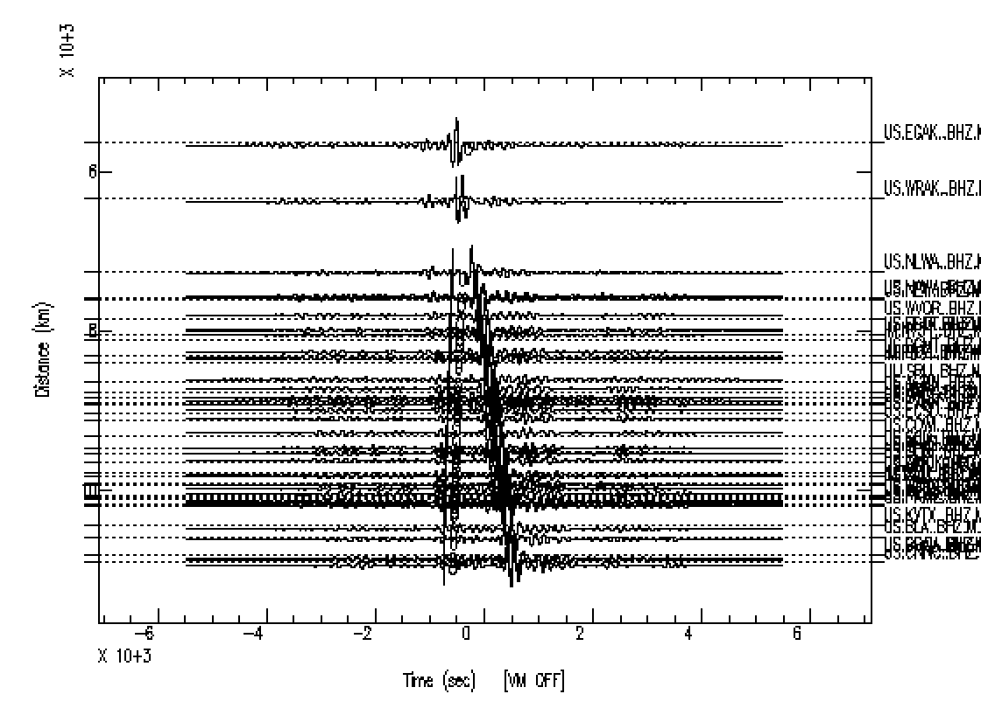
Record section
Simulate noise cross correlation
>SAC r *..BHZ*
IM.NV31..BHZ.M.2011.070.055653.SAC
...
UU.SRU..BHZ.M.2011.070.055718.SAC
SAC> rtrend
SAC> lp c .005
SAC> correlate master 1
SAC> sss
SAC/SSS> prs
SAC/SSS>

Slide 27
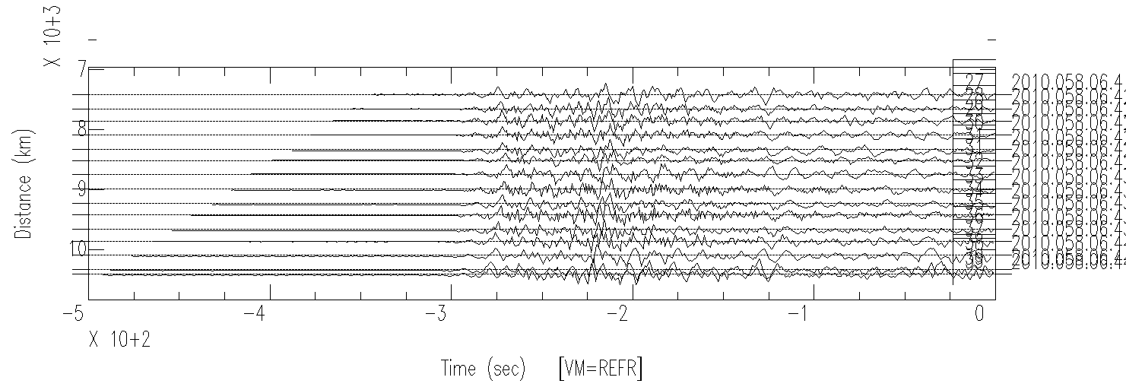
Signal Stacking Subprocess
Record section with reduction velocity
Notes:
SAC/SSS> timewindow -500 0
SAC/SSS> vm 1 refractedwave vapp 20
SAC/SSS> plotrecordsection

Slide 28
Fixing nasty file names
See script rename.sh
615 $ cd pbo_backbone_sac_data
616 $ ls | head -1
IM.NV31..BHN.M.2011.070.055653.SAC
617 $ rename.sh SAC 2 4
618 $ ls | head -1
AAM.BHE

Slide 29
Fixing nasty file names
See script rename.sh
628 $ cat rename.sh
#!/bin/csh
#to rename horrid iris dmc file names
#call with rename.sh A x y
#where A is the char string to find and x and y are the field numbers in the original
#file name (period is the field separator) you
#want to use for the final name
#eg if the file names look like
#1999.289.10.05.26.0000.IU.KMBO.00.LHZ.SAC
#the 8th field is the station name, KMBO
#and the 10th field is the component name, LHZ
#so you would call rename.sh SAC 8 10
#and it would rename it to KMBO.LHZ
#it will do this for all the file names that end with .SAC
foreach file (`ls -1 *$1*`)
mv $file `echo $file | nawk -F. '{print $'$2'"."$'$3'}'`
end
Notes:
From before I discovered sh/bash was better for scripts.
Notice this is mostly comments! Only 4 lines of code

Slide 30
Event Analysis Module:
This module is used to pick seismic phases.
An automatic phase picking algorithm can be applied using
APK

Slide 31
I got tired of forgetting to turn off qdp all the time, so I
• made a sac macro to turn off qdp
• then made an alias in your .bashrc (or .cshrc) to the sac command to call the macro from the command line.
Sac continues interactively after running the macro.
You should do that – now – class exercise.

Slide 32
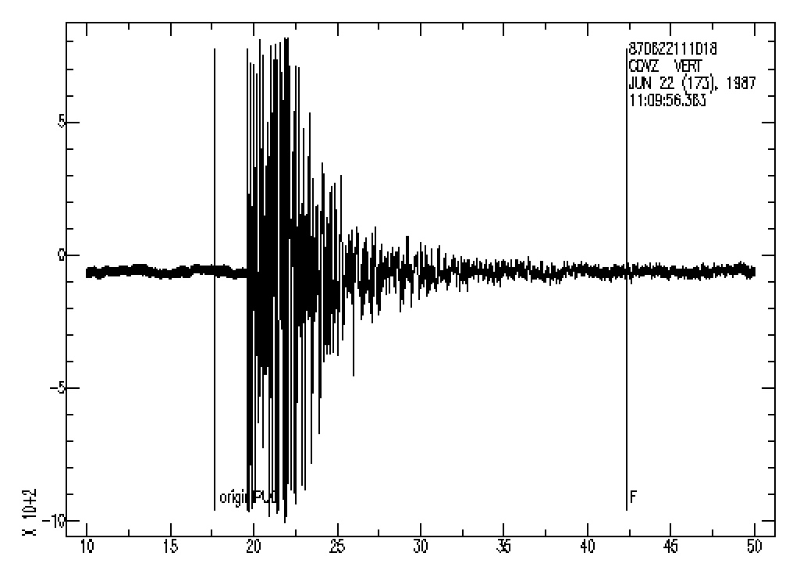
APK
867$ sac << this is now the alias after opening new terminal or sourcing the .rc file.
SAC> DATAGEN COMMIT SUB LOCAL cdv.z
SAC> p
no decimation→
Notes:
Lets get a seismogram – use one of the sample ones that comes with sac (the command above is supposed to be the default if you just type DATAGEN, but it does not work).

Slide 33
APK
867 $ sac
SAC> DATAGEN COMMIT SUB LOCAL cdv.z
SAC> p
SAC> apk
CDVZIPU0 87 622111015.97
SAC> p
Notes:
Finds a pick and prints out some gibberish
Makes plot uglier - adds pick label to plot
The origin is the time of the eq, and the F is some “end” for coda magnitude determination

Slide 34
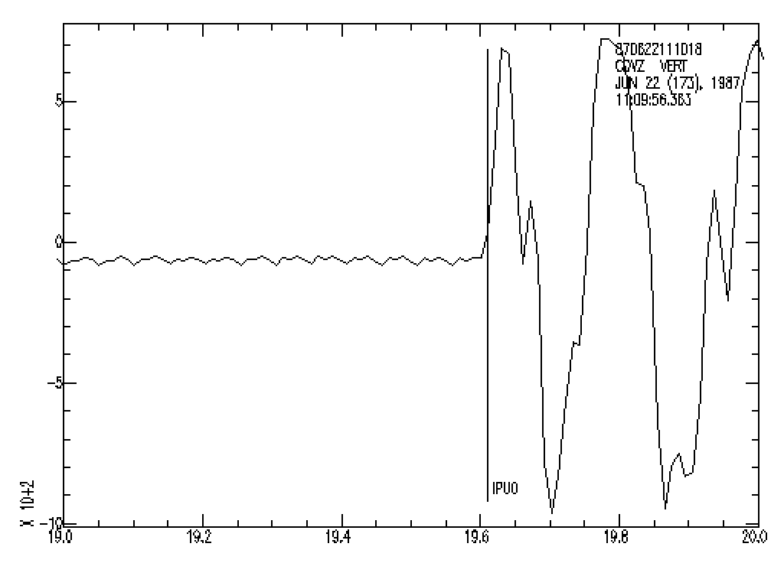
APK
867 $ sac
SAC> DATAGEN COMMIT SUB LOCAL cdv.z
SAC> p
SAC> apk
CDVZIPU0 87 622111015.97
SAC> p
SAC> xlim 19 20
SAC> p
Notes:
Zoom in
The delta (time between samples) for this file (look at it in listhdr) is DELTA = 1.017683e-02, which gives a sampling rate of 98.26 samples per second!
Let’s say 100 sps.
Where is the arrival? Is it the one picked or the one before, or somewhere in between?

Slide 35
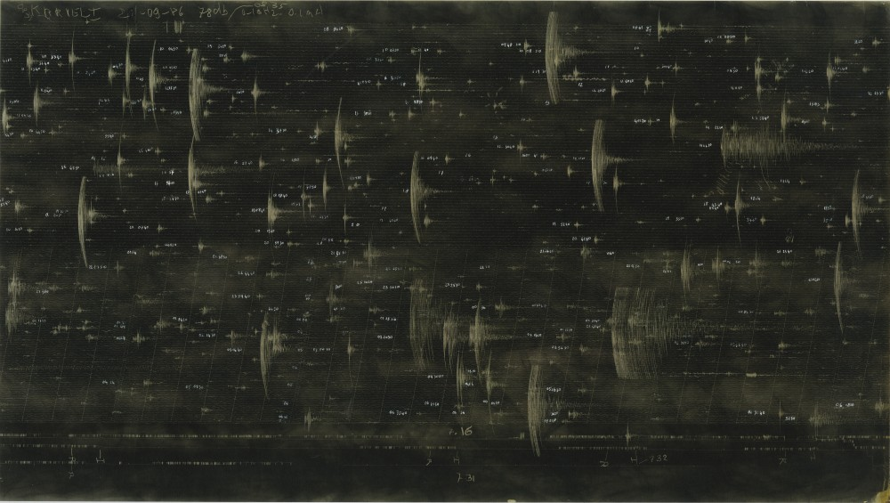
Springnether MEQ (Micro Earthquake Recorder) record from a short period seismometer.
Notes:
Example of a microearthquake (aftershock) survey recorded on an analog MEQ.
Explain smoked paper, diamond stylus, smoking and fixing record.

Slide 36
Springnether MEQ (Micro Earthquake Recorder) record from a short period seismometer.
Notes:
Every seismologist worth their salt claims they can read analog records, especially the old MEQ records recorded on smoked paper, to one hundredth of a second.
You get out your magnifying glass, and trusty Gerber scale.

Slide 37
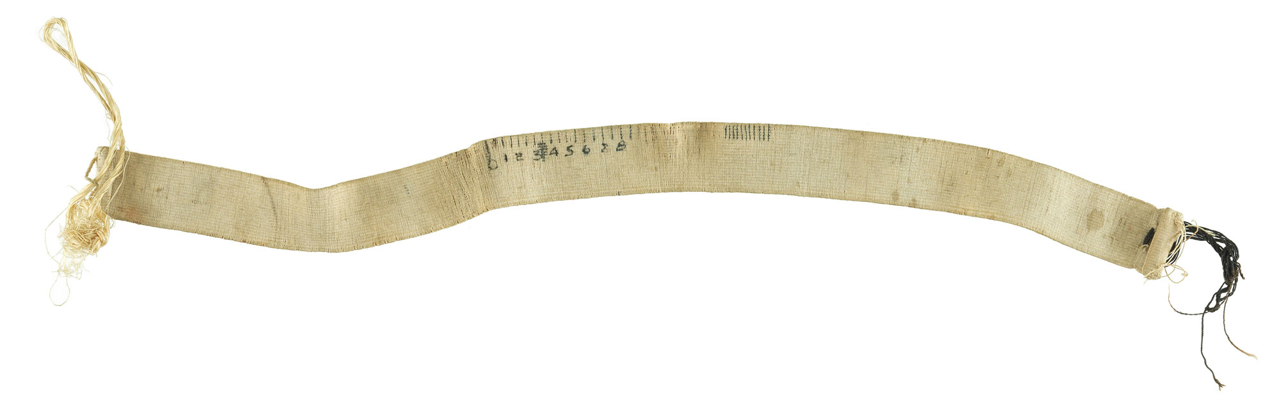
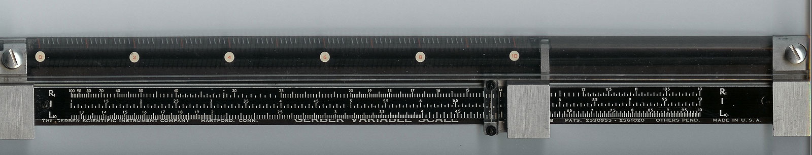
Gerber variable scale.

Slide 38
So take reported phase arrival time precision with a grain of salt.

Slide 39
The APK function, however, is not a panacea.
SAC> r *GLMI*..BHZ*
US.GLMI..BHZ.M.2011.070.055805.SAC
SAC> apk
WARNING: No valid pick found for the following file(s): US.GLMI..BHZ.M.2011.070.055805.SAC
Now you have to Read The Manual (RTM).
APK {param v {param v} ... },{VALIDATION ON|OFF}
Here’s the list of parameters – read the manual to find out what each does.
C1|C2|C3|C4|C5|C6|C7|C8|D5|D8|D9|I3|I4|I6
DEFAULT VALUES: > APK C1 0.985 C2 3.0 C3 0.6 C4 0.03 C5 5.0 C6 0.0039 C7 100. C8 > -0.1 D5 2. D8 3. D9 1. I3 3 I4 40 I6 3 VALIDATION ON
Notes:
The defaults are set de for local events recorded on short period instruments. You have to play around quite a bit to optimize the auto picker for the events you are studying.

Slide 40
Event Analysis Module:
You can also use
PPK
to pick phases using the graphics cursor.
( PPK is described in the section on Graphics Capabilities).
Notes:
Since the auto picker is not working – we are sent back to manual picking.

Slide 41
SAC> ch a -12345 t0 -12345 # remove P and S arrival picks (if they are there, or just in case, “-12345” is “NaN” in sac headers)
SAC> ppk # use the manual picker

Slide 42
# cheat sheet,
zoom in: type "x" to define the left-side of the time window, followed by a left click of mouse to define the right-side of the time window
zoom out: type "o"
P arrival: type "a", or "p" at the time where you think the p wave arrival is.
S arrival: type "t0", or "s" at the time where you think the s wave arrival in.
quit: type "q"
Notes:
Is a bit clunky

Slide 43
SAC> r *GLMI*..BH[NEZ]*
SAC> ppk p 3 m on bell off # pick using all 3 components together, turn marker on (draws pick on plot), turn the annoying bell off.
SAC> wh # to save the picked arrival, you can use the command "wh". But this command could # mess up the data if you have used the cut command. So be careful.
Class exercise – try it.
Notes:
Since the auto picker is not working – we are sent back to manual picking.

Slide 44
Event Analysis Module:
Picks can be saved in HYPO format using the
OHPF (open HYPO pick file) and
CHPF (close HYPO pick file) commands;
WHPF writes auxiliary cards into the HYPO pick file.
YOU MUST REMEMBER TO SAVE THE PICKS TO THE HEADERS AND RE-WRITE THE DATA FILES AND/0R WRITE OUT A HYPO INPUT FILE (OR YOU LOOSE YOUR WORK LEAVING SAC).
Notes:
Explain hypo-71, hypo inverse, hypo ellipse
Save the info in a text file to use with other programs

Slide 45
Event Analysis Module:
These picks can also be saved in a more general Alphanumeric format using the
OAPF (open alphanumeric pick file) and
CAPF (close alphanumeric pick file) commands.
YOU MUST REMEMBER TO SAVE THE PICKS TO THE HEADERS AND RE-WRITE THE DATA FILES AND/0R WRITE OUT A HYPO INPUT FILE (OR YOU LOOSE YOUR WORK LEAVING SAC).
Notes:
Explain hypo-71, hypo inverse, hypo ellipse

Slide 46
Phase Info
SAC can be used to pick and store phase information in header variables A & T0-T9
(although this is another place where it shows its age and is quite clumsy). These don’t come out in the HYPO files (they may in the general alphanumeric format files)
omarker is reserved to for the origin time.
All pick and origin times are stored in seconds from the reference time of the file.

Slide 47
omarker (origin time) is oftentimes set (incorrectly) to zero.
If amarker and t0marker are not set, they will not show in a lh.
OMARKER = 0
AMARKER
T0MARKER
T1MARKER = 462.7 (P)
T2MARKER = 834.76 (S)
T4MARKER = 472.5 (pP)
T6MARKER = 478 (sP)
You can also store what you think the time is.

Slide 48
SAC graphics to other formats
SGFTOPS
This runs within sac (sac passes stuff that are not sac commands to the OS) or from terminal command line.
Notes:
Next pages have description of command line items

Slide 49
Graphics
There are 2graphics devices currently supported.
SGF (SAC Graphics File) is a file with graphics information that can get converted into postscript, etc.
X-WINDOWS is a general windowing system running on most high-resolution, bit-mapped graphics workstations
(and where our plots have been showing up)
(SUNWINDOW, is a windowing system that was available on the Sun in SunOS 4.X. Listed for completeness)

Slide 50
X-windows or X
X is widely used on UNIX graphics workstations and offers one of the best frameworks (UNIX opinion, X follows the UNIX philosophy so it is powerful and difficult) for developing portable window-based applications.
It should be the default graphics device when you start SAC.
Can be turned on using begin device: (bd).
sac> bd x

Slide 51
SGF demonstrates the power (or kluginess) of SAC and UNIX.
Rather than burden the SAC program with producing graphics for a large number of possible devices
(postscript did not even exist when SAC was written)
have SAC write out a file (that is probably just the TEK401X commands) that some other programs read and translate into the appropriate format for display on any particular device.

Slide 52
SAC Graphics Files contain all the information needed to generate a single plot.
Each plot is stored in a separate file.
The file names are of the form “fnnn.sgf” where nnn is the plot number, beginning with 001, resetting each time you start SAC
(so if you have some preexisting files that you have not renamed, they will get clobbered – you have been forewarned).

Slide 53
SGF output is turned on with the command begindevice: (bd)
sac> bd sgf
Graphics output will now go to the sgf file.
You will not see it on the screen (X display).

Slide 54
There is no “save my figure” from the X-display
(this is UNIX and without an inordinate amount of work to bring out its power, X is very basic).
So if you want to make a figure for printing or sending anywhere but the X-display
(if it is a complicated figure you may have to first make it and look at it on the X-display - then).
Turn on the sgf device and (re-)make it with the output now going to the file.

Slide 55
Or if you are on a Mac or a PC you could use the screen capture function or grab program and then paste it into another file.
(there is no screen capture on the Sun, it is "pure" UNIX.)

Slide 56
To create a postscript file, you would turn on the sgf device, create your plot, and then run a conversion program called sgf2ps or sgftops.
SAC> qdp off
SAC> read ccm*_.bhz
ccm_india_.bhz ccm_solomon_.bhz ccm_sumatra_.bhz
SAC> bd sgf
SAC> p1
SAC> sgftops f001.sgf sac_example.ps
SAC> bd x
Unfortunately trying to display the figure using the gs command from within SAC falls over since gs also is a SAC command (plot greyscale image of data in memory). Need final “bd x” to send graphics back to screen.
Notes:
Do this and look at file
Here the sac passing of commands to the os fails.

Slide 57
SGFTOPS sgf-file ps-file {width} {YES|NO} {scale} INPUT sgf-file
sgs-file: name of a SAC Graphics File (SGF).
ps-file : The desired name for the POSTSCRIPT file.
width : A number specifying the width or thickness of lines in the output file.
This is an integer in the range 1 to 8.
Default is 1.

Slide 58
SGFTOPS sgf-file ps-file {width} {YES|NO} {scale} INPUT sgf-file
YES|NO : Flag to apply additional scaling.
A value of YES turns scaling on, NO ignores the additional scale parameter.
scale : An additional scale factor. Can be used for making large or full-size maps.

Slide 59
Getting stuff from headers for use elsewhere (gmt for ex). This shell script is in sta.csh. It runs sac independently for each file matching the name (*${sta}*z) and appends the output of the sac listhdr command to the sta.log file (loop in shell, not sac).
alpaca.ceri.memphis.edu668:> vi sta.csh
#!/usr/bin/csh
# Script to report b, e and t1 sac header values for stations
# usage: sta.csh [NAME]
\rm sta.log
set sta=$1
foreach file ( *${sta}*BH* )
sac <<EOF >> sta.log
r $file
lh b e t1
q
EOF
end
Notes:
Runs sac independently for each file – file name expansion done by csh. The output from the stuff in blue goes into sta.log

Slide 60
alpaca.ceri.memphis.edu666:> sta.csh AREN
sta.log: No such file or directory
alpaca.ceri.memphis.edu667:> more sta.log
SEISMIC ANALYSIS CODE [09/04/2008 (Version 101.2)]
Copyright 1995 Regents of the University of California
FILE: AREN.BHE - 1
--------------
b = 7.400000e+04
e = 7.600000e+04
SEISMIC ANALYSIS CODE [09/04/2008 (Version 101.2)]
Copyright 1995 Regents of the University of California
FILE: AREN.BHN - 1
--------------
b = 7.400000e+04
e = 7.600000e+04
SEISMIC ANALYSIS CODE [09/04/2008 (Version 101.2)]
Copyright 1995 Regents of the University of California
FILE: AREN.BHZ - 1
--------------
b = 7.400000e+04
e = 7.600000e+04
alpaca.ceri.memphis.edu668:> vi stainfo.csh
Notes:
Output of file on all files *${sta}*z where sta is AREN
(notice 3 sets info – one for file for each component – and sac is run 3 times)

Slide 61
What is this awk line testing for if I apply it to the output of sta.csh?
awk '{if (/FILE/) f=$2; if ($1=="b") b=$3; if ($1=="e") e=$3; if (/t1/ && $3>b && $3<e) \ print "r more",f}' sta.log
Notes:
Prints out sac "read more" command for file if some conditions are met on time (nawk processes every line, so will set f, b and e – they are always in the sac header before t1 – and when it gets to t1 will do testing and print out the read command based on the testing. Depends on the strict order, and existence, of stuff in the sac header.

Slide 62
Use SAC macros to try to automate SAC as much as possible.
- Saves time if have to do something over and over.
- Documents what you did – you can reproduce it exactly.

Slide 63
Notice importance of
- Organization/structure
- Naming conventions
Take advantage of them to automate processing.

Slide 67
example: basic macro for creating a plot
%vim plot1.macro
r BJT.BHZ* BJT.BHN* BJT.BHE*
xvport 0.1 0.6
qdp off
xlim t1 -5 50
title on "Sumatra Event 2/13/2005 1:22:09 at BJT”
xlabel on "Time, sec”
ylabel on "Digital Counts”
bd sgf
p1
ed sgf
sgftops f001.sgf plot1.ps 1 y

