Slide 1


Communication lessons learned from the March 2020 Mw 5.7 Magna, UT earthquake
Rebecca Sumsion and Katherine Whidden
University of Utah Seismograph Stations

Slide 2
Land acknowledgment
We acknowledge that this land, which is named for the Ute Tribe, is the traditional and ancestral homeland of the Shoshone, Paiute, Goshute, and Ute Tribes. The University of Utah recognizes and respects the enduring relationship that exists between many Indigenous peoples and their traditional homelands. We respect the sovereign relationship between tribes, states, and the federal government, and we affirm the University of Utah’s commitment to a partnership with Native Nations and Urban Indian communities through research, education, and community outreach activities.
native-land.ca

Slide 3
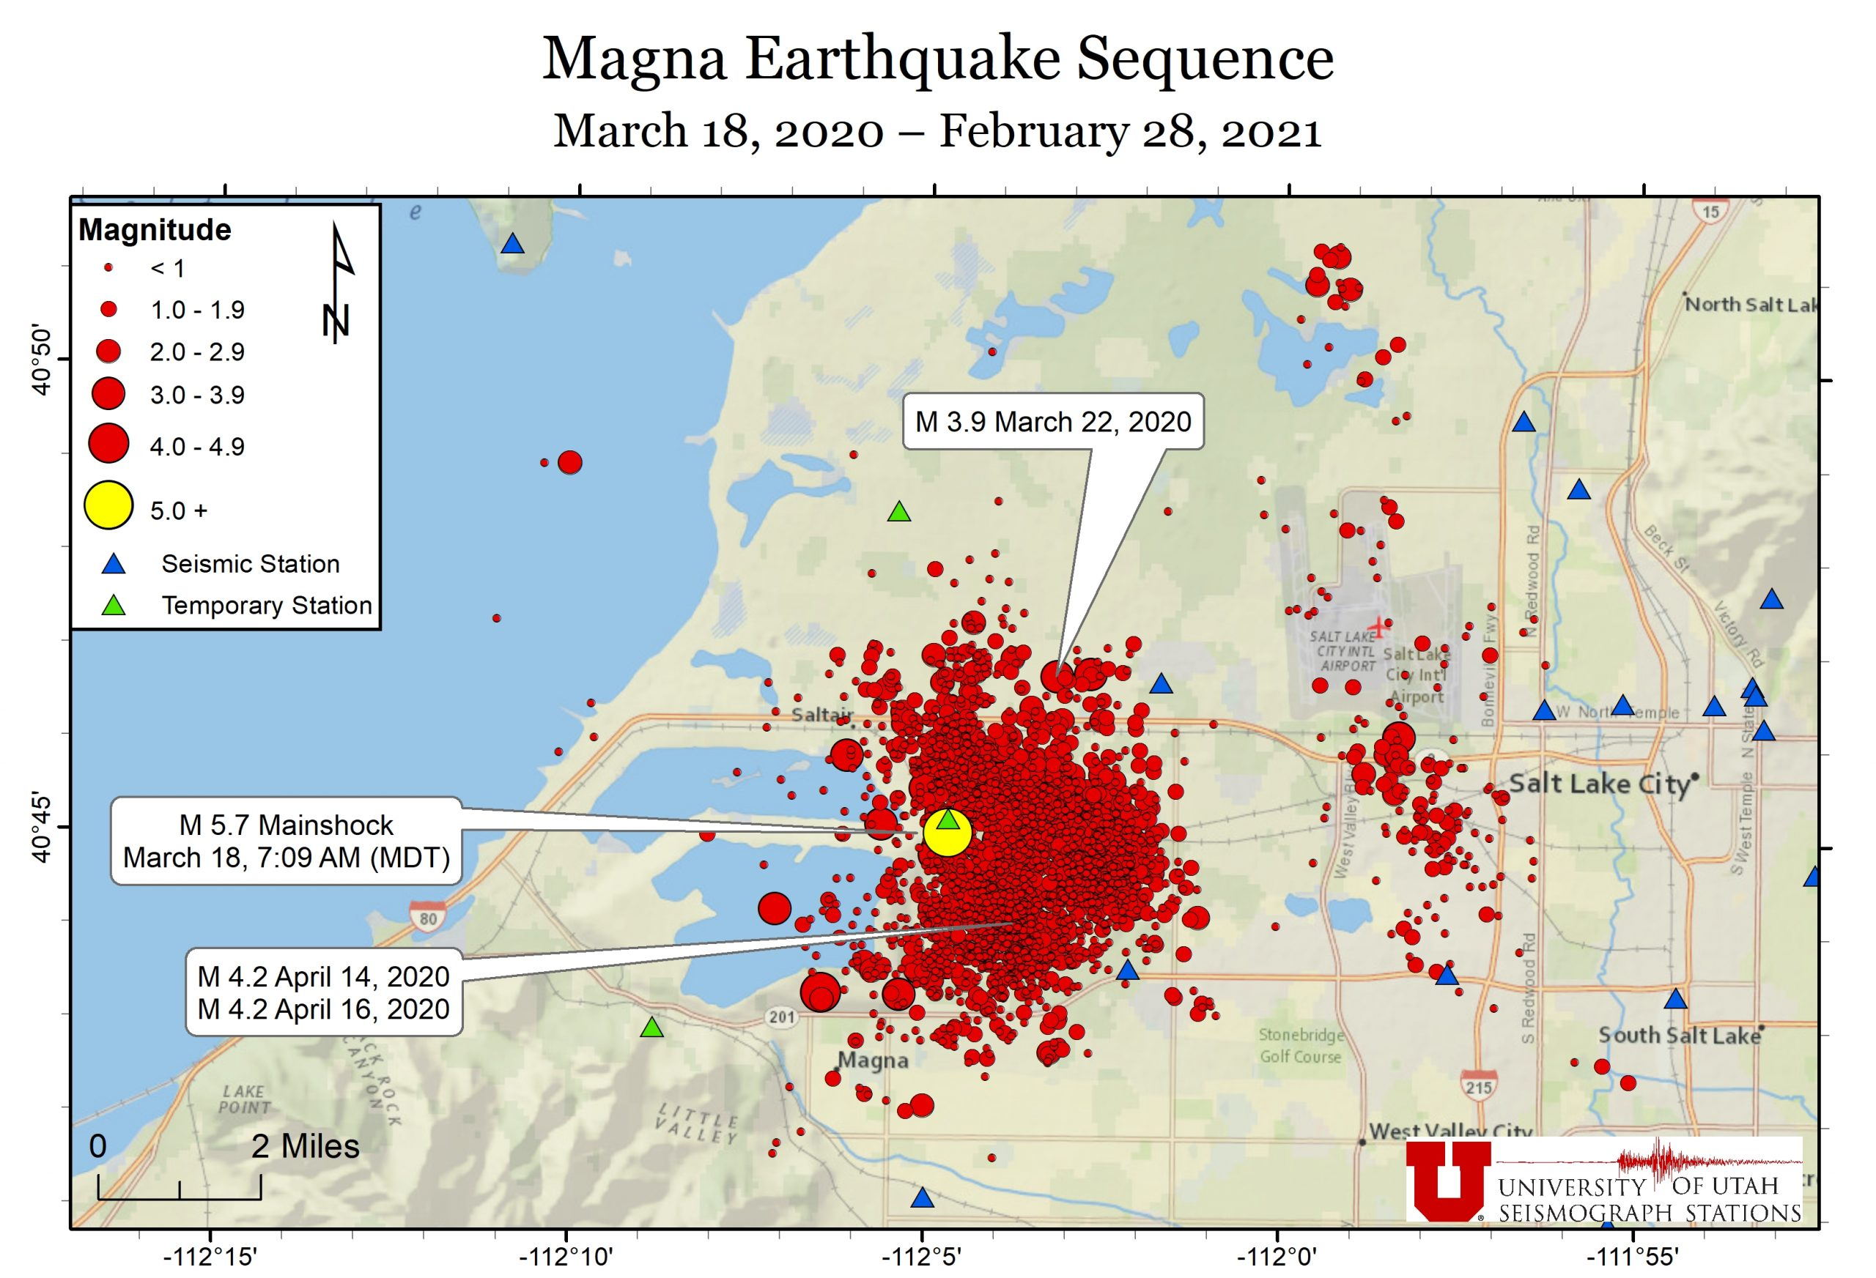
Magna: Before and After
Mw 5.7 earthquake in a Salt Lake City suburb
Widely felt throughout the most populated area in Utah
Largest earthquake in this urban area since Magna 1962 M5.2
Some building damage
No serious injuries or deaths
Before
Social media limited to automatic tweets and infrequent human updates
Rely on press release to get our information out
After
More active social media presence
Focus on getting information out quickly
YouTube channel
More interaction with partner agencies
Still looking for the best way to respond to people’s anxieties

Slide 4
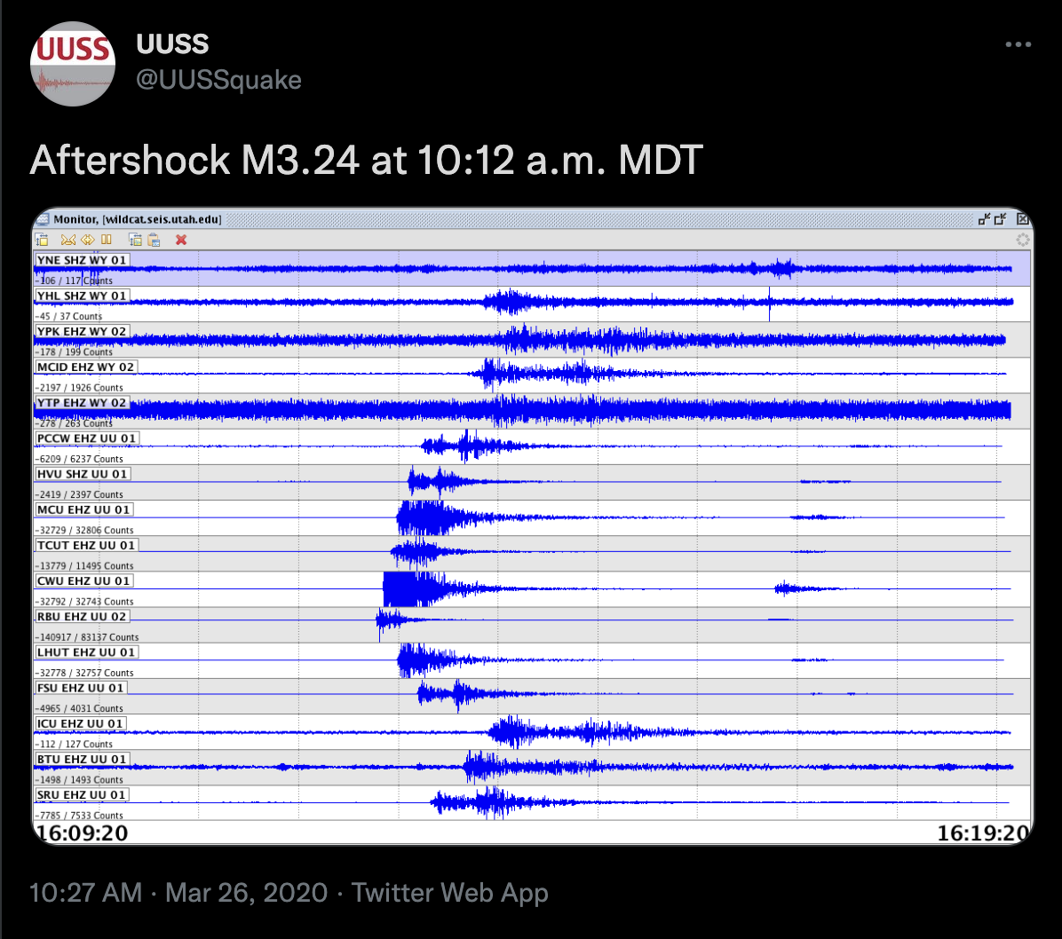
Importance of speed
People expect Twitter updates quickly, as soon as they feel shaking
Incomplete information is better than silence
Let people know
  Yes, it was an earthquake
  we’re working on it

Slide 5
Educating the public & misinformation
The public doesn’t know as much as we think they know
Rumor of imminent M9 earthquake after Magna M5.7
FAQ page on website for commonly asked questions
Weekly Magna updates as aftershock sequence went on
  We now do biweekly Utah and Yellowstone updates
Behind the scenes: Google spreadsheet to organize questions from social media and our responses

Slide 6
Is this normal?
Hyperawareness of Utah seismicity that they didn’t pay attention to before, also becoming aware of what they don’t know
  Website map
Difficult question to answer scientifically
  history, statistics, research
  Answering them in a way they understand
Realization: really asking “Am I going to be okay?”

Slide 7
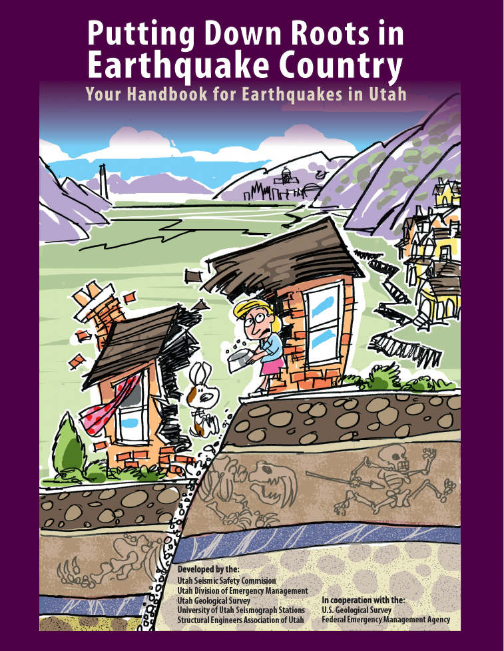
Am I going to be okay?
Hard to calm their fears but maintain accurate info about Utah’s risk
  False sense of security vs fearmongering
Give them something to do
  Emergency Preparedness
Know where to send them
  Resources
Reaching out to partner agencies

Slide 8





Working with others
Turning traffic to other agencies
Pool resources
  Handle topics unequipped to talk about
  Reach a bigger audience
Joint communication
  Magna one year anniversary press release
  earthquakes.utah.gov

Slide 9
For more information:
Pankow, K. L., J. Rusho, J. C. Pechmann, J. M. Hale, K. Whidden, R. Sumsion, J. Holt, M. Mesimeri, D. Wells, and K. D. Koper (2021). Responding to the Magna, Utah, earthquake sequence during the COVID-19 pandemic shutdown, Seism. Res. Lett., 92, 6-16, https://doi.org/10.1785/0220200265

Slide 10
Discussion prompts
How do you deal with misinformation?
How do you strike the balance between reassurance and accurately conveying the hazard?
What tone do you take? Purely facts? Casual/relatable?

