Slide 1
Alaska Earthquake Outreach
Lea Gardine
Alaska Earthquake Center
University of Alaska Fairbanks

Slide 2
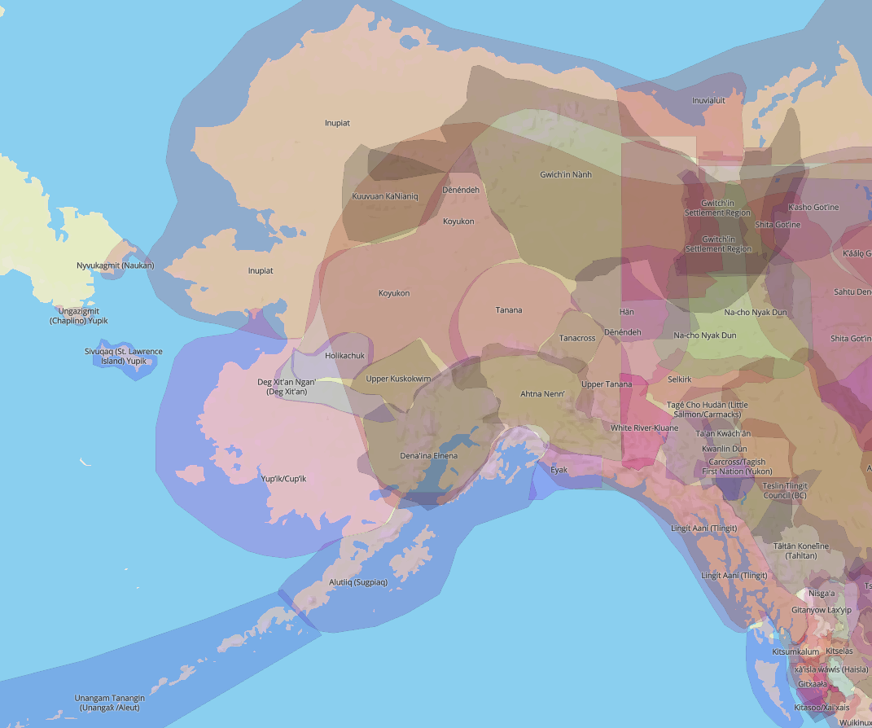
We respectfully acknowledge the Alaska Native peoples upon whose ancestral lands our network of sites operate.
In Fairbanks, the Alaska Earthquake Center office is located on the traditional lands of the Troth Yeddha' Dena people of the Lower Tanana River.
Map from https://native-land.ca/

Slide 3
our mission
Our mission is to strengthen Alaska’s resilience to earthquakes and tsunamis through monitoring, research, and public engagement.

Slide 4
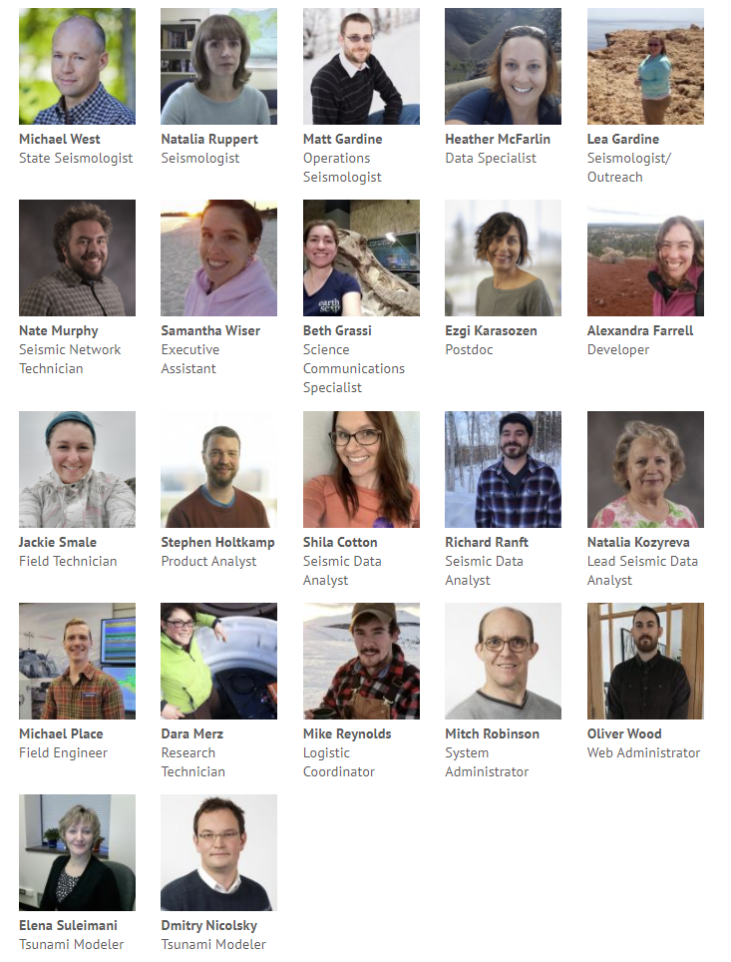
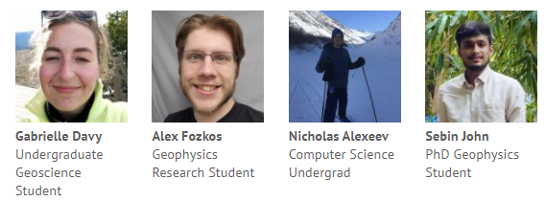
who are we?
We are scientists, engineers, data analysts, field technicians, educators, and students with a shared passion for working in the evolving geology of Alaska.
We are motivated by the reality that some of the great tragedies of our time are caused by earthquakes, as well as the knowledge that earthquakes are a powerful tool for understanding our landscape and the resources it contains.
We partner with several local, state and federal partners.

Slide 5
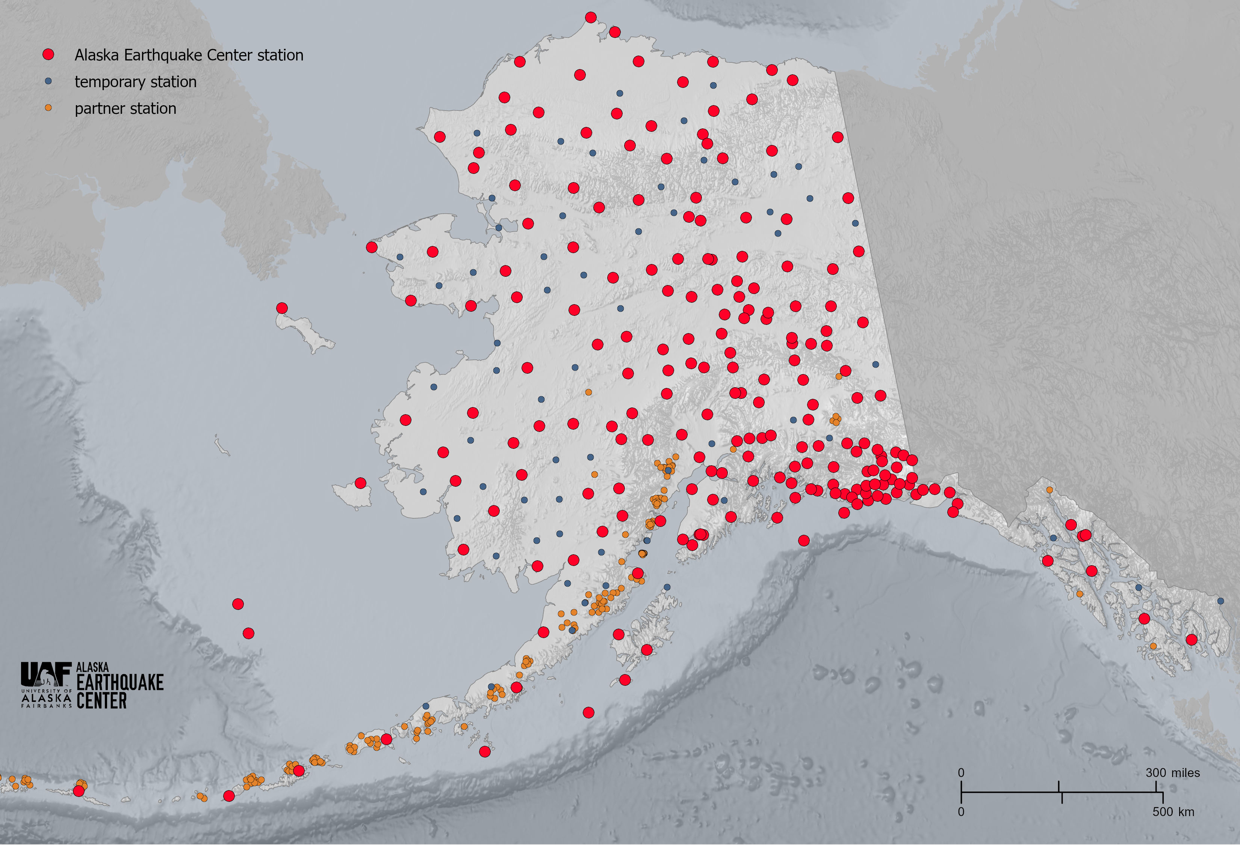
monitoring Alaska earthquakes

Slide 6
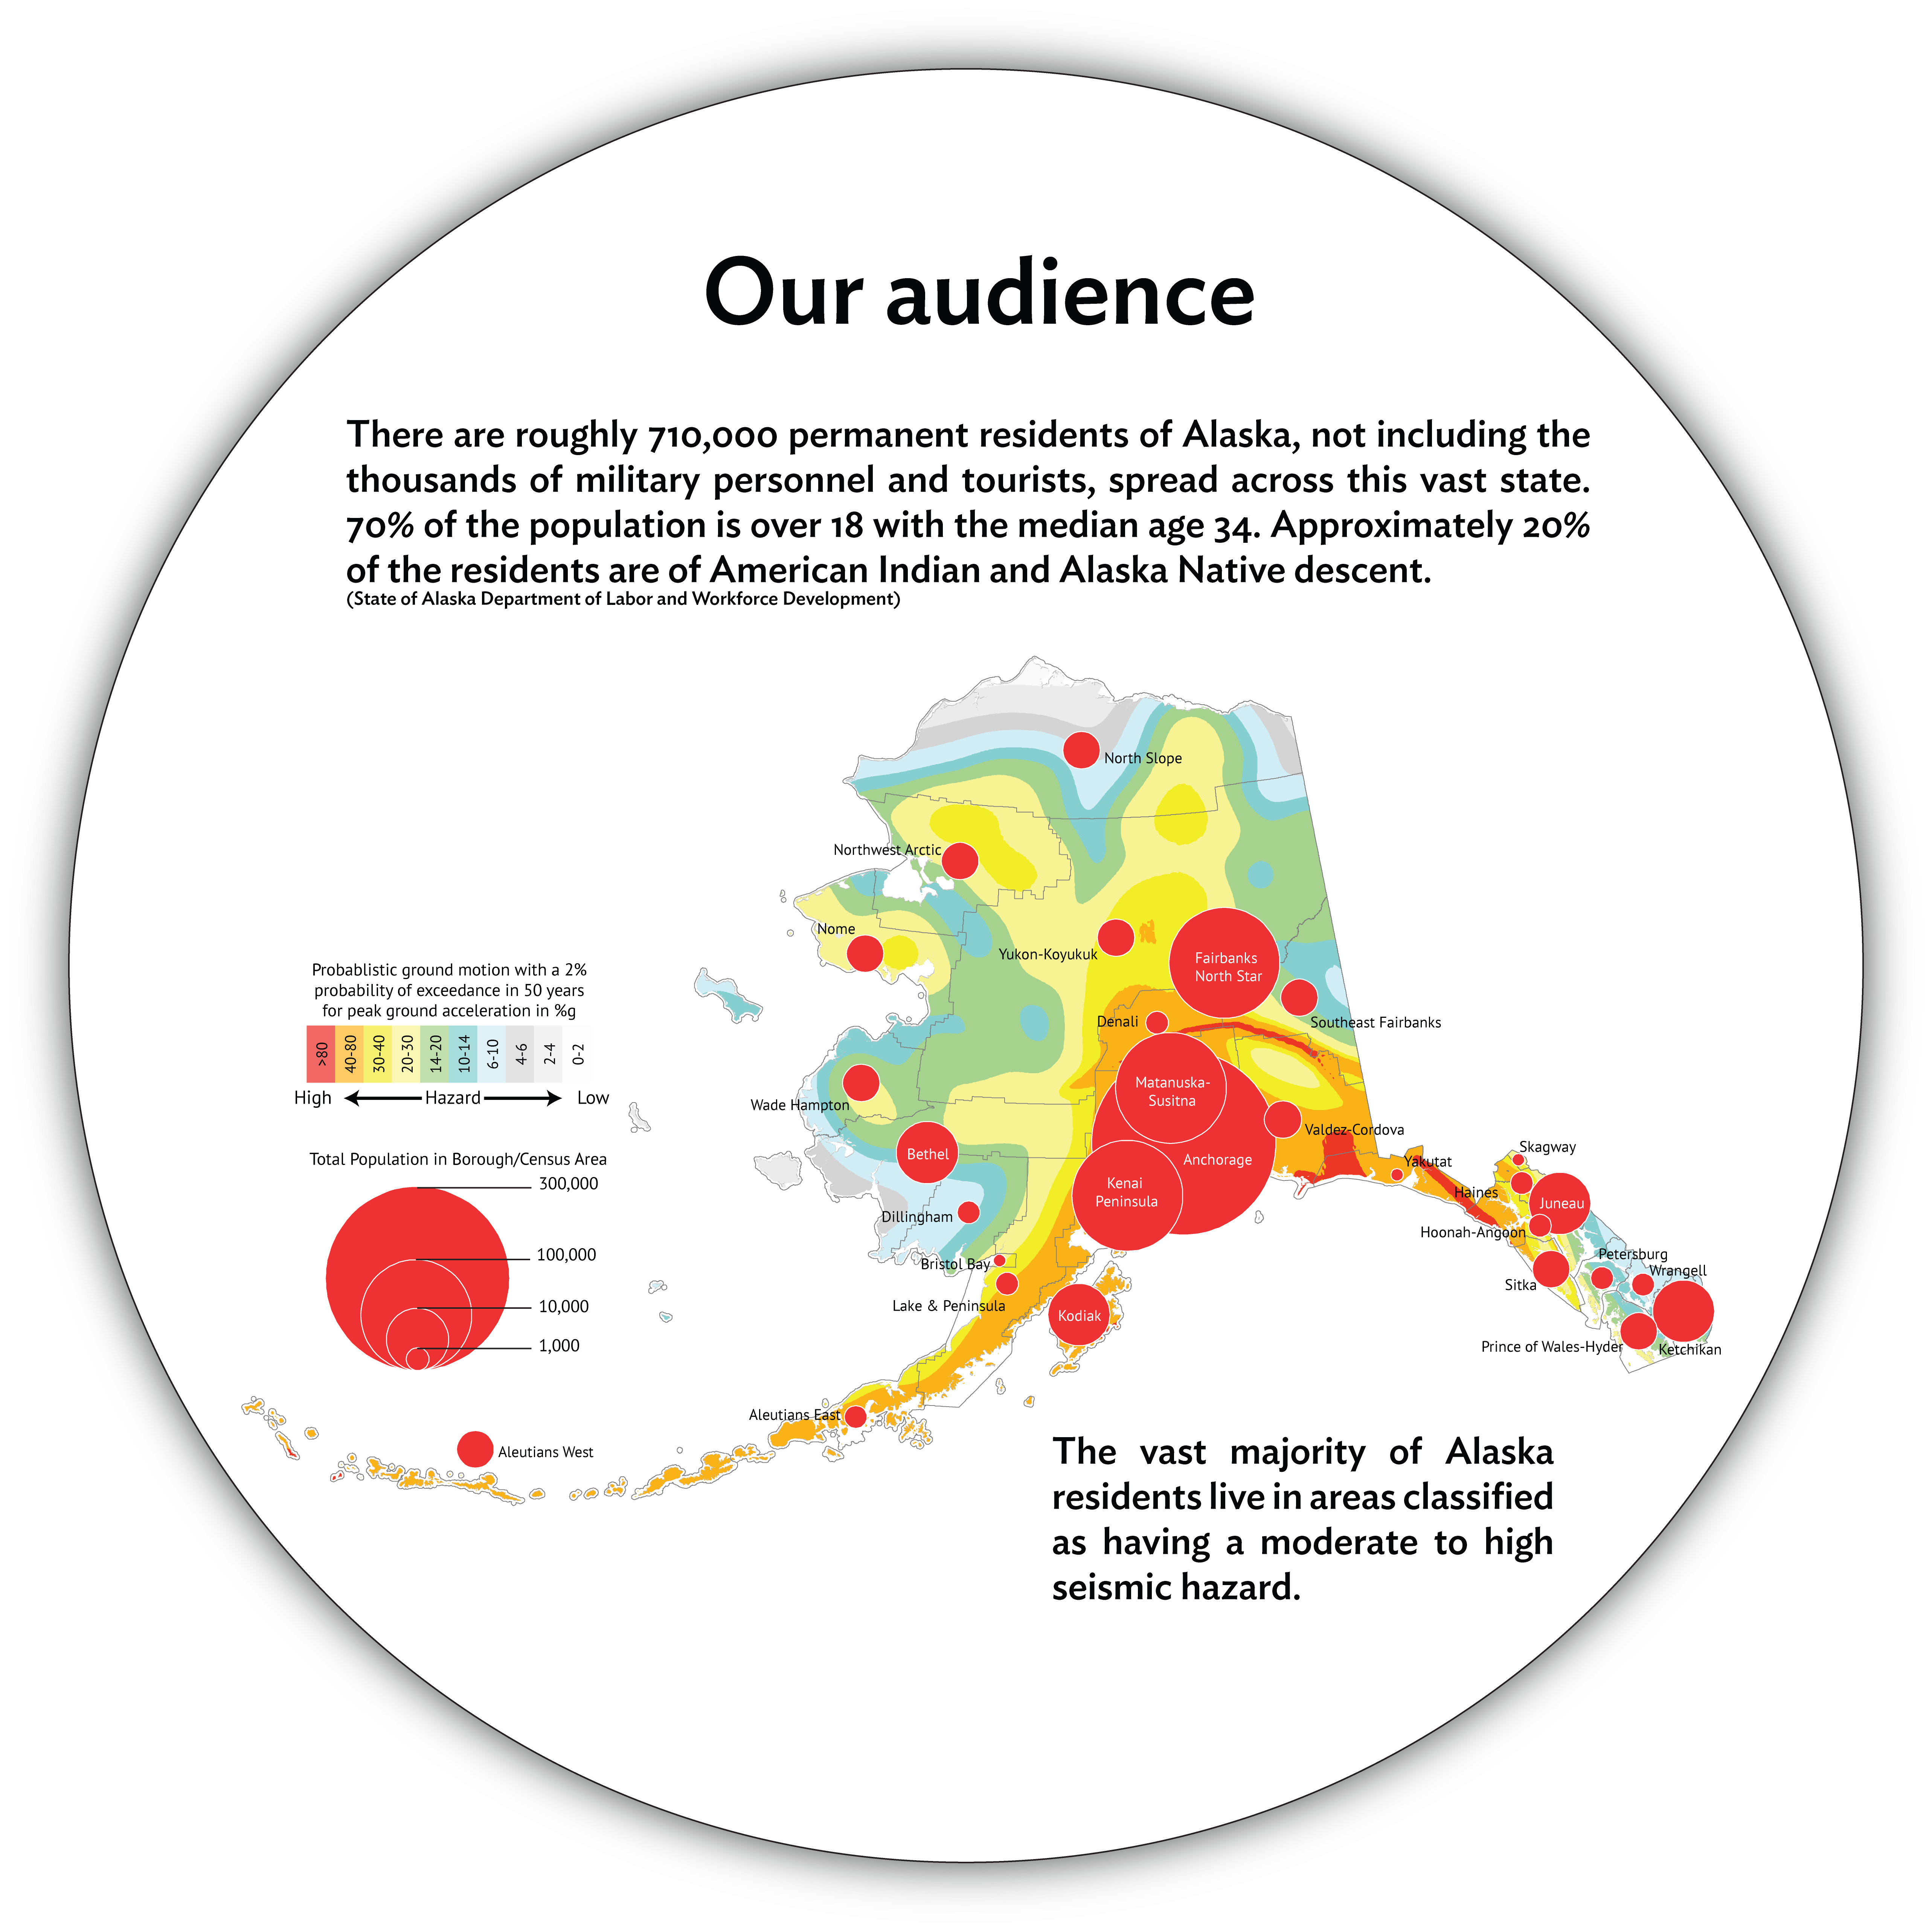

Slide 7
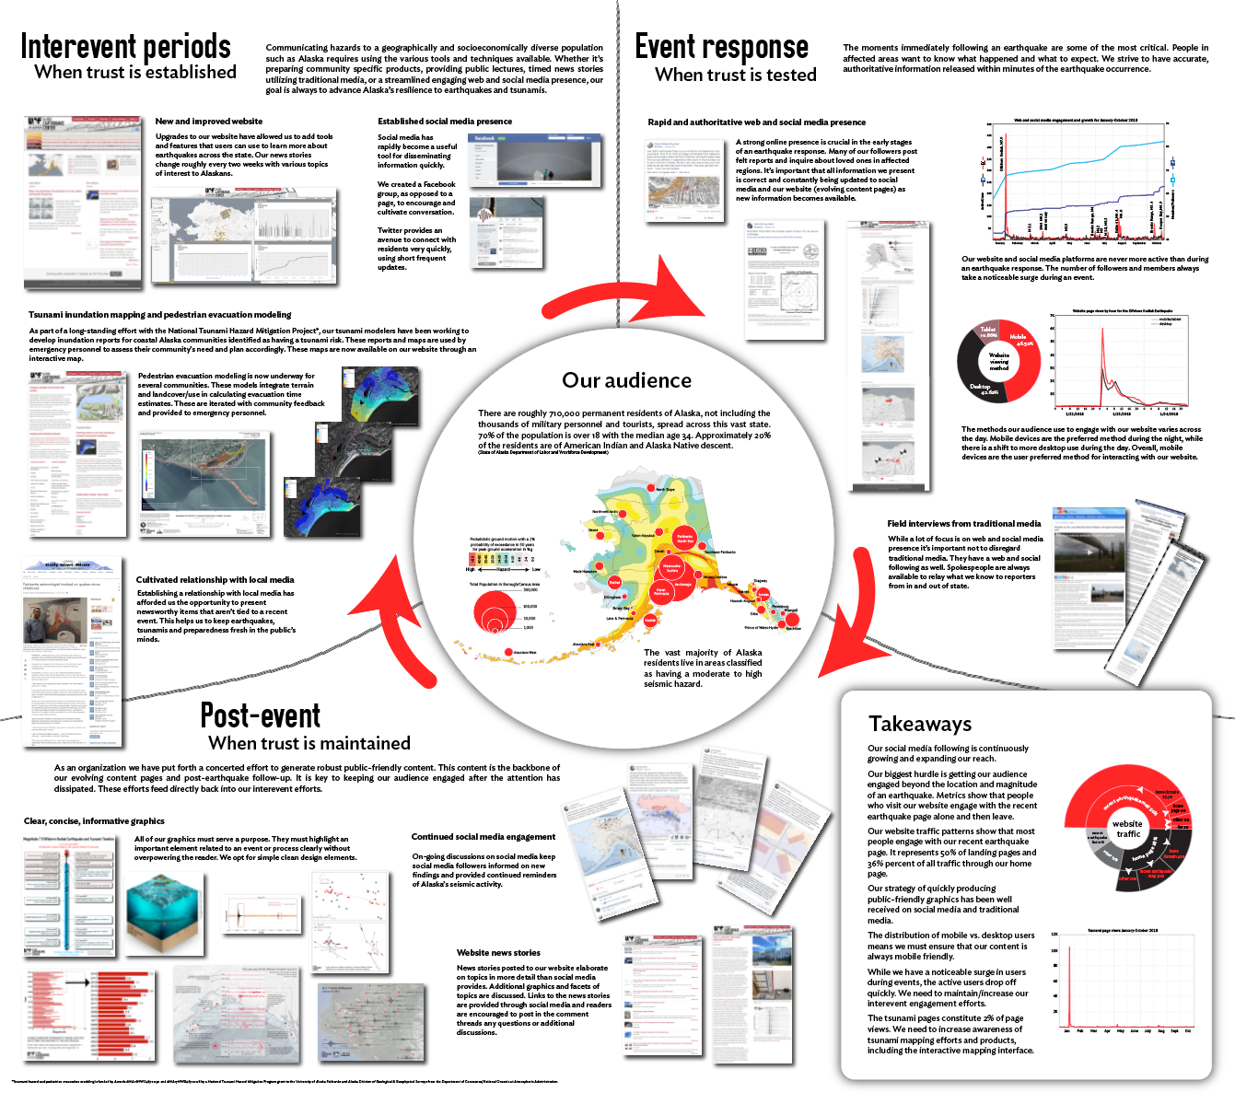

Slide 8
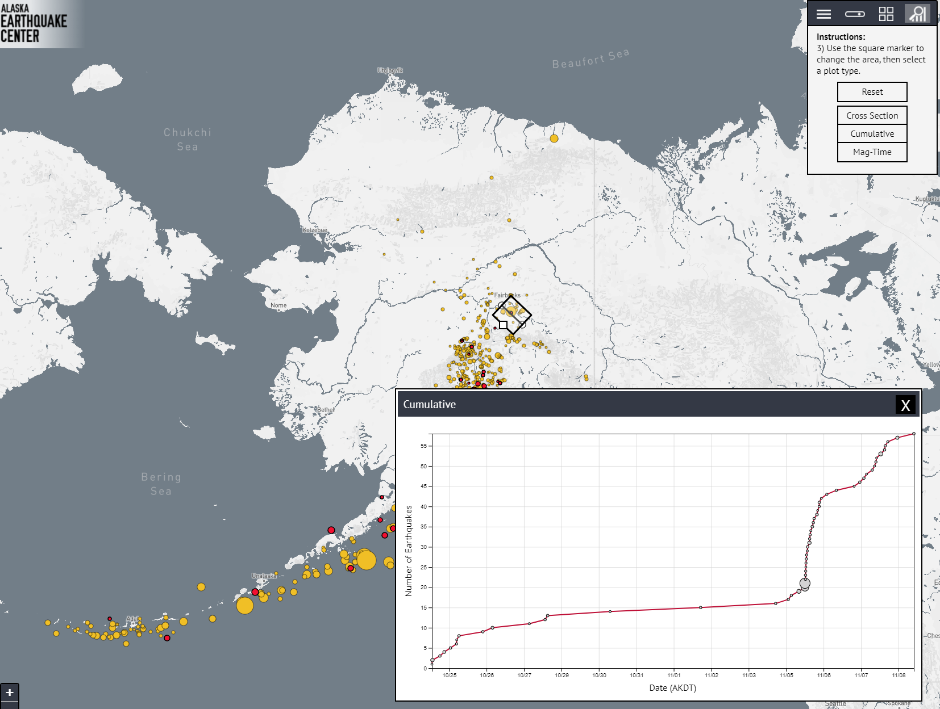
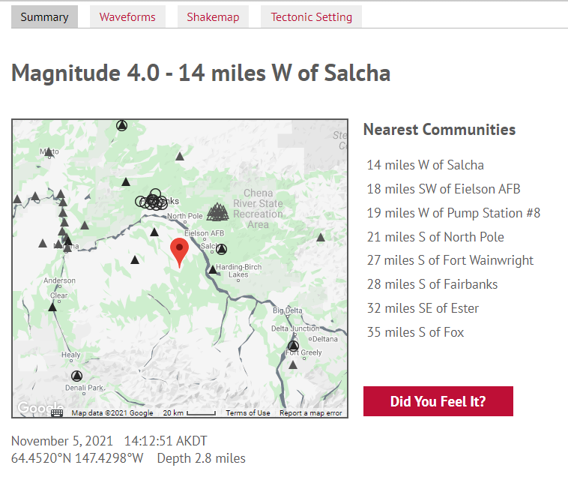
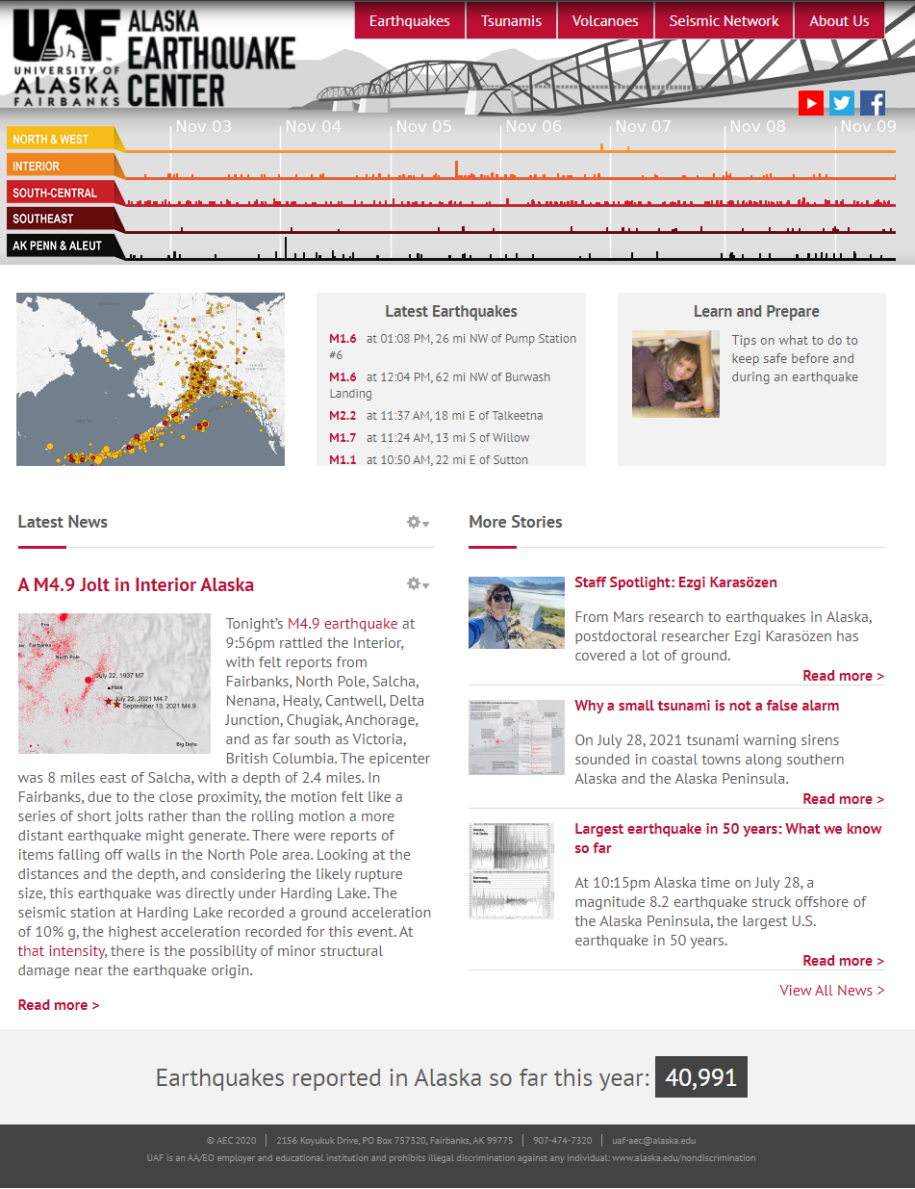
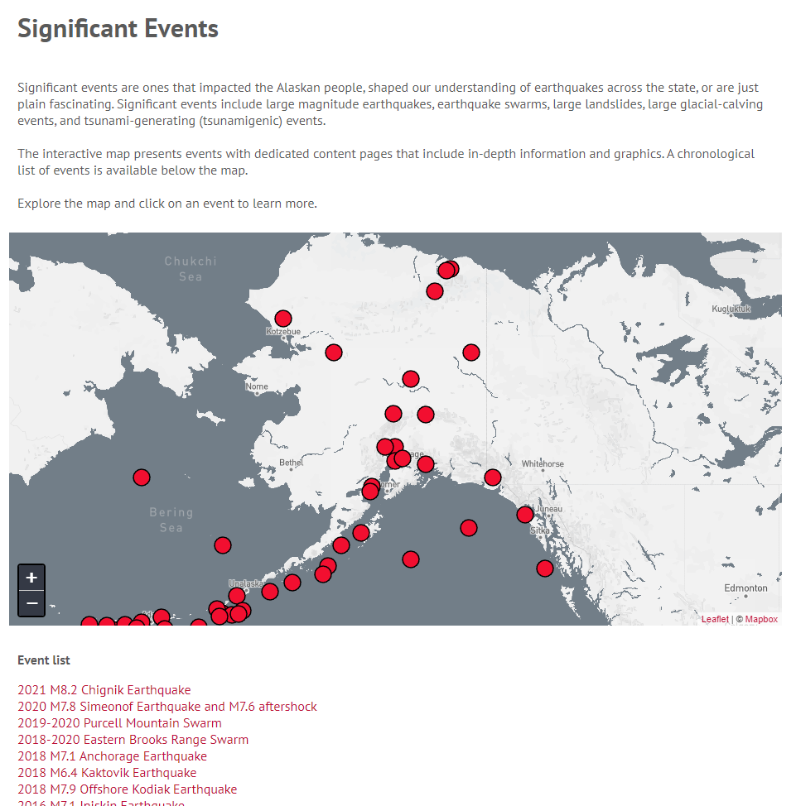
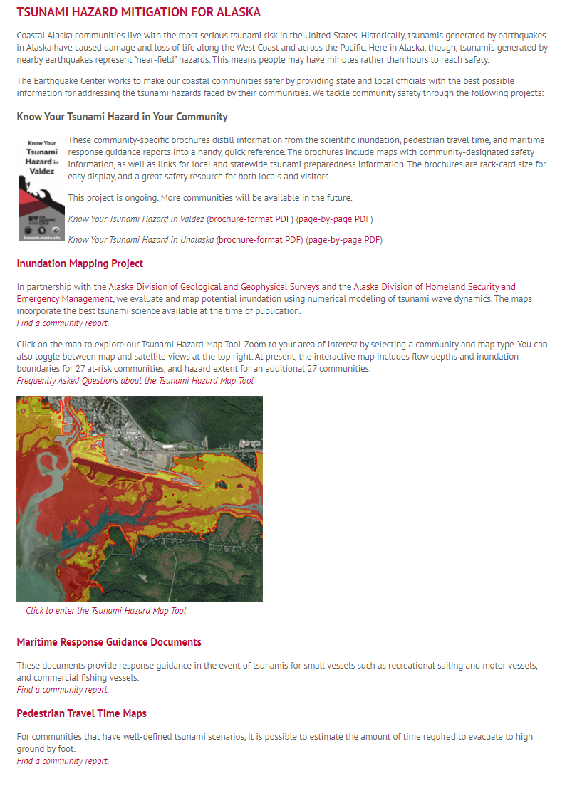
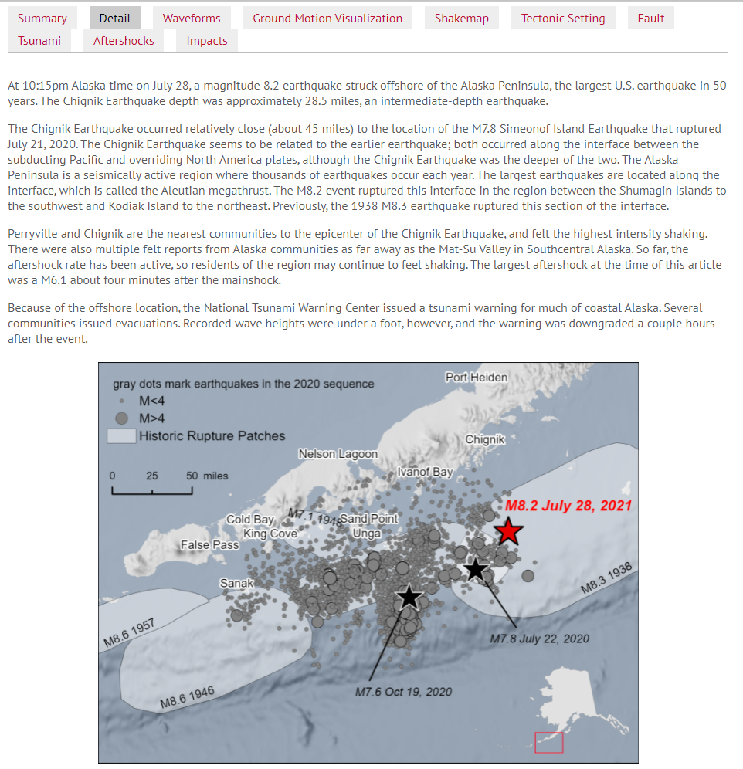
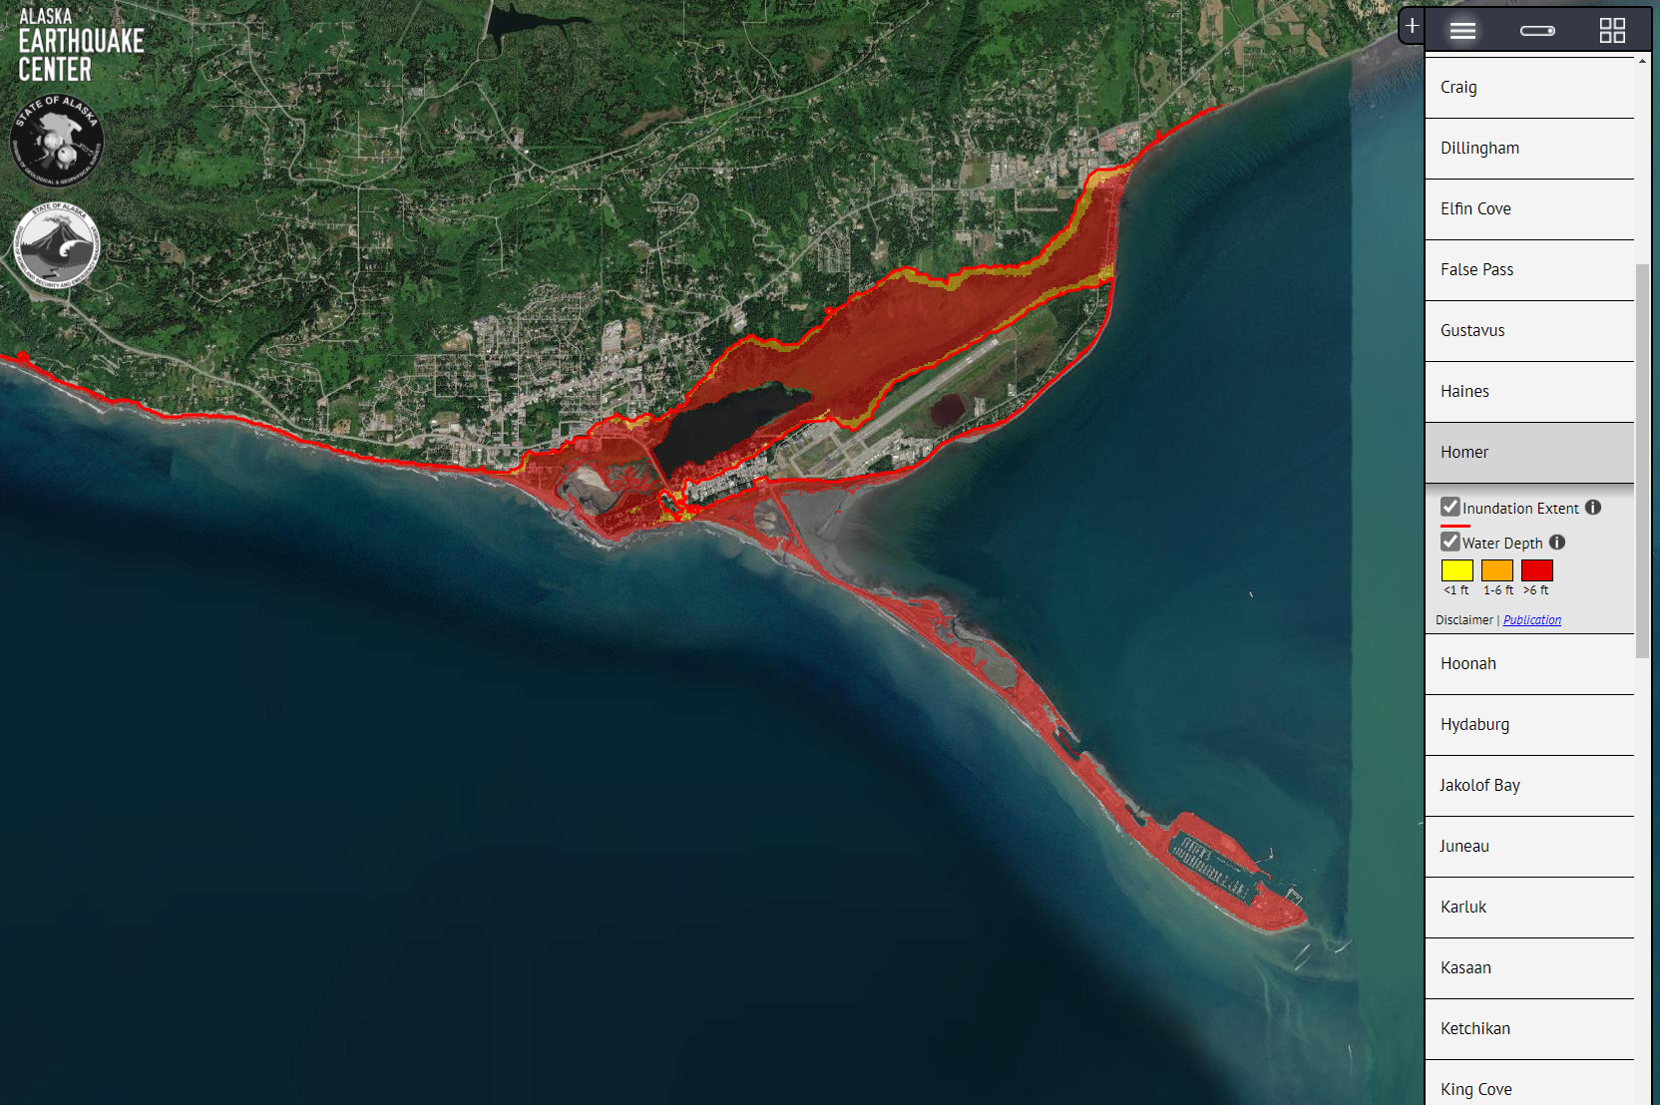
website

Slide 9
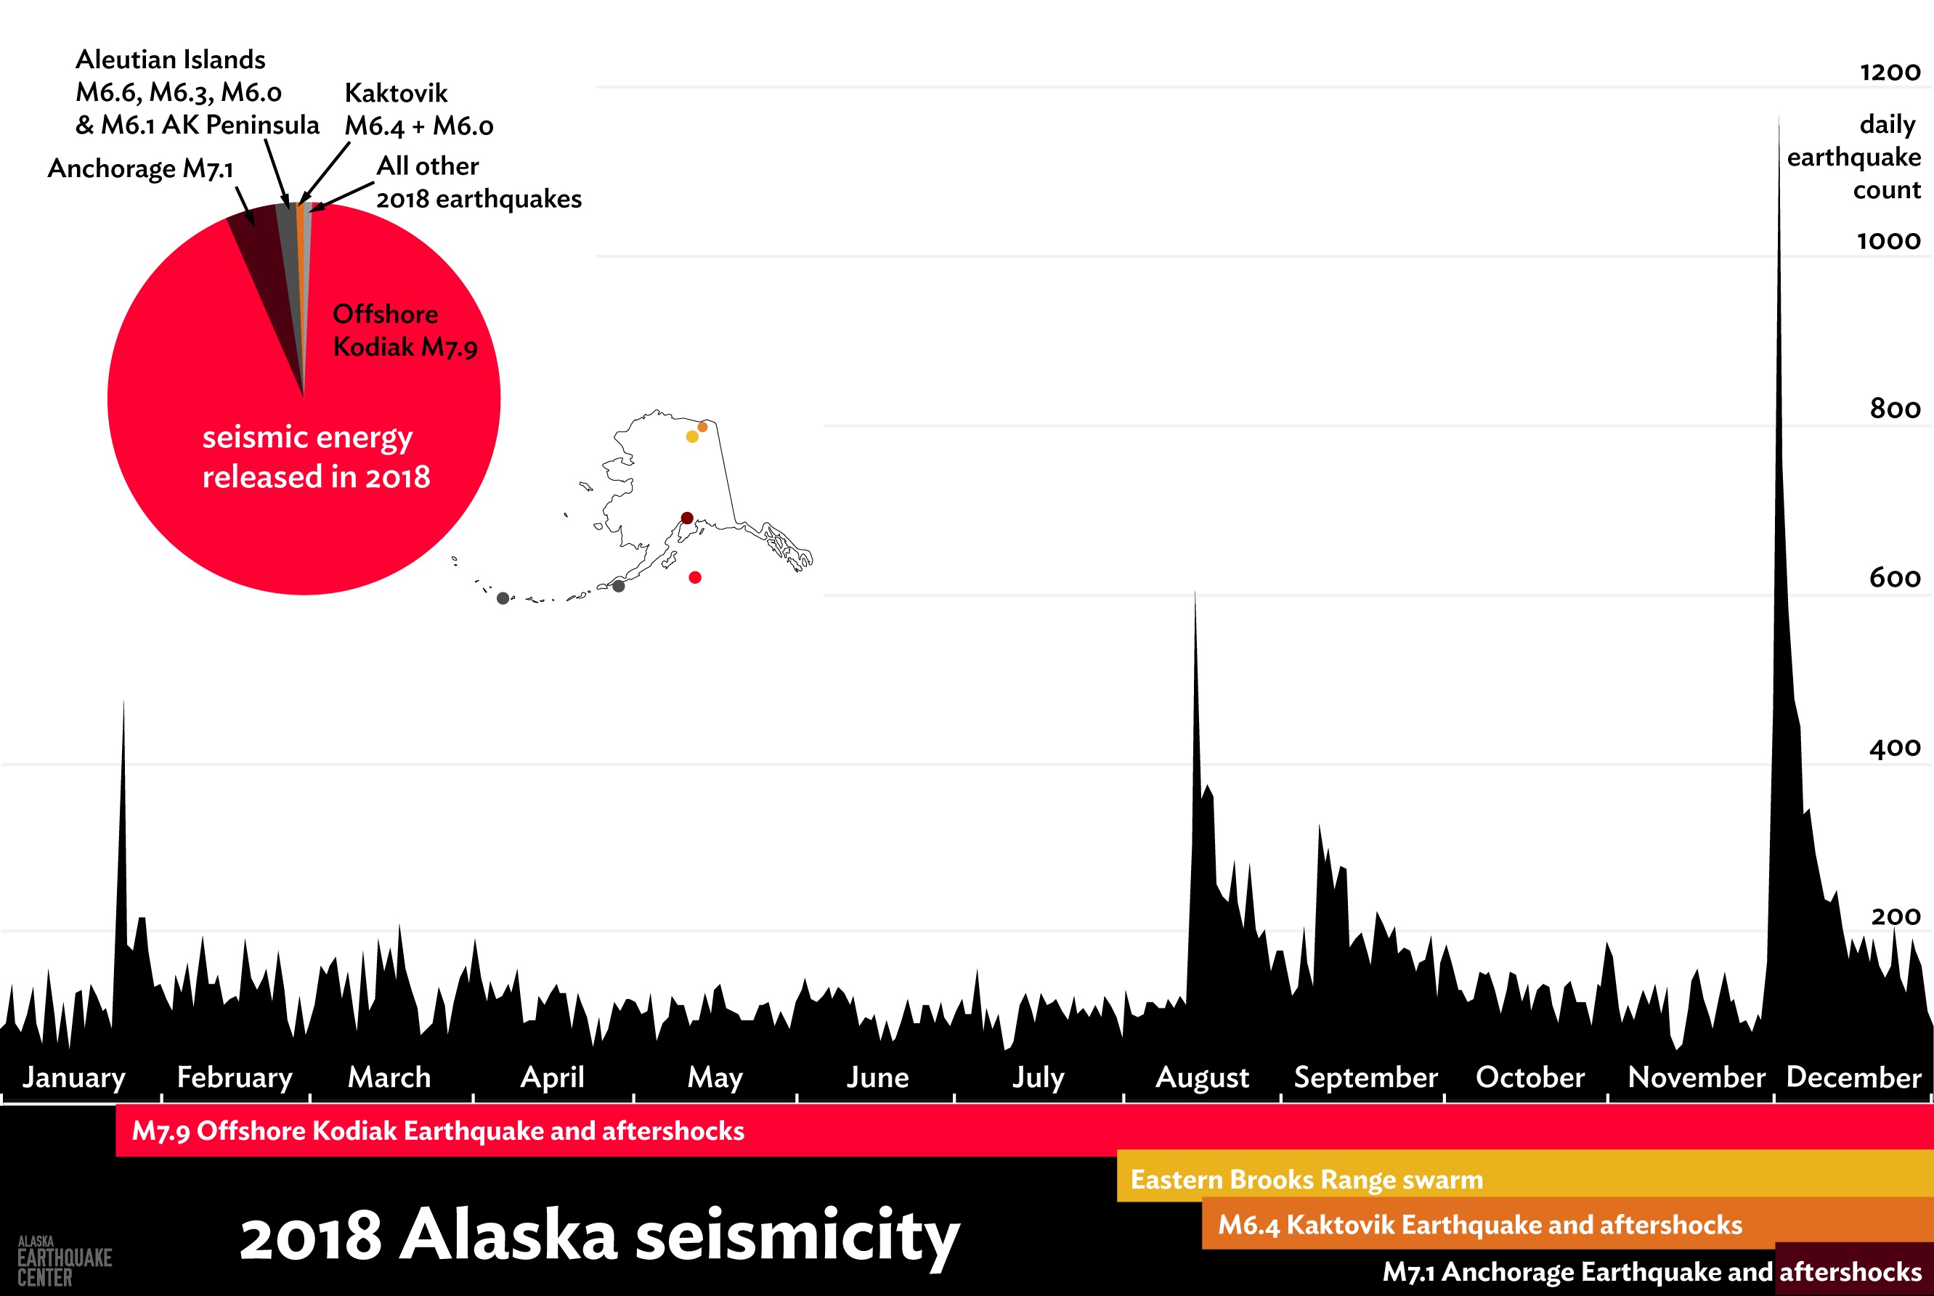
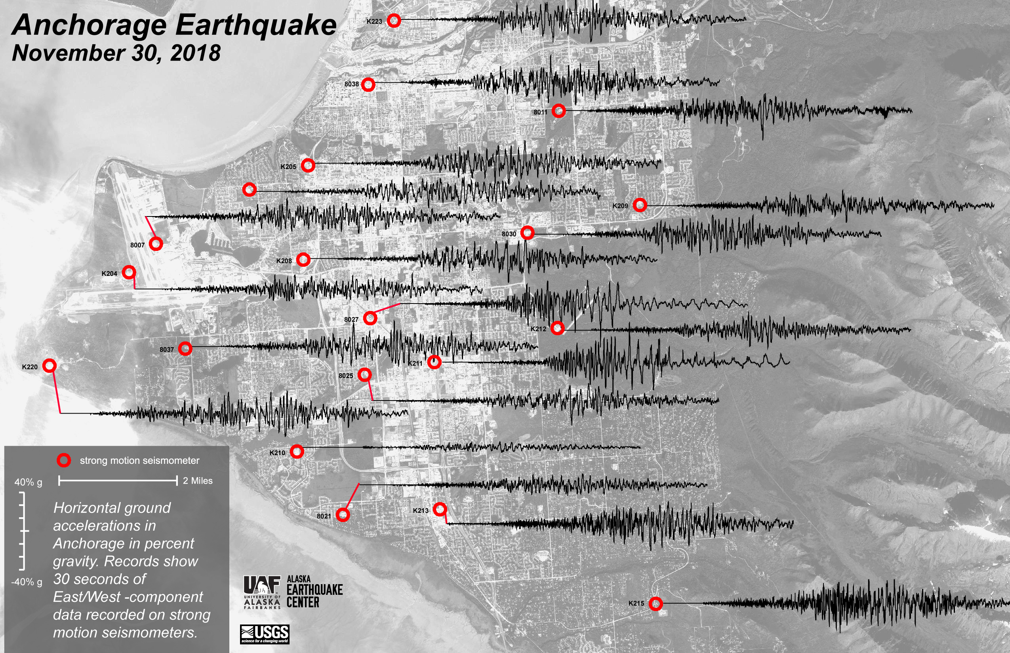
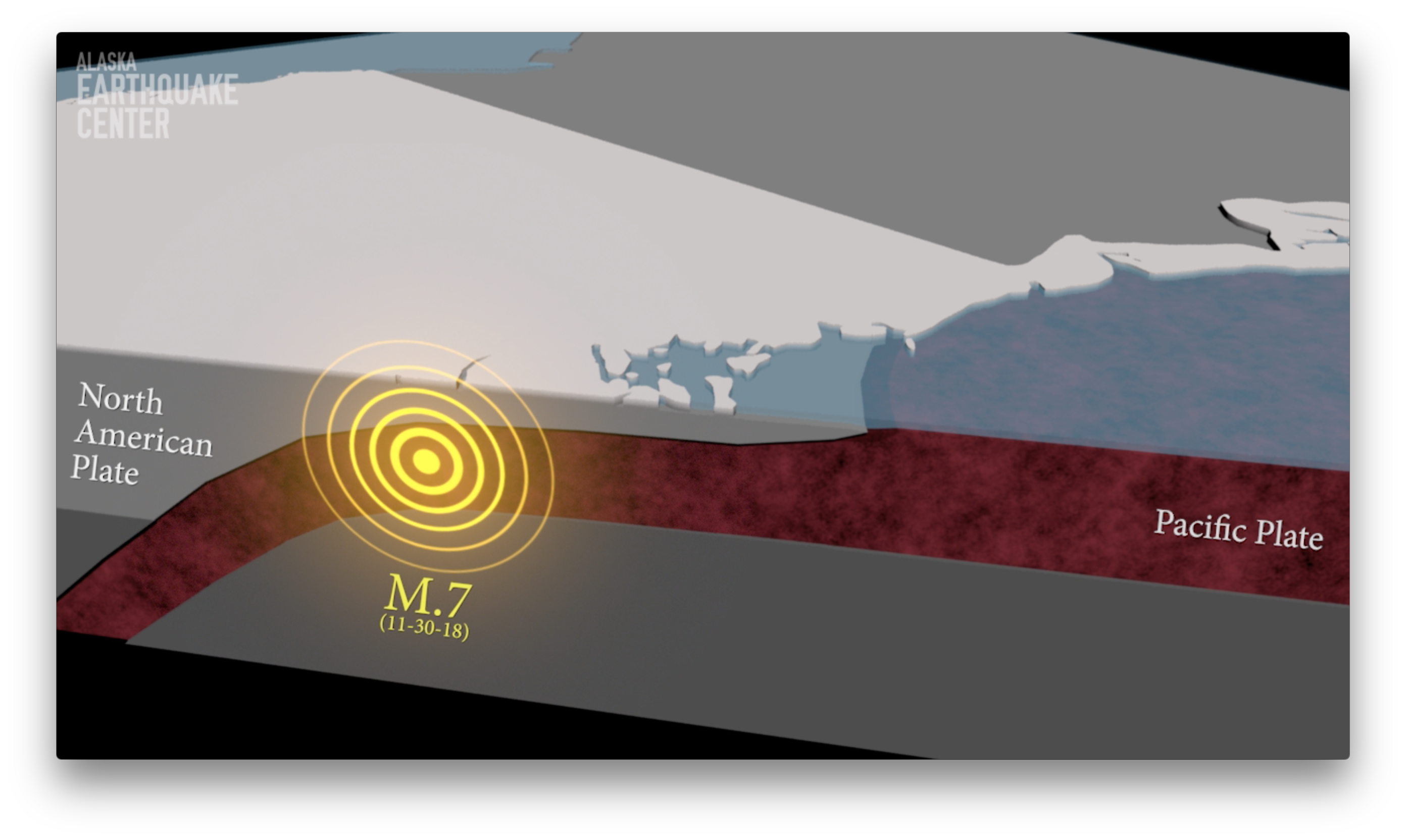
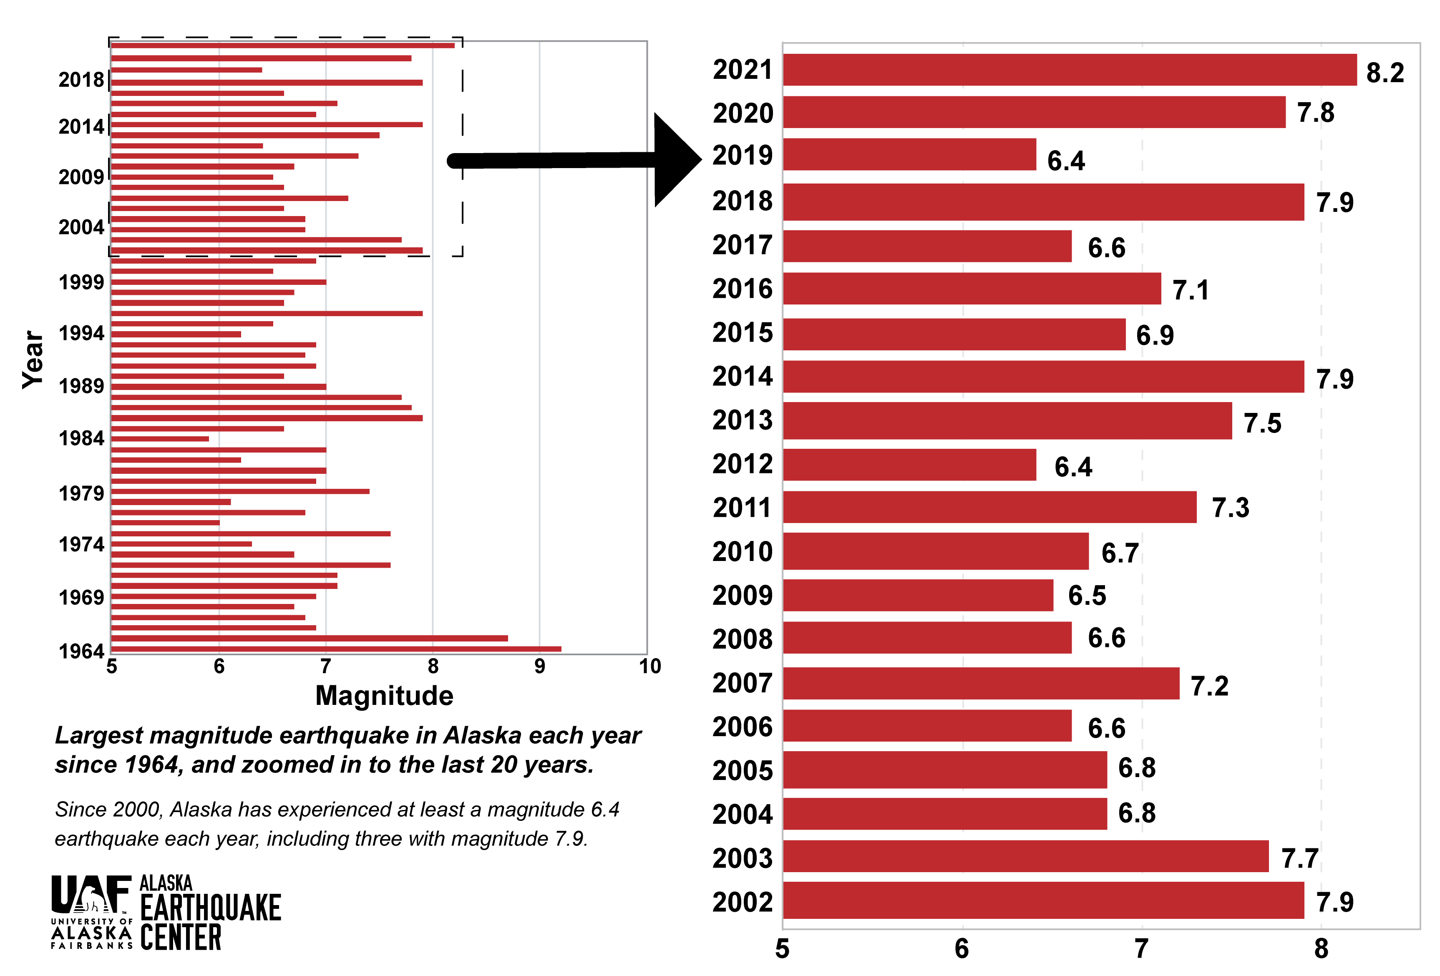
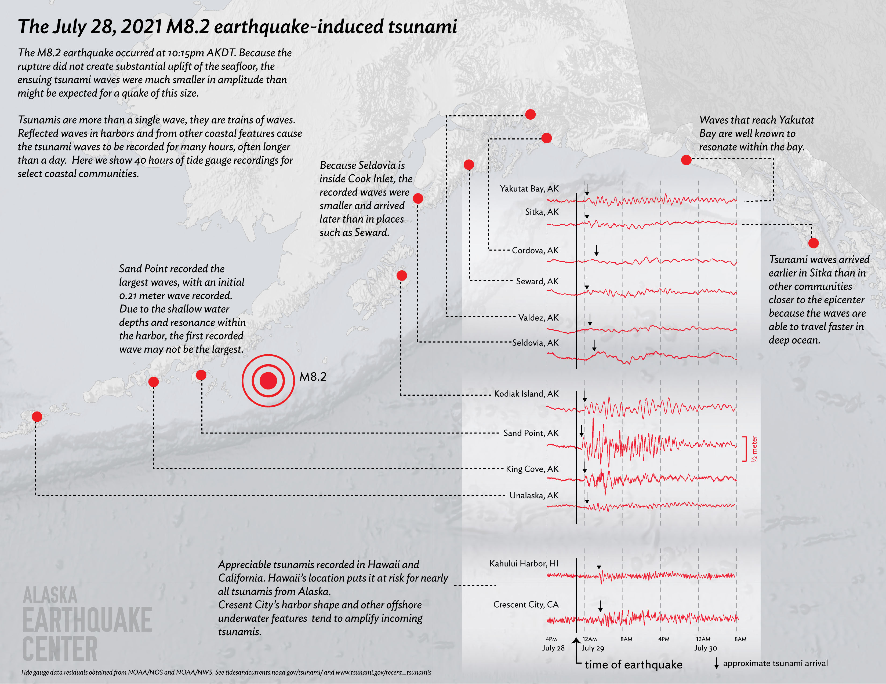
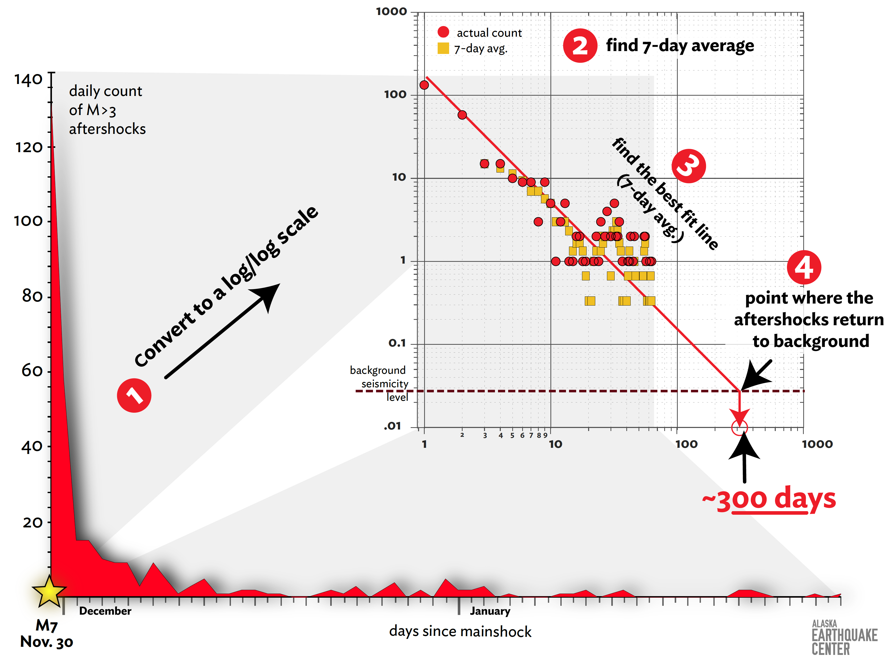
animations and data graphics

Slide 10
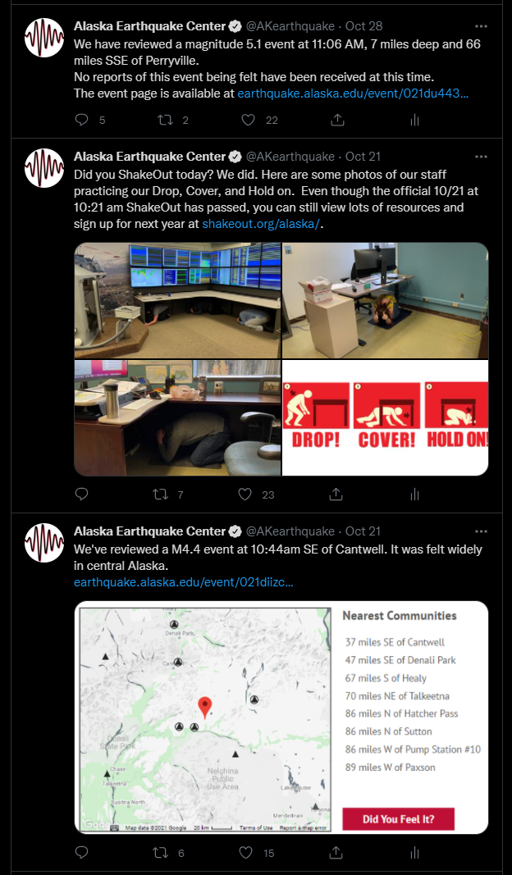
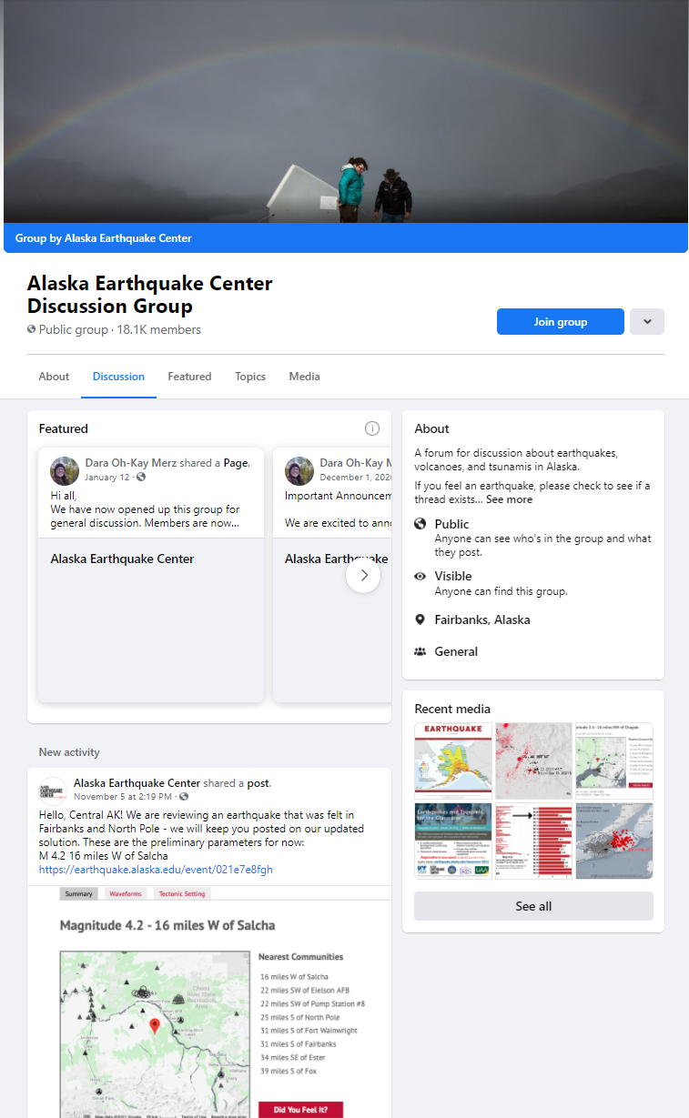
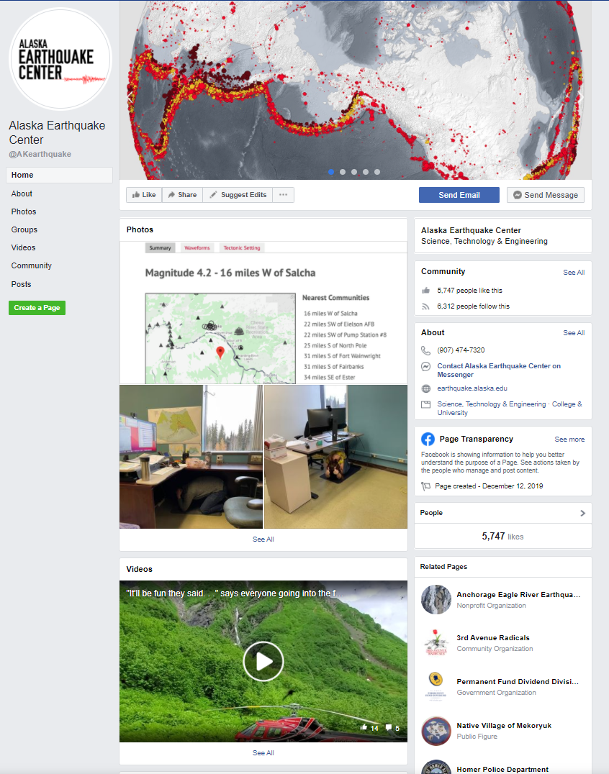
social media
23K Twitter followers
18.1K Facebook Group members
5.7K Facebook Page Likes
6.3K Page Followers

Slide 11
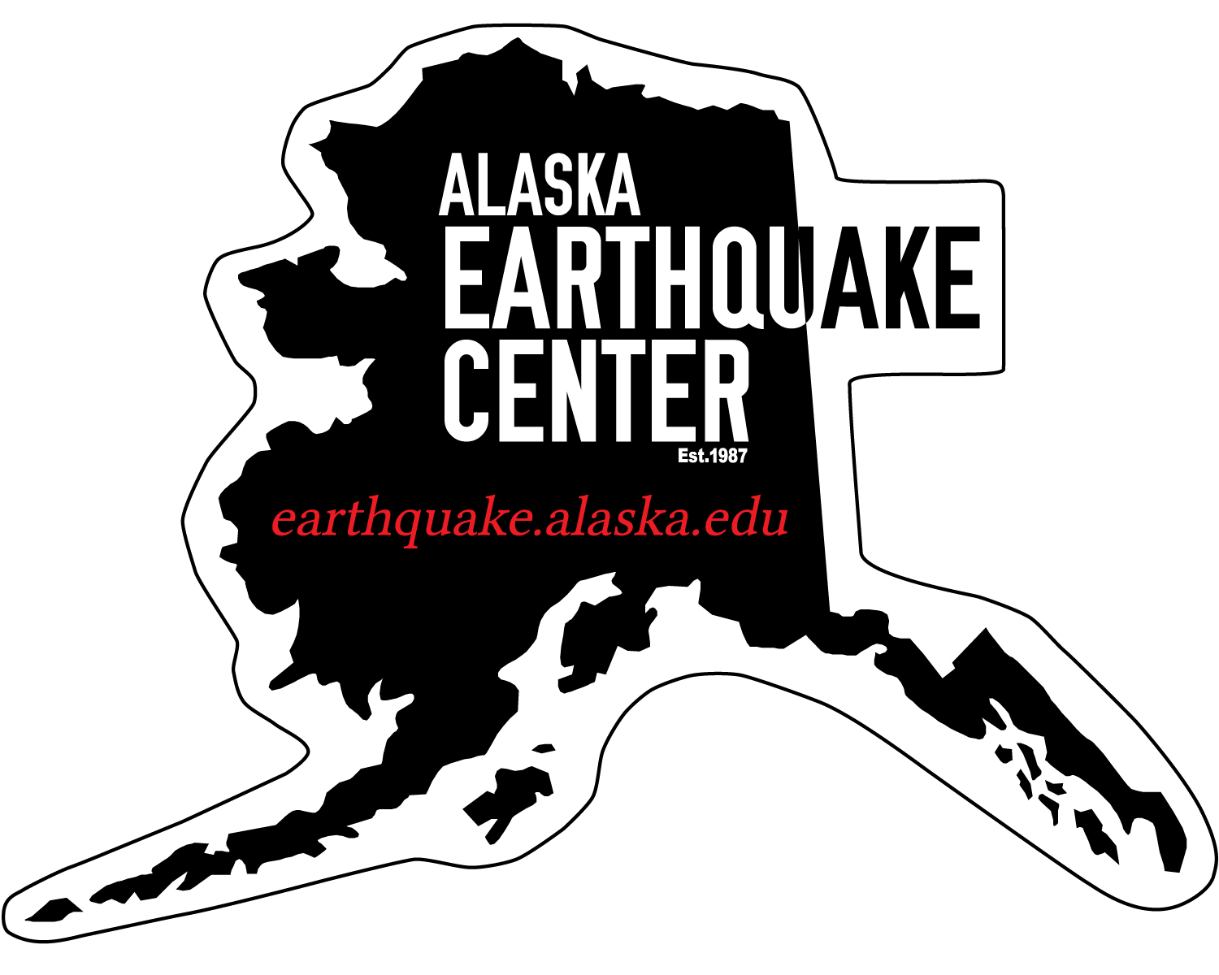
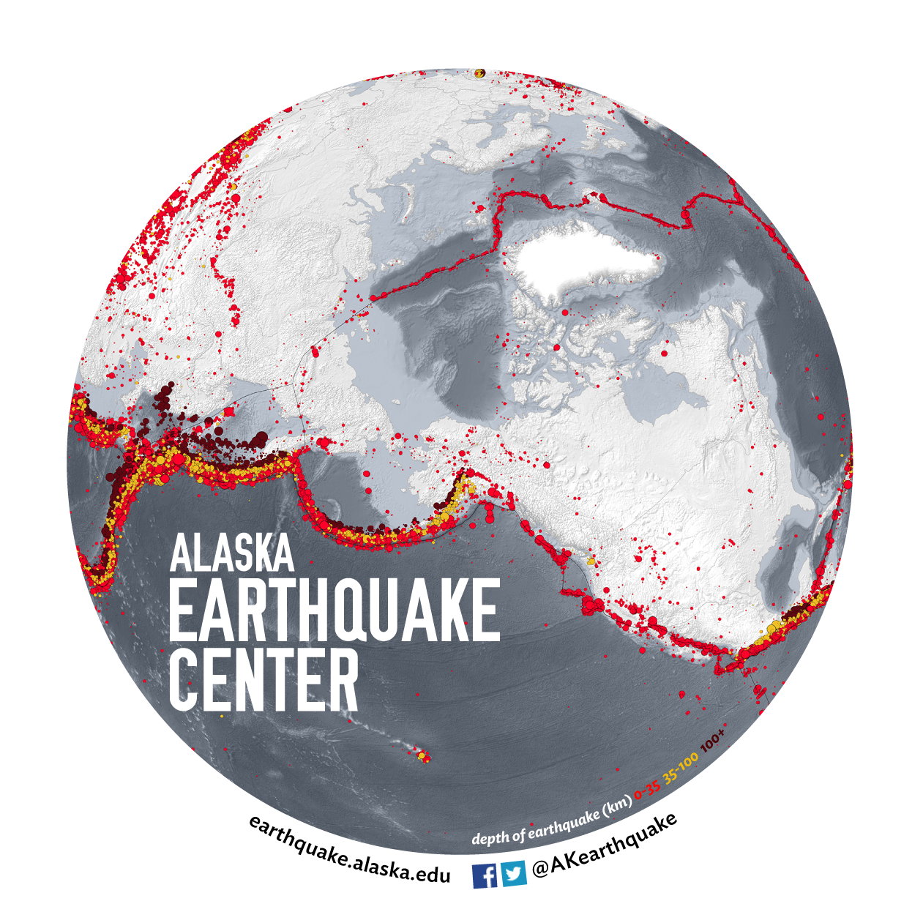

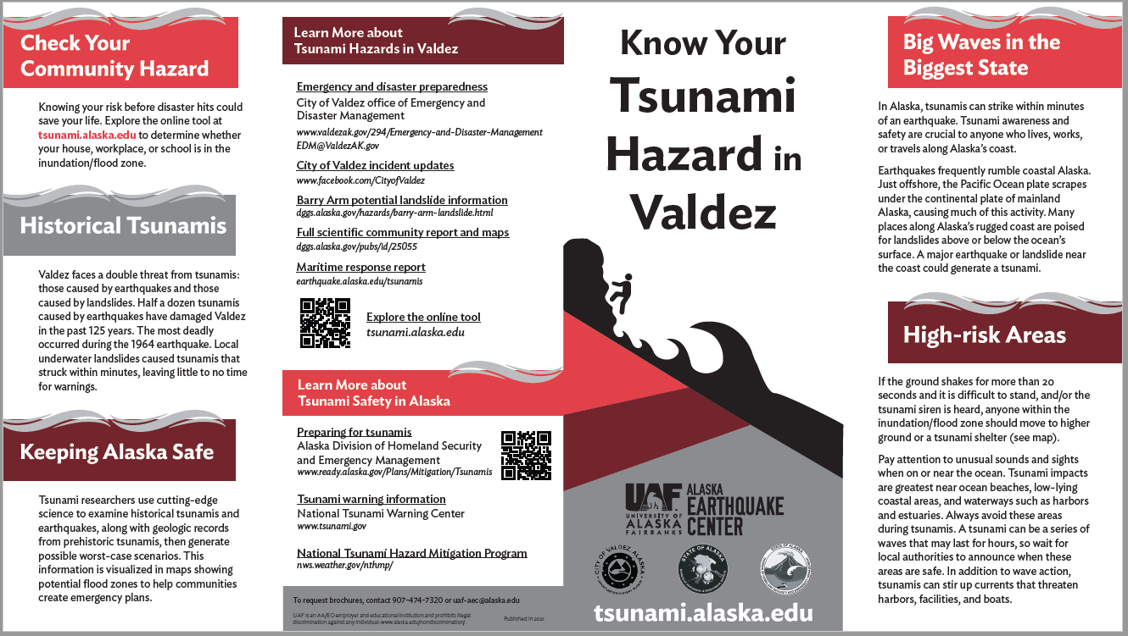
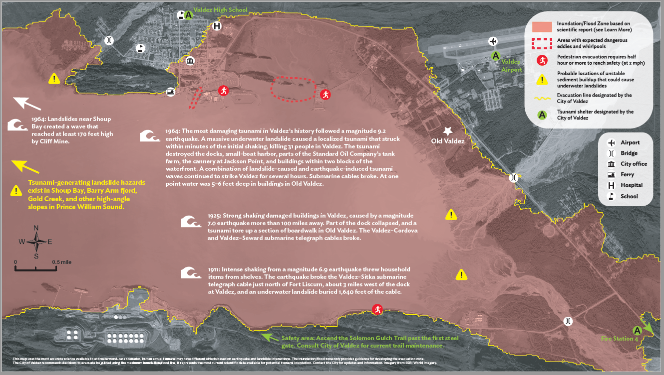
distributable products

Slide 12
challenges & struggles
Combating “predictions”
Several large earthquakes with tsunami warnings/evacuations that haven’t resulted in appreciable waves
Tourists and temporary populations
High turnover of residents, military families, teachers, etc.
Gap in science understanding and preparedness/resilience

