Slide 1


Data Path Redundancy
Chris Bruton and Glenn Biasi
Southern California Seismic Network

Slide 2
Outline
Redundancy, what and why? – 3 min
Topologies in redundant telemetry – 5 min
Case studies, SCSN (Chris Bruton, SCSN) – 15 min
Quick-look summaries, other ANSS networks 2-3 min ea
  Utah, Alaska, ... your network here!
Discussion
Feedback

Slide 3
Redundancy, what and why?
Telemetry Redundancy: Provisioned path alternatives for seismic network traffic.
Why? So data can continue flowing around a failed or non-performing component.
Applications
  Day-to-day: continuity through “ordinary” failures
  Better maintenance options – scheduled repair vs. emergency/after-hours
  Operational continuity, esp. in/after shaking

Slide 4
Redundancy: Magic and Fool’s Gold
Reliability and down-time:
  99% -> 87.6 hrs (~3.6 days)/yr
  99.9% - 8.76 hrs/yr
  99.99% - 53 min/yr
  99.999% - really?
Two independent 99% systems: magic -> 0.9999 availability ☺
Two dependent 99% systems: fool’s gold -> 0.99 availability ☹
Design and components matter

Slide 5
Data Path Redundancy
At the station
  radio-cell combinations
  cell-cell dual provider
From Hubs
  data volume can justify redundant connection
  cell backup
Microwave backbone
  Main strategy: loop
  Exploring fiber drop for loopback
Parallel and redundant data acquisition and processing

Slide 6
Radio-USGS Microwave (SCSN)
Redundant backhaul element
USGS Microwave
router
others
IP Radio
router
Datalogger
IP Radio
IP Radio Pair to Op’ns Center
Acquisition computer
Redundant from the station
T-1 Alternate
Carrier
Acquisition computer
router
EW Ring
3rd-party, opaque
Cell modem
Amazon Cloud Acquisition and Processing
variant: Parallel acquisition and processing

Slide 7
Case Studies
Desert Loop
U.S.G.S. Microwave, Southern California
Recent outage examined

Slide 8
USGS Microwave

Slide 9
USGS Microwave South
T1
Pasadena
525 S Wilson
Idle backup path
Fiber
Data flow direction
Pasadena
South Mudd
Pleasants Pk
Strawberry Pk
Shadow Mtn
Edwards AFB
SSS
PDW
TA2
CFT
HOL
JNH2
EDW2
CJV2
FOX2
MPI
BAC
LPC
HYS
THC
HDH
MPP

Slide 10
USGS Microwave South
T1
Data flow direction
Pasadena
525 S Wilson
Fiber
Data flow direction
Pasadena
South Mudd
Pleasants Pk
Strawberry Pk
Shadow Mtn
Edwards AFB
SSS
PDW
TA2
CFT
HOL
JNH2
EDW2
CJV2
FOX2
MPI
BAC
LPC
HYS
THC
HDH
MPP

Slide 11
USGS Microwave South
T1
Pasadena
525 S Wilson
Idle backup path
Fiber
Data flow direction
Pasadena
South Mudd
Pleasants Pk
Strawberry Pk
Shadow Mtn
Edwards AFB
SSS
PDW
TA2
CFT
HOL
JNH2
EDW2
CJV2
FOX2
MPI
BAC
LPC
HYS
THC
HDH
MPP

Slide 12
USGS Microwave South
T1
Pasadena
525 S Wilson
Fiber
Data flow direction
Pasadena
South Mudd
Pleasants Pk
Strawberry Pk
Shadow Mtn
Edwards AFB
SSS
PDW
TA2
CFT
HOL
JNH2
EDW2
CJV2
FOX2
MPI
BAC
LPC
HYS
THC
HDH
MPP

Slide 13
USGS Microwave South
T1
Pasadena
525 S Wilson
Fiber
No path to Pasadena
Pasadena
South Mudd
Pleasants Pk
Strawberry Pk
Shadow Mtn
Edwards AFB
SSS
PDW
TA2
CFT
HOL
JNH2
EDW2
CJV2
FOX2
MPI
BAC
LPC
HYS
THC
HDH
MPP

Slide 14
USGS Microwave South
T1
Pasadena
525 S Wilson
Cal OES PSC MPLS
Fiber
Data flow direction
Data flow direction
Pasadena
South Mudd
Pleasants Pk
Strawberry Pk
Shadow Mtn
Edwards AFB
SSS
PDW
TA2
CFT
HOL
JNH2
EDW2
CJV2
FOX2
MPI
BAC
LPC
HYS
THC
HDH
MPP

Slide 15
USGS Microwave South
T1
Pasadena
525 S Wilson
Idle backup path
Cal OES PSC MPLS
Fiber
Load balanced flow
Load balanced flow
Data flow direction
Pasadena
South Mudd
Pleasants Pk
Strawberry Pk
Shadow Mtn
Edwards AFB
SSS
PDW
TA2
CFT
HOL
JNH2
EDW2
CJV2
FOX2
MPI
BAC
LPC
HYS
THC
HDH
MPP

Slide 16
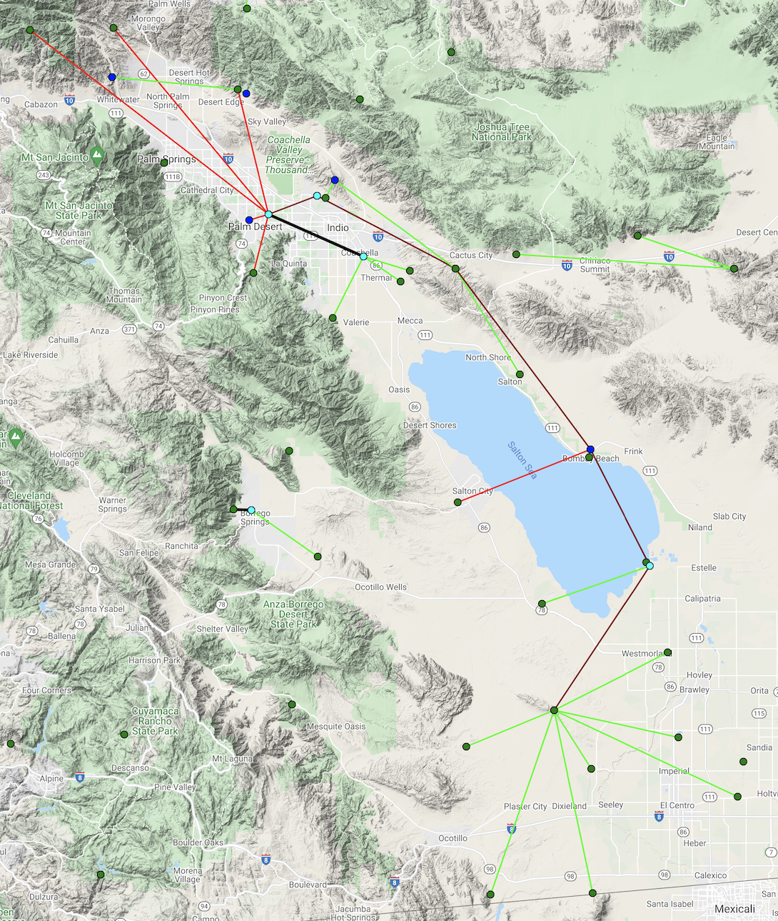
Desert Loop
XPDT
T1
Private radio links between hubs in a geographic area
Allows stations to share Internet and T1 access
Many redundant paths – even multiple failures will not bring stations down
Routers use OSPF dynamic routing to determine the best path
XSSW
T1
Map:
https://anss-sis.scsn.org/sis/sites/telconn/?operatorids=24

Slide 17
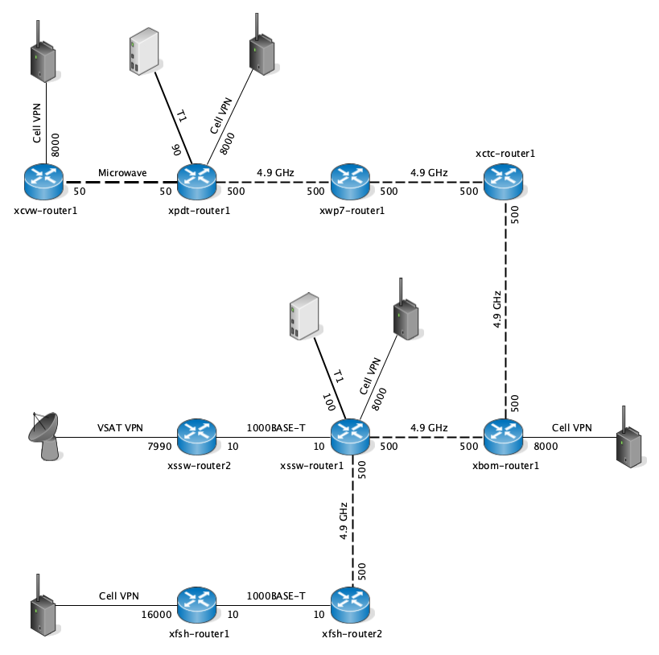
XPDT
T1
Desert Loop Network
36 active stations
4+ more planned
XCTC
CI.CACT
CI.CTC
CI.IDO
CI.IDOG
CI.IDQ
CI.IDQG
CI.SLB
XPDT
T1
XCVW
CI.THM
CI.THMG
CI.TOR
NP.5444
XPDT
CI.PMD
CI.COTD
CI.WWC
CI.WWMT
CI.WIDC
CI.SNO
CI.SNOG
CI.MSC
CI.MSCG
XSSW
T1
XBOM Planned:
CI.BOM
CI.BOMG
CI.SAL
NP.5271
XSSW
T1
XSSW
CI.ERR
CI.ERRG
CI.RXH
XFSH
CI.WMD
CI.WMDG
CI.IMP
CI.CRR
CI.COK2
CI.COKG
CI.DRE
CI.YUH2
CI.YUHG
CI.SGL
CI.SGLG
CI.SWS
CI.FSHB

Slide 18
Network Dialog
Examples from other networks
  Alaska
  Oregon
  Utah and Others

Slide 19
Alaska Earthquake Center
Data routing redundancy
Nate Murphy
NetOps 2021

Slide 20
AWS backup routing and data acquisition system
Initial development began in summer, 2019.
Mikrotik CHR instance serves as the VPN endpoint for field network tunnels
  AWS t2.micro instance and single AWS elastic (public) IP
  Consistent tunnel configurations with Mikrotik RB750 field routers
  Prefer L2TP VPN tunnels
  Tunnels remain active, route priority settings on field routers determines data path.
Separate AWS instances host data acquisition, processing, and development VMs
Provides alternate routing options or full backup data acquisition
  UA Cisco ASA firewall occasionally blocks a subset of our field VPN connections -> backup route through AWS
  Full local server or network outage -> AWS backup acquisition system takes over

Slide 21
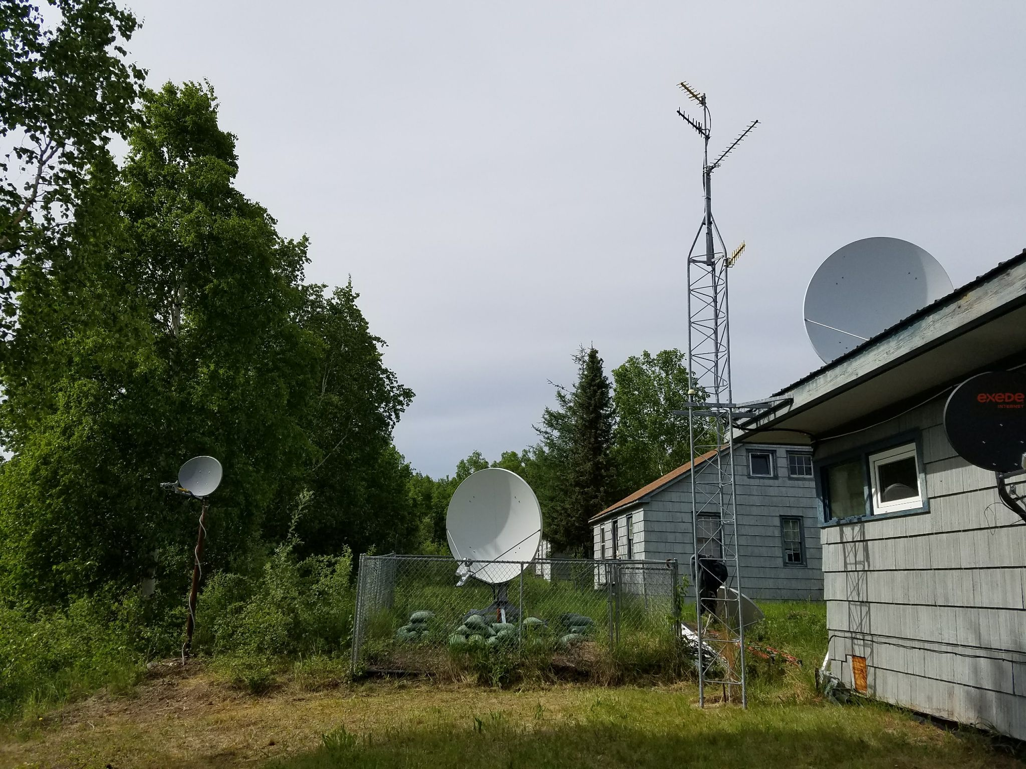
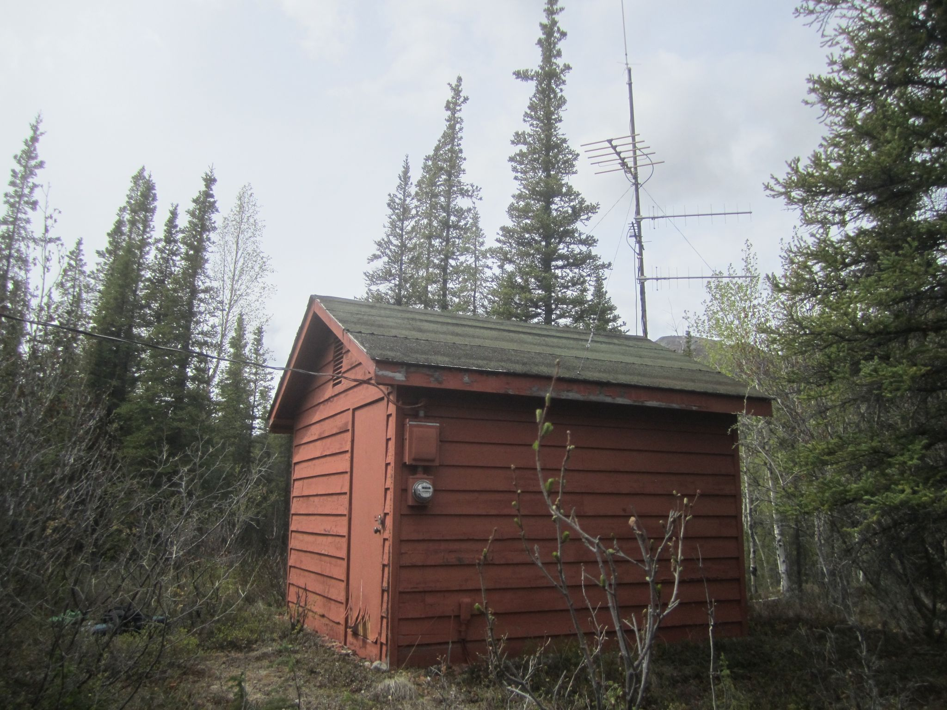
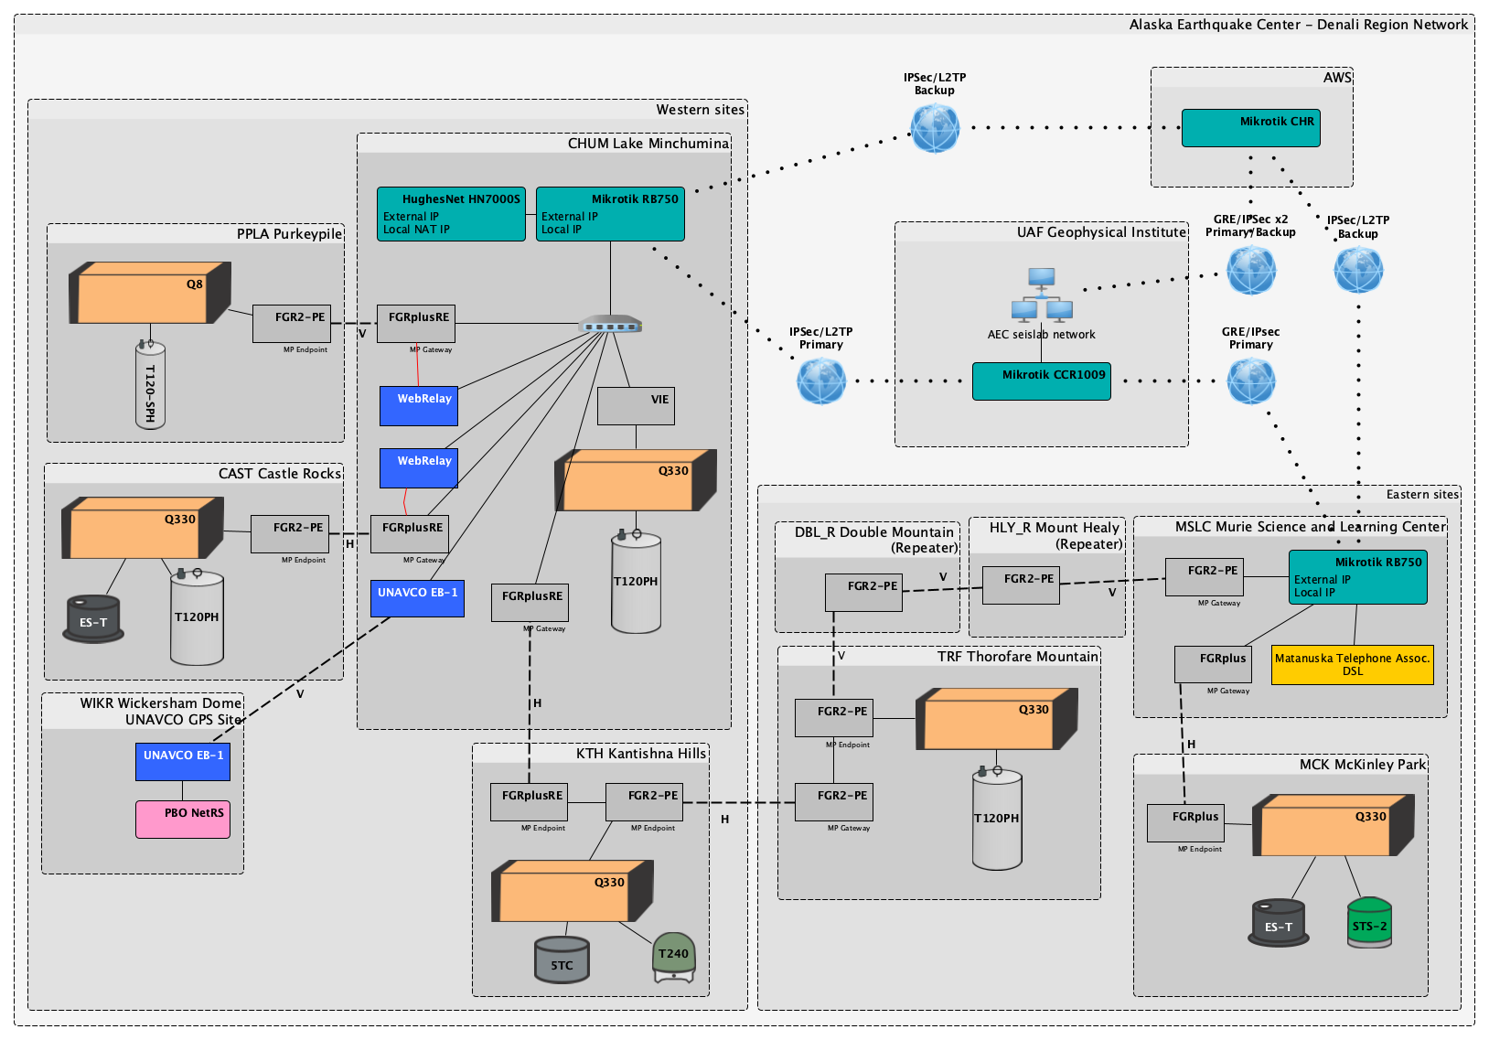
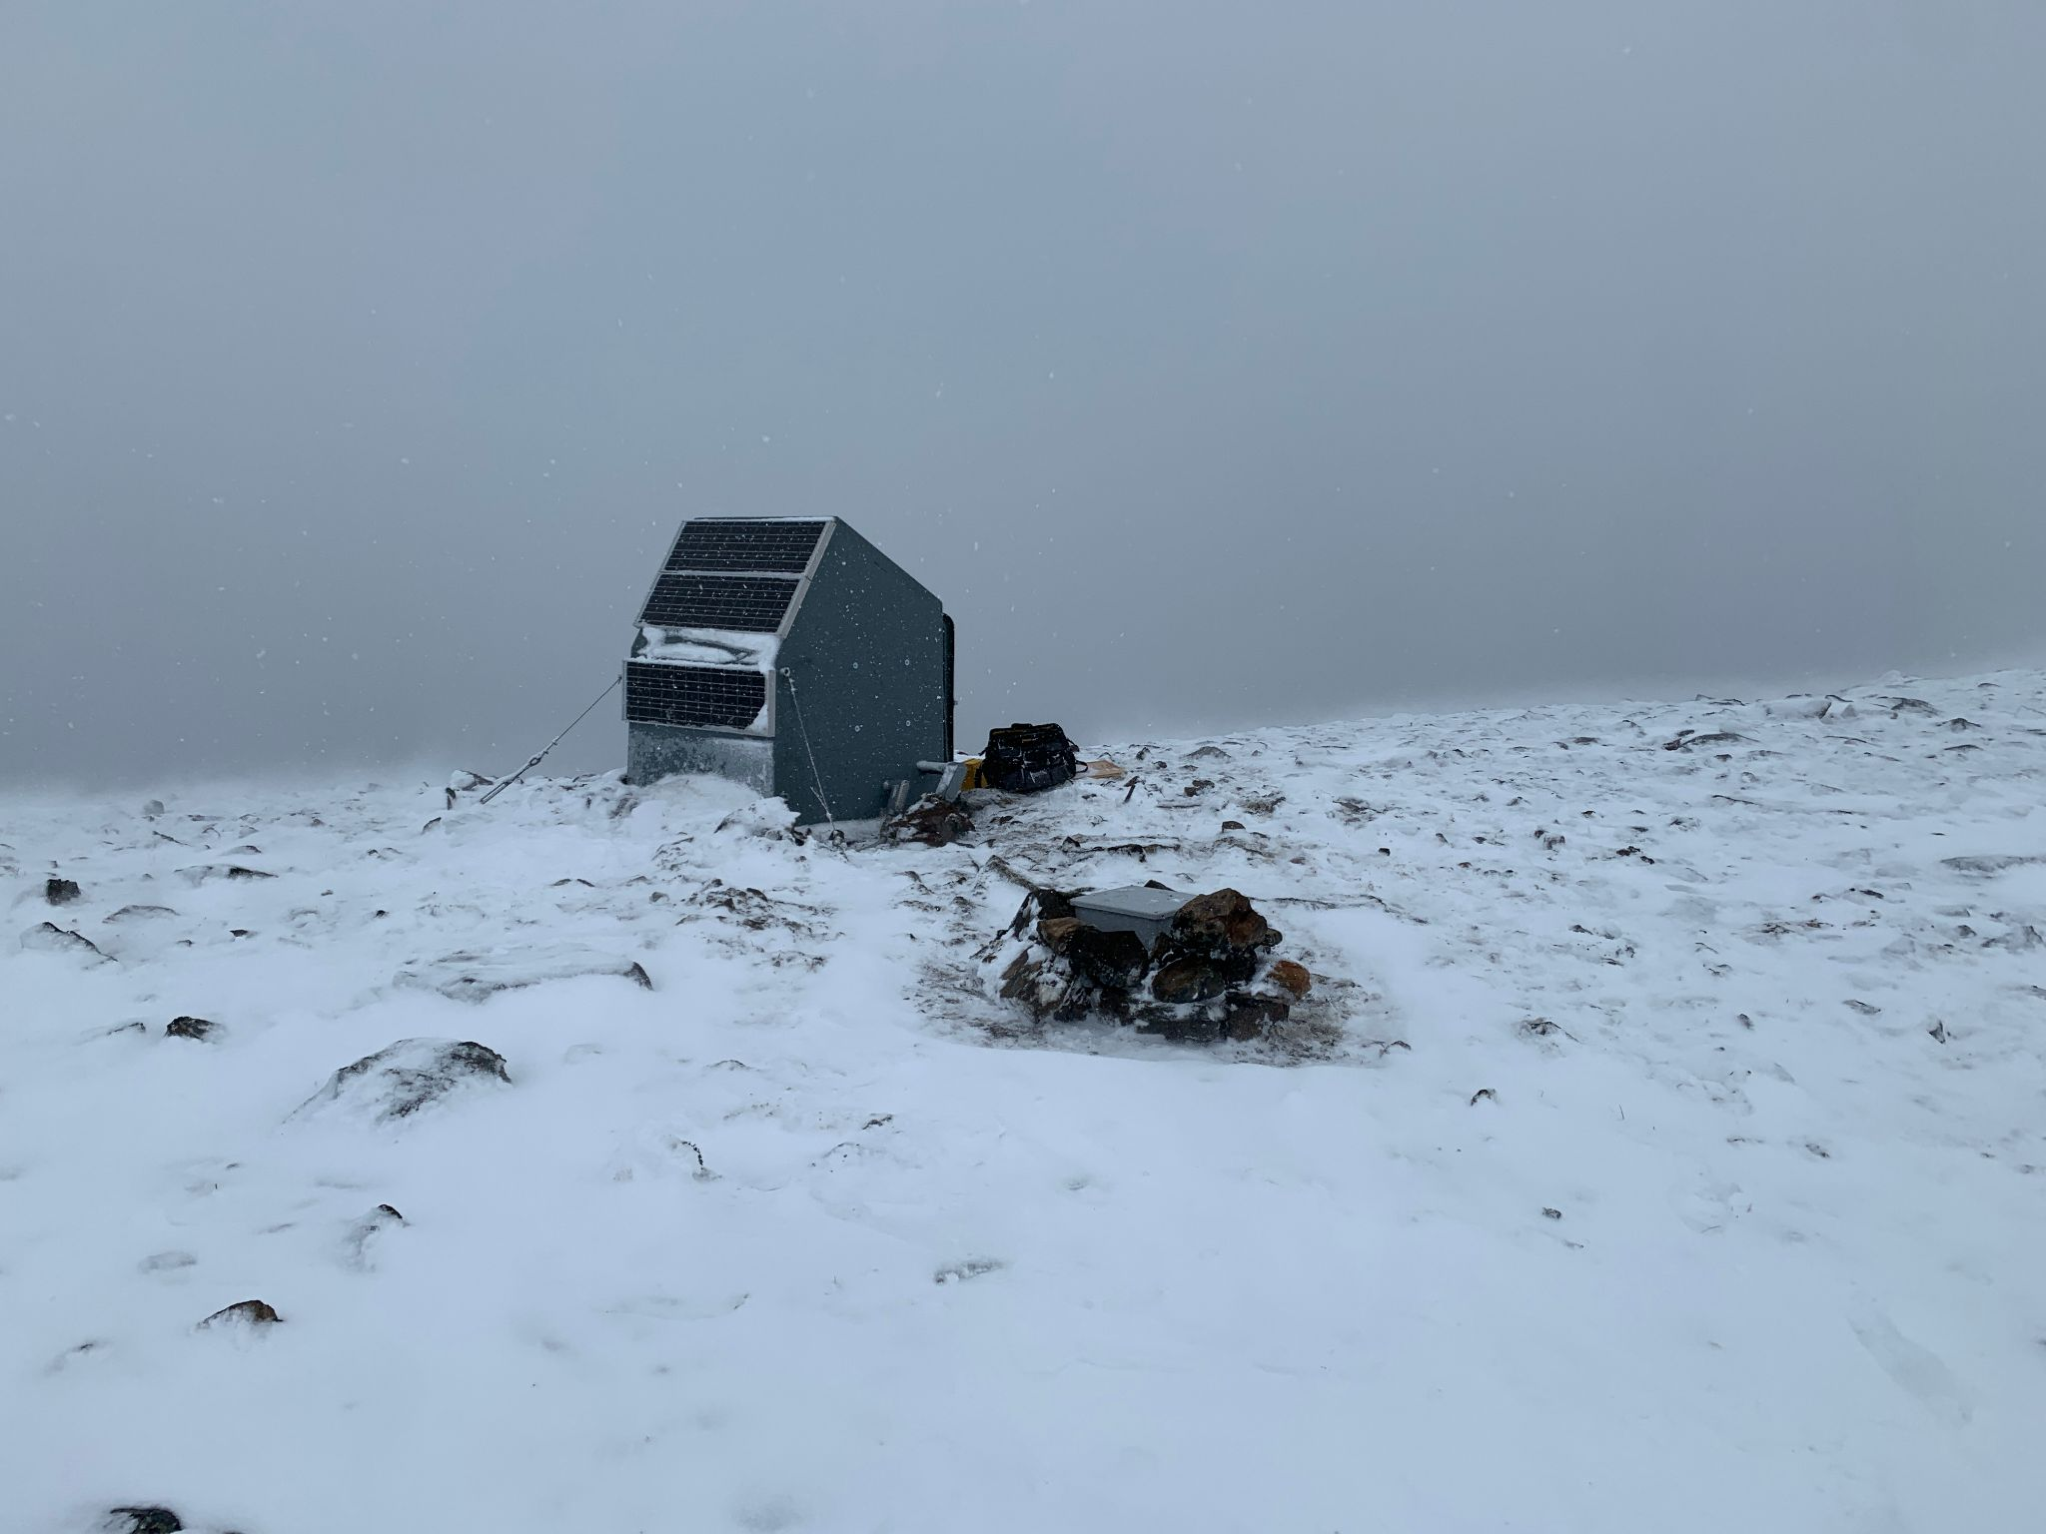
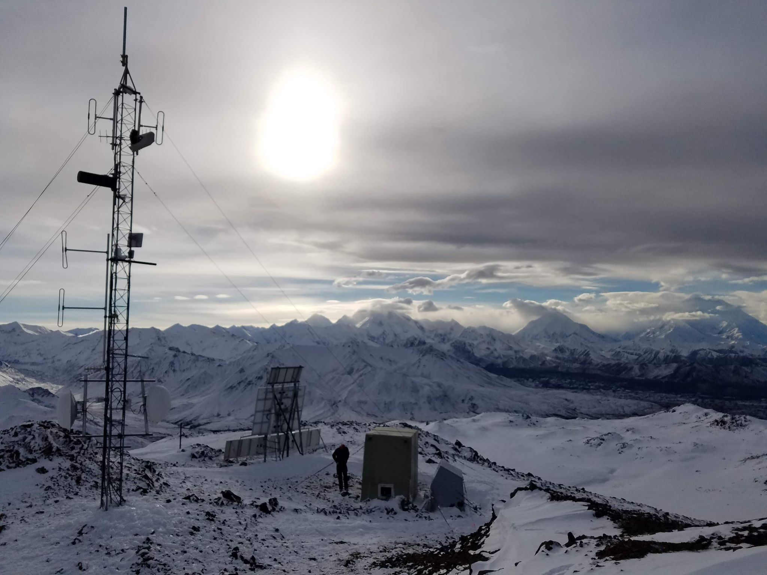
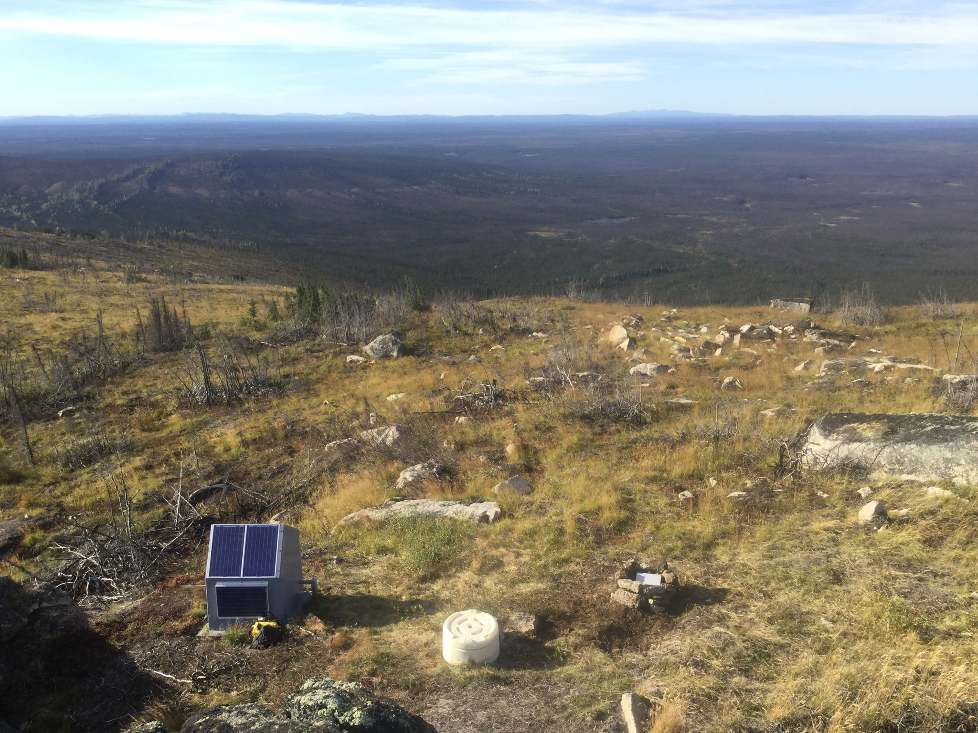
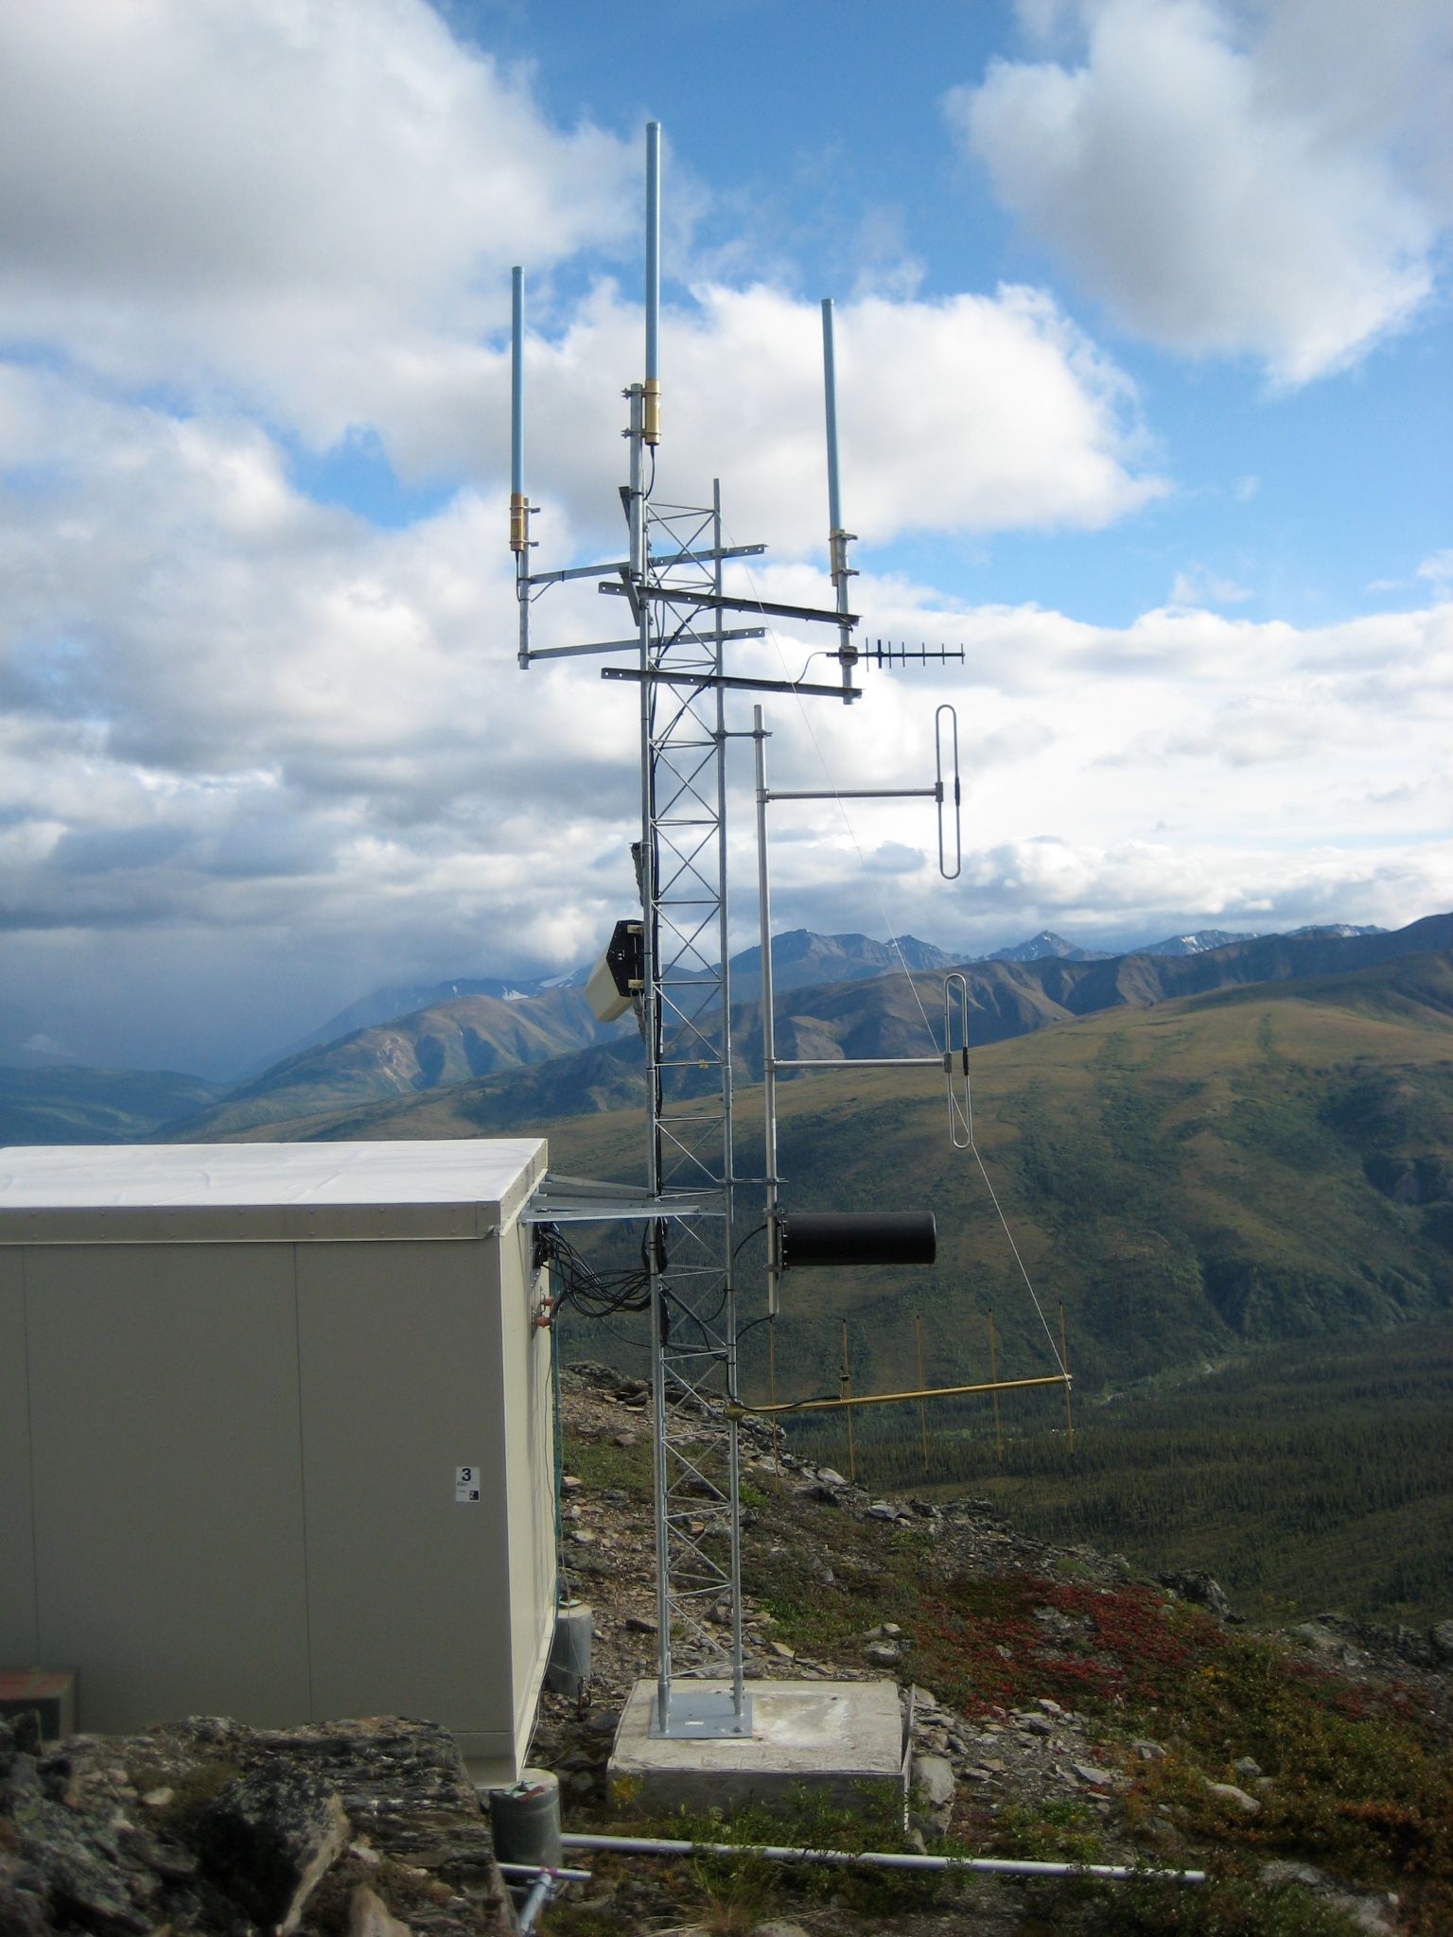
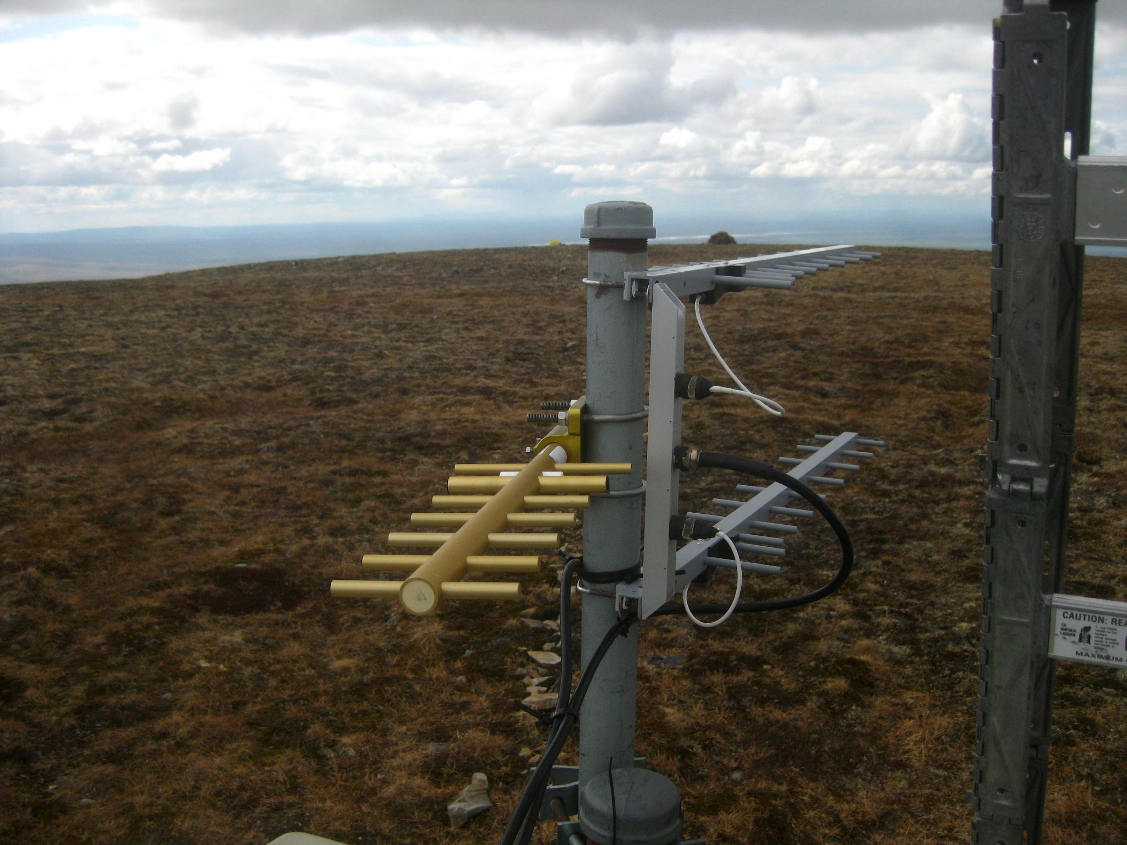
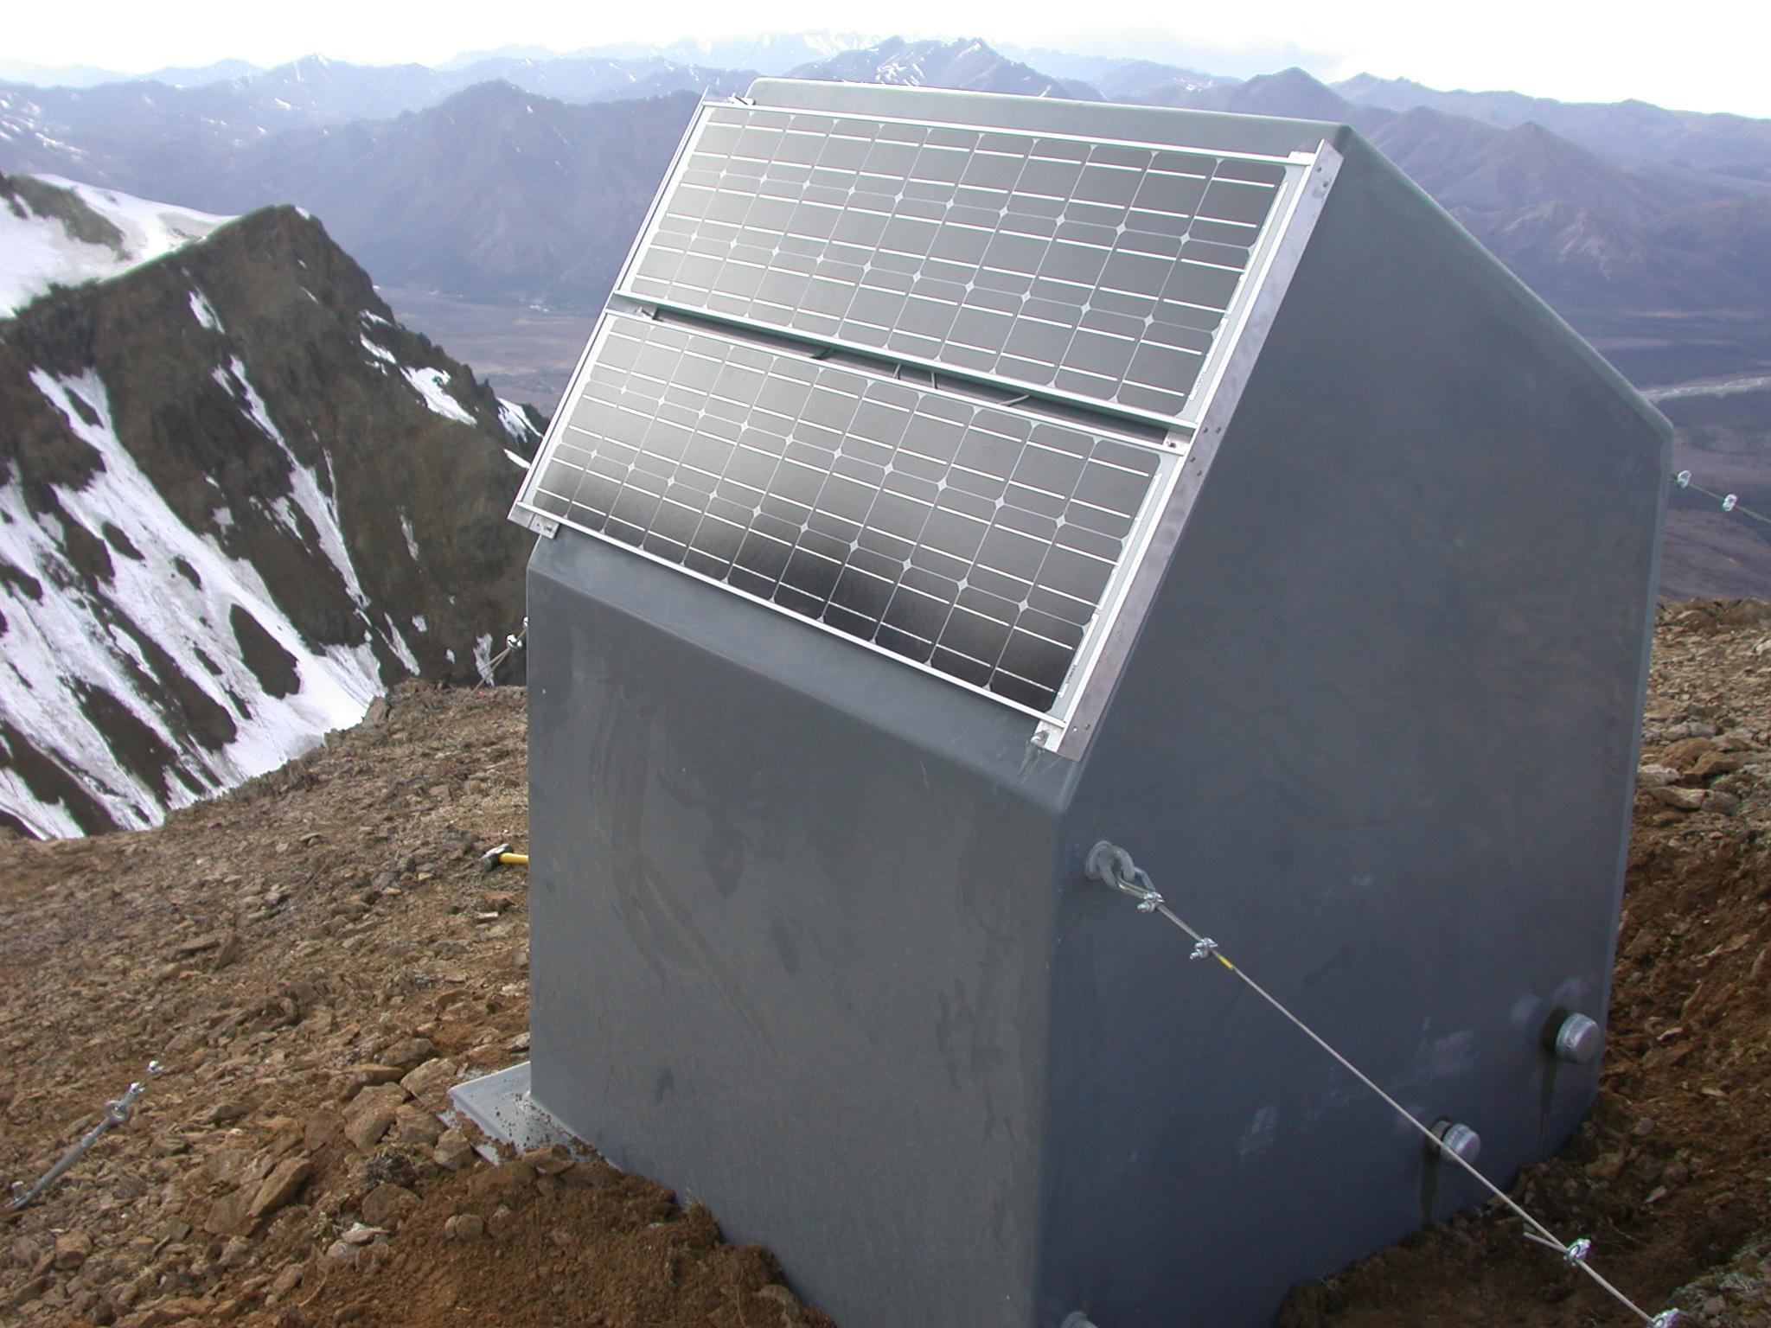
Denali Region Network
AK.CHUM
AK.MCK
AK.PPLA
AK.TRF
AK.CAST
HLY_R
AK.KTH
DBL_R

Slide 22
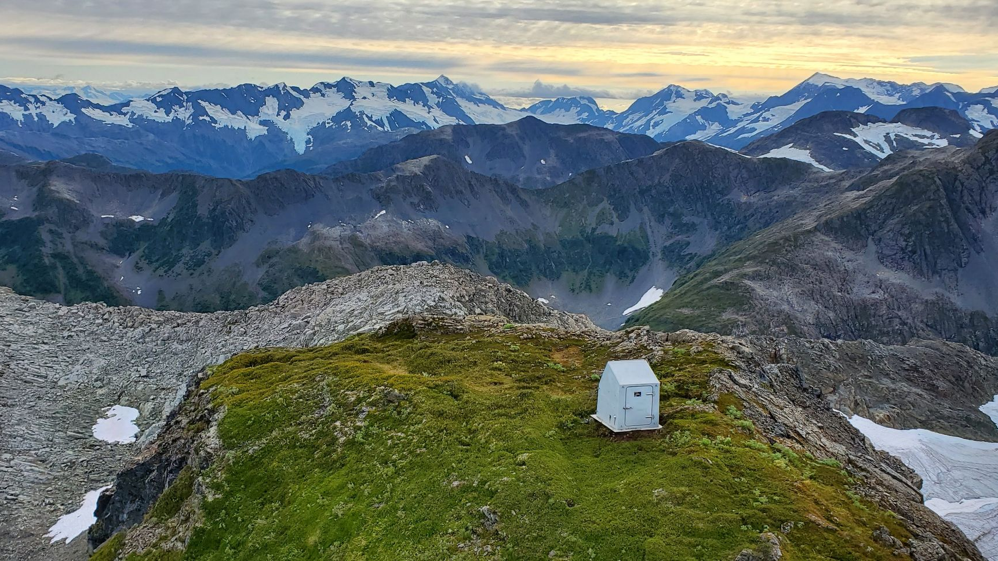
Future Improvements
Coordinate with cell and BGAN carriers to implement backup VPN tunnels direct to AWS
Develop automatic data acquisition failover
Expand AWS data storage and processing capabilities
Hurdles
Limited ISP options for most field networks
Remote site power and bandwidth constraints
Lack of available time, personnel

Slide 23
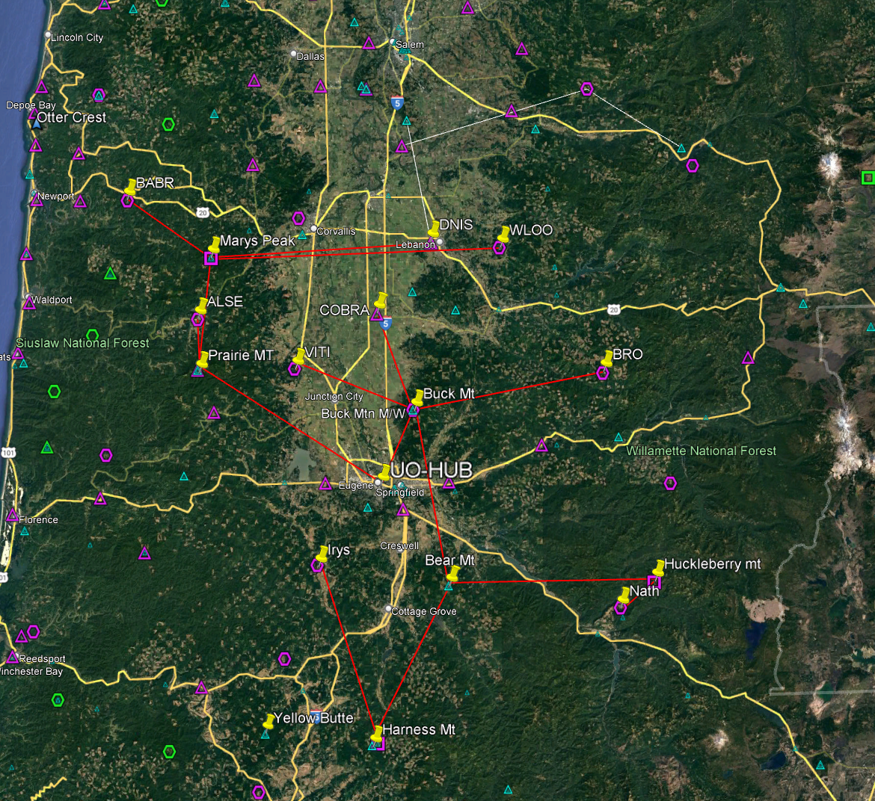
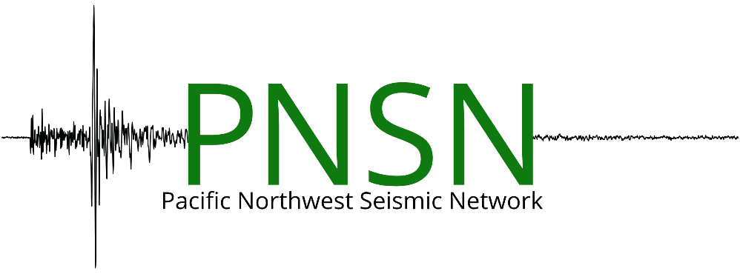
Current Physical Topology of networks connected directly to UO via ISM bands:
5.8 GHz (green)
900 MHz (red)
50 km
Notes:
- UO currently has very little redundancy
- Planning and testing is underway to split two larger networks into interconnected smaller, routed segments with multiple paths. Time, and expertise building have been limiting factors, but we are moving forward more quickly now.

Slide 24
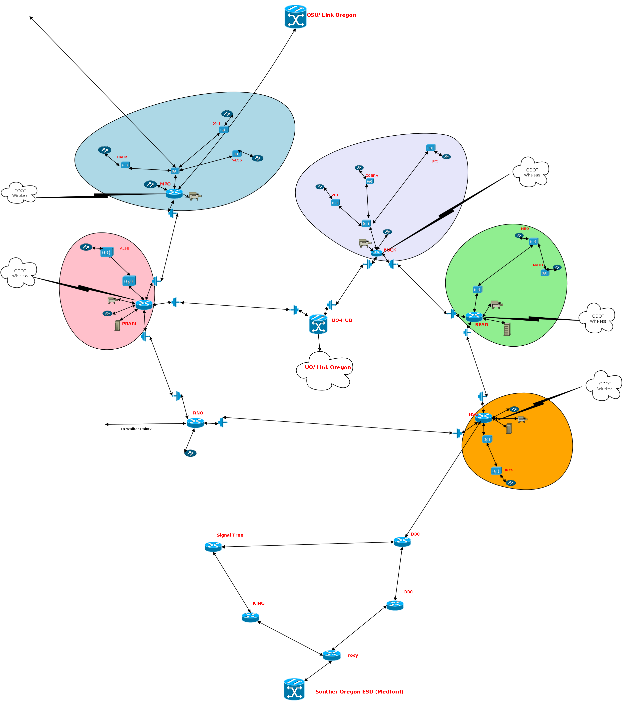
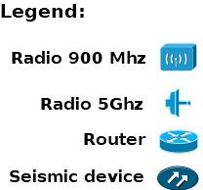
Logical topology of routed, multi-path network
Notes:
We have near term plans to deploy routers and reconfigure network scheme on both networks directly connected to UofO. This will be the first step in a multi-phase project. Redundant pathways will be provided via microwave links between several tower sites forming a ring with two or more direct links to UO. Tertiary paths at many sites are available via ODOT's wireless network. Future segments will be added to the north and south to incorporate existing and new sites.

Slide 25
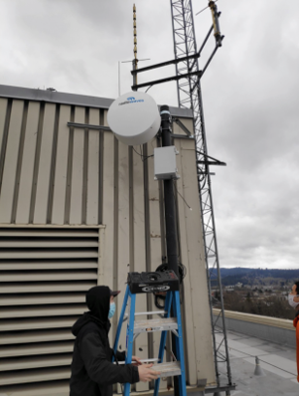
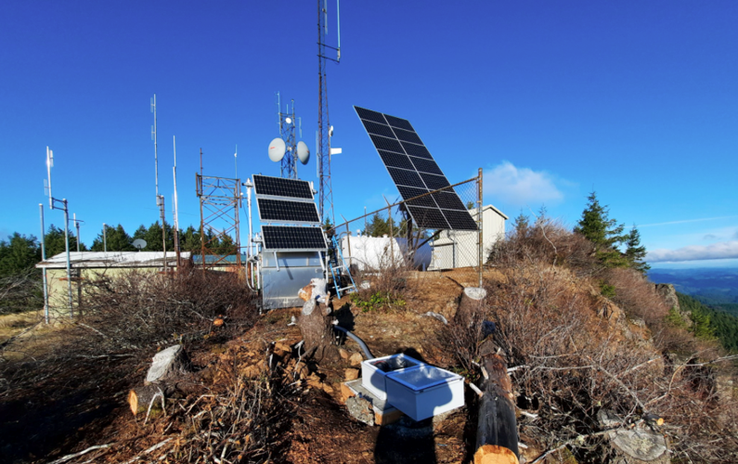
Notes:
Left: radio mast at UofO
Right: Seismic site Roman Nose in Oregon coast range.

Slide 26
Network Dialog
Examples from other networks
  Alaska
  Oregon
  Utah and Others

Slide 27
Discussion
Other examples or issues?
Questions:
  If redundancy is unused or under-used in your network, why is that?
  Plans/opportunities to increase it
  Challenges
Stay tuned for part 2, coming right up.

Slide 28
Wrap-up and Messages
Closing thoughts
Messages to management
  Reliability costs money
    installation and equipment
    staffing to monitor and maintain
    recurring costs for second connections – cell, T1/fiber, etc.
  Staffing and special skills needed
Stay tuned for part 2, coming right up.

