Slide 1
AlaSQA
Alaska Statistics for Quality Assurance

Slide 2
QuARG
Quality Assurance Report Generator
-uses IRIS MUSTANG metrics
-combines MUSTANG metrics ( #of gaps vs percent availability = GapRatio, % above NHNM & sample rms = hiAmp, dead channel lin & % below NLNM = lowAmp)
-customizable thresholds and metrics
-can pull data from IRIS or from ISPAQ
-has a ticketing system that is searchable
-generates reports for you based on tickets created

Slide 3
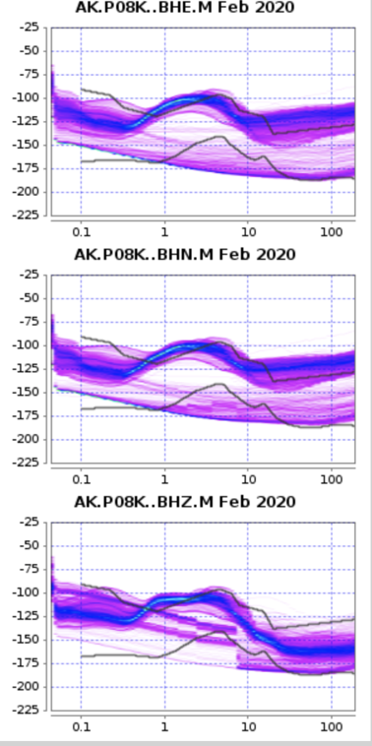
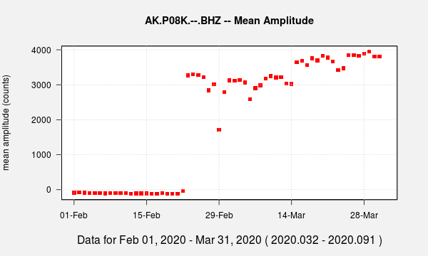
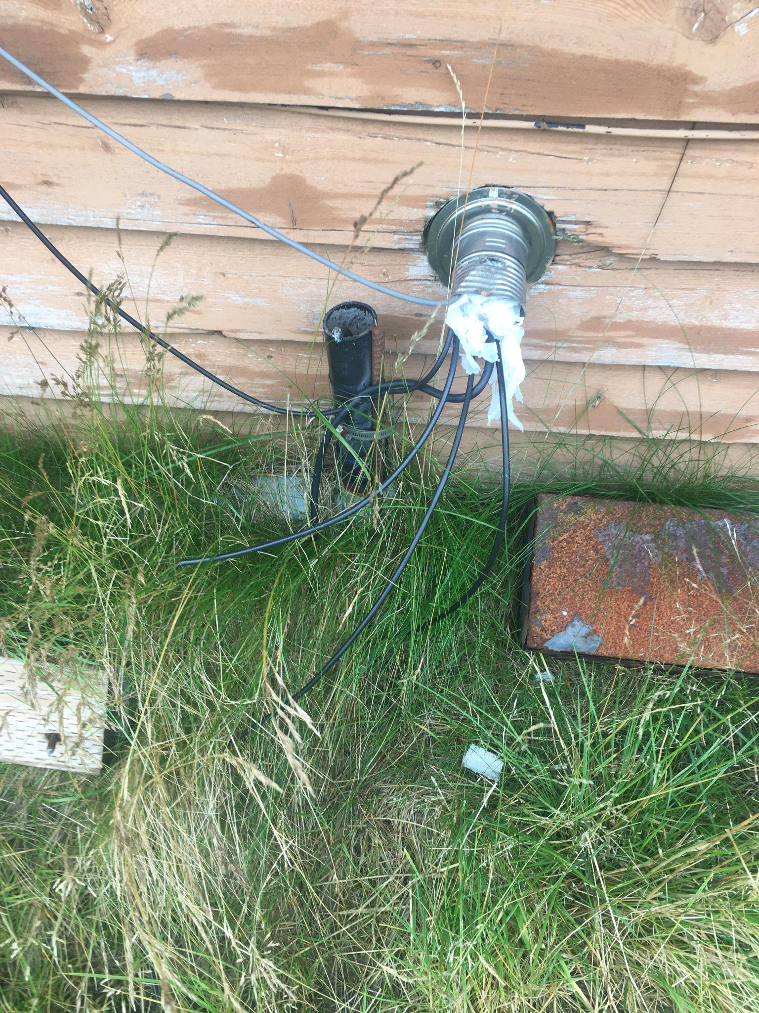
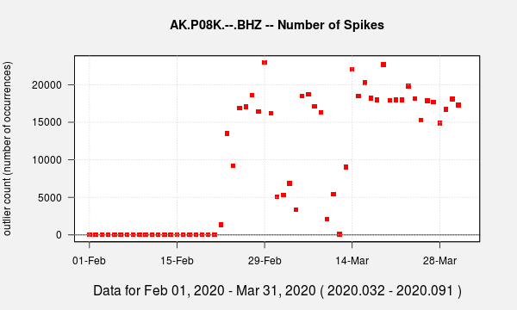

Slide 4
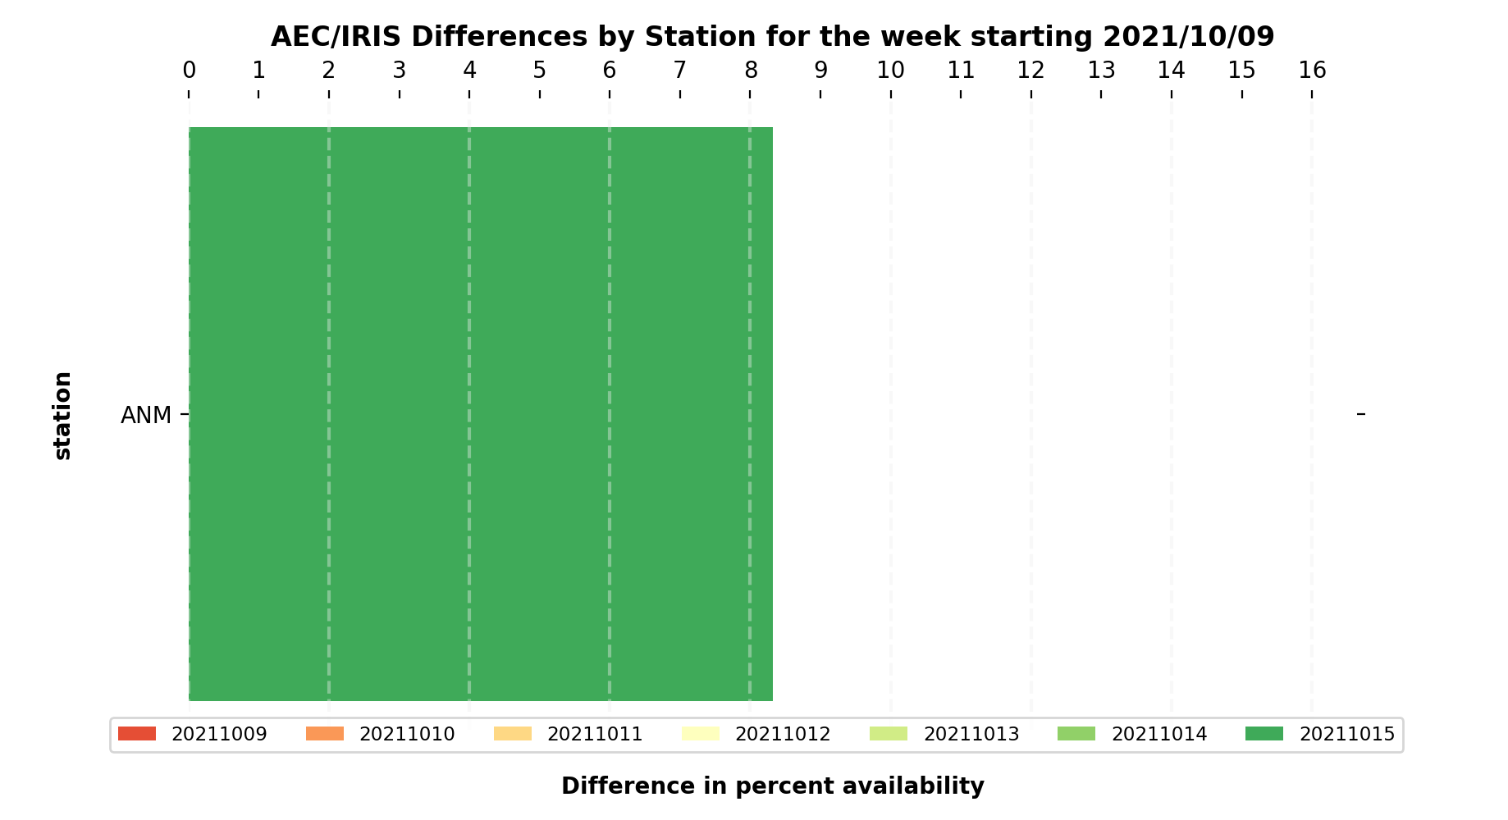
Compare Percent Availability- In-house Vs IRIS Holdings

Slide 5
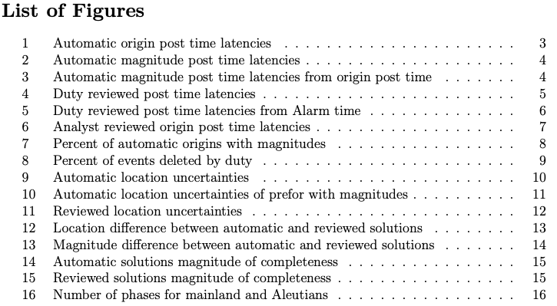
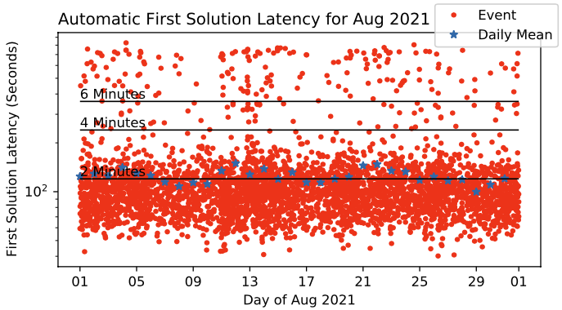
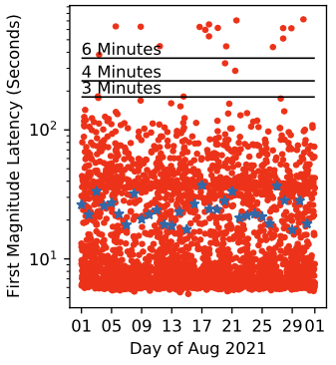
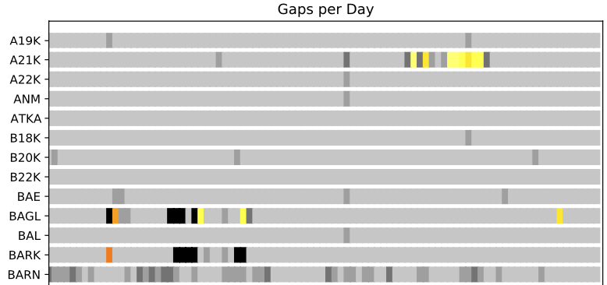
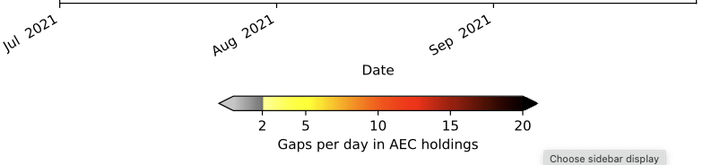
Produced Monthly:
Produced Quarterly:
Automatic magnitude post time latency from origin post time

