Slide 1








Seismic Quality Assurance Console
GUI
django backend API
Kyla Marczewski
Carl Ulberg
*Alex Hutko
simple python read/write scripts
NetOpsXI 2021
Notes:
Wiki has everything: https://github.com/pnsn/squacapi/wiki

Slide 2
What is SQUAC?
It’s a fancy metrics database & interface tuned for PNSN
AWS EC2 w RDS db, 2-10 servers (autoscaled), S3 archive ~$500/mo
Metrics: waveform- N big/small bumps, power, noise floor, peak Acc...
SOH- latency, gaps, completeness at datacenter
Variable granularity: 10 min/hourly/daily/monthly
Contributor source agnostic; currently 8 sources
1 Billion measurements
10 Million measurements/day (>100/sec)
Performance: Create_or_overwrite ~80 measurements/sec
Read ~500 measurements/sec
Notes:
Contributors: 16 full time CPUs @PNSN, power from IRIS MUSTANG, latency/gaps sniffed at 4 ShakeAlert centers, ShakeAlert trigger counts from UCB & CIT

Slide 3
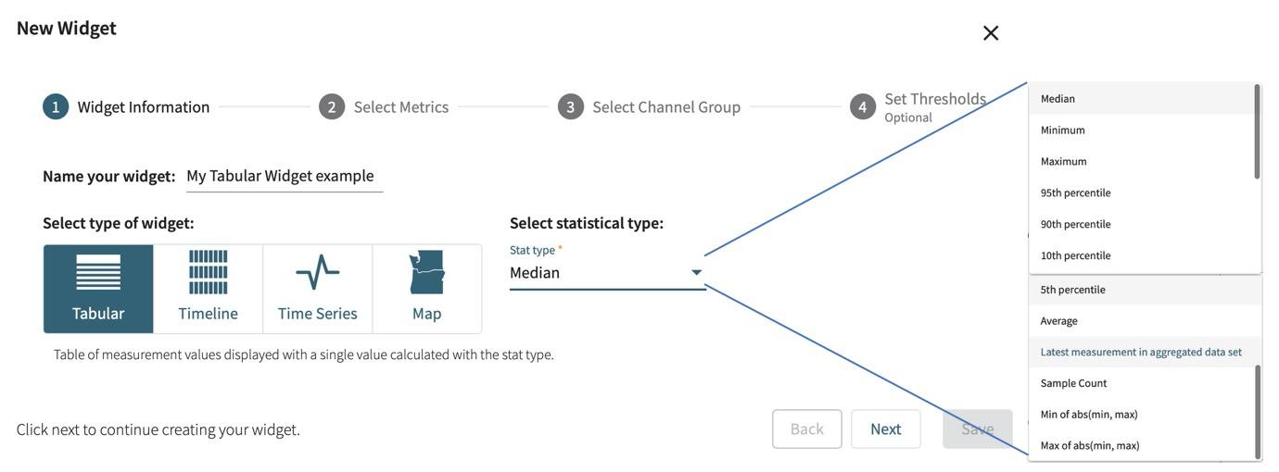
Creating your dashboards
Notes:
Can plot raw measurements or any of a dozen statistics.

Slide 4
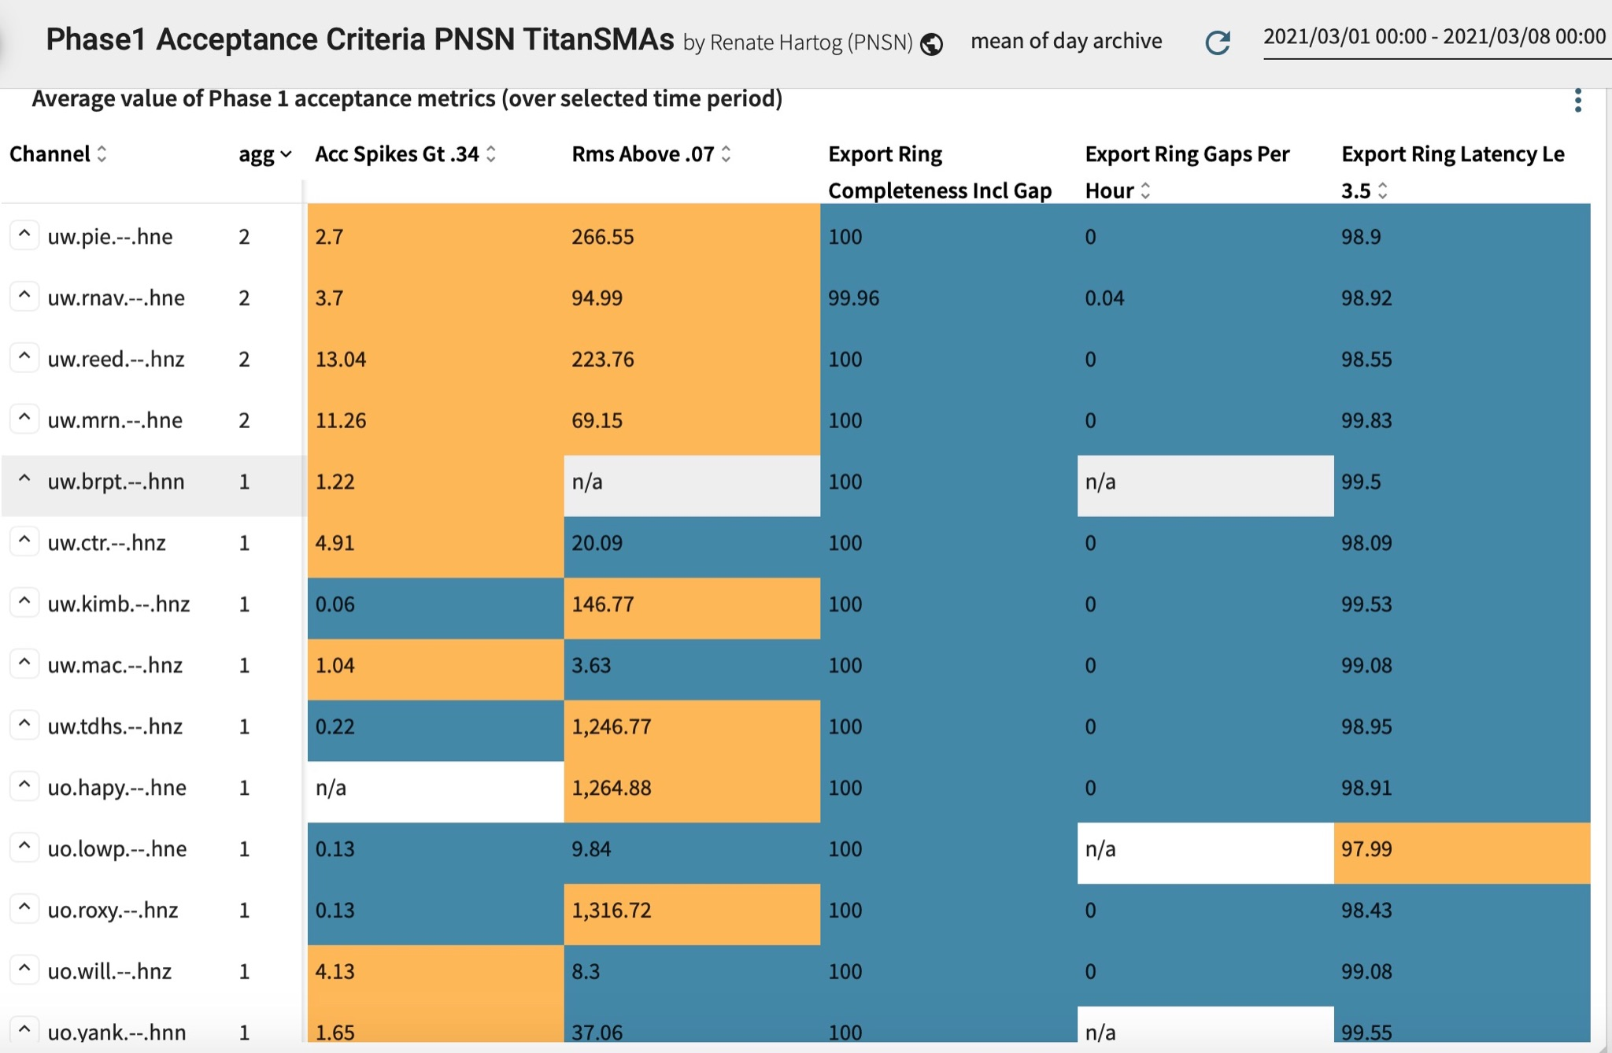
Single view of multiple metrics over a time window
Notes:
“agg” is the count of metrics that are failing the user-defined thresholds.

Slide 5
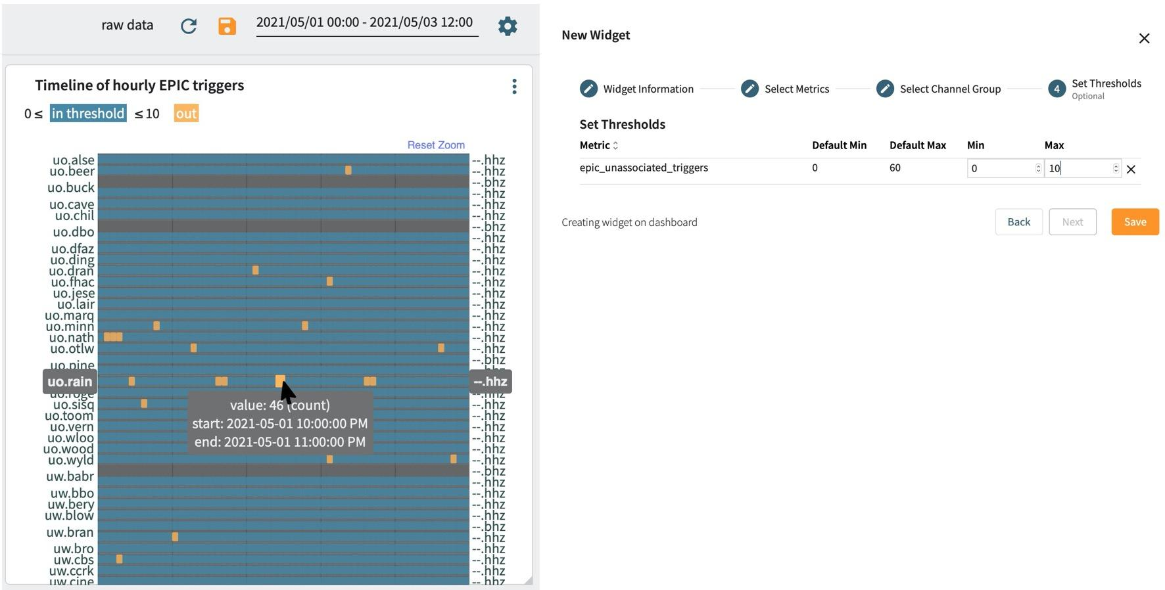
Timeline- think: SeisNetWatch with thresholds/color gradients

Slide 6
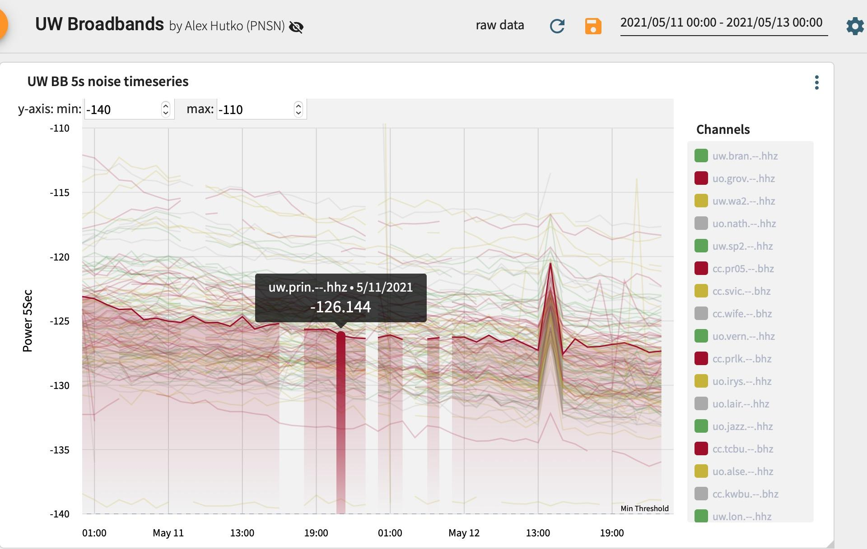

Slide 7
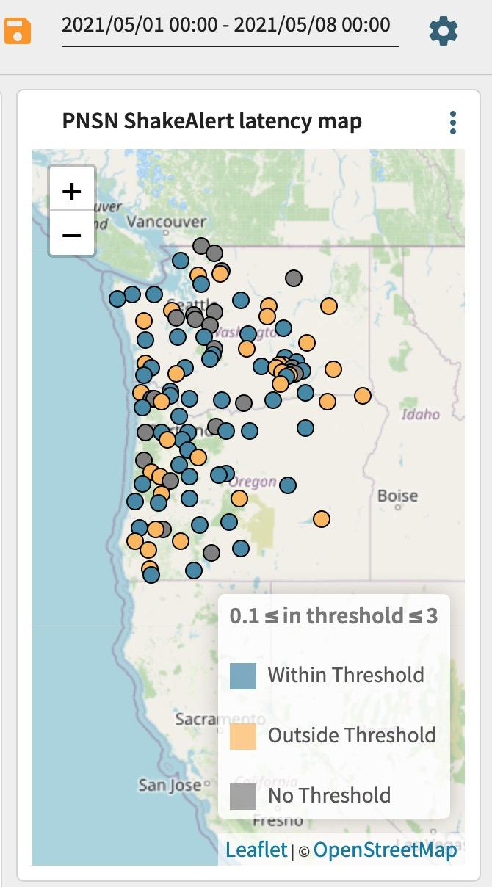

Slide 8
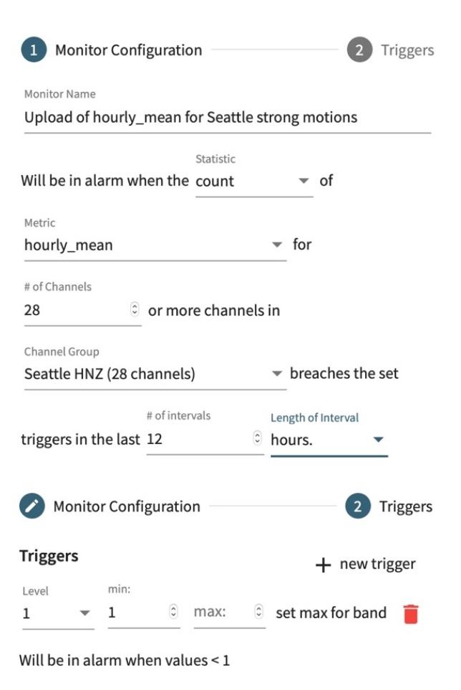
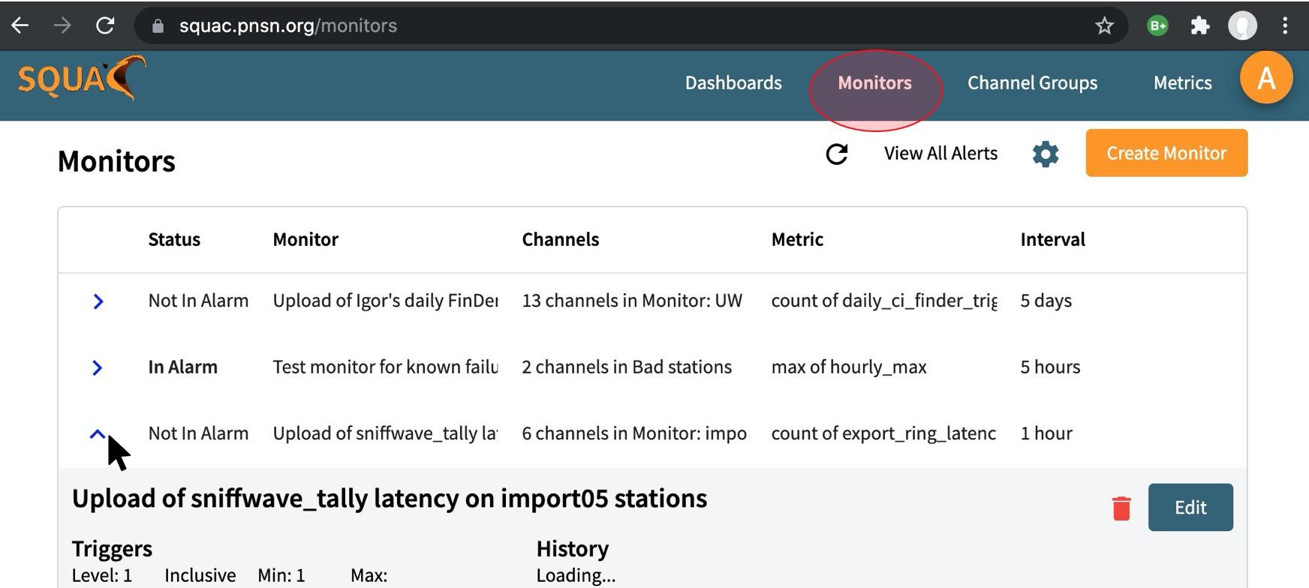
Alarms (webpage or email)
- measurement upload counts
- in/out of bounds
- raw measurements or stats of data
- variable granularity time windows
Notes:
If desired, Level 1: only webpage, Level 2: email you, Level 3: email multiple people

Slide 9
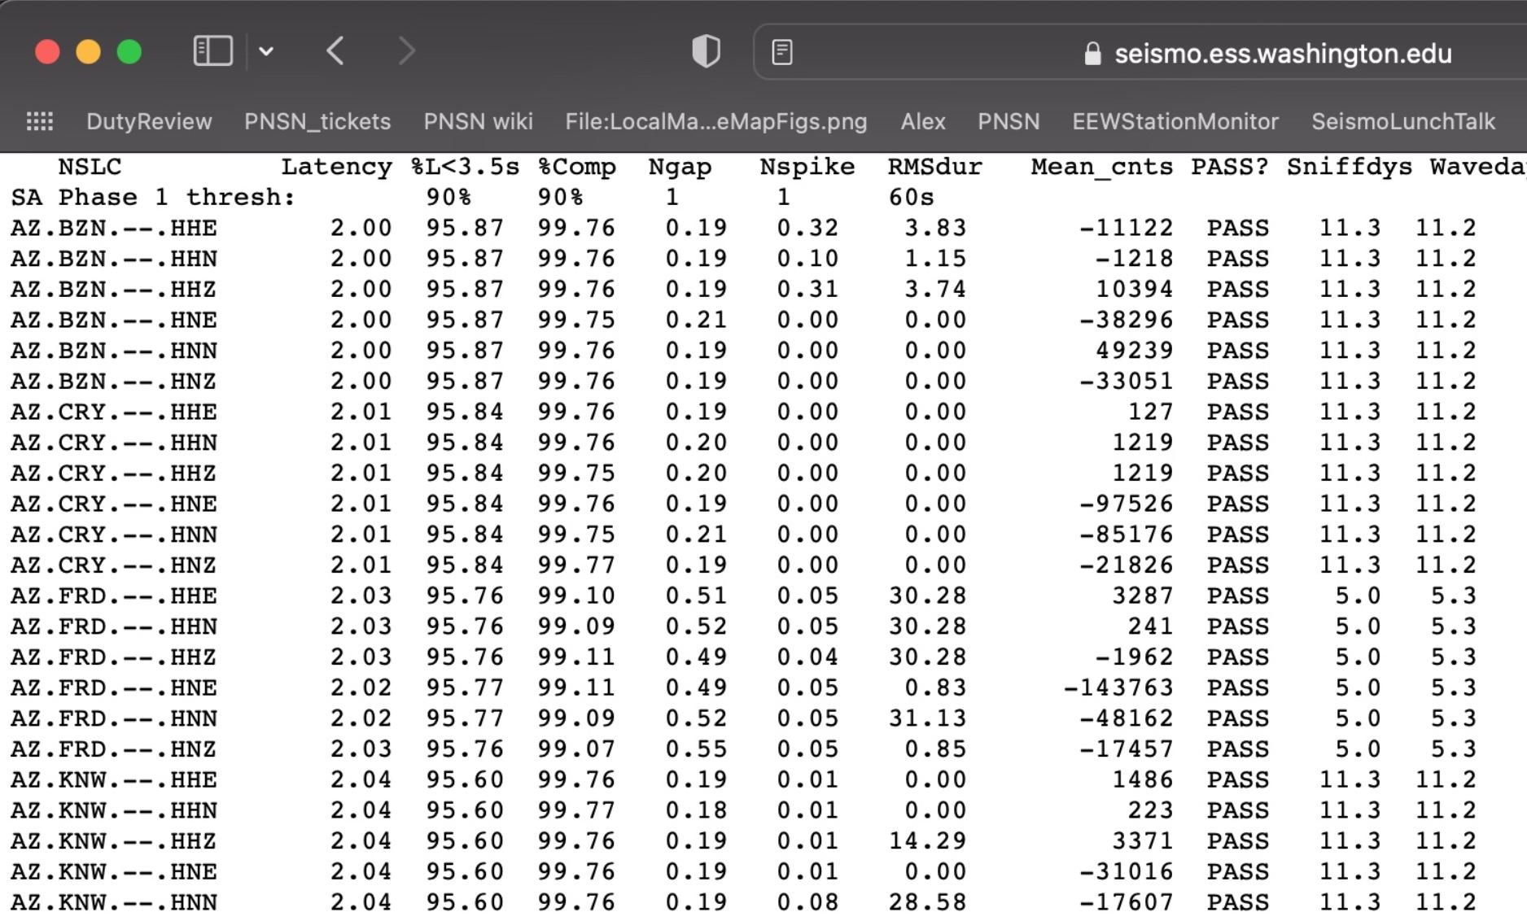
Use case: daily update of ShakeAlert station acceptance

Slide 10
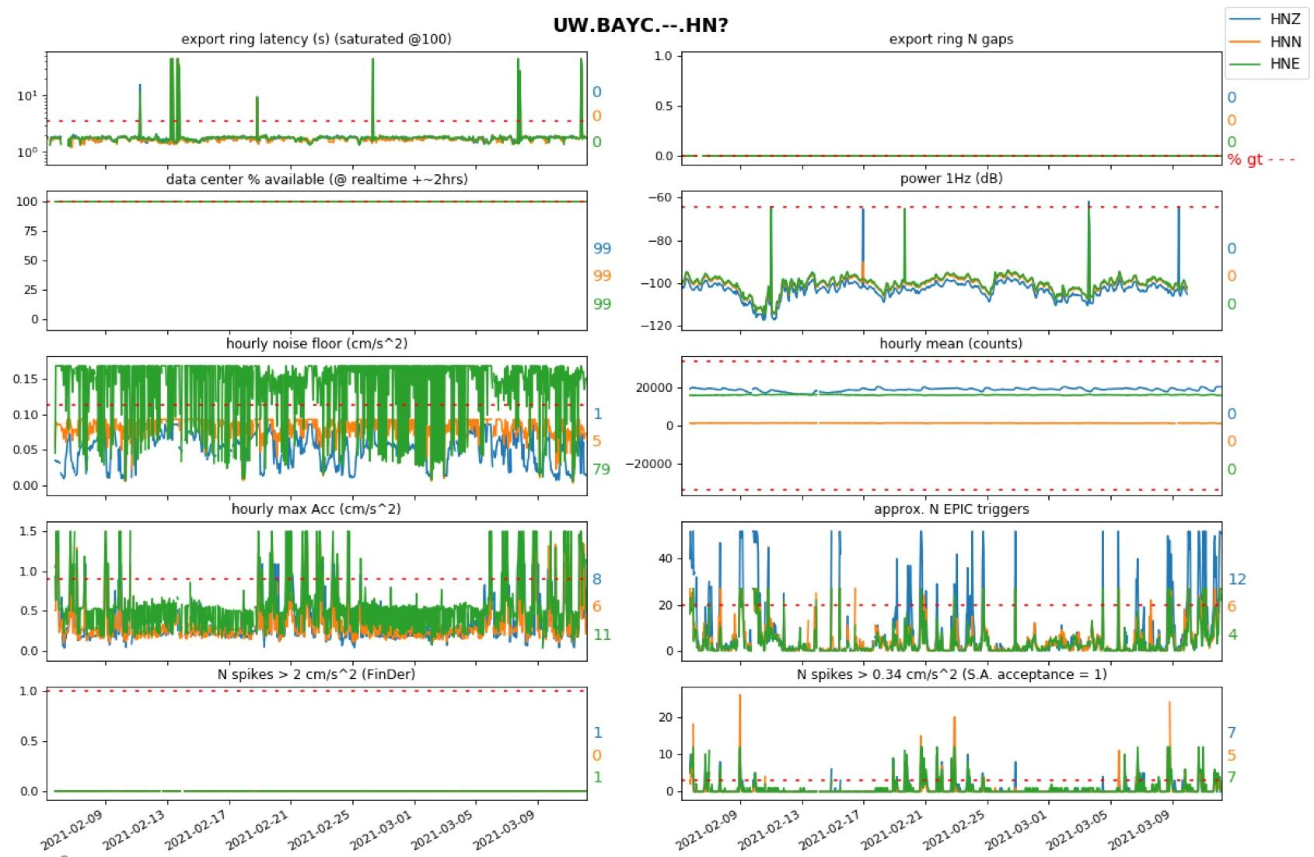
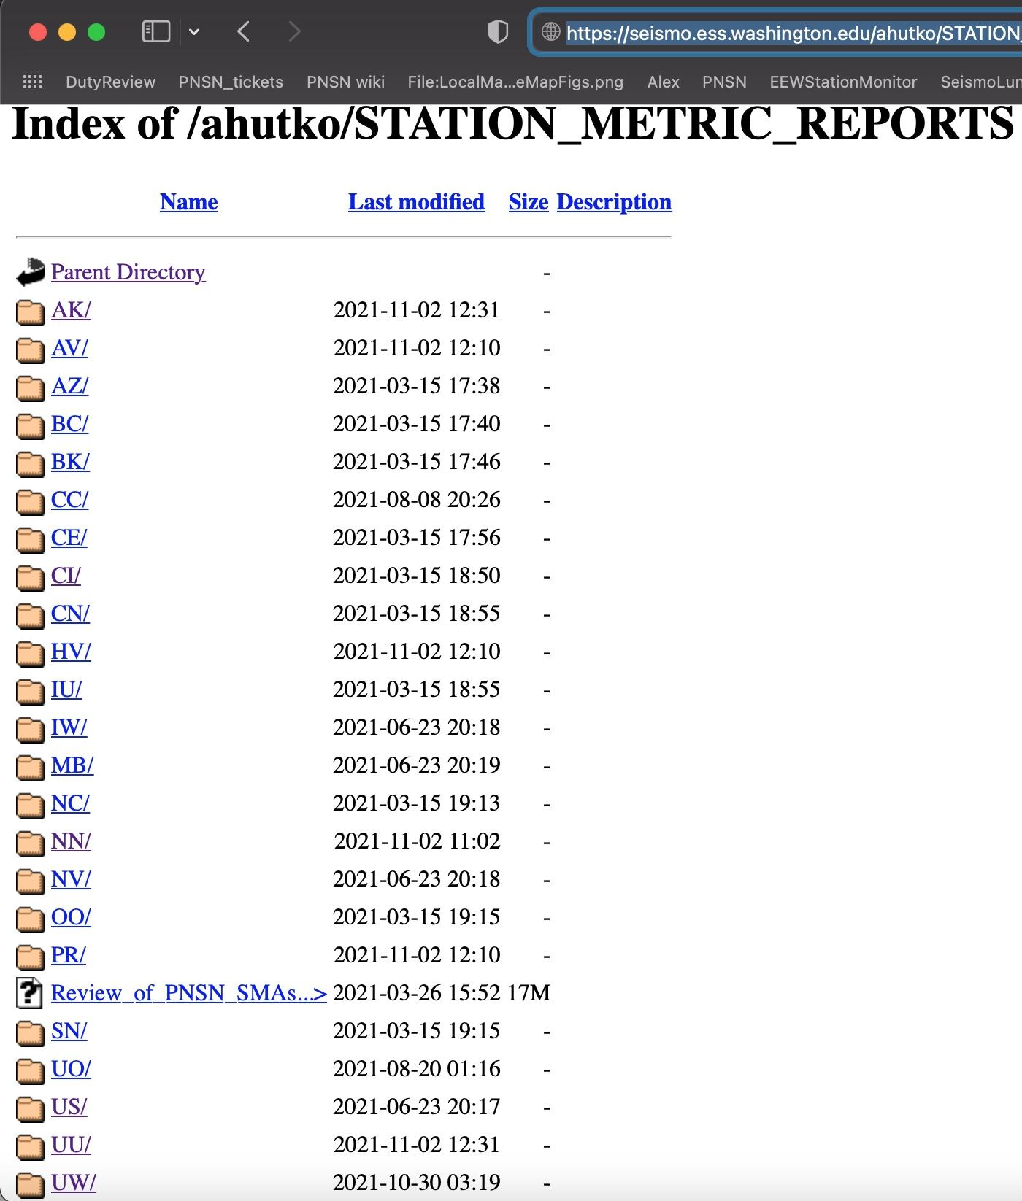
Use case: holistic report of station over past few weeks
Reports for most stations in ANSS:
Techs were informed something wrong w HNE.
pier was coupled to house foundation :-(
Updated 2x/week: https://seismo.ess.washington.edu/ahutko/STATION_METRIC_REPORTS/
Notes:
https://seismo.ess.washington.edu/ahutko/STATION_METRIC_REPORTS/
NOTE: networks outside of ShakeAlert were only recently added and might not be complete. Only PNSN & ShakeAlert stations are being sniffed for latency & gap info. SQUAC was down for a bit about a week ago → no measurements.
These Station Metric Reports have ~50k measurements shown. Red dashed lines show the median value at the 95th percentile worst station in the PNSN for the shown metric aka typical values for a “bad” station. Colored numbers show % of time measurements exceed the red dashed line…. I.e. % of time it is really bad for that metric.

Slide 11
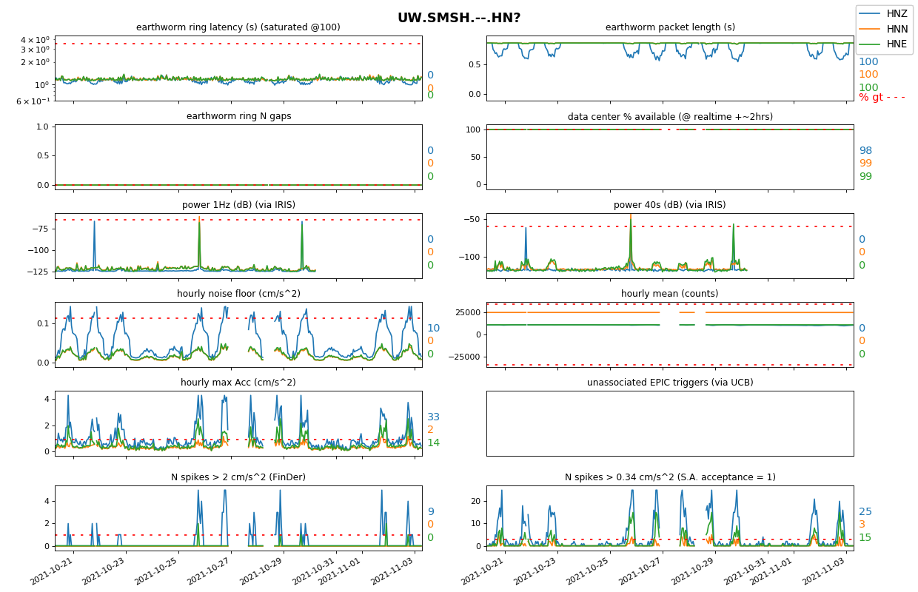
Use case: holistic report of station over past few weeks
Reports for most stations in ANSS:
Updated 2x/week: https://seismo.ess.washington.edu/ahutko/STATION_METRIC_REPORTS/

