Slide 1
PDL2AQMS
NetOps XI
Ellen, Lind, & Paul
Coding by Ellen Yu, Mike Hagerty, & Aparna Bhaskaran

Slide 2
PDL2AQMS
ISTI Python application that allows QuakeML to be injected into an AQMS database.
Works on both Oracle and Postgres systems (orig developed for Postgres by MH)
Motivation: Originally for PRSN to ingest USGS NEIC PDL solutions to compare in Jiggle against local AQMS and EarlyBird solutions.
PDL drives it via command line options (listens for origins, mags, arrivals, amps).
Also allows command line QuakeML injection as a pure loader process.
Allows filtering of events by depth, magnitude, location, and originating network.

Slide 3
PDL2AQMS - Mww usage
The finer points of Mww ingest
ANSS Large Magnitude policy requires RSN’s to use Mww from NEIC for events with M >= 6.0 as preferred Magnitude
NEIC is producing automatic moment tensors with Mww and distributing via PDL
PDL2AQMS can automatically assoc origins in AQMS using “eventassoc” table
Assoc of origins is local solution with NEIC origin+Mww
Assoc happens using PDL Indexer <OR> brute force configuration - dx,dy,dz,dOT.
RSN retains local solution,
Currently, setting Mww be the pref magnitude is a manual operation via a Flask App
Automating this process requires 3 modifications to AQMS, adding eventassoc table, and Mww rules for magprefpriority table, stored procedure updates.

Slide 4
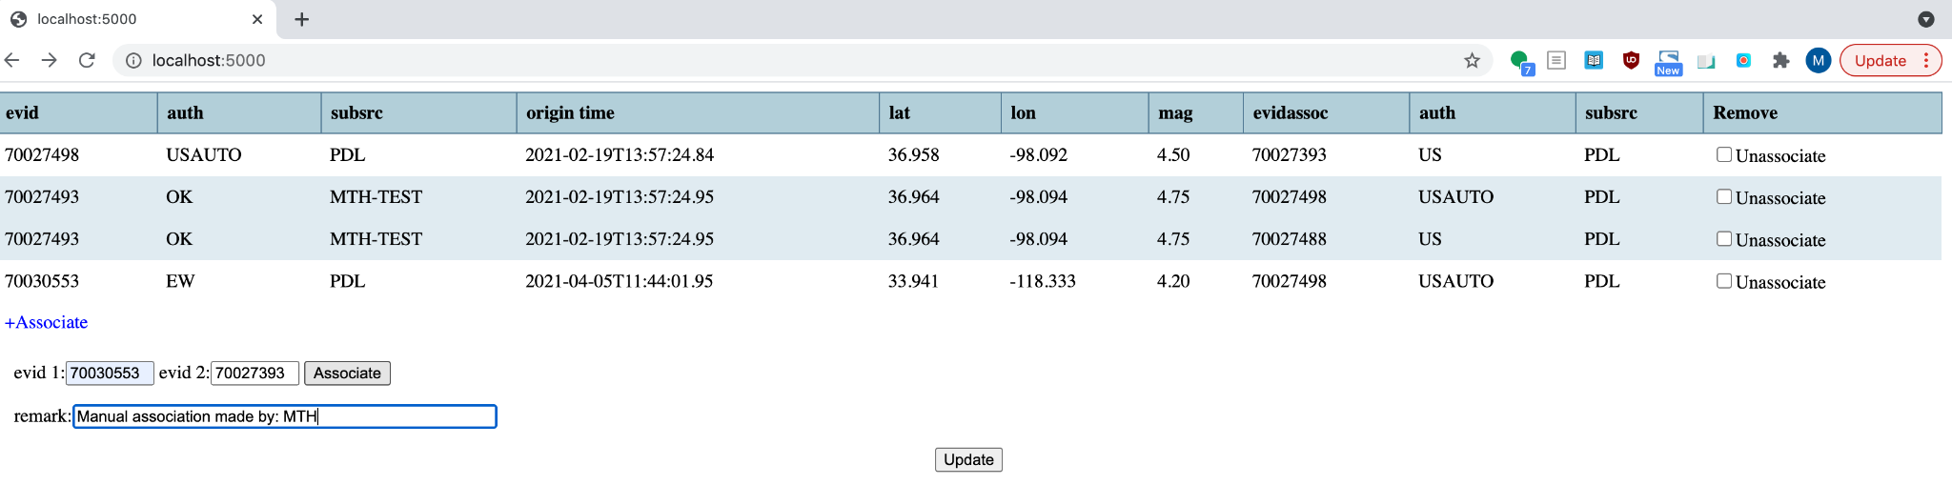
AQMS Mww - Flask App
Notes:
PDL2AQMS uses PDL indexer and internal rules if necessary to make associations.
Flask App can be used to view associations (Jiggle cannot see the new table!) and allow un-association if operator deems it incorrect.

Slide 5
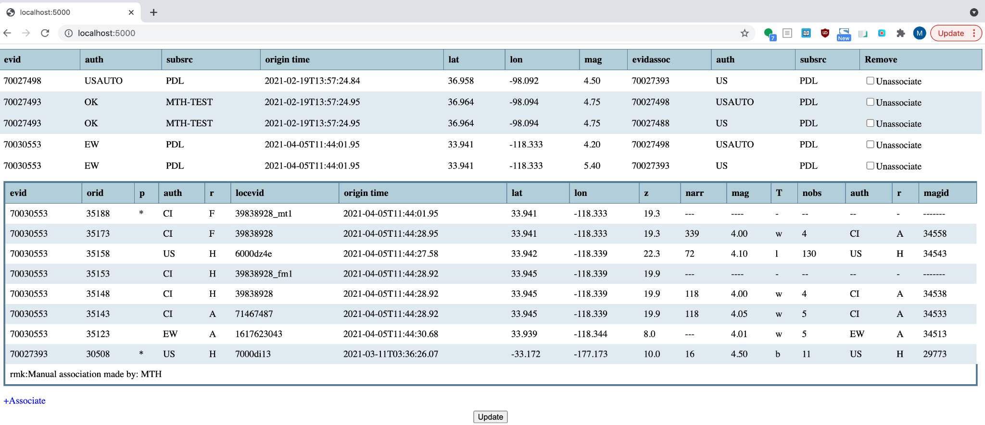
AQMS Mww - Flask App
Notes:
Once Mww is associated with the local origin

Slide 6
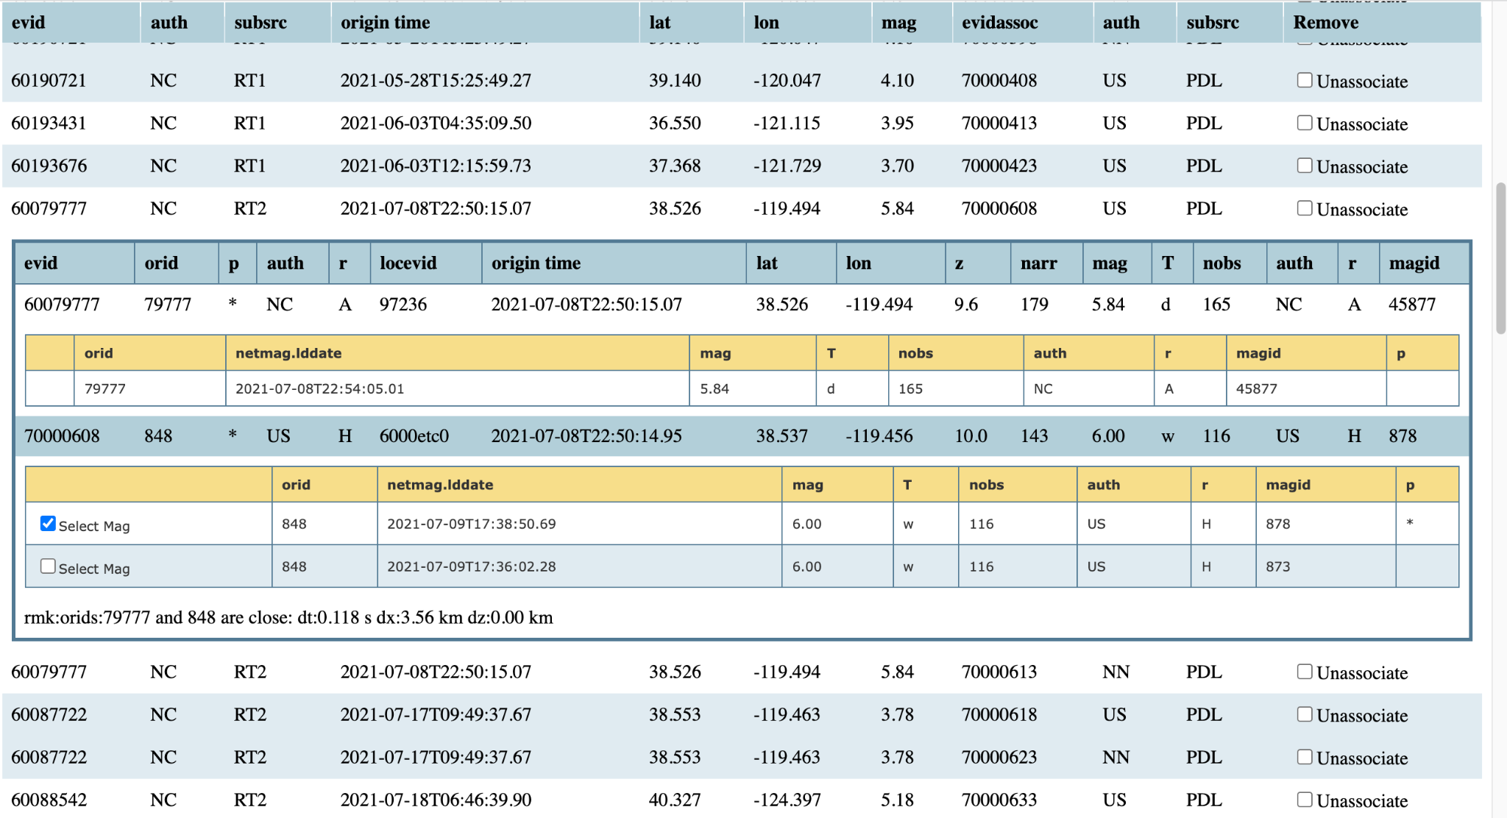
AQMS Mww - Flask App
Notes:
fig1 - shows just as you select the Mww 6.0 mag to be associated with the local evid 60079777.
Note that there is also an association below this with the NN solution - the mag from this could've
been chosen instead.

Slide 7
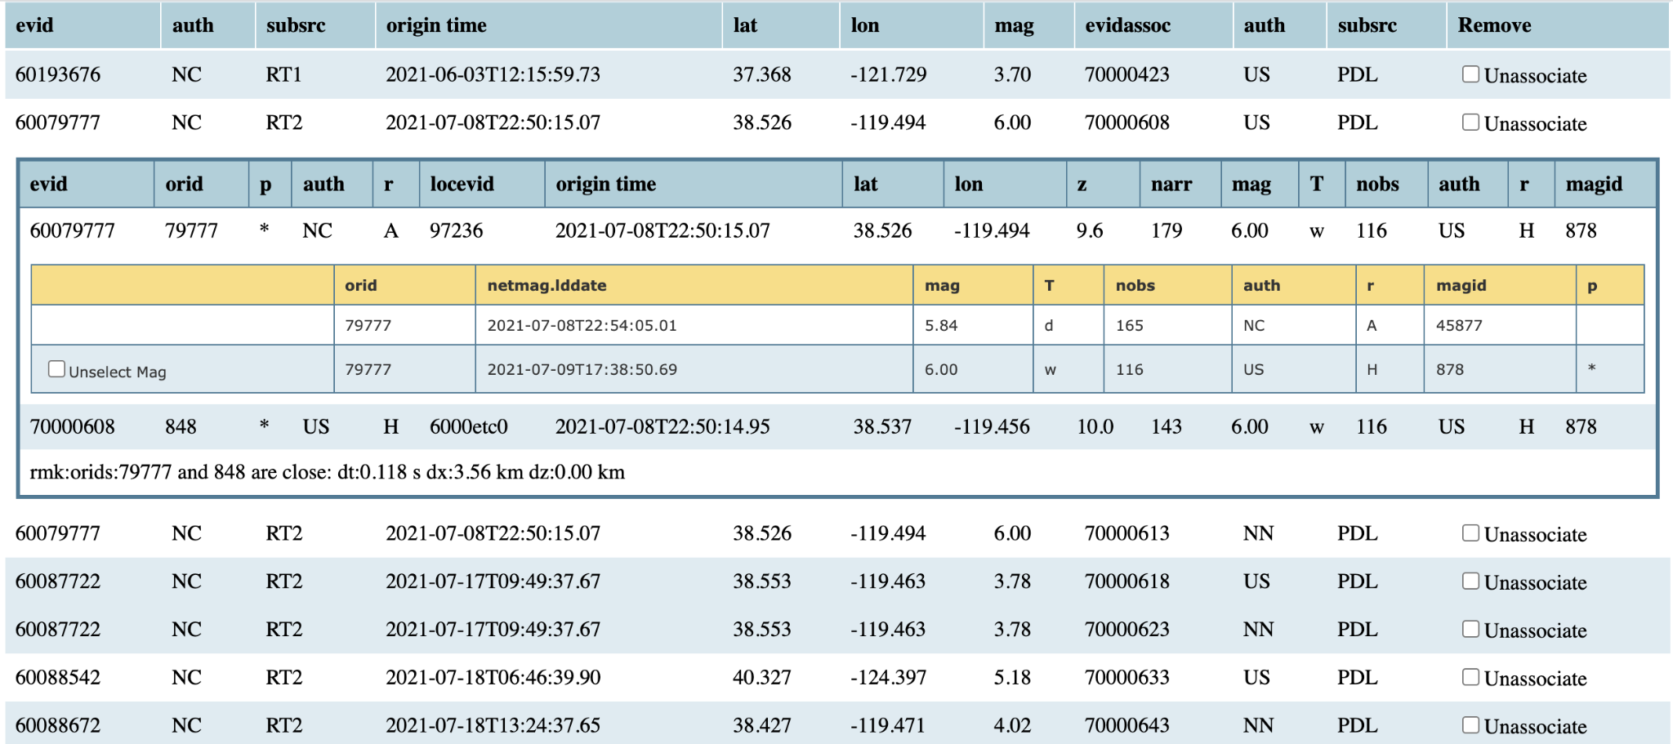
AQMS Mww - Flask App
Notes:
fig2 - shows the change in the table view (! not the table itself!) after we've made the change to
eventprefmag table. Now the selection allows you to Unselect the Mww mag if desired, to
reverse the process.

Slide 8
PDL2AQMS
SCSN Implementation
Oracle port - https://gitlab.com/aqms-swg/aqms-db-ora
Running in production since 3/2021
  Database insert of solution automatic. No auto association of magnitude
Current settings chosen to gather more use cases. Likely to be refined when process is automated.
  selectflag=0
  Magnitude >=3.5
  Lat 31-41, lon -113, -126 (CA, NV region)
  All network sources
  Imported 108 events - but only 2 candidate events (i.e. those with Mw’s) - other RSNs encouraged to try either database port

Slide 9
AQMS via Docker Containers
Netops XI
Paul Friberg
Coding by Serhiy Vasilyev and deployment testing by Mitch Gold

Slide 10
Docker, what is it?
Docker is a virtualized environment which is “Platform As A Service” (PAAS) to deploy applications.
Effectively a mini-light-weight VM that contains just what is needed to run a single software program
Docker instances are called Containers
Containers allow easy deployment anywhere, on bare-metal, VMs, and in the cloud.
Communicate with each other using well defined channels & share data over Volumes.
Provides developers with a consistent build environment for testing.

Slide 11
AQMS Database containers
Gitlab repo: https://gitlab.com/aqms-swg/docker-playground
Postgres 10,11,12
Oracle 18.4 (developer release)
All containers have copy of the AQMS database schema.
Next step: enter scripts to populate metadata, reference tables (for example magprefpriority etc) into gitlab

Slide 12
AQMS containers
ISTI has been testing a fully containerized AQMS for CGS & ISTI
Tested so far: CMS, Earthworm, Winston, & AQMS DB postgres
Currently being tested: alarming, ec, rcg, pws, & wa
To be developed: trig2db, tc
All internal to ISTI gitlab, but will be pushed to AQMS-SWG gitlab once tested.
ISTI versions: fdsn eventservice, fdsn dataselect service
Provides a clean way to build AQMS software suite from gitlab repo

Slide 13
EW + AQMS RPMs
ISTI has been building RPMs for the Earthworm distro
We are awaiting the results of docker AQMS testing because that will obviate the need for AQMS RPMs.

