Slide 1
AQMS Overview 2021
NetOps XI
November 2, 2021

Slide 2
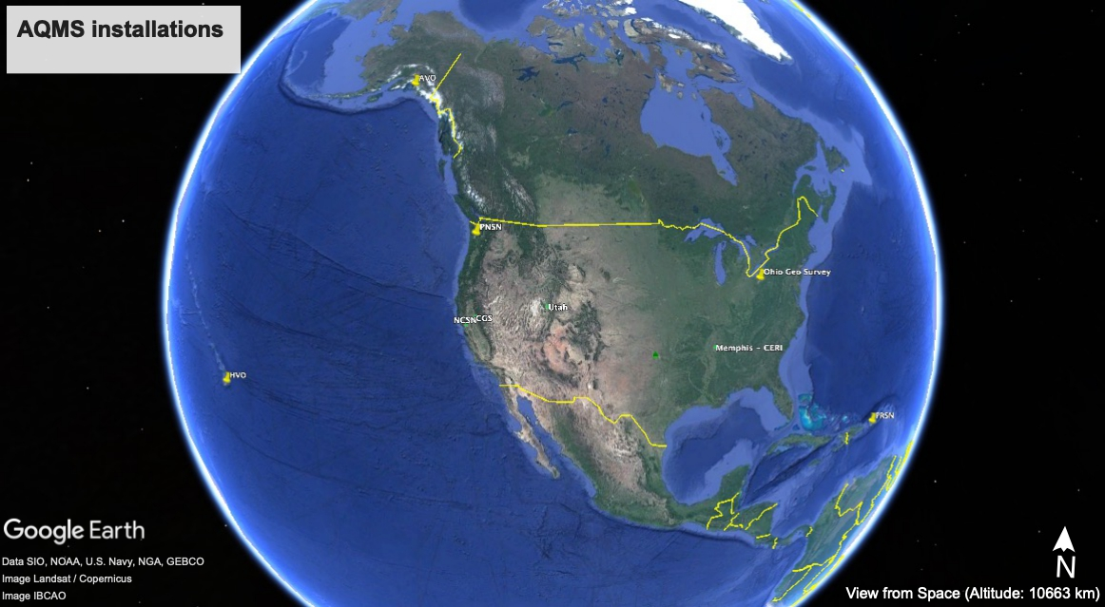
AQMS installations status

Slide 3
AQMS status
Postgres and operational:
PNSN,
HVO,
AVO,
Ohio Geo Survey (not authoritative), and PRSN(ready to go operational)
ISTI 4 instances with public/private networks
Postgres in test or parallel test: CERI, NCSN, & UUSN

Slide 4
Gitlab URLs AQMS Software Working Group
www.gitlab.com/aqms-swg AQMS SWG repositories (public and private)
https://aqms-swg.gitlab.io/jiggle-userdocs/ Jiggle User Guide
https://aqms-swg.gitlab.io/aqms-docs/ AQMS User Docs (in progress)
https://gitlab.com/aqms-swg/aqms-jiggle/-/releases Jiggle Releases

Slide 5
AQMS PostgreSQL Migration Status
Majority of modules now ported to AQMS Postgres from Oracle
Big change is requirement of StationXML for metadata.
Remaining Issues:
Sorting out amplitude processing tools - Renate has ShakeMap plugin now
TMTS - still a bear, port to be part of PRSN (partial start)
Gitlab migration not complete yet - affecting docker builds.
Testing of built in replication with PostgreSQL 14 (in since 11)
NonLinLoc integration - in works at ISTI

