Slide 1
MUSTANG Training Session for North American Regional Networks
Gillian Sharer
ANSS Network Operations Meeting
March 21, 2018

Slide 2
MUSTANG Session Planning
Proposed 2-3 day workshop on the topic of using MUSTANG for quality assurance
Targeted toward regional network operators
In late-July or early-August 2018
Limited IRIS funding for travel available
We are gauging interest and looking for feedback on topics of interest

Slide 3
Using MUSTANG Web Services
http://service.iris.edu/mustang/
measurements
noise-psd
noise-pdf
noise-pdf-browser
noise-mode-timeseries

Slide 4
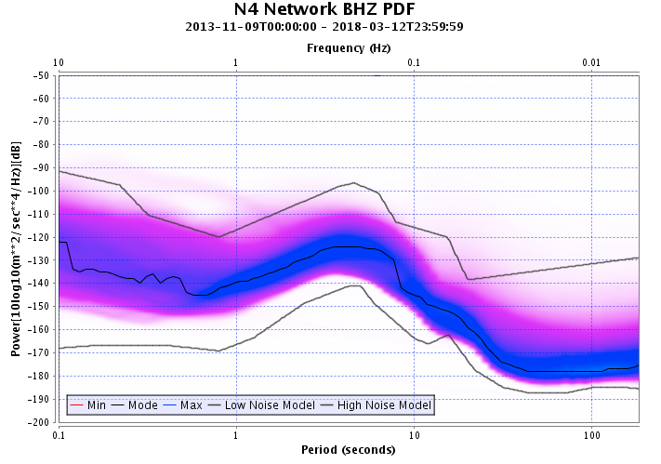
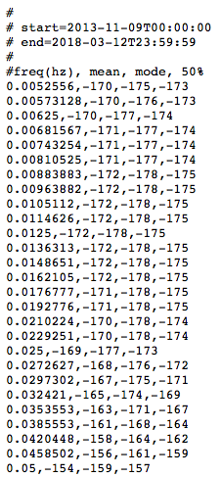
New Feature: PDF Statistic Text Output
http://service.iris.edu/mustang/noise-pdf/1/query?net=N4&sta=*&loc=*&cha=BHZ&quality=M
&format=noiseprofile_text&noiseprofile.type=mode,mean,median

Slide 5
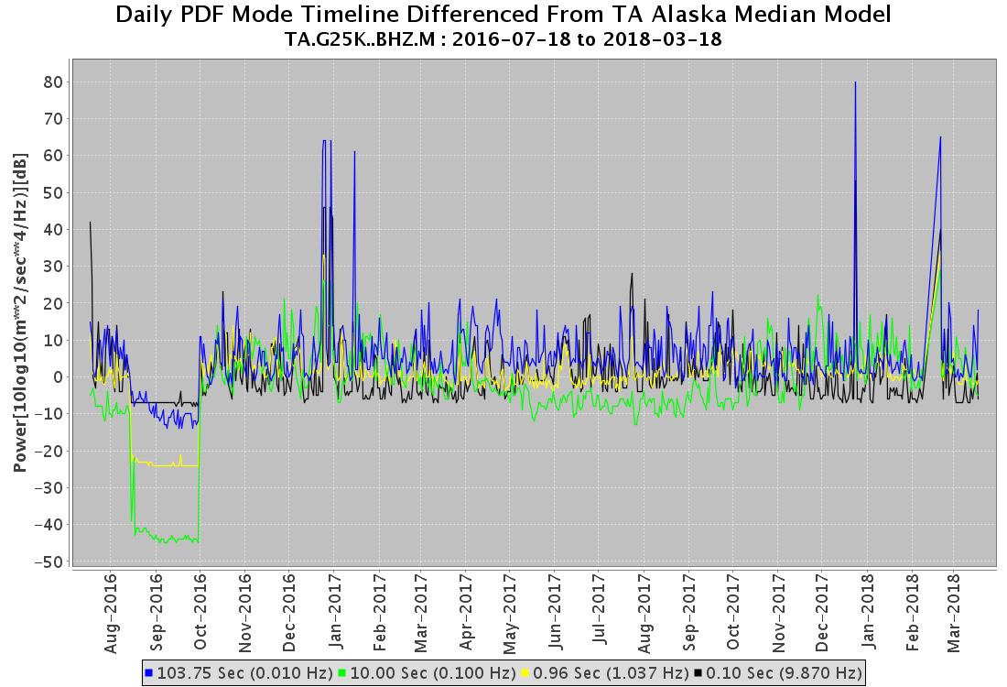
PDF Daily Mode Differenced from Model
http://service.iris.edu/mustang/noise-mode-timeseries/1/query?target=TA.G25K..BHZ.M
&plot.title=Daily PDF Mode Timeline Differenced From TA Alaska Median Model
&output=powerdhnm&format=plot&periods=0.1,1,10,100
&noisemodel.byperiod=0.1,-147|1,-146|10,-141|102,-177

Slide 6
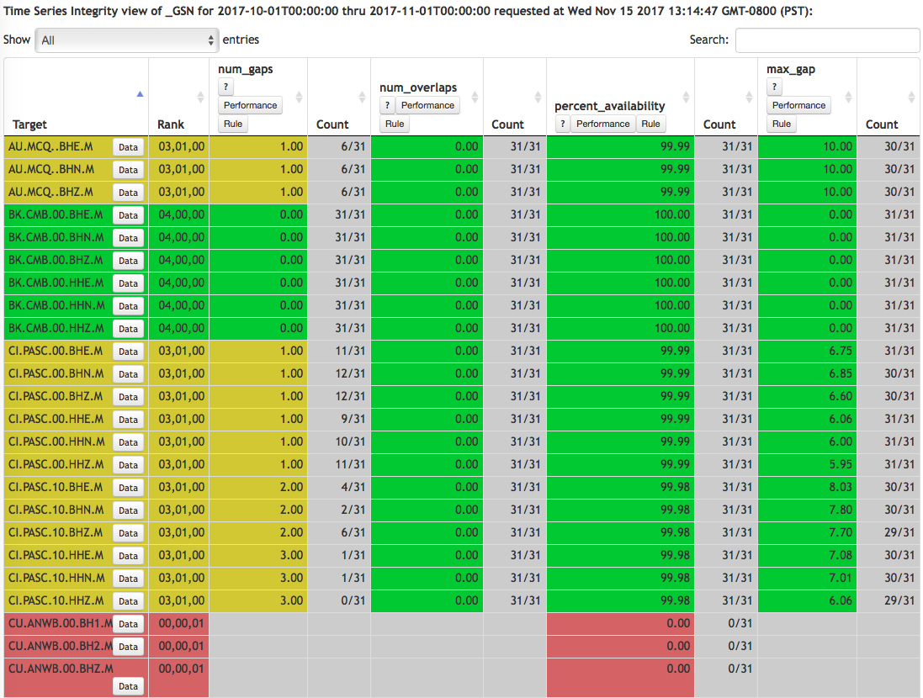
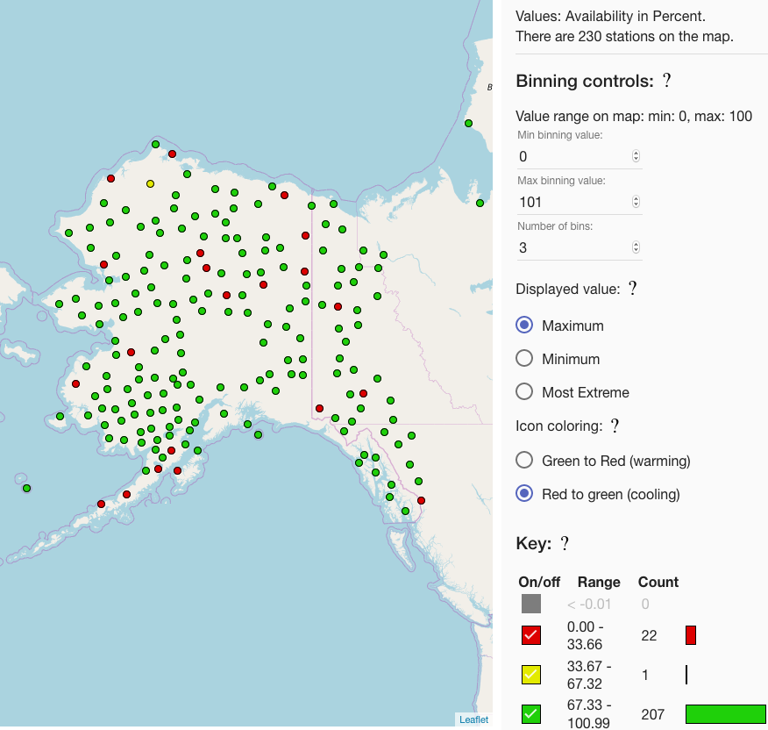
Using MUSTANG Clients
LASSO : Station Ranking
MUSTANGular : Plot Metrics on Map
http://lasso.iris.edu
http://ds.iris.edu/mustang/mustangular

Slide 7
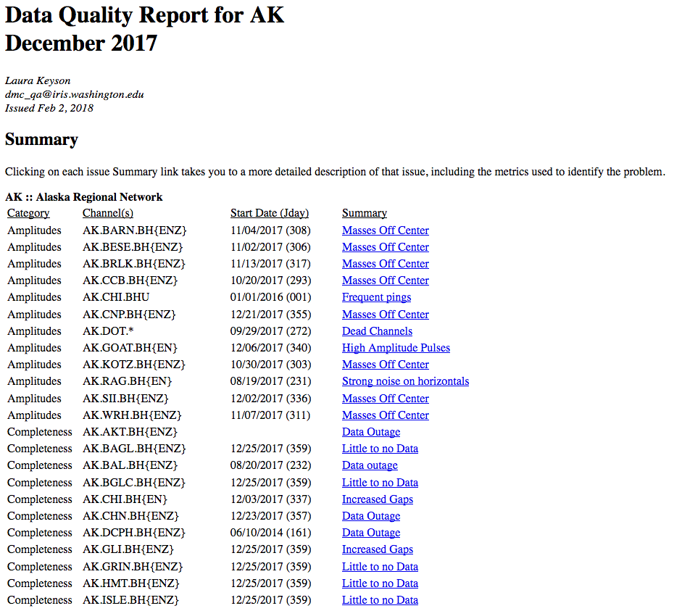
Creating Network Quality Reports

Slide 8
Creating Network Quality Reports
Identifying metric threshold values that indicate a station problem
Using scripts to compile metrics and flag potential issues
Analyst review and issue tracking
Compiling information into a readable report

Slide 9
Survey Participation Request
www.surveymonkey.com/r/RegionalNetworkQA
Short, 10-minute survey about your network's QA practices and what you would want to learn from a MUSTANG workshop
Closes on March 23

