Slide 1
Station UI
Maintaining channel lists in AQMS
NetOps 2018

Slide 2
The problem
Stations change with updates in the field.
Gain channels, lose channels, get offlined, get onlined again.
AQMS processes use a subset of available channels.
Each such subset is a channel list maintained in database table appchannels.
How do we reconcile:
Station metadata updates and channel list membership
Policy changes regarding channel list membership
Temporarily removing poorly performing stations from channel lists
How to give the people most familiar with a channel list a way to maintain it?
When a station has updates, how to propagate this to all channel lists?
Can we formulate some general rules for membership of a channel list?
How do we handle the case when station data and metadata become available at different times?
NetOps 2018

Slide 3
Before Station UI
Updates were made via sql scripts
The true owners/users of channel lists had to request someone with access to these sql scripts if they wanted a change.
No visibility into channel list membership apart from running sql queries
No incremental updates, only remove and replace
NetOps 2018

Slide 4
Station UI
Browser / web based UI
Users can
Create new channel lists
View, add, update and offline channels from channel lists
New channels are auto added to channel lists based on rules
Channel source can be CWB or metadata
Anyone can view, only authenticated users can make changes. All changes are logged.
UI connects to archival or post-processing database. Changes are propagated to real time databases.
Integrated with CWB, dataless2aqms, Request Tracker
NetOps 2018

Slide 5
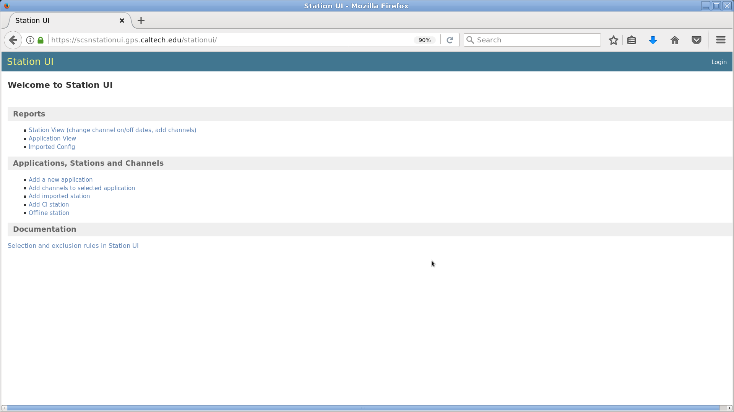
Station UI
NetOps 2018

Slide 6
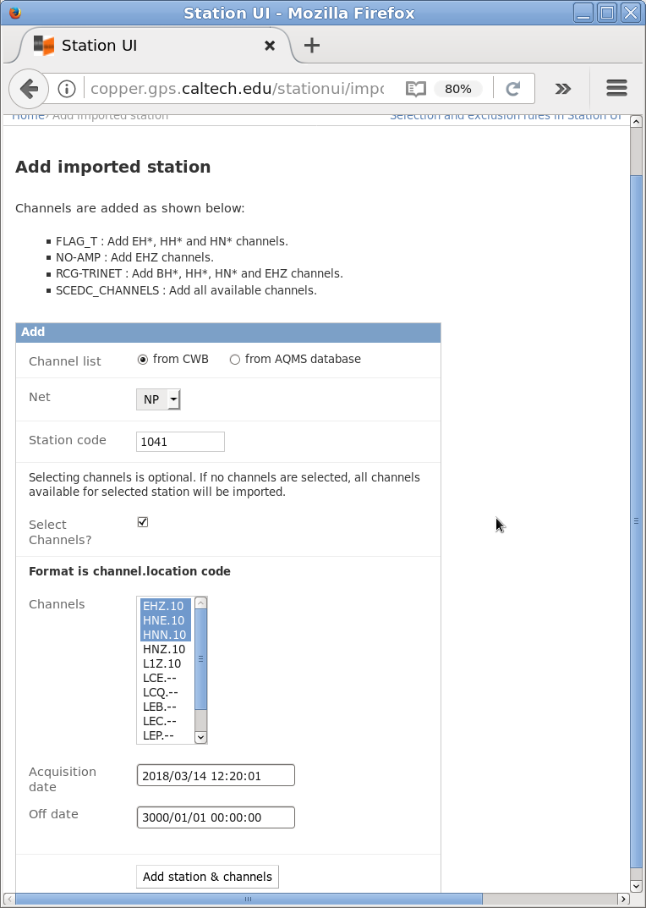
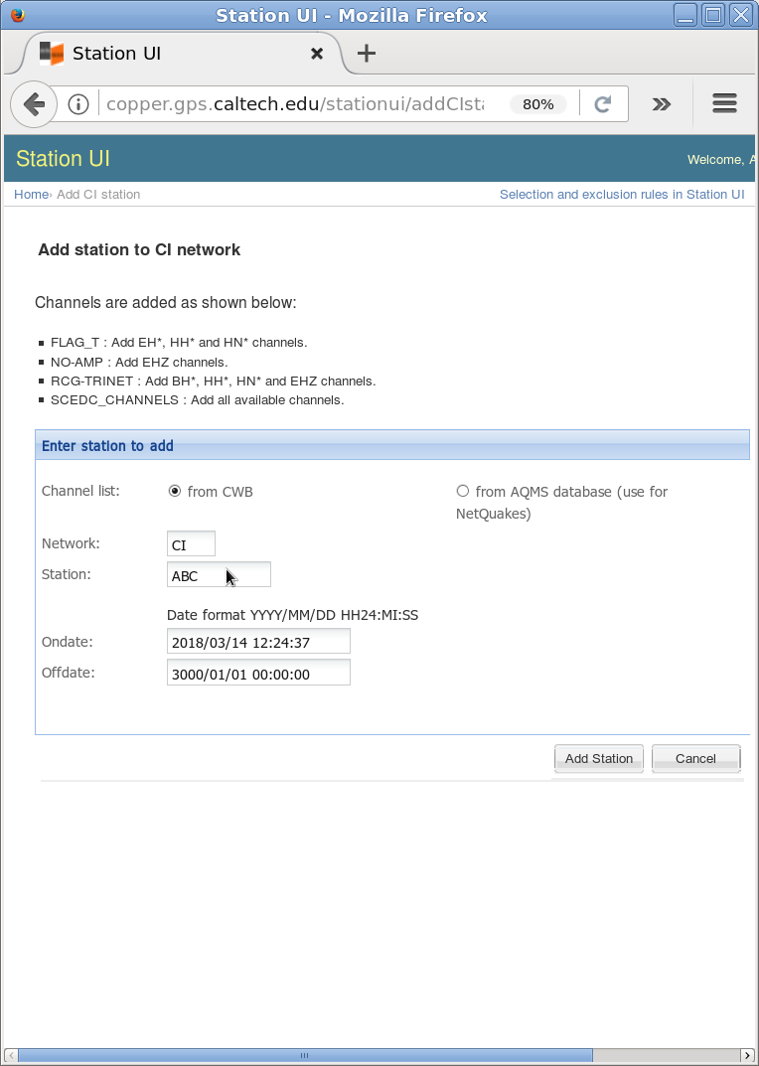
Add new channels
Add imported channels
Add CI channels
NetOps 2018

Slide 7
Rules for adding channels - the HARD(coded) part
FLAG_T : Channels that can be used for RT processing.
NO-PICK : Channels that are NOT to be used for picking on the RT systems.
NO-AMP : Channels that are NOT to be used for amplitude/magnitude calculation on the RT systems.
IMPORT : Channels that are imported from other networks (i.e. non-CI channels).
RCG-TRINET: Channels that are used for triggered request card generation.
Adding imported channels
All selected channels are added to the IMPORT list.
If any of the selected channels are EHZ, HH or HN, they are added to FLAG_T.
If any of the selected channels are BH, HH, HN or EHZ, they are added to RCG-TRINET list.
If any of the selected channels is EHZ, it is added to NO-AMP.
Adding CI channels
EHZ, HH and HN channels are added to FLAG_T.
BH, HH, HN and EHZ channels are added to RCG-TRINET.
EHZ channel is added to NO-AMP.
NetOps 2018

Slide 8
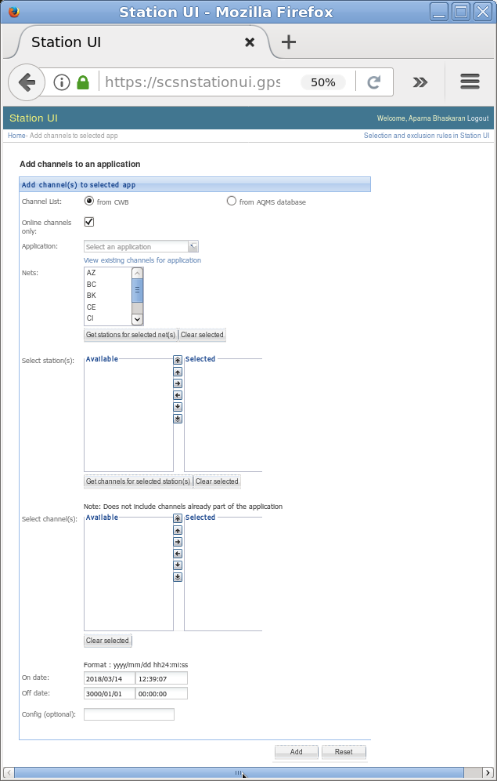
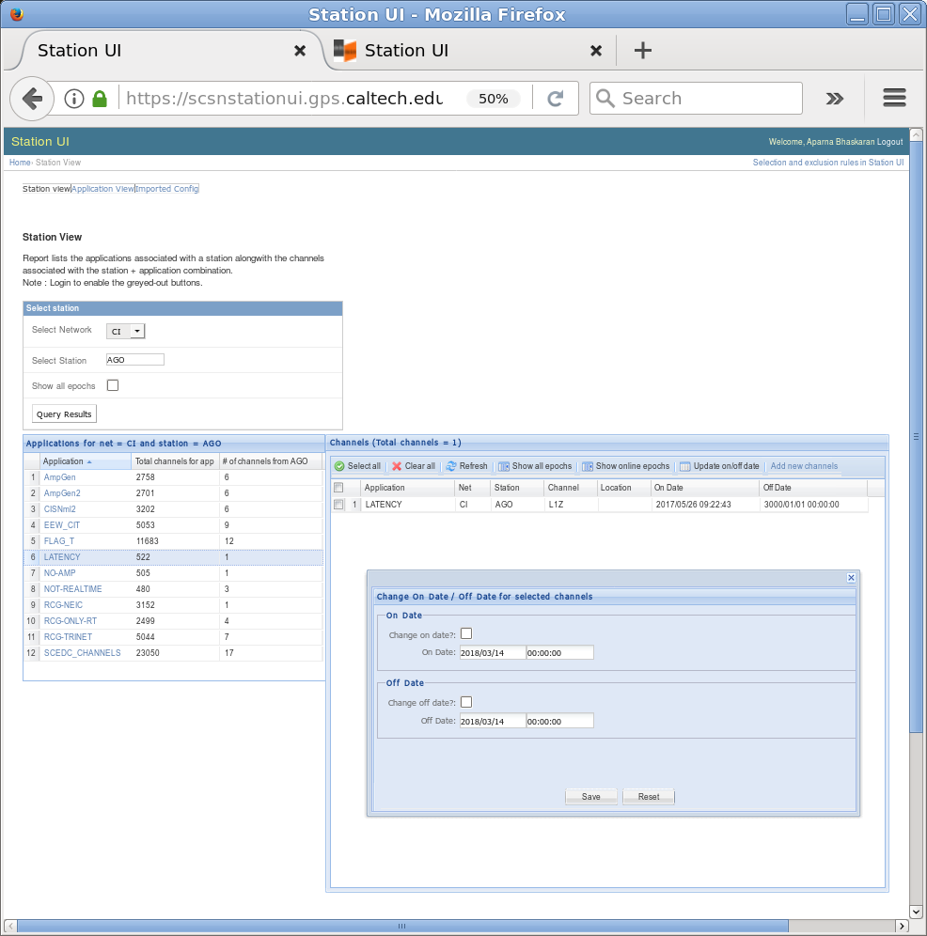
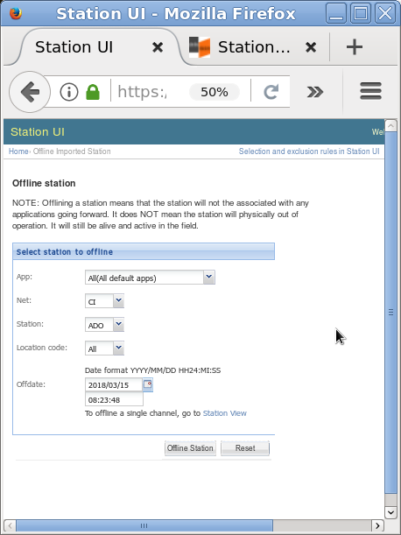
Update channels
Change membership of a list
Change on/off date for channels
Offline a station
NetOps 2018

Slide 9
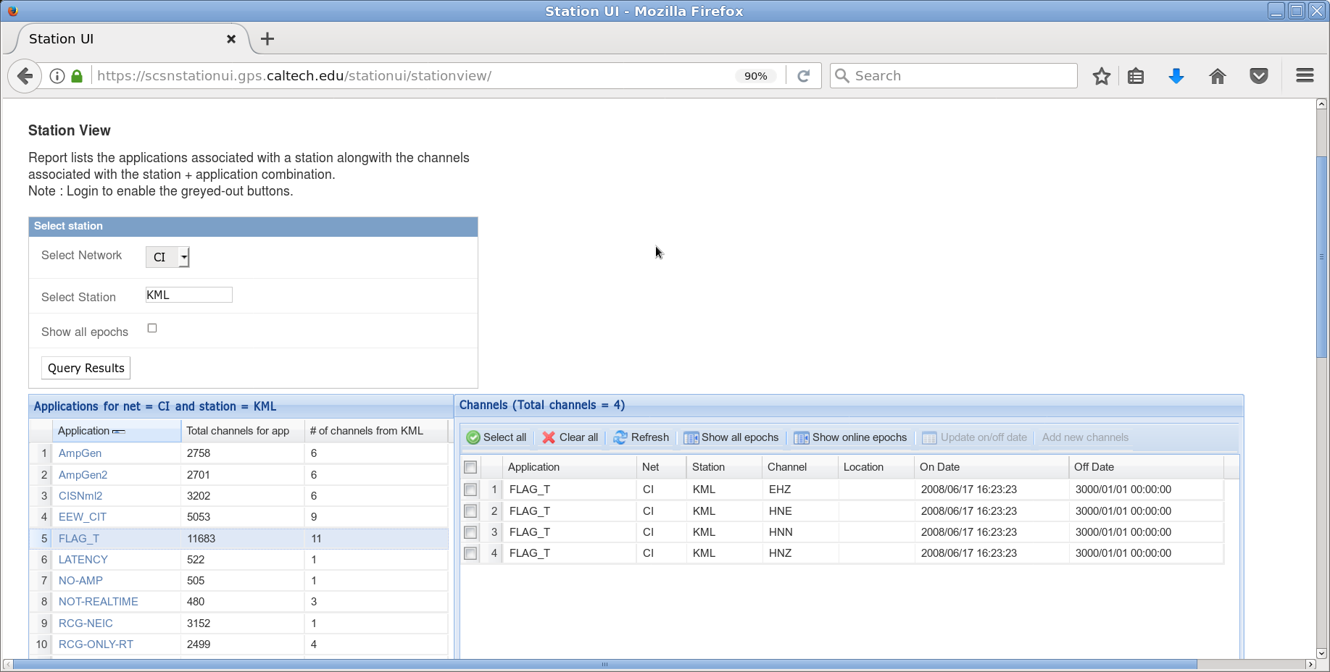
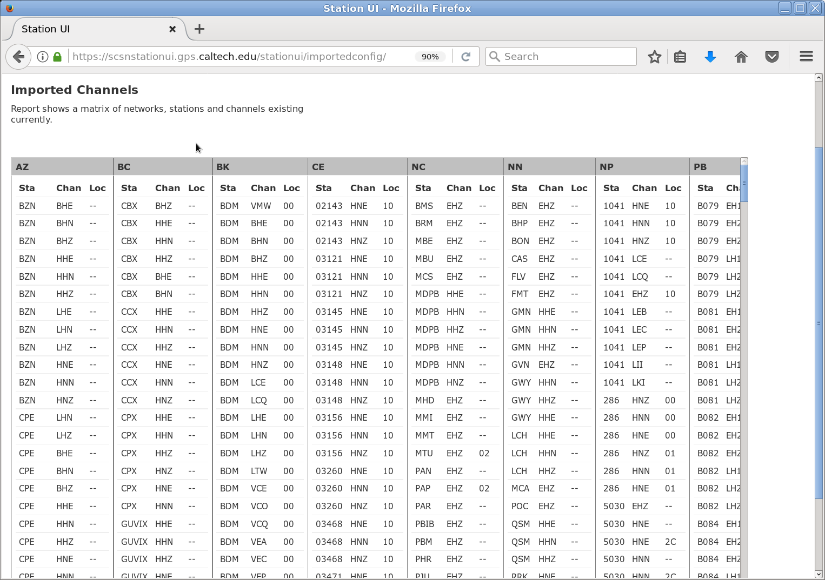
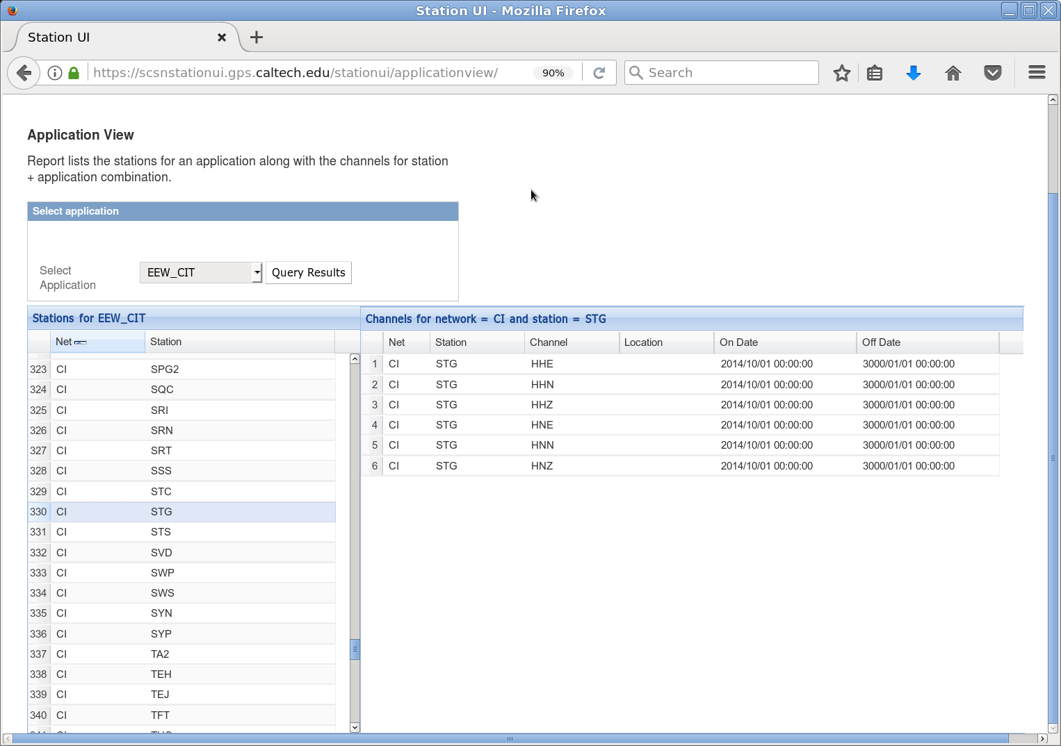
Reports
Station view
Application view
Imported config
NetOps 2018

Slide 10
Authentication and Logging
Users request a login
PostgreSQL db
User authentication information
Log user actions resulting in DML.
All interactions with the UI logged into log files
Python logging library
NetOps 2018

Slide 11
Future work
UI to delete channels from a channel list
UI or config file or ?? to allow an RSN to formulate their own rules
Export reports into CSV
Add more reports
Channel list metadata
Is SNCL present in CWB? Does it have metadata?
Suggestions are welcome
NetOps 2018

Slide 12
Software details
Redhat Enterprise Linux v7
Python 2.7, Django 1.5, cx_Oracle, MySQLdb, psycopg2
Apache, mod_fcgid
Javascript (ExtJS-3.3.1), CSS, Django templates
PostgreSQL, Oracle
Version controlled in local gitlab.
Deployed at SCSN via puppet.
NetOps 2018

Slide 13
Acknowledgements
Thanks to Ellen Yu and Mike Watkins
Design : Ellen Yu and Aparna Bhaskaran
Development : Aparna Bhaskaran (aparnab@gps.caltech.edu)
NetOps 2018

Slide 14
Questions?
NetOps 2018

