Slide 1
CI/CD Workflow and
Event Pages
NetOpsIX - Developer’s Workshop
Jeremy Fee <jmfee@usgs.gov>

Slide 2
CI/CD Workflow
Development
Coding Standards
Build Tools
Version Control
Versioning
Planning
Deployment

Slide 3
Coding Standards
Pick one as a group
Document, or just pick an existing standard
Tools
Code Linting
Code Rewriting
autopep8
clang-format
google-java-format
go fmt
“Indeed, the ratio of time spent reading versus writing is well over 10 to 1. We are constantly reading old code as part of the effort to write new code ... making it easy to read makes it easier to write.”
- Robert C. Martin, Clean Code: A Handbook of Agile Software Craftsmanship

Slide 4
Build Tools
Build is more than just compile
Compile
Linting
Tests (Unit and Integration)
Coverage
Examples
Angular CLI / Grunt, Jasmine, Karma
Ant, Cobertura, Junit
Make, ...

Slide 5
Version Control
CVS
Git
Decentralized
Working copy is entire repository history
Works offline
Subversion
Requires access to central server
Working copy is only current revision

Slide 6
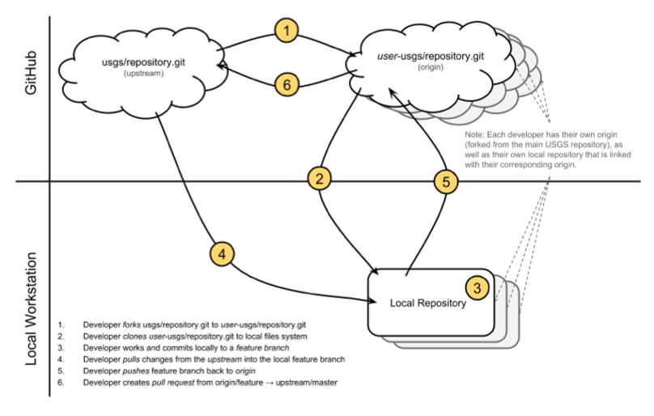
Version Control - Git
Forking workflow
Simpler access control
Simpler collaboration
Pull requests
Do not commit to master branch
https://guides.github.com/activities/forking/

Slide 7
Git - Pull Request
Manual review checkpoint
Reference GitHub issues
Discuss comments
Automatically check incoming code
Travis CI
Check coding standards
Compile
Run unit tests
Upload code coverage
Codacy

Slide 8
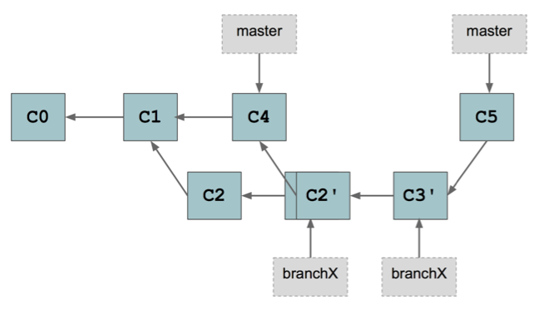
Git - Rebase
Apply same changes starting at different point
Update Master Branch
git checkout master
git pull --ff-only upstream master
Rebase against Master Branch
git checkout branchX
git rebase master
https://git-scm.com/book/en/v2/Git-Branching-Rebasing

Slide 9
Versioning
Semantic Versioning (major.minor.bugfix)
Major - incompatible changes
Minor - add new features
Bug fix - fix existing features
Git tag
git tag -am vX.Y.Z vX.Y.Z
Subversion tag
svn copy ^/project/trunk ^/project/tags/vX.Y.Z

Slide 10
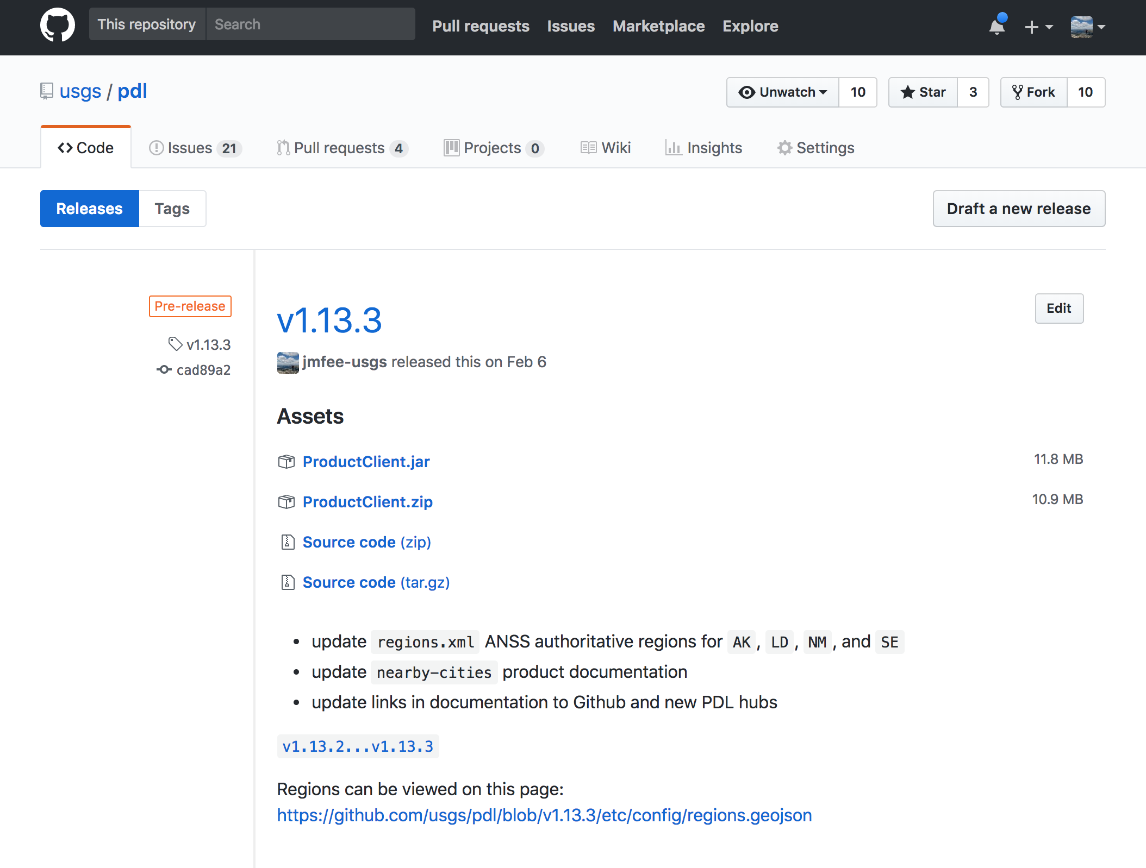
GitHub Releases
Based on Git tags
Add release notes
Attach binaries

Slide 11
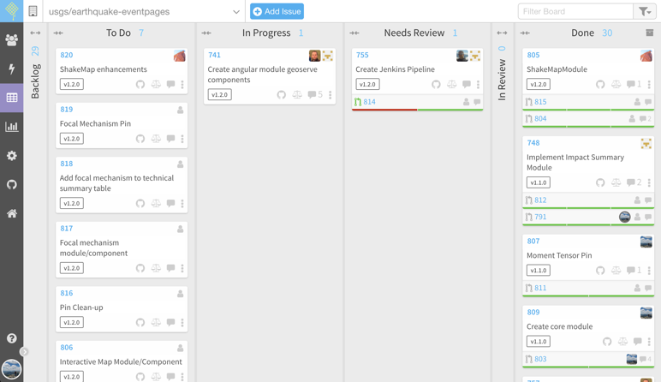
Planning
Waffle Board
Uses Git Issues
Columns map to Issue Labels
Sprints
Alternatives
GitLab, JIRA

Slide 12
Deploy Automation
Manual deploys
Acceptance testing
Code review
Deployment planning
Scheduled downtime?
Automated deploys
Same problems
Test, Plan, Review incrementally
Automate to avoid manual errors

Slide 13
Deploy Automation - Crontab
Pull code/configuration changes
Always use --ff-only
Different branches for different environments
master => staging
production => production
Doesn’t easily support
More complex builds
Build status reporting

Slide 14
Deploy Automation - Puppet
Manually create PDL releases
Pull request for puppet environment project
Puppet master deploys
Configuration via ERB template
Init Script
ProductClient.jar
Restart services when config changes
On hubs, EIDS configuration and services

Slide 15
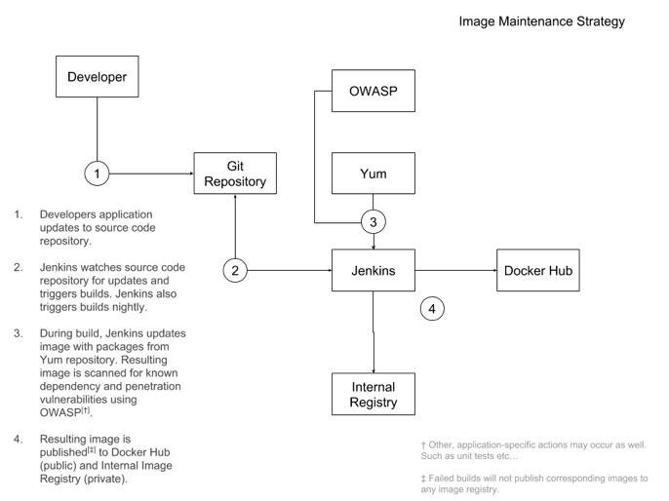
Deploy Automation - Jenkins
Separate build/deploy pipelines
Jenkinsfile for build with source
Jenkinsfile for deploy in separate repository
Vulnerability checks
Nightly patching

Slide 16
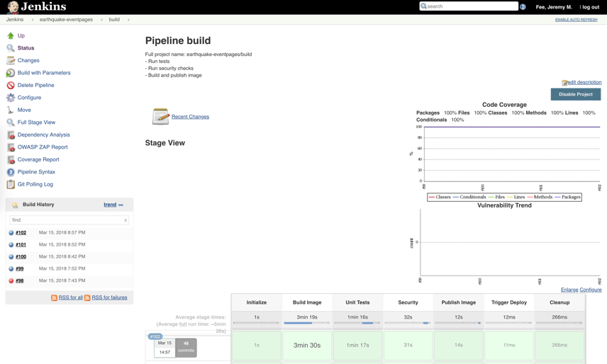
Jenkins Build
master automatically triggers build
Deploys to staging
Manually deploy release tags to production

Slide 17
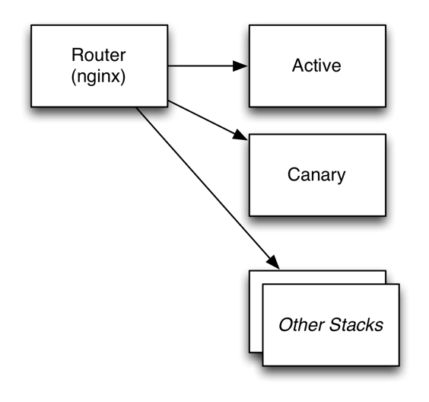
Zero-downtime Deploy
Docker Stack/Swarm
Deploy Canary
Health/QC checks
Update routing to Canary
Deploy Active
Health/QC checks
Revert routing to Active
Clean up

Slide 18
Continuous Improvement
It doesn’t happen overnight
Improve coding standards
When working on code
Add tests
To reproduce bugs
Automate deployments
Triggered when a button is clicked

Slide 19
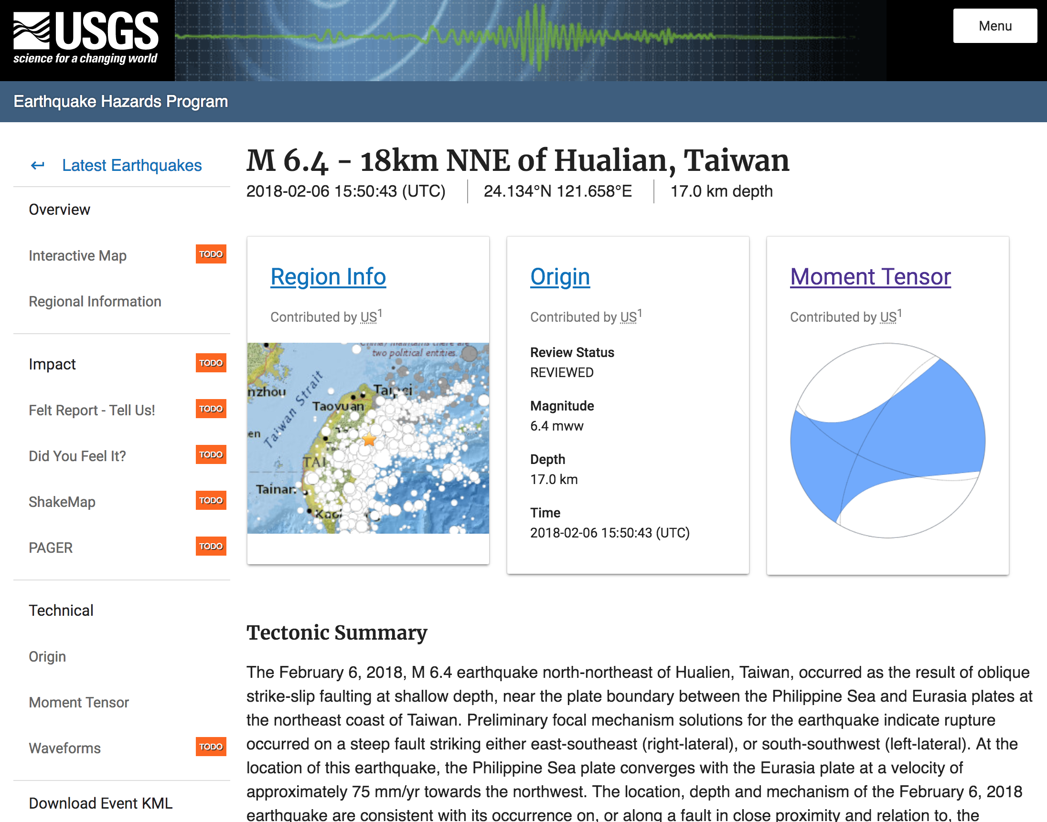
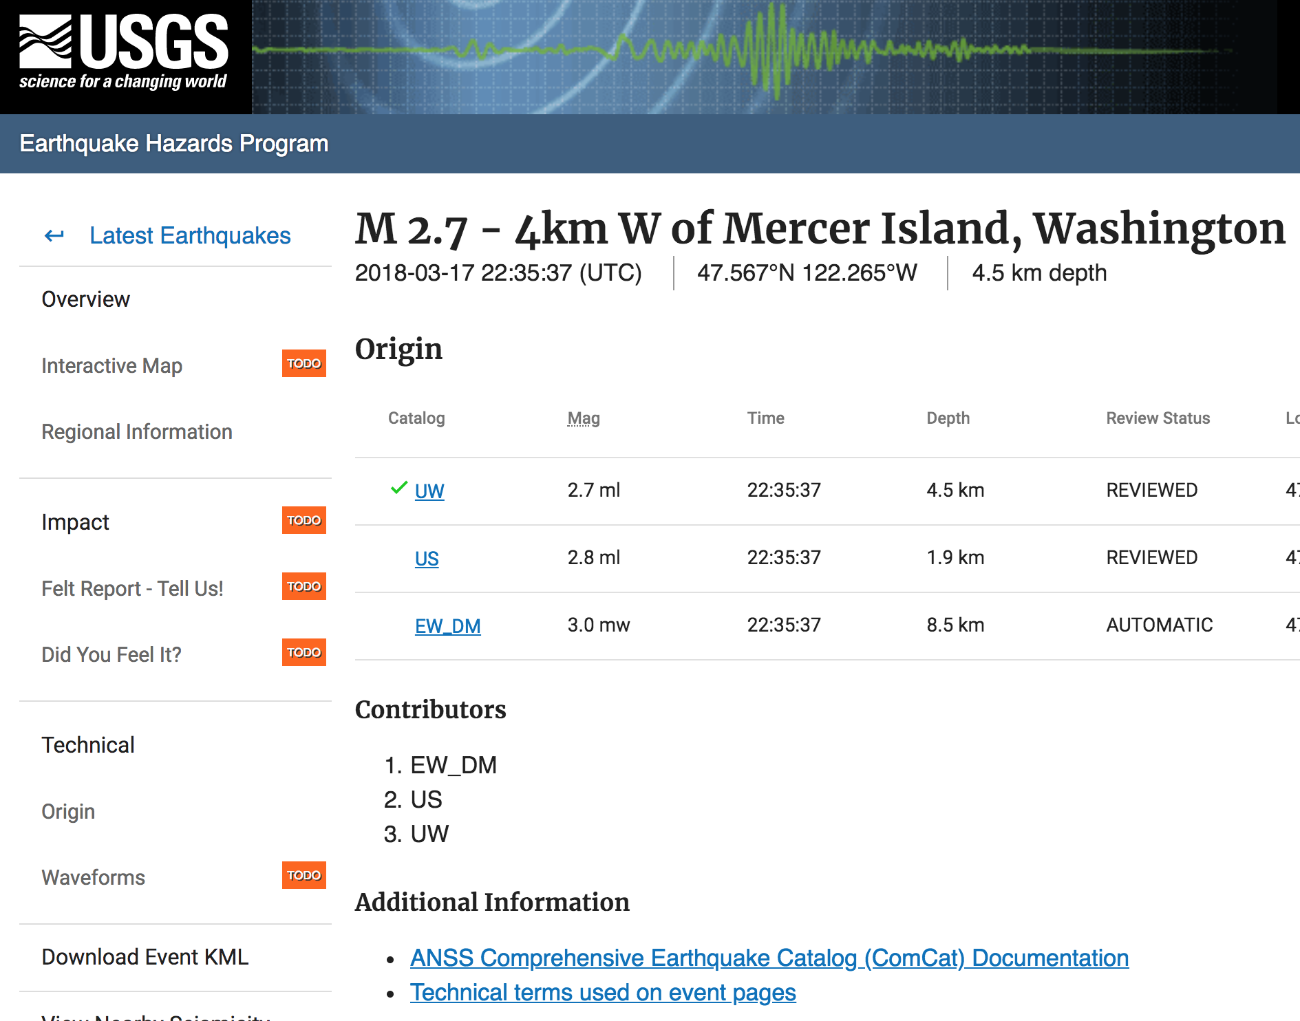
Event Pages
Improving Scalability
Angular framework
Client side data access
ShakeMap code reuse
Improving CI/CD pipelines
https://github.com/usgs/earthquake-eventpages
https://waffle.io/usgs/earthquake-eventpages
https://dev-earthquake.cr.usgs.gov/beta/earthquakes/eventpage

Slide 20
Questions?
Thank You

