Slide 1
Jiggle Discussion
Weston Thelen USGS CVO

Slide 2
Giving the people what they want
2 parts:
Jiggle Best Practices, hacks, suggestions for improvements
Comparison of Jiggle GUI views
Results of survey
Examples of using jiggle.jar w/o the GUI
Examples from the Caltech
Other examples from the audience?

Slide 3
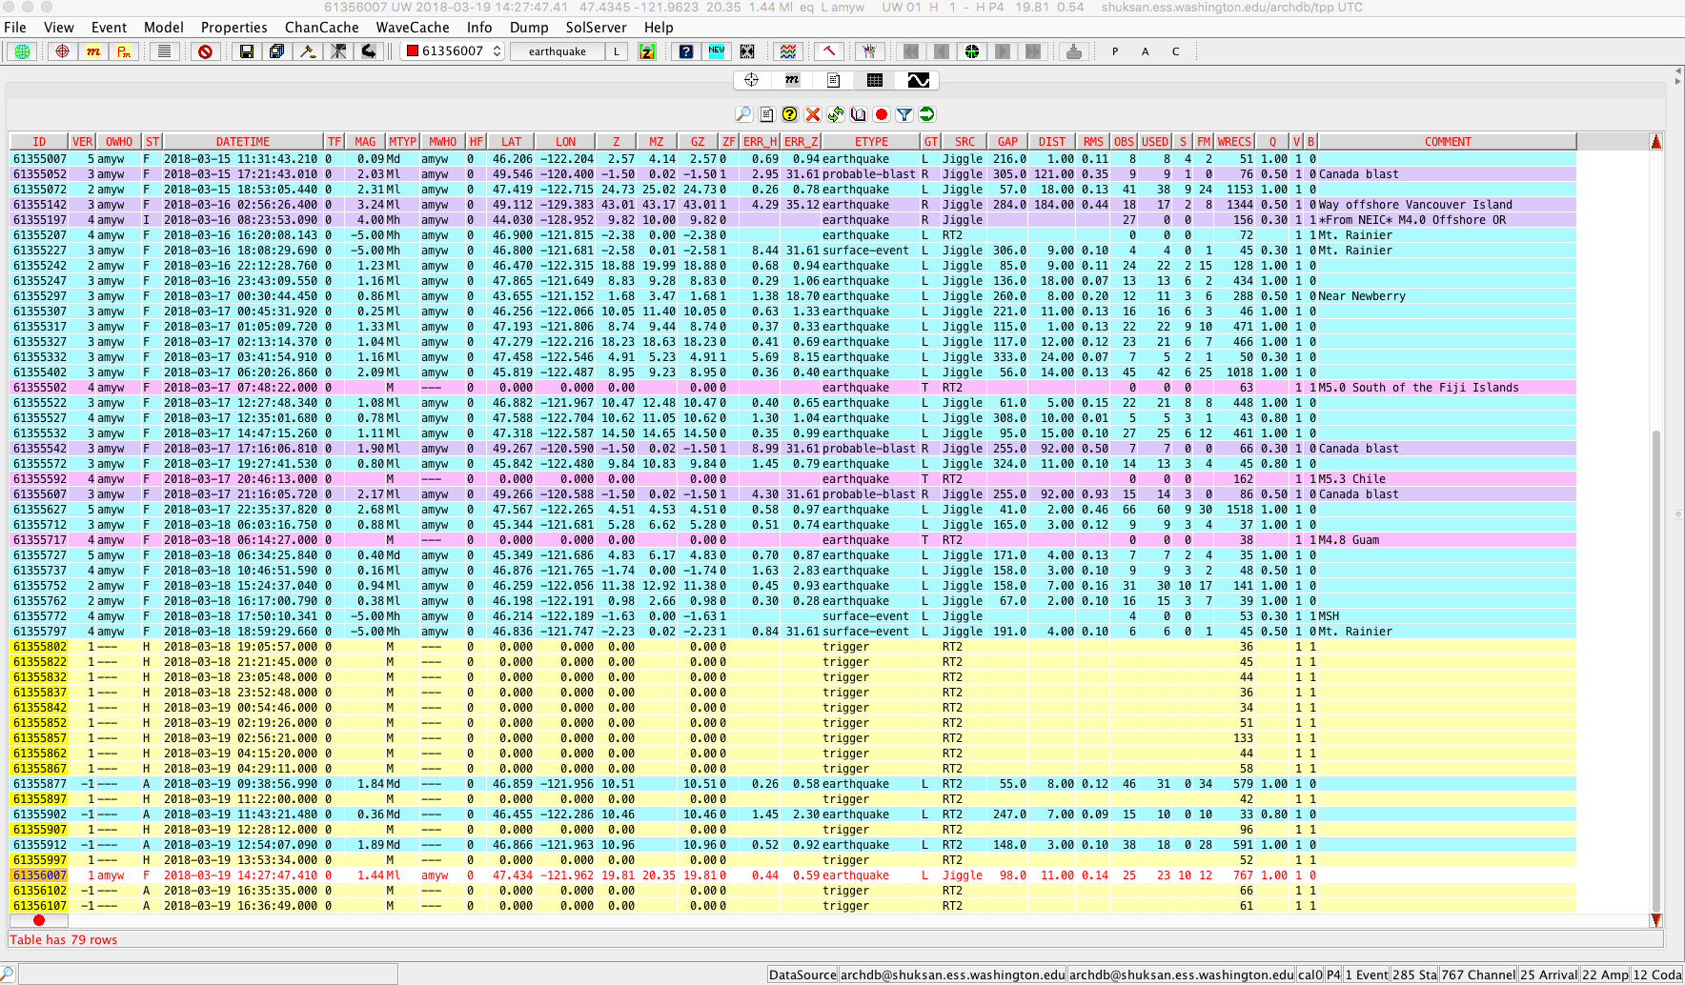
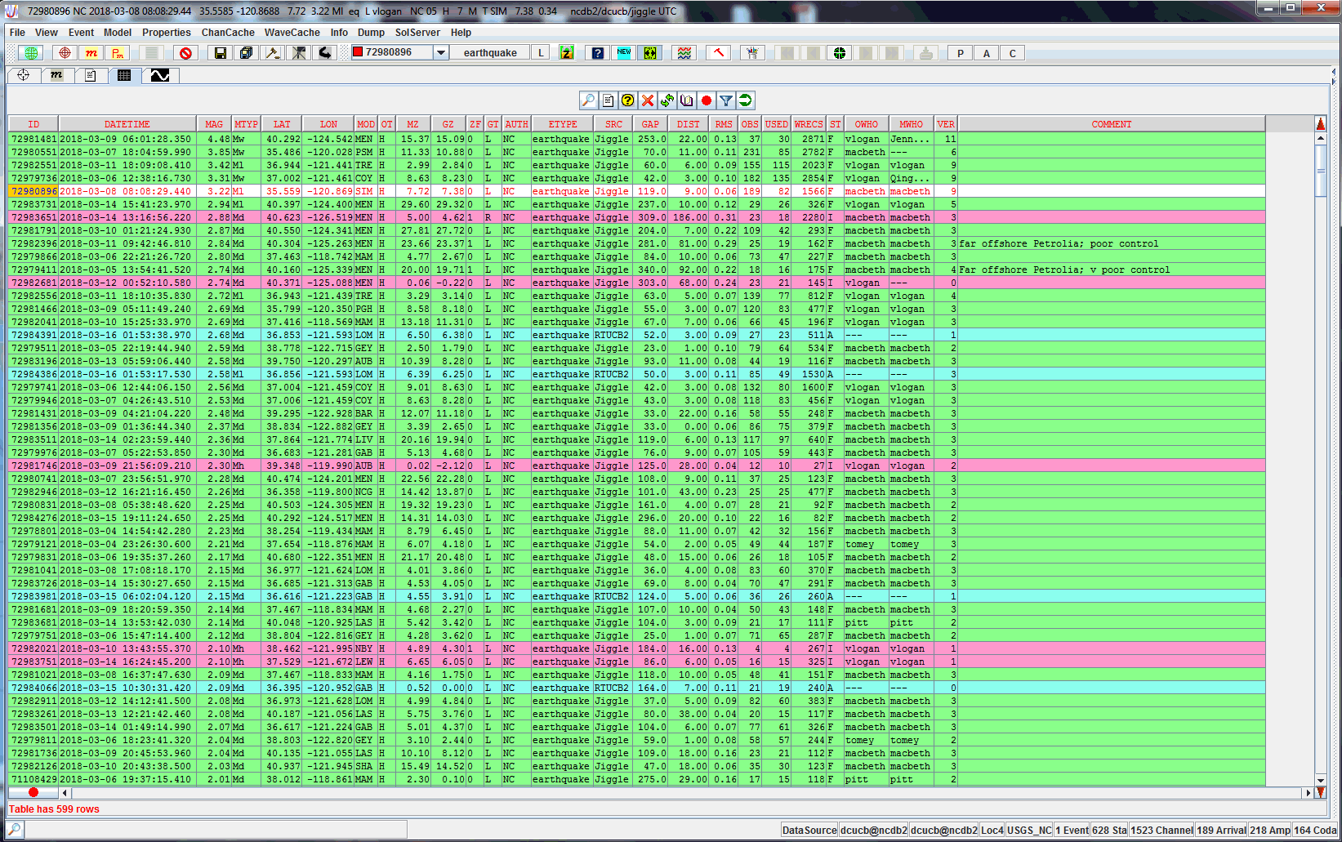
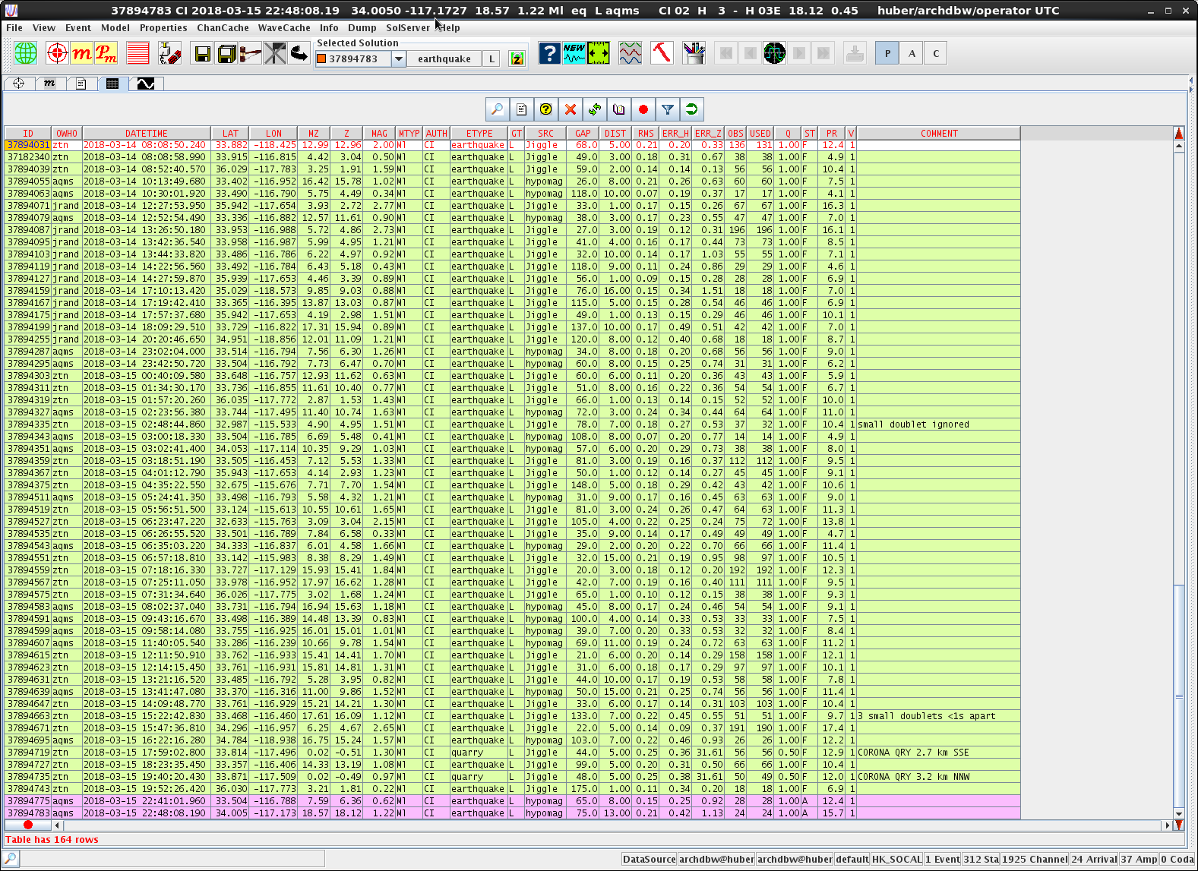
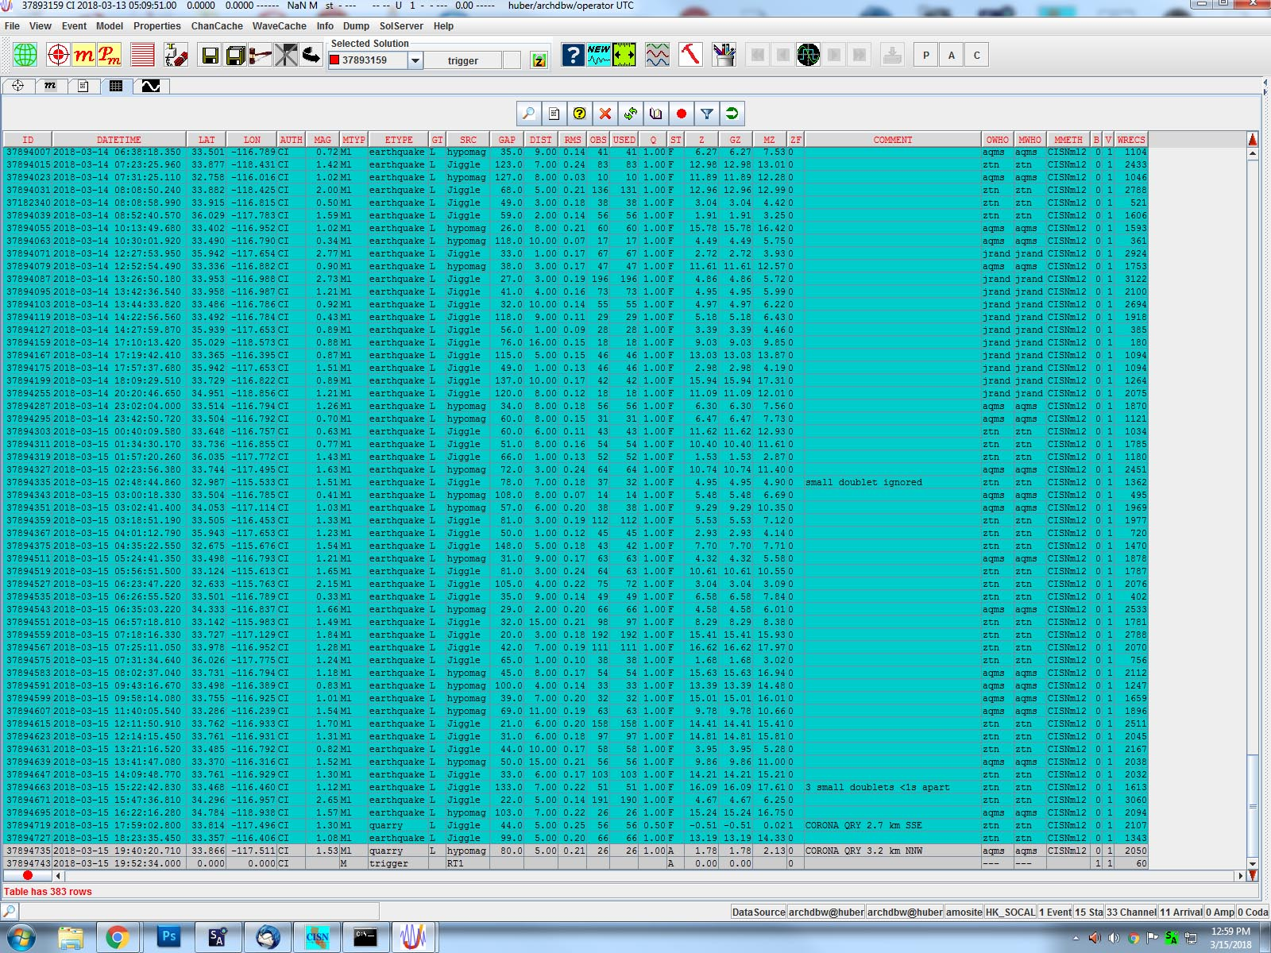
Comparison of GUI views: Catalog View
CERI
NCSN
UUSS/UW/PNSN/HVO
Caltech 1
Caltech 2
AVO

Slide 4
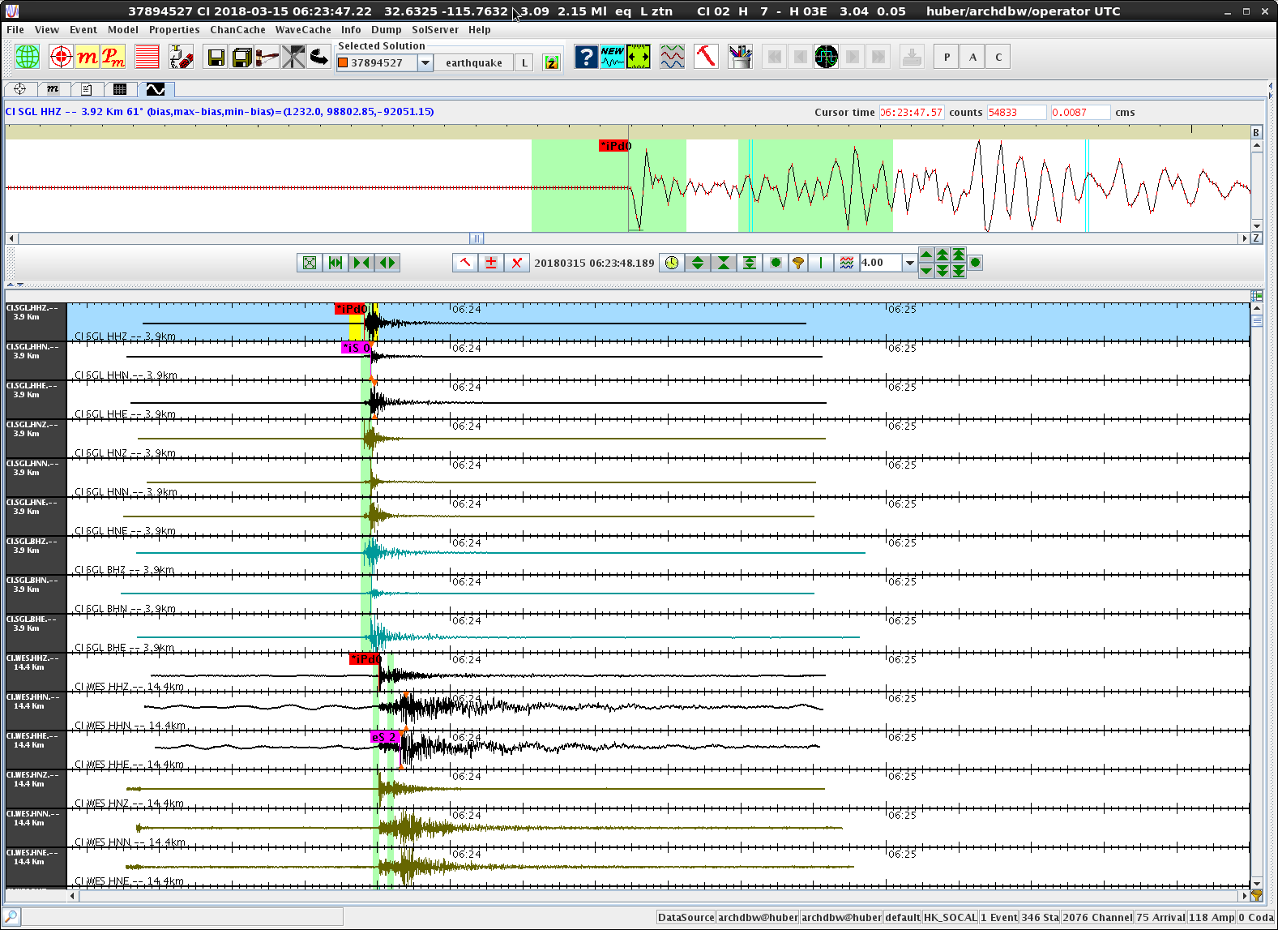
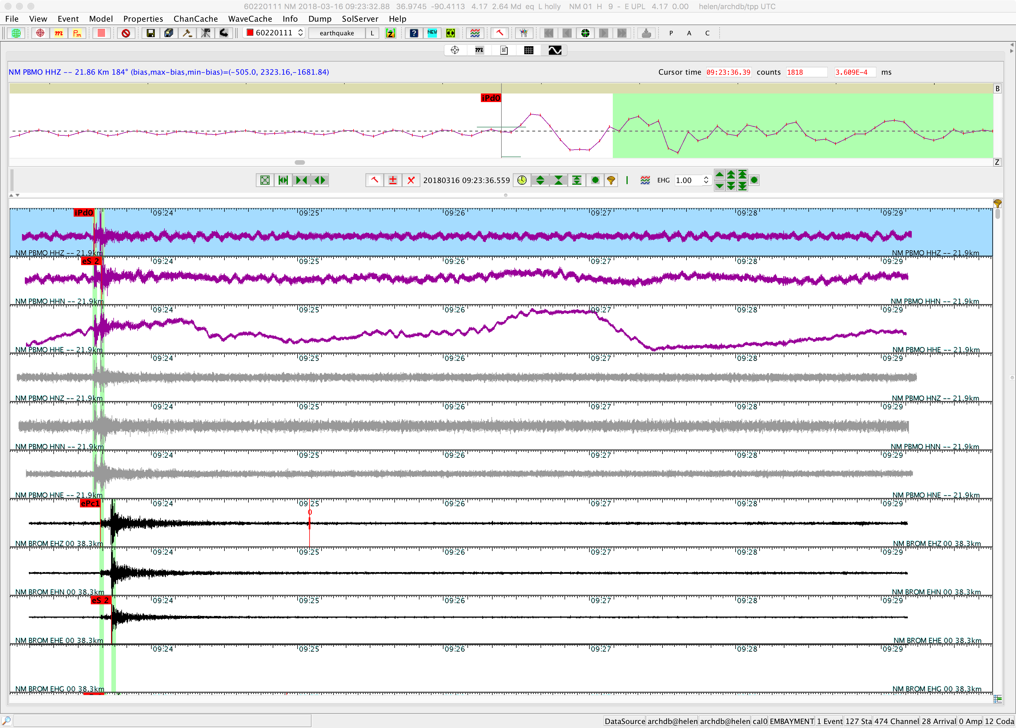
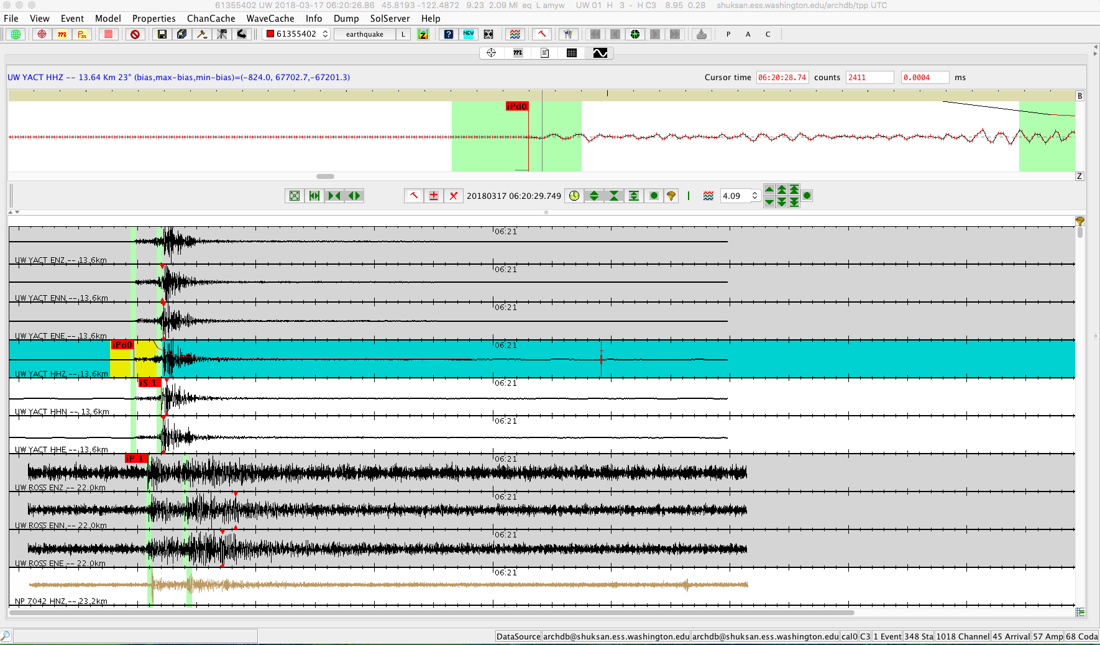
Comparison of GUI views: Wave View

Slide 5
Comparison of Jiggle GUI views: Location View

Slide 6
Comparison of Jiggle GUI views: Ml View

Slide 7
Comparison of Jiggle GUI views: Md View

Slide 8
Best Practices
Survey completed by analysts in the following groups:
AVO
Caltech x2
CERI
HVO
NCSN
NEIC
MBMG
PNSN
UUSS
LCSN
Asked for various best practices under typical conditions (NOT strange events)
Asked for improvements to various interfaces
Not advocating for a position, just giving the range of responses

Slide 9
Filtering
Most groups allow analyst discretion to filter (75%)
BUT
Groups variably change the weights based on whether the trace is filtered
Some do change the weight (or change the weight only on EH* channels)

Slide 10
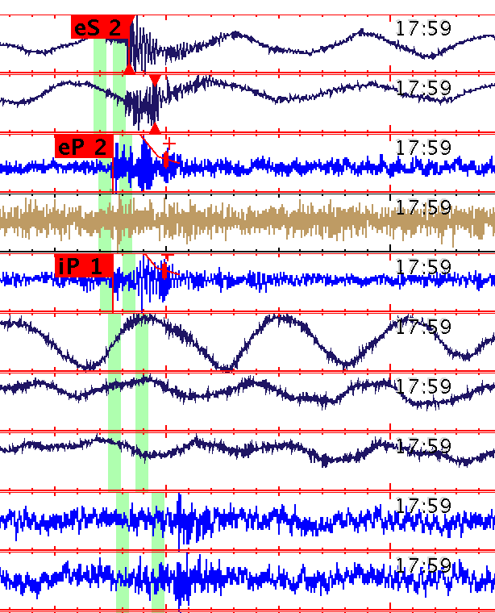
What to pick…
Stop picking at a certain radius (mostly networks with lots of stations)
All identifiable phases (mostly networks with fewer stations)
Stop when solution becomes stable
Networks with fewer stations, or if within a sequence

Slide 11
More on picks…
Most groups manually pick, some accept automatic picks if in the correct place
Impulsive vs. Emergent
0 weight: Groups with volcanoes can have a “e” or “i” on zero weight. Others only “i”
1 weight: Either “i” or “e” for the most part
2 weight: Nearly unanimously “e”

Slide 12
Use of 4 weight picks (no influence on loc)
Typically, I'm sure the phase is Pg and I can't see the Pn arrival well enough to use it.
To pick on a station that will be used for a Md, but the the pick is too poor to use in the location.
TYPICALLY IF A PICK SHOULD NOT BE USED IN SOLUTION
To exclude a pick on a station that is invalid because of a error that can be corrected later
Our 4-weight picks are not considered in the location but can be used in the magnitude calculation which can be helpful.
Post processing, velocity modeling, station corrections
Used inconsistently, to mark stachans w/ timing issues (either known or new)

Slide 13
Phase window for picking
P2P Amplitude
Most leave it to the analyst to figure out the window in which to pick
Encourage analyst to either
Zoom to P2P
Zoom to pre-event noise
Bimodal prescription of 3s and 10s window in which to pick within
“apply last amp scale”
Noise Amplitude
Small Time Window + p2p Amplitude

Slide 14
Duration Magnitudes (Md)
Md used when Ml is unavailable in most cases
Most groups use only vertical channels
Several groups use only short periods
50/50 adjust the duration windows…others just accept the auto durs
All groups using org.trinet.jasi.magmethods.HypoinvMdMagMethod engine

Slide 15
Amplitude Magnitudes (Ml)
Nearly everyone uses Ml
Most appear to trust Ml as long as the s2n is ok
Some begin to distrust Ml at M0 or M1
Interesting mix of horizontal and vertical channels used
Many use only horizontals, others use only verticals, some use vertical only if single channels seis
50/50 Adjust Ml amplitude/take at face value
Several mag engines used
RichterMlMagMethod2, CISNmlMagMethod2, MxMlMagMethod

Slide 16
Response Event
Most review the event initially, remove a few spurious events and get it out the door before doing a more through review
Most networks start looking for a Mw at M3-4.

Slide 17
Remote Access
All groups use jiggle remotely
~40% experience a slowdown that changes their workflow
networkModeWAN=true
Other fixes???
Remote desktop???

Slide 18
Improvements to the Map Interface
Many suggested the need for better basemaps.
Good news…that capability already exists!
See the WMS service from USGS (https://viewer.nationalmap.gov/services/)
Additional vote for toggling between model depth and geoid depth.
USGS Imagery Topo
USGS Imagery Only
USGS Shaded Relief
USGS Topo

Slide 19
Improvements to Picking Interface
Automatically turn specific filters on/off depending on the type of trace displayed in the pick window (ie. turn band pass off when switching from a broadband station to a short period vertical station).
Guided automatic re-picking, i.e. drag to specify time window then apply auto-pick.
I would like to be able to assign keyboard shortcuts to picks that I make the majority of the time. Ex: ep1 (only ip1 is available now) Also be able to assign keyboard shortcuts for s picks.
HotKey for next waveform
Include a channel QC ability so that is a channel is broken you would be able to flag it and have that channel included in a list of some sort so that action can be taken by the relevant support to fix the station.
3 component mode (setting/unsetting)
Ability to make comments on sta/chan that could enter a db. As a right-click option, when a trace is selected in the multi-pane. Wish there was a filters user's guide.

Slide 20
Improvements of Location Interface
Allow sorting of channels by residual, or distance, or weight, or any of the other data columns.
Indication of degree of change with a re-locate, so stabilization is easier to determine. Map view of error.
It's trivial, but I would move the RMS, gap, and dmin to the start of the second line of data at the top to make them easier to find. These are the most important parameters to look at.

Slide 21
Improvements to Magnitude Interface
Display only broadband or strong motion horizontal channels when reviewing Ml and display only EHZ channels when reviewing Md.
Map view of residual / weight to detect bias.
I would put Chmag, Resid, and Corr (in that order) closer to the beginning of the channel lines, right after Lc or at least after Az to get them closer to the channel name. Alternatively, I would put Corr, ChMag, and Resid at the end of the line (in that order) to make them easier to find amongst the many columns of data.
More info on why stations are rejected or mags not computed
Ability to run an Mw through Jiggle?

Slide 22
Overall New Feature Request
When a blast is identified, the geographic description is automatically entered into the Jiggle comment field. I wish that upon saving a local or regional event, the geographic location information from the gazetteer was automatically loaded in the comment field.
Interface with other products (focal mechanism and Mw (TMTS) in our case).
Plot a 3D map that can rotate on axes;
Increase the speed of the loading time for viewing traces. When you scroll down you have to pause to let the traces appear.
Add an option to Event-->RCG to enable the user to retrieve new waveform snippets for ALL data traces for which the necessary data can be found in the wave server. Currently, one can use the waveserver power law to retrieve data from additional channels and/or data from a more suitable time window for an event, which is necessary to relocate some events with very poor automatic locations. However, there is no way for the user to save revised waveform snippets from channels that already had a waveform saved. Event-->RCG will only retrieve wavforms from channels for which there are no waveform data available under waveform source/model "DB event." It would also be nice if Jiggle had the capability to read in phase data from a file created using Dump--> Phase info followed by using the "Save all text to file.." option in the phase data window.
A quick clone feature. Since clones in our network more often than not tend to be in the same general location just before or after the featured event it would be nice to have the option of copying the picks from the original event and just moving them over as a single group over to the time of the new event (I guess similar to template matching?) at which point they can then be fully reviewed and corrected/deleted and/or added to. This would make major swarm sequences a lot faster to handle instead of having to start from scratch for every clone that wasn't picked up by the RT system.
dbselect type output to run hypodd directly from event selections. Calculate focal mechanisms internally so that picks can be adjusted as needed without going back and forth between command line outputs and adjustments in jiggle.
Allow for finalizing a network wide trigger for occasional QC
Adding other magnitude engines
How about a couple? First, a progress bar that rates quality - something akin to a "strong" password generator. Some feature that would measure the process of an event being analyzed against all the parameters needed for the best location and for timing efficiency in general. A feature that would tell you (in a manner of ways) what stations to pick (to close gaps, etc) and when to stop picking (minimal improvement with continued picks). Ability to run, view, (and approve?) Focal Mechanisms.

Slide 23
Efficiency Hacks
I had trouble figuring out the Scope mode functions or finding anybody that used it. Now that I have figured it out, it is very useful adding small events that didn't trigger the system or looking at other weird things that show up on the network.
Use of default filtering for specified channels; polygon catalog filtering with mag levels; Use of "last scale amp"; use of arrow keys; sort traces by distance from a selected channel; reject/strip more distant picks/amps/codas... SCOPE utility and more
When applying a filter ex:high gain it is faster to not click it on the first station otherwise it slows down dramatically applying the filter to all the traces. You can go back up and pick it after it loads. I'm not sure if it's a bug.
The method for creating a new event from scratch which we found on a CISN wiki page.
Keyboard picking shortcuts are a must, if you're not using them you're wasting your time. Overinflated auto magnitudes on LPs can be tamed by calculating the magnitude in Jiggle without making any picks/ other changes.
Noticed manually fixing depth (either deep or shallow) for eqs in particular areas helps hypoinv resolve locations. Utilize Event->Undo...->Restore ALL observations Phase and Amp filter buttons a must. Utilize Page Down button to quickly move through wfs. Utilize center data "bar/pipe" on zoom panel menu bar. Scale Up/Down button options on multi-pane "Funnel" button (bottom, right hand corner).

Slide 24
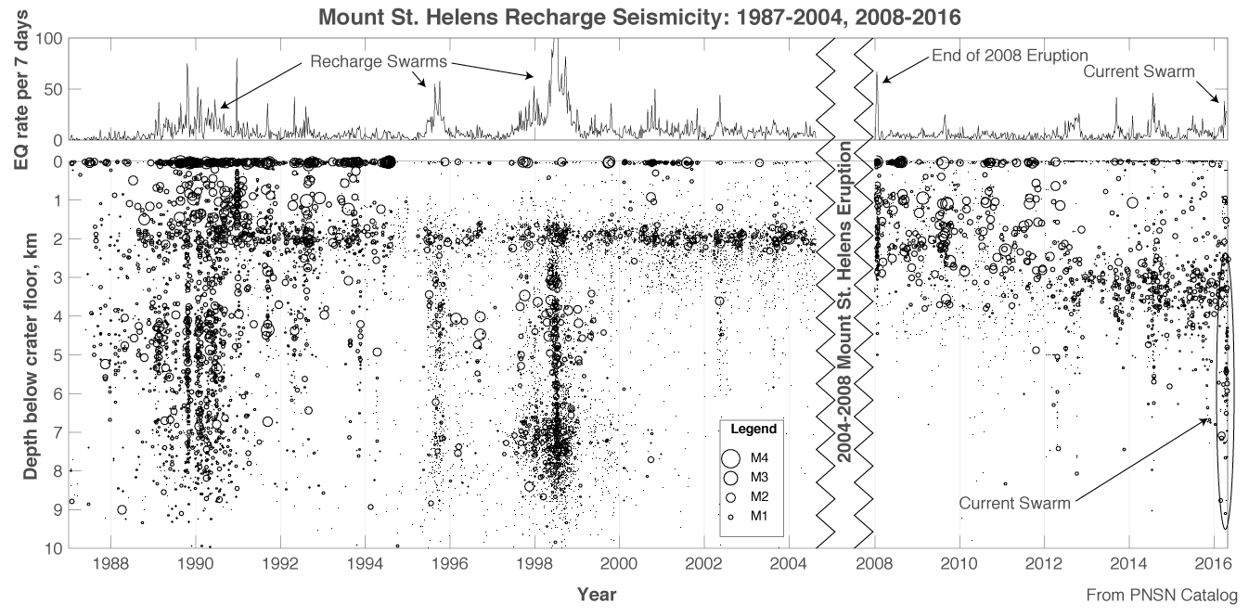
What did I miss?
Manual Codas to improve Md
What else?

Slide 25
The dark side of the Jiggle.jar
Disclaimer: I’m not a java programmer, so there are lots of people in this room who are better qualified to lead this discussion than me. Pipe up when I say something stupid. Thanks to Allan Walter and Ellen Yu for assistance.

Slide 26
Use for jiggle.jar outside of the GUI
DRP/TRP Images
Hypomag: post-post-processing of earthquake locations and magnitudes
Mung: tabular viewer of catalog with ability to relocate
Newtrig.pl: creating a new event trigger for a specified time.
Ampgenpp.pl: generating strong motion amps and writing to db like those generated by rt system.
runRCG.sh: generating request cards for waveform archiver

Slide 27
DRP/TRP Images
set jiggle_libs = $TPP_BIN_HOME
set classpath = $jiggle_libs/jiggle17-p6g.jar:$jiggle_libs/acme.jar
java -cp ${classpath} -Djava.awt.headerless=true org.trinet.web.SnapGif 61131946 15 120 $PWD/../conf/properties_event ./event.gif

Slide 28
Hypomag
Post- post-processing
Recalculate mag and location using AQMS infrastructure
Relies on PCS
Use cases: Caltech, Catalog recalc (HVO, AVO), elsewhere?
<java params> org.trinet.pcs.PcsProcessingController hypomag ${propFile}

Slide 29
Mung
GUI with tabular view of hypocenter and magnitude recalculation
Does anyone use?

Slide 30
Creating new triggers
org.trinet.apps.NewTrig
Creates a new trigger written to the database based on a evid or time

Slide 31
Submit requests to RCG
org.trinet.apps.RequestGeneratorCont
Based on event file or event list

Slide 32
Create new amplitudes
org.trinet.apps.AmpGenPp
Based on event ID

