Slide 1
AQMS Modules
NetOps IX
20 March 2018
Session facilitator: Brian Shiro (bshiro@usgs.gov)

Slide 2
Motivations
To highlight some useful/popular contributed modules
To make contributed modules easier to install/configure
To discuss when/how contributed modules should merge into the main AQMS distribution
… To improve and extend the functionality of AQMS
Note: We’ll draw a clear distinction between modules meant for integration into AQMS vs. external APIs or systems that might work with AQMS (tomorrow’s 9am session).

Slide 3
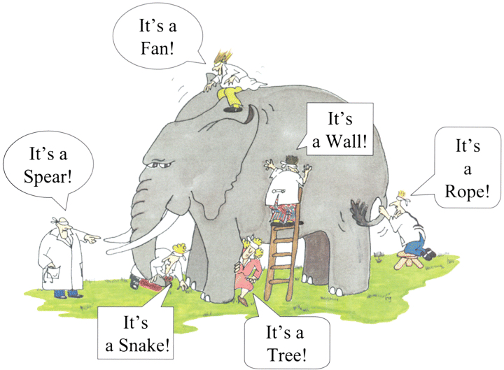
What is AQMS and what should be AQMS?

Slide 4
1. Contributed modules available now
Examples:
  EREMARK, FPFIT, FMHASH, SWARMON, TMTS2, WEBICORER, HypoDD
Seem to be located in difference places on the repo:
  /Contrib/
  /PP/trunk/PP_tasks/ and /PP/trunk/FMHash
  /PP/branches/**-dev-branch/PP_tasks/ and /PP/branches/**-dev-branch/FMHash
  /RT/branches/**-branch/TMTS2

Slide 5
2. Your favorite modules
What are your “must-have” modules?
  TMTS2, FPFIT, SWARMON, FMHASH, dbselect, qml, HypoDD, eremark (at AVO)
  Importing historical event parameters and data into the database (used rarely but important)
  Ones that write to DB vs ones that only read

Slide 6
3. Installing and configuring modules
YMMV if installing with differing configs
Is a README with source code enough?
Need for how-to guides for installation into AQMS?
Issue of shared wiki vs separate wikis (moderator?)
Good idea but who has time?

Slide 7
4. Integration of modules into AQMS
Making it easier for RSNs
Avoiding stove-piping of configurations
Leveraging existing AQMS configuration files where possible
Do we need an API to reign in sprawling scripts and varying standards?
Keep source separate from organization/layout
Put modules on github as their own projects?

Slide 8
5. Bringing modules from Contrib to Dist
Decision criteria
How to test, validate
Standards and practices
Documentation
When is the community ready to support it?
Connection to AQMS DB vs seismological output

Slide 9
6. Future modules
Available now: What should be folded into AQMS now?
In development: What is coming down the pipe soon?
Needed: What should we start developing? API

Slide 10
Summary

