Slide 1
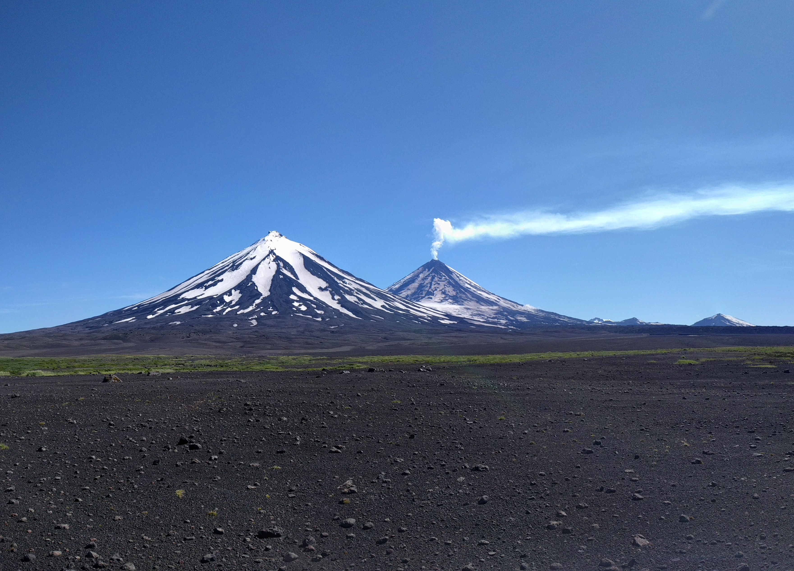
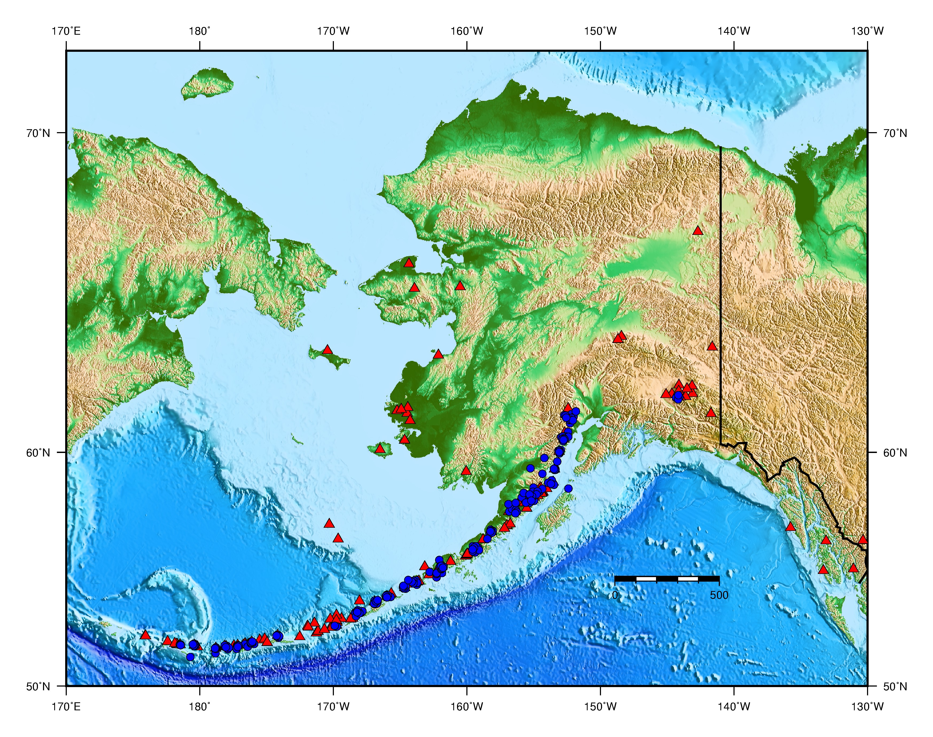
Recalculation of Hypocenters and Magnitudes at Alaskan Volcanoes John Power, Paul Friberg, Matt Haney, Tom Parker, Scott Stihler, Jim Dixon
Pavlof Sister & Pavlof
2017
AVO Network ~ 212 stations
Alaska Volcano Observatory
Monitor 32 active volcanoes
~212 station network (blue)
Networks of 4 to 15 Stas./Volcano
Locate ~ 7000 Eqs./year (reviewed)
AQMS since 2012

Slide 2
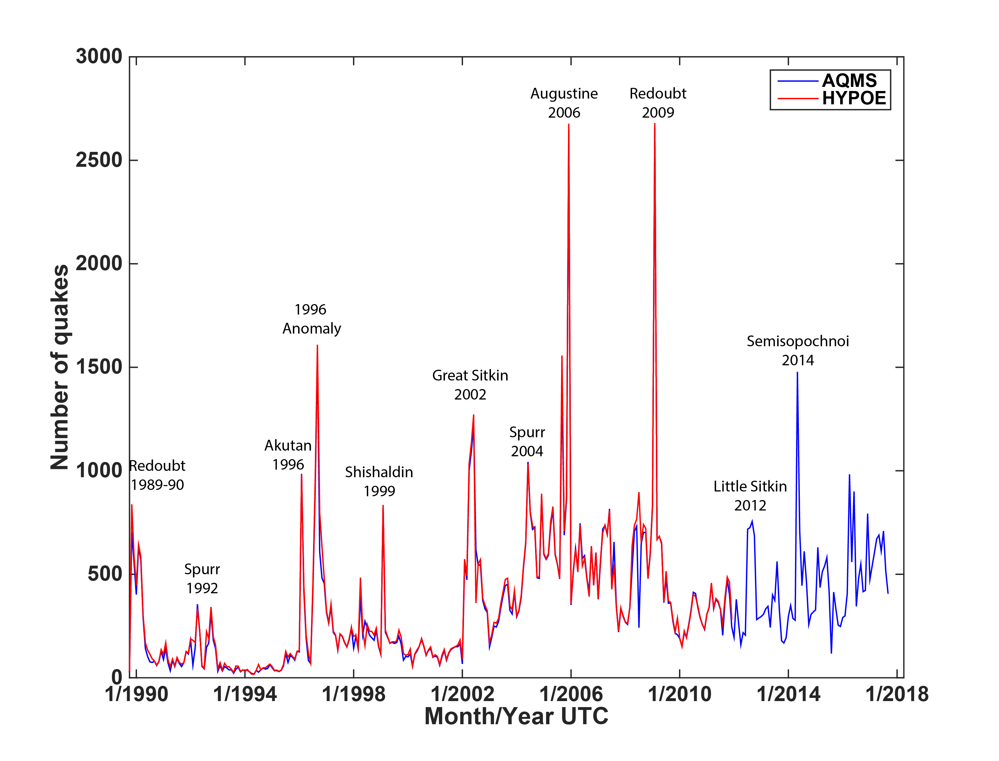
AVO Earthquake Catalog: 1989 - 2017
AVO AQMS Goals
Load historical catalog & waveforms into AQMS
Develop consistent catalog: recalculate hypocenters with hypoinverse.
Recalculate magnitudes (2012-2017) with Jiggle to eliminate changes in configuration and matadata problems.

Slide 3
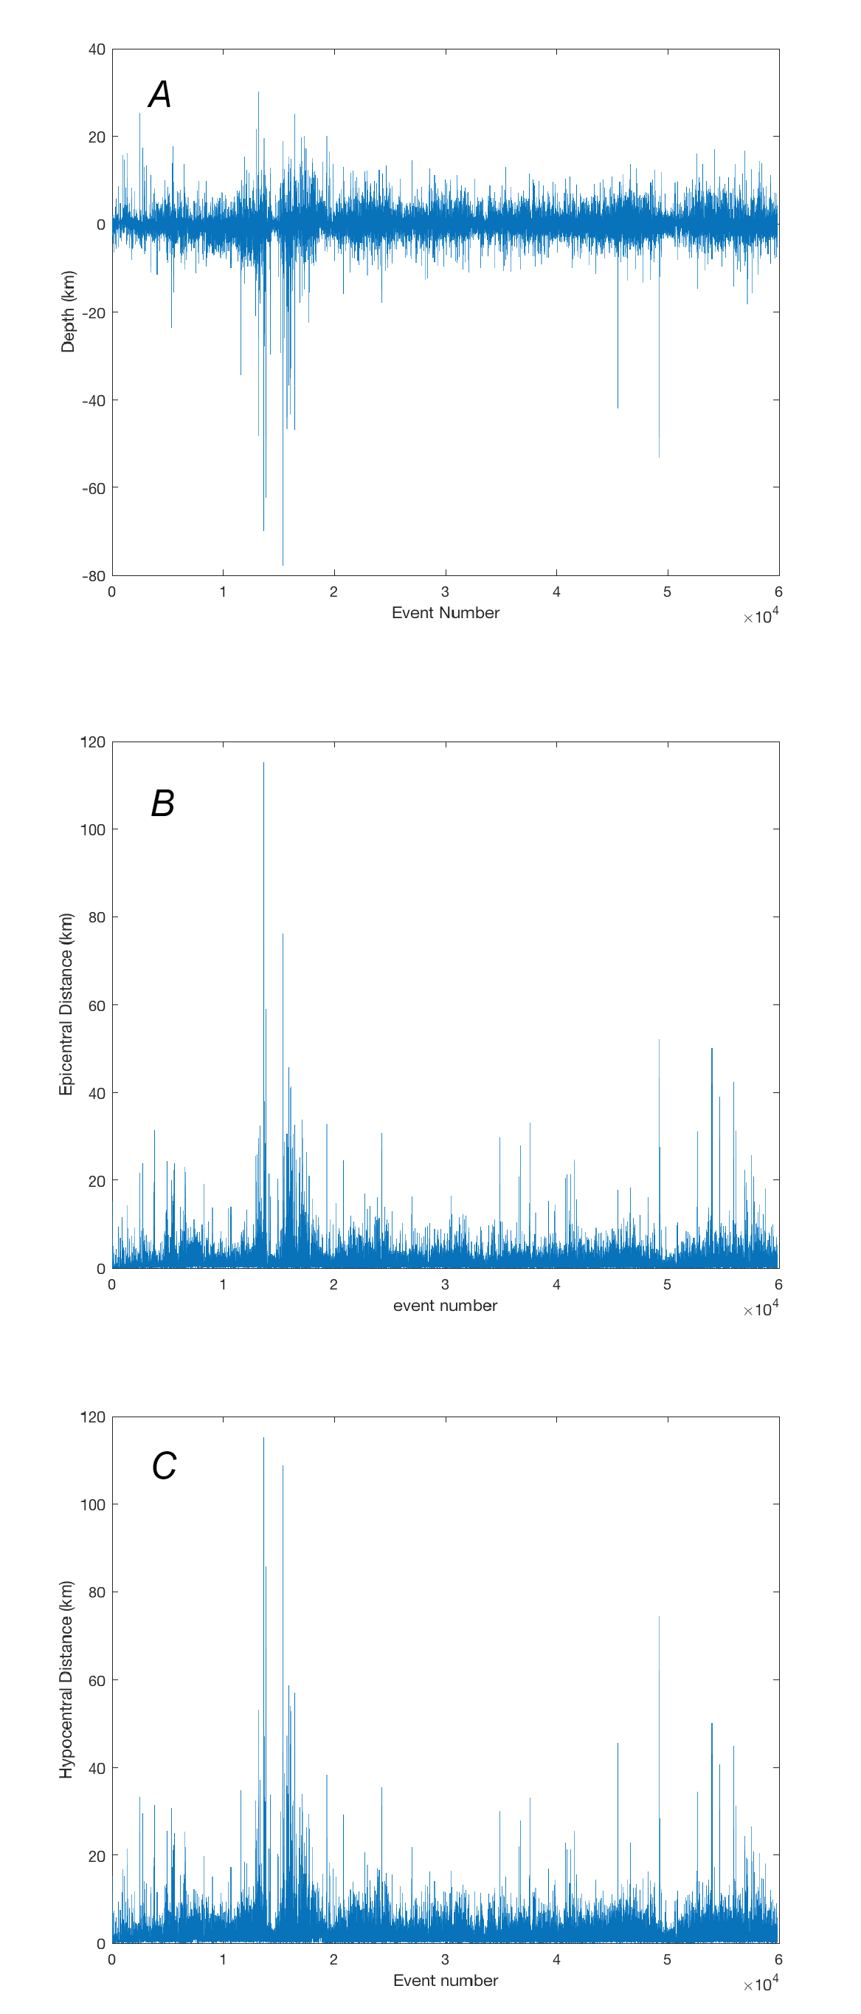
Hypoinverse & Hypoellipse: 1989 - 2012
Depth
HYPOCENTER RECALCULATION
Recalculated all hypocenters between 1989 and 2012 with Hypoinverse using HYPOMAG. Original Locations with Hypoellipse. Results indicate:
Average change in depth = 0.07 km
Average change in epicenter = 1.22 km
Average change in hypocenter = 1.87 km
The two location algorithms provide similar results.
Epicenter
Hypocenter

Slide 4
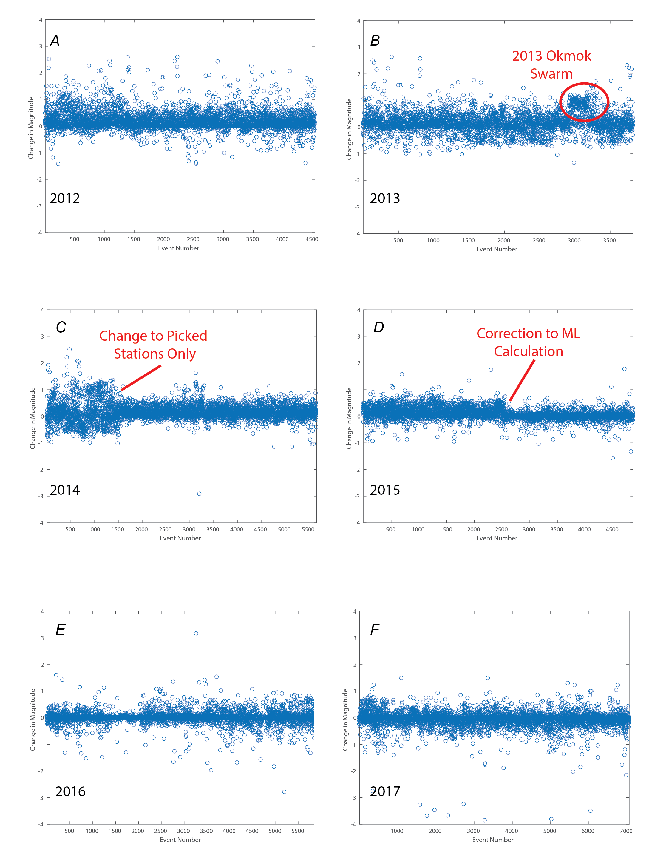
Magnitude Calculation Adjustments: 2012 - 2017
Recalculation of magnitudes with HYPOMAG highlights problems with metadata and adjustments to magnitude calculation in Jiggle. Major corrections result from:
Correction to response information; largest observed at Okmok Caldera.
Change to only using picked traces in magnitude calculation.
Change to RichterMLMagMethod2 to allow interpolation as Suggested by A. Walter.
Recent adjustments in TrimDistance (increased) and S2N Levels (greatly reduced) increases number ofevents with ML.
Results in an average change in magnitude of 0.19, 0.16, 0.10, 0.08, 0.01, and -0.04 for 2012, 2013, 2014, 2015, 2016, 2017 respectively.

Slide 5
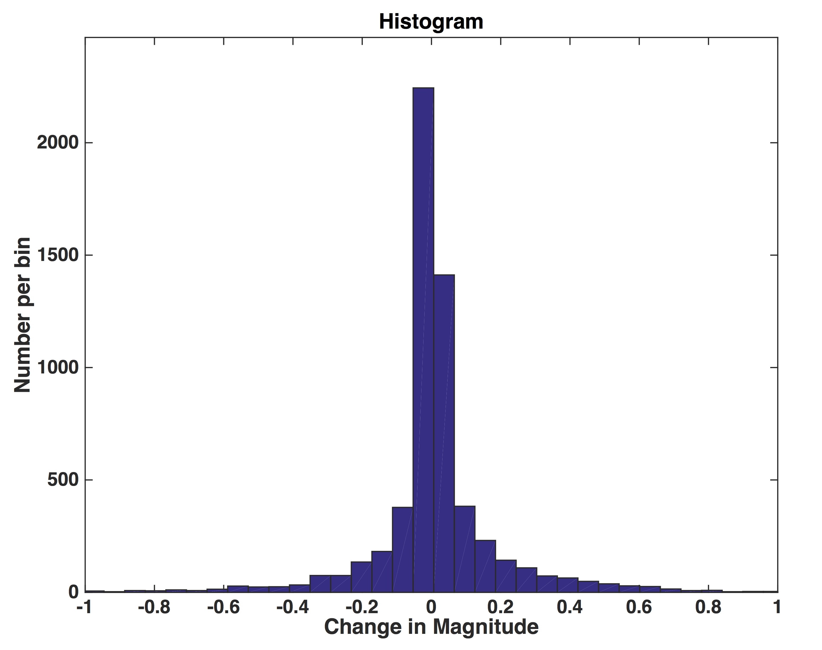
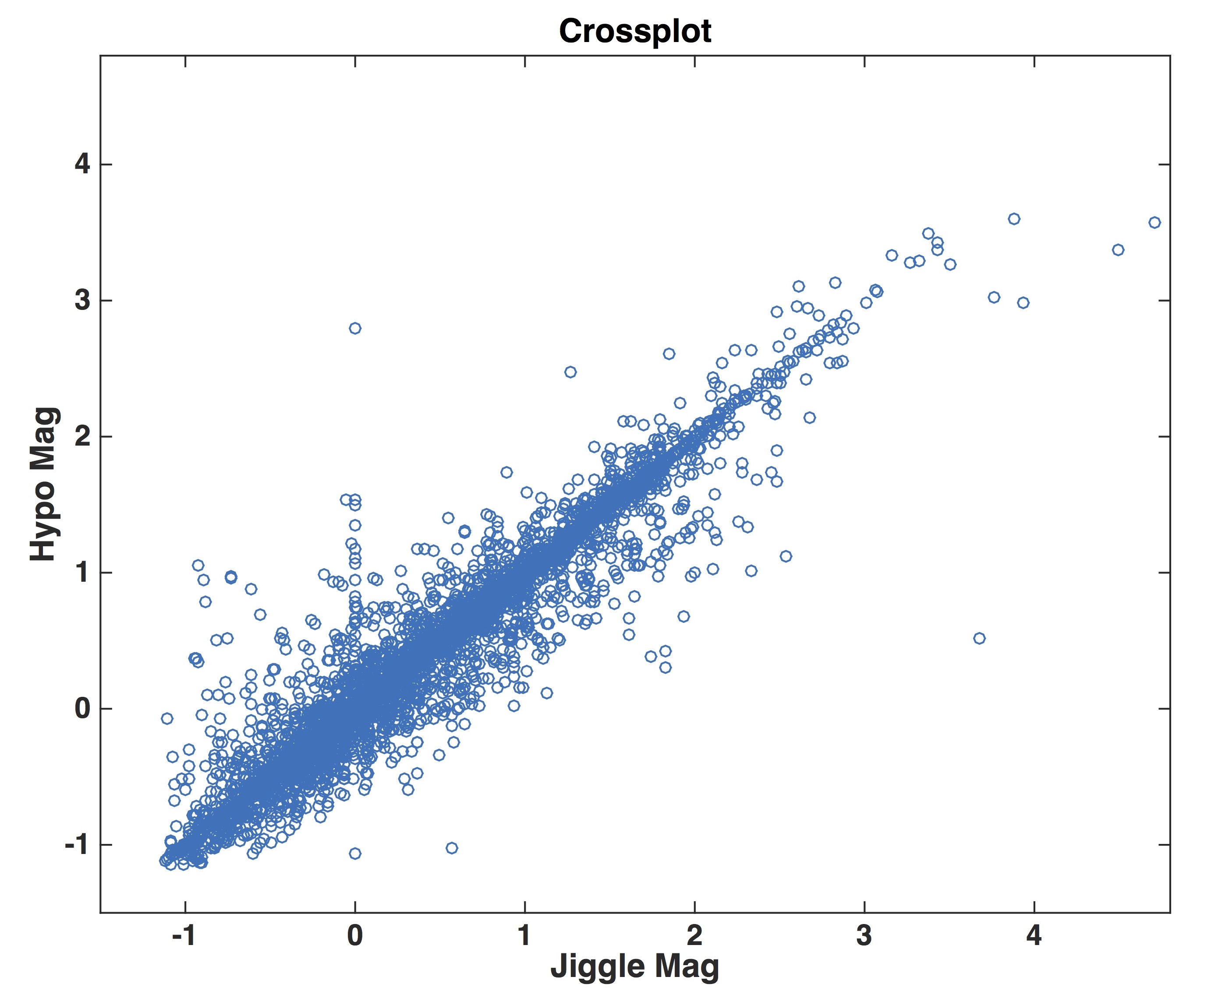
2016 Magnitudes
Standard Deviation +/- 0.22

