Slide 1
Earthquake Early Warning – Testing and Certification Platform
Stephen R. Guiwits
Computer Scientist
United States Geological Survey

Slide 2
Testing and Certification Architecture (hardware and software)
Redundant RHEL 7 servers
64 GB RAM
40 Cores
Configuration Management Control
Mix of custom and open source software
Python (Numpy and Obspy)
Go
Bash
Earthworm
Git

Slide 3
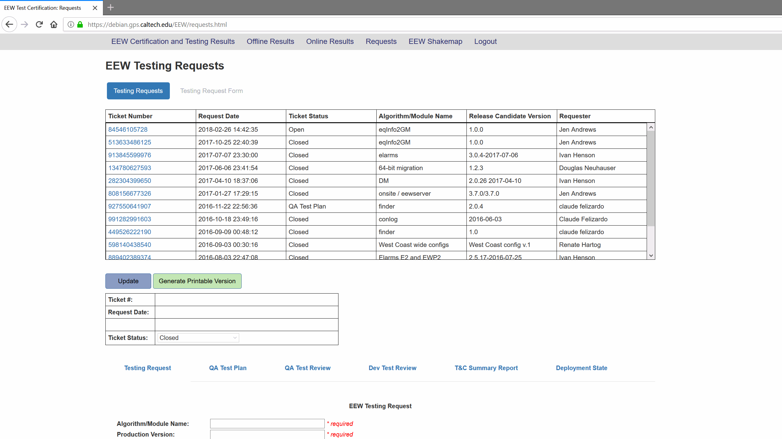
Testing and Certification Requests
Created a web page to allow users to request when new software should be tested
Software written using
host: linux
web server: apache
certificate auth: letsencrypt
database: mongo
front end: vue.js
back end: originally written
with node but recently
changed to C (not a typo)

Slide 4
Testing and Certification Testing
Build the requested software based off of commit hash
Configure Puppet and any configuration files that may have chaned.
Most configuration files are generated by ERB templates
Deploy the software on one of the testing servers
Run the testsuite which consists of 105 events
11 Northern California
17 Southern California
12 Pacific Northwest
29 Teleseismic
8 Calibration
17 Recentering
11 Anomalous

Slide 5
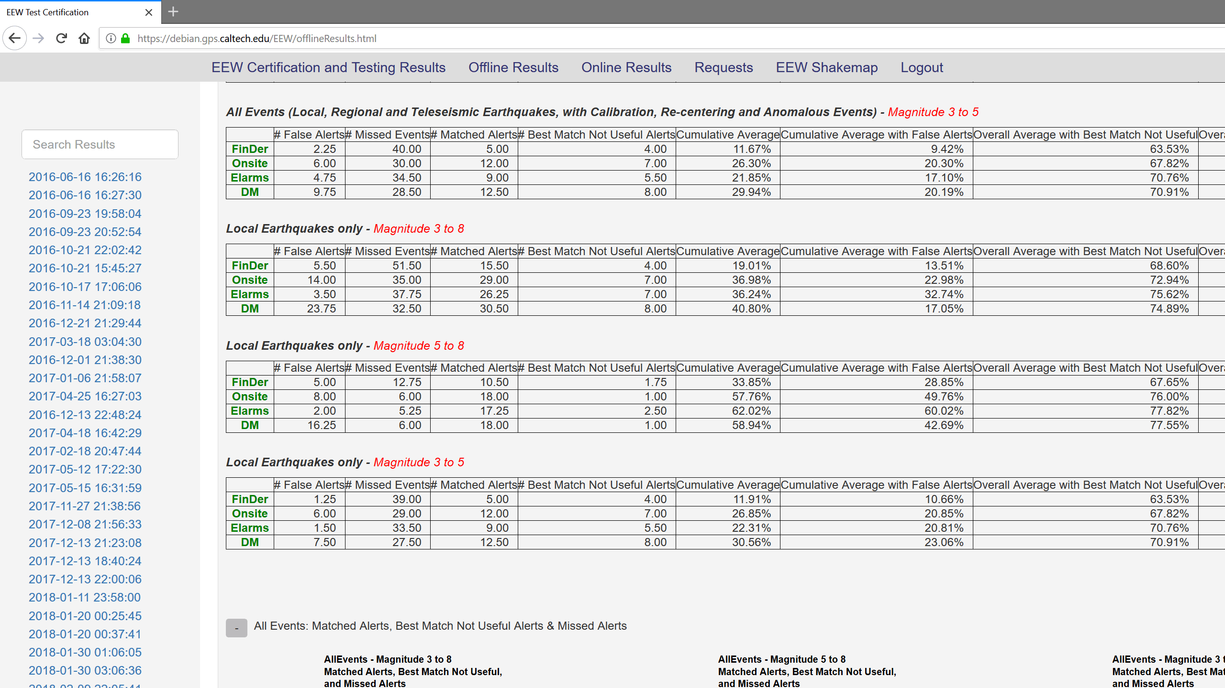
Testing and Certification Results
Created a web page to display the results of the completed tests
Software written using
host: linux
web server: apache
database: mongo
front end: vue.js
google charts
back end: originally written
with node but recently
changed to C (still not a typo)

Slide 6
Testing and Certification Future
Continue to refine software for extensibility
Move to the “cloud”
Currently a run takes about 3 days
100 EC2 instances (minimum: 7 minutes, maximum: 4 hours)
Perhaps kubernetes and runc/docker to orchestrate tests
Auto generate new tankfiles for any new event over magnitude 3
Automate CM builds to run the full testsuite

