Slide 1
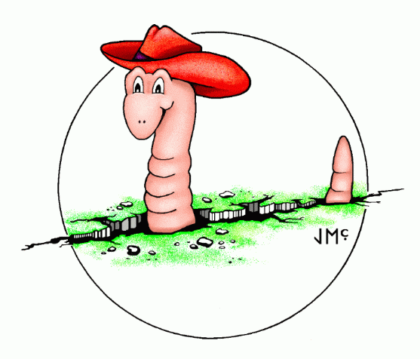
Tuning Earthworm’s Binder
NetOps VIII Seattle, Washington
March 20-21, 2018
Paul Friberg

Slide 2
When & How to tune
New stations being added in.
Edge case event that causes problems (missed, split events, or bad initial location).
Save all picks from the binder_ew log.
Use putpick module for playback (no need to simulate picks more than once unless tuning picker)! NEW ringplayer modules coming in Earthworm v7.10 (in AQMS now).

Slide 3
Developments in Binder since 2009
Multiple phases from a single station can be handled now.
More logic for handling horizontals (S phases)
Smarter selection of picks (pkfilter made superflous) – throw all your picks at it.
Amplitude information can be used on S selection.
Split event handling (blackout distance and time for nucleation)

Slide 4
Parameters to focus on: Nucleation
rstack – the size of the grid in km around the nucleating phase.
stack – how many picks do we look back
grid_wt – how do you weight different quality phases in the nucleation
thresh – maximum grid hit counts to trigger a nucleation
focus – tightness of clustering of max grid hits.

Slide 5
Parameters to focus on: Association
t_diff – Time filter – min/max time for picks after OT.
rAvg_Factor – Distance filter based on rAvg (average distance to stations associated so far)
taper and taper_OT – residual tolerance adjustments based on distance to epicenter and the quality of the hypocenter.

Slide 6
Recent Case

