Slide 1
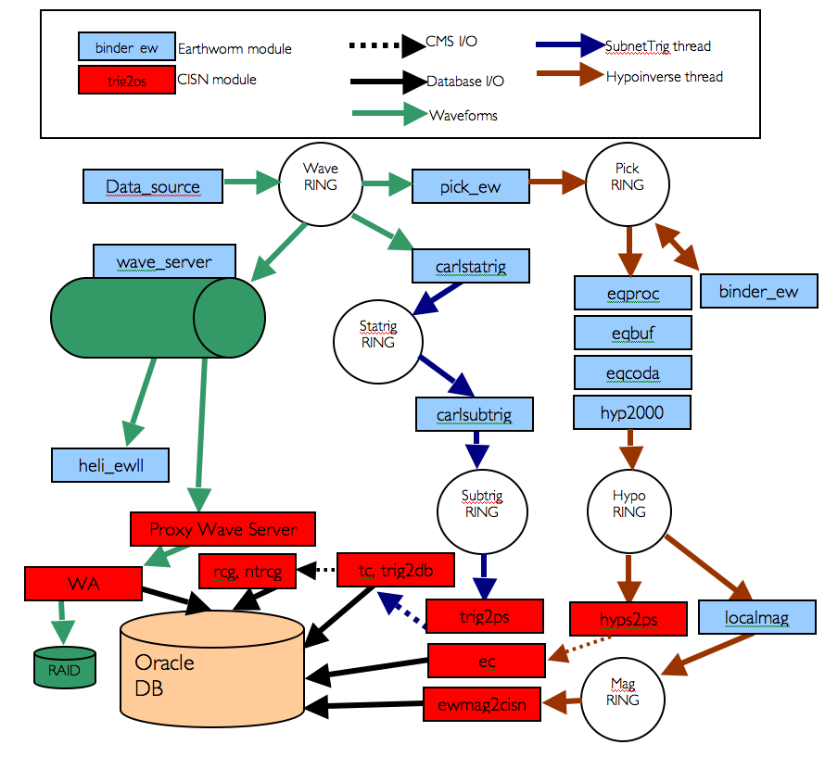
AQMS CMS
NetOps VIII Seattle, Washington
March 20-21, 2018
Paul Friberg

Slide 2
CMS: What? Why?
What:
CMS is a messaging system used between AQMS applications (ec, tc, trig2db, ampgen, trimag)
Transport of XML messages
Lowest layer is CORBA event service, C++/Java API
Uses EIDS – efficient with small messages (< 100kb).
Why:
Networked – Interprocess comms.
Persistent messages – Talerian Smart Sockets
Earthworm messages were not trusted at the time AQMS was developed.

Slide 5
Troubleshooting
Review console logs (conlog output).
Review or remove queue files. These are non EIDS constructs meant to persist messages once delivered.
Check channel names.
Make sure Java JVM has enough memory at startup (Java JVM’s cannot grow once started)

