Slide 1
Tues 20 March 2017, 13:30 – 14:30 Rayo Bhadha & Jen Andrews, Caltech & Southern California Seismic Network
NetOps IX
AQMS tuning, testing and troubleshooting

Slide 2
Overview
How do we assess performance?
How do we improve performance?
Tuning
Motivation for / experiences with / best practice tuning AQMS components
Testing
Current testing practices / future framework development
Troubleshooting
Experiences / best practice troubleshooting AQMS components
Requests to developers to make future troubleshooting more efficient
Outcomes
Identify community resources: experience / scripts
Identify community needs and future requests for developers

Slide 3
Tuning
What motivates you to undertake tuning, testing or troubleshooting?
Majority: response to failure
What AQMS components have you tried to tune?
detection/association/location: pick_ew, pickFP, binder_ew, hypoinverse
magnitudes: trimag, codamag, md
alarms
Do you have scheduled tuning tasks?
No, but interested…
Tuning for new stations?
Do you tune components to
account for variable station
density?
Mainly alarms
Rarely detection/
association/location
Notes:
Paul: binder
Wes: pickFP and codamag
Jen: trimag
JohnP: hypomag

Slide 4
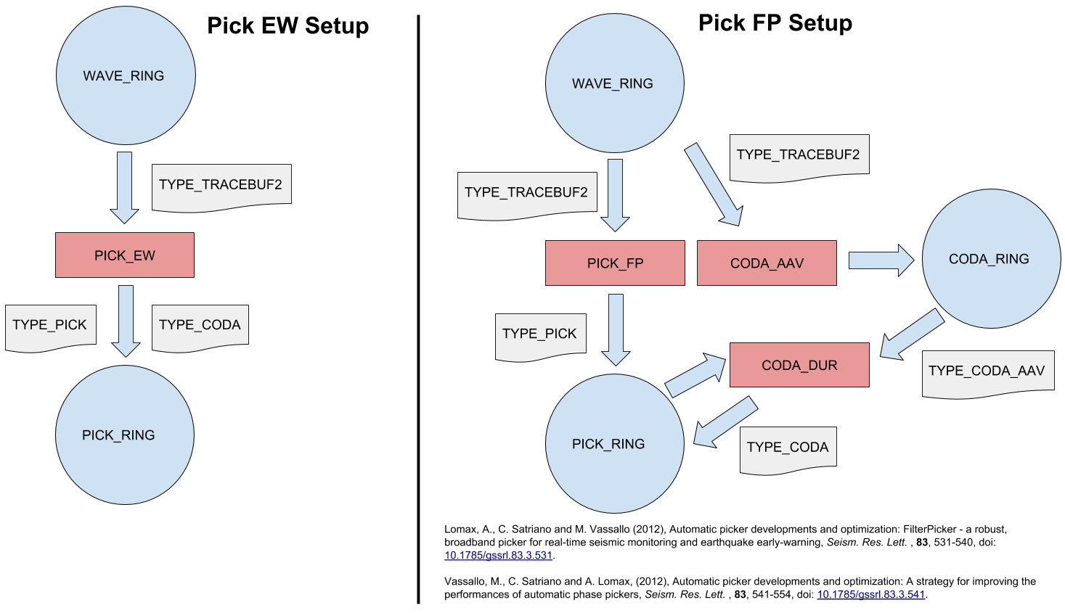
pickFP

Slide 5
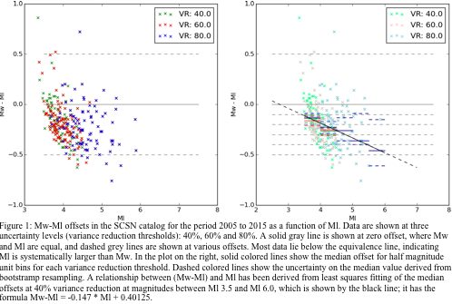
Trimag: modifying Ml

Slide 6
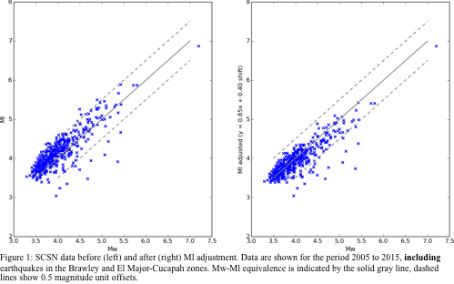
Trimag: modifying Ml
Ml_adjusted = 0.853*Ml + 0.40125

Slide 7
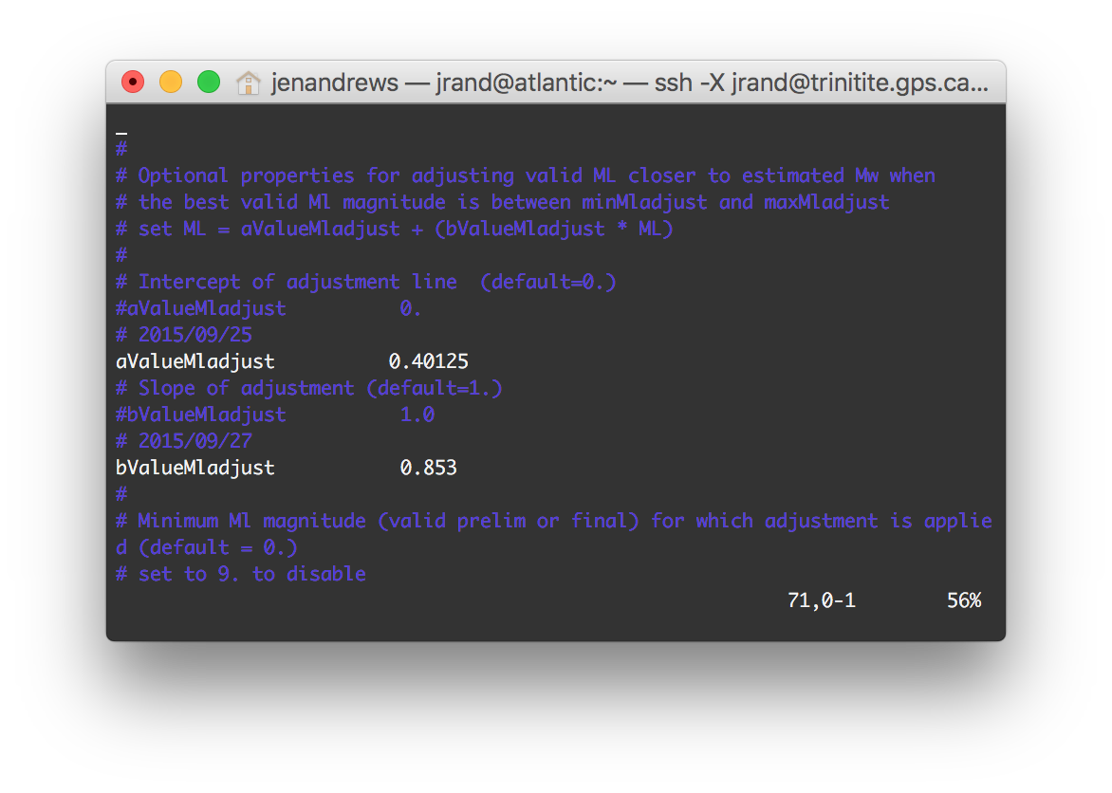
Trimag: modifying Ml
trimag.cfg

Slide 8
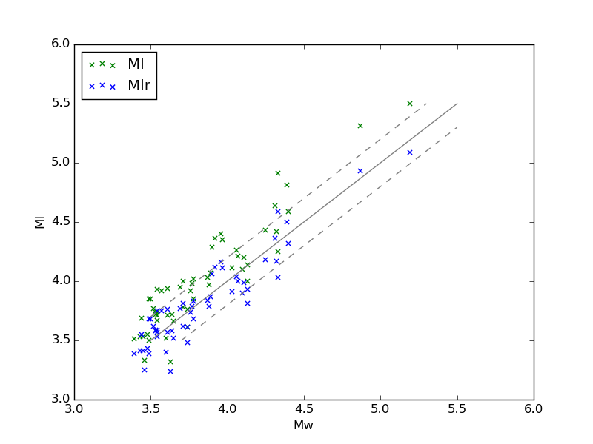
Trimag: modifying Ml
Real-time experience: 2015 - 2018
+0.2
-0.2

Slide 9
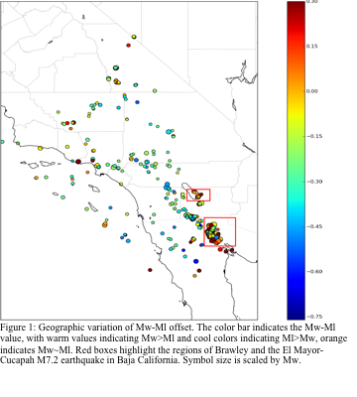
Trimag: modifying Ml
Regional variability
Opposite trend in Bombay Beach area of Salton Sea and near El Mayor-Cucapah
This is undoubtedly a more nuanced and interesting scientific question/problem, but we needed an easy/fast operational solution

Slide 10
Testing
What AQMS components have you needed to test recently?
binder
hypomag
tmts
alarms
What testing framework do you use?
Majority: end-to-end
Offline component tests
How do you test and document new software changes:
Local and trac wikis, one mention of ticket system
One mention of offline / staging / primary and shadow system promotion
Are there additional tests you wish you could do:
Development & build: Unit tests and code coverage
Operation: ’earthworm status’ command for all AQMS components
Network calibration: scripted/automatic station correction (travel time and magnitude) for new / modified stations
Notes:
Paul: CMS
Steve: T&C testing framework

Slide 11
CERI “regular maintenance/testing schedule”
Not really that much; it works
Monthly deleted event cleanup
Annual waveform organization
Every event is an opportunity for test/verification
Periodic software updates (esp. wrt. DRP/TRP for http security)
Periodic metadata updates and alarm adjustments
Event driven metadata updates (9999 distance)
Recent authoritative polygon updates
Reprocessing archived events provides troubleshooting opportunities

Slide 12
Troubleshooting
What AQMS components have you tried to troubleshoot?
binder, ampgen, wavearchiver
Event-specific system behaviour, often related to db errors
What are the hardest components to troubleshoot?
cms
tmts, ampgen, trimag, alarming, db query interaction
What would make troubleshooting easier?
Formal testing framework
Unit tests
More informative logs
Notes:
Jeremy & Michelle: best practices to help troubleshooting
Jen: plog

Slide 13
Plog (thanks to Garret Hartman)
PLOG is a header file only, thread safe logging framework for C++
Header only with no external dependencies (light weight)
Allows for multiple logger objects to multiple locations
Messages can be filtered by severity. This filter can be changed at run time.
Main advantage over conlog is that developers don’t need to handle the mutex locks individually. Plog supports multithreading when writing log messages from different threads to the same destination. This eliminates the need for manually handling the mutex lock that is needed when writing directly to stdout which is captured by conlog.
EEW is migrating to using plog, and has created wrapper classes and macros to make the transition easier, and temporarily support a mix of conlog and plog. Still need to work out capture of third party logs.
More info on the EEW wiki:
https://eew-repo.wr.usgs.gov/trac/wiki/SoftwareLogging

Slide 14
Plog (thanks to Garret Hartman)
Example usage and output

Slide 15
Thank You

