Slide 1
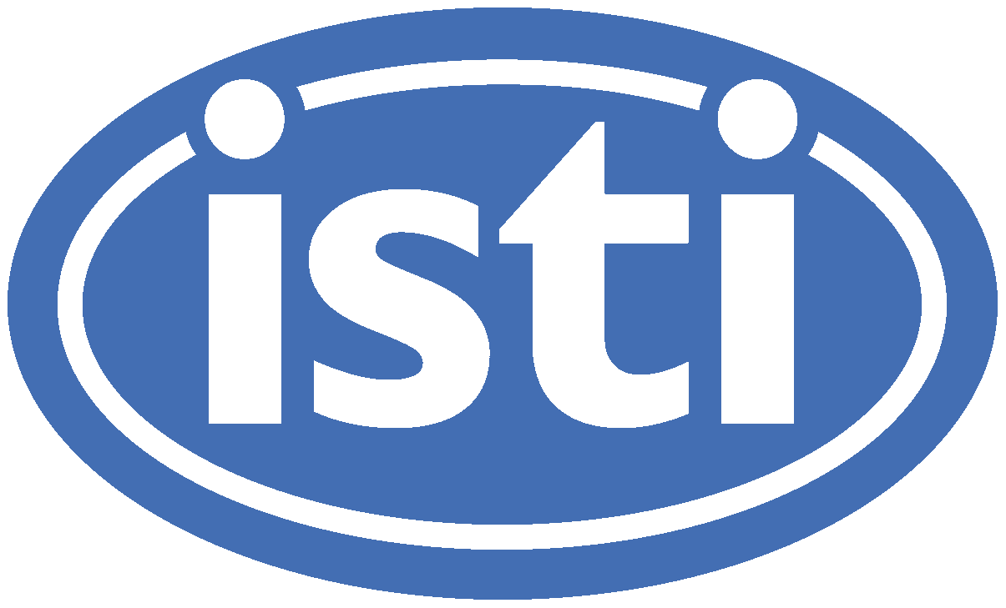
AQMS Current Status: where are we now
NetOps VIII Seattle, Washington
March 20-21, 2018
Paul Friberg

Slide 2
Talk Outline
Timeline
Current state of RSN’s and AQMS
Issues encountered along the way
Progress in AQMS
Where are we headed?

Slide 3
AQMS Timeline
2005 – 2007 CISN software transitions to AQMS
2008 USGS buys Solaris/SPARC servers for RSNs
2009 HVO is the first RSN operational, EW 7.3, INV
2009 to 2011, PNSN, Utah, CERI, LCSN progressively start using AQMS, COSO
2011 ARRA funds get AVO to AQMS
2015 Linux port available, SIS path for RSNs, CADWR
2016-17 Linux & Cloud AQMS at Caltech
2017 Postgres port begins, 1st non academic user
2018 Postgres, Versioning continues, EW 7.10

Slide 4
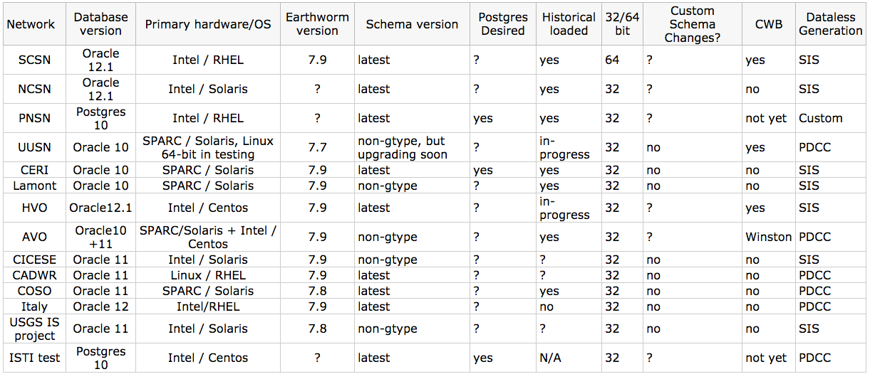
Current Status

Slide 5
Issues encountered along the way
Versioning of AQMS schema is really hard to keep up with (e.g. gtype, stored procedures).
Oracle is a bitch (upgrades, maintenance, cost, replication). Few Oracle experts available.
Metadata is non-trivial to maintain, especially compiling historical versions.
Historical data loading is non-trivial.
Versioning of AQMS software becomes overwhelming with N different branches.

Slide 6
Progress in AQMS
Linux version
Cloud experience at Caltech, VM’s at HVO/AVO/Caltech
Improvements in Earthworm V7.10 coming
Versioning and eventually moving to github
Streamlining EW to AQMS connection.
Postgres in production

Slide 7
The Future
All running on Cloud or VM’s on-site
Open Source OS
GitHub repo
Versioned
Secure
Backed up offsite
More bells and whistles….

