Slide 1
AQMS migration to PostgreSQL
Renate Hartog and Victor Kress, PNSN
Paul Friberg, ISTI
NetOps IX 20-21 March 2018

Slide 2
2015
Database Working Group: PostgreSQL (v9.4) cannot do multi-master asynchronous replication which is required in Northern California
AQMS Software Working Group creates a priority list, a new database system has a low priority.
PNSN decides to forge ahead because…

Slide 3
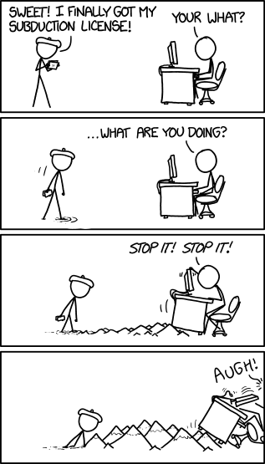
Motivation
One-time license in 2009 w/o support
Cannot upgrade the database:
Oracle 10.2
Cannot upgrade our hardware:
Sparc, Solaris 10, 8 GB of memory
Oracle is expensive
https://xkcd.com/1388/

Slide 4
Guiding principle
Do not change AQMS
(interaction with database only)

Slide 5
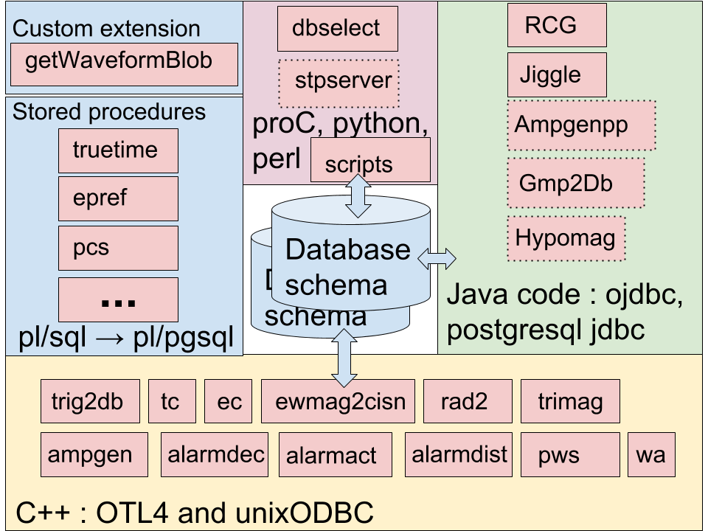
AQMS

Slide 6
Get ready for some details
Database
schema
Database
schema

Slide 7
Database schema
Oracle | PostgreSQL
NUMBER(1-4,0) | SMALLINT
NUMBER(5-9,0) | INTEGER
NUMBER(>9.0) | BIGINT
NUMBER | DOUBLE PRECISION
FLOAT | DOUBLE PRECISION
VARCHAR2() | CHARACTER VARYING
DATE | TIMESTAMP
BLOB | BYTEA
CREATE
DATABASE
SCHEMAS
USERS (ROLES)
SEQUENCES
TABLES
VIEWS
TYPES
Notes:
Explain why we why we are not using NUMERIC

Slide 8
Stored procedures
truetime
epref
Database
schema
Database
schema
pcs
...
pl/sql → pl/pgsql

Slide 9
Stored procedures : pl/sql → pl/pgsql
TrueTime.putEpoch(:dtime<double>,'UTC')
geo_region.authOfRegionInGroup(:lat<double,in>,:lon<double,in>,:authGroup<char[15],in>)
Oracle | PostgreSQL
Package | Schema
Functions and Procedures | Functions
Can commit within function/procedure | Cannot commit within function
*Only porting functions/procedures that are used

Slide 10
Custom extension
getWaveformBlob
Stored procedures
truetime
epref
Database
schema
Database
schema
pcs
...
pl/sql → pl/pgsql

Slide 11
getWaveformBlob
Provides access to miniSEED data on disk to the database server so that a client (Jiggle) can retrieve it.
Oracle | PostgreSQL
Java | C
loadjava utility | aqms_ext.so in /usr/local/lib/postgres/
pl/sql wrapper function | pl/pgsql wrapper function

Slide 12
getWaveformBlob
Oracle | PostgreSQL
CREATE OR REPLACE PACKAGE wave AUTHID DEFINER AS FUNCTION fill_wf_blob( p_blob BLOB, p_filename VARCHAR2, p_traceoff NUMBER p_nbytes NUMBER, p_startTime NUMBER, p_endTime NUMBER) RETURN NUMBER AS LANGUAGE JAVA NAME ‘org.trinet.waveserver.dc.WaveformBLOB.fillWaveformBLOB(oracle.sql.BLOB, java.lang.String, int, int, double, double) return int’; | CREATE OR REPLACE FUNCTION wave.get_waveform_blob( p_filename TEXT, p_traceoff BIGINT, p_nbytes BIGINT, p_startTime DOUBLE PRECISION, p_endTime DOUBLE PRECISION) RETURNS BYTEA AS ‘/usr/local/lib/postgres/AQMSpg_ext.so’, ‘getWaveformBlob’ LANGUAGE C STRICT;

Slide 13
Custom extension
getWaveformBlob
Stored procedures
truetime
epref
Database
schema
Database
schema
pcs
...
pl/sql → pl/pgsql
trig2db
tc
ec
ewmag2cisn
rad2
trimag
ampgen
alarmdec
alarmact
alarmdist
pws
wa
C++ : OTL4 and unixODBC

Slide 14
C++ : OTL4, unixODBC, psqlodbc → compile time flag
trig2db
tc
ec
rad2
trimag
ewmag2cisn
ampgen
alarmdec
alarmact
alarmdist
wa
pws
#ifdef USE_POSTGRES
otl_nocommit_stream magpins(1,
"select epref.setprefmag_magtype(:evid<long,in>, "
":magid<long,in>, :evtpref<int,in>, :bump<int,in>, "
":commit<int,in>)", dbconn);
#else
otl_nocommit_stream magpins(1,"begin "
":res<int,out> :=epref.setprefmag_magtype(:evid<long,in>, "
":magid<long,in>, :evtpref<int,in>, :bump<int,in>, "
":commit<int,in>); "
"end ;", dbconn);
#endif
Source code
use #ifdef blocks

Slide 15
C++ : OTL4, unixODBC, psqlodbc → compile time flag
trig2db
tc
ec
rad2
trimag
ewmag2cisn
ampgen
alarmdec
alarmact
alarmdist
wa
pws
########################################################################
# Oracle Definitions
# Choose one of the two sections:
# 1. Full Oracle installation:
#:: # Set appropriate major Oracle version (9, 10, 11, etc)
#:: DBVERSION = 10
#::
#:: # If you have both 32-bit and 64-bit Oracle libraries installed,
#:: # you should change "lib" in the next line to "lib32":
#:: VENDOR_LIB_DIR= -L$(ORACLE_HOME)/lib
#:: VENDOR_LINK = -lclntsh -lcommon$(DBVERSION) -lnls$(DBVERSION) -lcore$(DBVERSION) -laio -ldl
#:: ODBLIB = $(VENDOR_LIB_DIR) $(VENDOR_LINK)
#::
#:: OTLDBINCL = -I$(OTLINCL) \
#:: -I$(ORACLE_HOME)/rdbms/demo -I$(ORACLE_HOME)/rdbms/public \
#:: -I$(ORACLE_HOME)/network/public
# 2. Oracle InstantClient
#DBINCL = -I$(OTLINCL) -I$(ORACLE_HOME)/sdk/include -I$(ORACLE_HOME)/rdbms/public
#DBLIB = -L$(ORACLE_LIB) -lclntsh -lnnz12 -lons -laio -lclntshcore
# or for postgres use unixODBC drivers
DBINCL = -I$(OTLINCL) -DUSE_POSTGRES
DBLIB = -L/usr/lib -lodbc -L$(ORACLE_HOME) -lclntsh -lclntshcore -laio
Makefile
Compile flag

Slide 16
C++ : OTL4, unixODBC, psqlodbc → compile time flag
trig2db
tc
ec
rad2
trimag
ewmag2cisn
ampgen
alarmdec
alarmact
alarmdist
wa
pws
[rtem@rt1 ~]$ ec
usage: ec <config file>
Version: 2.4.3 2017-07-17 Md Coda's processing enabled
DB: Using Postgres SQL syntax

Slide 17
Custom extension
RCG
getWaveformBlob
Jiggle
Stored procedures
Ampgenpp
truetime
Gmp2Db
epref
Database
schema
Database
schema
Hypomag
pcs
...
Java code : ojdbc, postgresql jdbc
pl/sql → pl/pgsql
trig2db
tc
ec
ewmag2cisn
rad2
trimag
ampgen
alarmdec
alarmact
alarmdist
pws
wa
C++ : OTL4 and unixODBC

Slide 18
Java : ojdbc and postgresql jdbc
Jiggle
RCG
amgenPP
Gmp2Db
Hypomag
private String getRowLimitClause(EventSelectionProperties props, boolean useANSISQL) {
StringBuffer sb = new StringBuffer(64);
int maxRows = props.getMaxCatalogRows();
if (maxRows >= 0) {
// Limit the returned rows from the earliest to maxCatalogRows
if (debug) System.out.println("INFO: SolutionTN getByProperties row count limit set to maxCatalogRows = " + maxRows);
if (useANSISQL) {
sb.append(" OFFSET 0 ROWS FETCH NEXT ").append(maxRows).append(" ROWS ONLY");
}
else {
// Oracle before version 12c
sb.append(" AND (ROWNUM<=").append(maxRows).append(")");
}
}
return sb.toString();
}
Lots of SQL changes and use of stored pl/(pg)sql procedures

Slide 19
Java : ojdbc and postgresql jdbc
Jiggle
RCG
amgenPP
Gmp2Db
Hypomag
private static void initFactory(int type) {
switch (type) {
case JasiFactory.TRINET:
case JasiFactory.EARTHWORM:
factory = new OracleConnectionFactory();
break;
case JasiFactory.PNSN:
factory = new PostgresqlConnectionFactory();
break;
default:
System.err.println("JDBConn unknown connection factory type id: " + type);
factory = null;
}
}
New jasi object type

Slide 20
Java : same jar, different property values
Jiggle
RCG
amgenPP
Gmp2Db
Hypomag
# Jiggle Properties that need to be different to connect to a PostgreSQL Database
# All these Connection Properties *have to be set* for Jiggle to work
# correctly with PostgreSQL. This because Jiggle assumes Oracle-specific
# values if they are NOT specified.
jasiObjectType=PNSN
dbLastLoginURL=jdbc\:postgresql\:@pp1.ess.washington.edu\:5432\:archdb
dbTimeBase=TRUE
dbaseDomain=ess.washington.edu
dbaseDriver=org.postgresql.Driver
dbaseHost=pp1
dbaseName=archdb
dbaseTNSname=archdb
dbaseUser=tpp
dbasePasswd=password
dbasePort=5432
dbaseSubprotocol=postgresql
New jasi object type

Slide 21
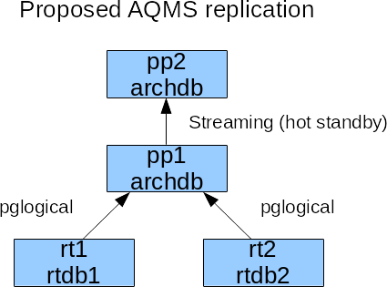
Replication

Slide 22
Fully working system
Earthworm hyp, mag, and picks, trimag, ampgen → RT db → PP db
Alarming works
Trigger on the archdb Event Table starts the PCS system → RCG → wa
Wavearchiver makes Proxy Wave Server requests to fulfill request cards and write mini-SEED files.

Slide 23
Utilities: ProC, python, perl, php
Done
dbselect
Init scripts
Role switch scripts
Some perl scripts
Load StationXML instead of dataless
To Do
Tools for dbselect –P option
stpserver?
DRP and TRP
seisnetwatch feeder scripts
Hypomag, AmpgenPP, Gmp2Db
FP
Alarm action scripts
dbselect
stpserver
proC, python, perl
scripts

Slide 24
Custom extension
dbselect
RCG
getWaveformBlob
Jiggle
stpserver
Stored procedures
Ampgenpp
proC, python, perl
truetime
scripts
Gmp2Db
epref
Hypomag
pcs
Database
schema
Database
schema
Java code : ojdbc, postgresql jdbc
...
pl/sql → pl/pgsql
trig2db
tc
ec
ewmag2cisn
rad2
trimag
ampgen
alarmdec
alarmact
alarmdist
pws
wa
C++ : OTL4 and unixODBC

Slide 25
Interested in PostgreSQL instead of Oracle?
Yes | Maybe | No
PNSN (obviously) | BSL | UUSS
CERI | LCSN
SCSN
USGS-AVO
USGS-CalVO
USGS-CVO
USGS-HVO
Questions?

Slide 26
Blank slide here on purpose

Slide 27
Changed the directory layout and PP user
[rtem@rt1 ~]$ ls -F
alarmact/ alarmdist/ bin/ cms/ dist/ ew/ getmag/ lib/ logs/ pws/ RT1/ solserver/ temp/ trig2db/ utils/
alarmdec/ ampgen/ chan-configs/ db@ ec/ gcda/ jars/ locks/ maillists/ rad2/ RT2/ tc/ thisRT@ trimag/ uwbin/
[rtem@pp1 ~]$ ls -F
alarmact/ alarmdist/ amp/ chan-configs/ db/ FP/ lib/ maillists/ PP2/ rcg/ snw/ stp/ utils/ wa/ wavefiles@
alarmdec/ alarmevent/ bin/ cms/ drp/ jars/ logs/ PP1/ pws/ sendcancel/ solserver/ thisPP@ uwbin/ wavearchive@
Load StationXML instead of dataless SEED https://github.com/pnsn/aqms-ir

