Slide 1
Virtualization, Cloud Computing, Hardened Networks
NetOps IX
March 2018

Slide 2
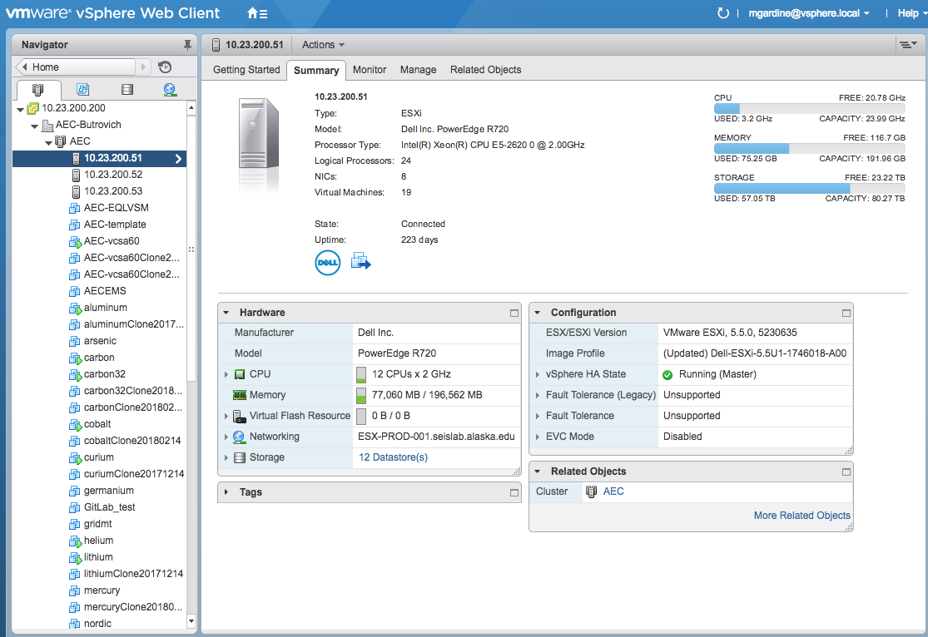
Virtualization @ AEC
3 host cluster managed with VMware vSphere 6.0
Web, acquisition, automated processing on ~10 production VMs
80 TB usable storage in 2 arrays (1x 15k drives for databases and recent waveforms, 1x 7.2k drives for historic data)

Slide 3
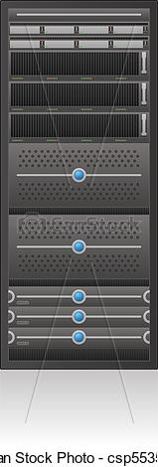
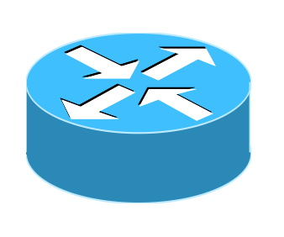
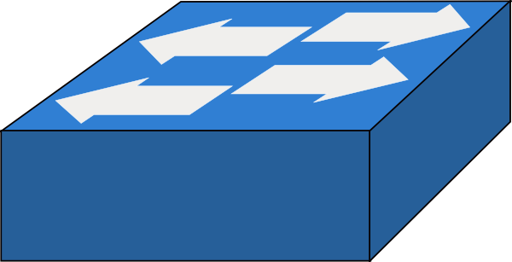
Virtualization - Issues
Storage arrays are not redundant - firmware upgrades require downtime
Upgrade path from ESXi 5.5 to 6.x (necessary for vSphere 6.5+ compatibility)
Reliant on UPS power (~60 minutes), although path in place for 3 days generator power
Elvey
Butrovich

Slide 4
Cloud Computing @ AEC
Amazon web services (AWS) in active development
Anticipated EC2 resources
MikroTik RouterOS for networking
CentOS VM + Antelope for acquisition & automated processing
LAMP stack for overflow web hosting
Modest short-term storage?

Slide 5
Cloud Computing - Issues
Getting networking right
Persistent GRE tunnels to remote sites with keep-alive heartbeats
Failover conditions? Triggered startup vs. partial redundancy
Many AEC sites cannot support concurrent data streams (network throughput, power draw, or both)
How to keep databases in sync before & after outage
Poor AK <- -> lower 48 latencies
On-the-job learning

Slide 6
Network Hardening @ AEC
Standard setup:
Field routers
GRE + IPSec tunnels
Change default users, passwords
Disable unused ports, services
Some stakeholders require a partial network isolation, yearly security audits
Isolated with dedicated T1 circuit to field sites, inline firewalls w/IDS

Slide 7
Network Hardening - Issues
Balancing security with accessibility
Security experts = $$$
Password policy on field sites (accessibility)

